Slide 1
Reqs
Deposition worksheet
Fossil table worksheet
Rock Cycle diagram
Extension/Homework
W/S 8Hd-7

Slide 2
Objectives
Recall the names of some sedimentary and metamorphic rocks.
Describe the textures and properties of sedimentary rocks.
Describe how sedimentary rocks are formed.
Describe how fossils are formed.
Describe the link between the size of rock fragments deposited and the water or wind speed.
Relate the grain size and roundness to transport history.
Compare quantitative data about the effect of speed on the size of grain that can be transported.
Use the rock cycle model to link the formation of igneous, sedimentary and metamorphic rocks.
Appreciate the different timescales involved in different rock cycle processes, and give examples of fast and slow processes.

Slide 3
C/W
10/02/2019
8Hd – Sedimentary Rocks
Starter
What is the source of igneous and metamorphic rocks?
How else do you think it might be possible to form a rock?

Slide 4
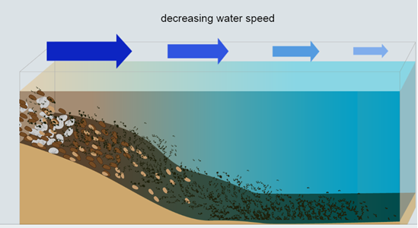
What does water clarity tell us about the movement of the water and sediments?
What is a sedimentary rock?
Watch the video then complete the activity. As you complete the activity, label your diagrams. Include details about water clarity and how big the sediment that settles to the bottom is at each stage.

Slide 5
What is a sedimentary rock?
Copy the text below and fill in the blanks
A sedimentary rock is created by the build-up of layers of sediment over time.
These types of rocks are made from grains of sediment, not interlocking crystals.
When moving air or water _____ ____, it deposits any sediments it is carrying.
As debris accumulates and layers start to form, the lower levels are put under ________ pressure, and the sediment is squashed together.
This compression gradually changes the _______ to ____; this process is called compaction.
slows down
increasing
sediment
rock

Slide 6
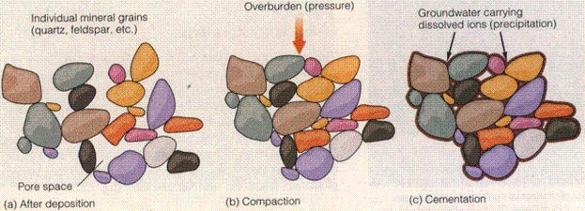
Cementation
Copy the text below
Sometimes, dissolved minerals from water that the sediment was in can get trapped in between the sediment grains. This then acts as a sort of glue which holds the rock together.

Slide 7
Fossils
Fossils can form when dead plants and animals become caught up in these rock forming processes before they rot away.
When the sediments surrounding the organism are turned into sedimentary rock, the organism turns to rock too.

Slide 8
As you go through the next few slides, complete the table for how fossils can form in sedimentary rocks then glue it into your books under the heading 'fossils'.
Notes:
Hand out a sample of granite and sandstone per pair of students as a reference for the next few slides

Slide 13
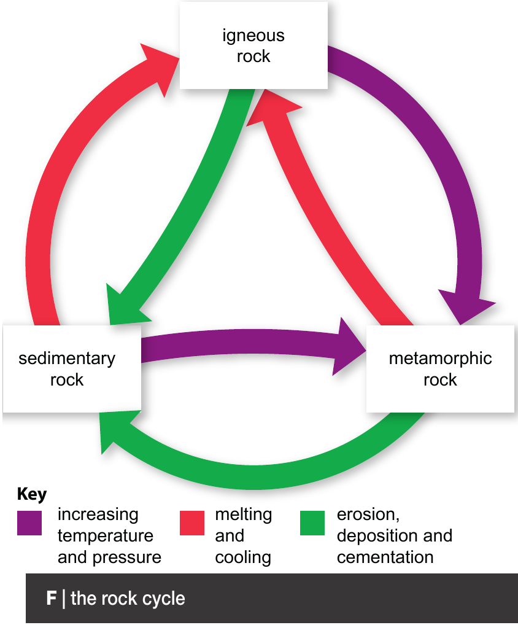
Rock cycle
Over geological time, rocks tend to change form. This can happen fast or slowly and is known as the rock cycle.
Glue in this diagram then add in the examples on the following slides

Slide 14
Rock Cycle
When sedimentary and igneous rocks are heated or compressed they can turn into a metamorphic rock.
For example, mudstone can turn to slate when heated and compressed. When this happens, it's properties will change (slate is harder than mudstone and can be split into layers)

Slide 15
Rock Cycle
When sedimentary or metamorphic rocks are buried within the earth, they can form molten rock and be reformed into an igneous rock.
Igneous and metamorphic rocks can also be broken down into sediment which can then form new sedimentary rocks

Slide 17
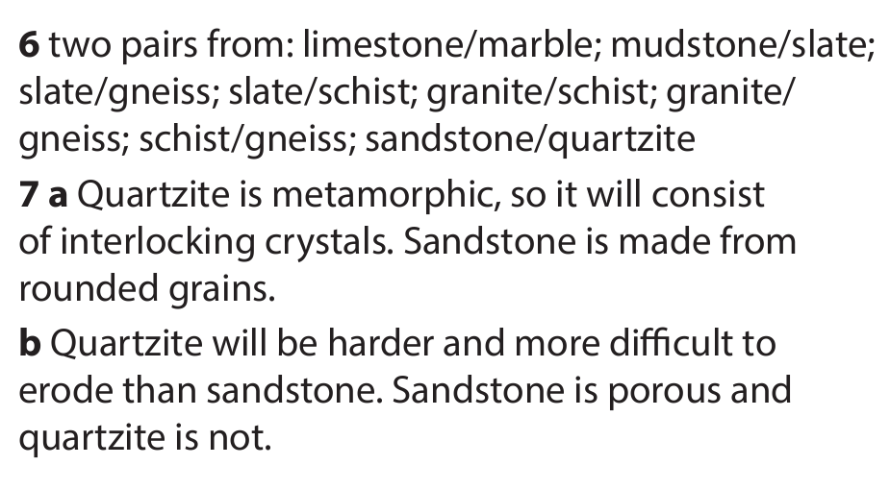

Slide 19
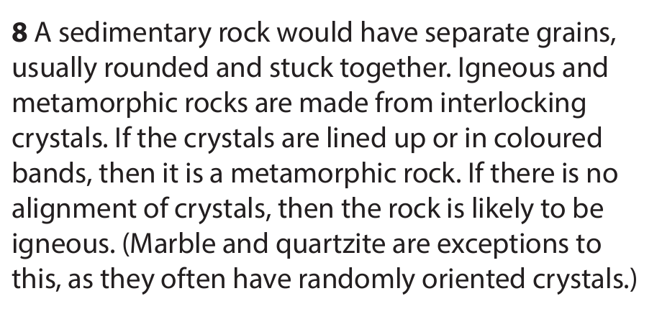

Slide 20
Extension/ H/W
Complete W/S 8Hd7

Slide 22
 Give a clue or definition for these keywords.
Hot Seat

Slide 23
Hot seat
 Give a clue or definition for these keywords.
Sedimentary

Slide 24
Hot seat
 Give a clue or definition for these keywords.
Deposit

Slide 25
Hot seat
 Give a clue or definition for these keywords.
Compaction

Slide 26
Hot seat
 Give a clue or definition for these keywords.
Concretion

Slide 27
Hot seat
 Give a clue or definition for these keywords.
Rock Cycle

Slide 28
Hot seat
 Give a clue or definition for these keywords.
Fossil

