Slide 1
[First name surname] [Your Form]
Science (Physics) 8a/Sc3
Mr Barker
Wed Period 2 E4
 Fill in the front of your book like this.
What was your favourite topic from Year 7 science?
What do you think my rules are?

Slide 2
If I or someone else is talking or you have been told to work in silence, you must:
Listen or work without speaking about anything. Even the work.
Put up your hand if you want to say something and wait until asked to speak.

Slide 3
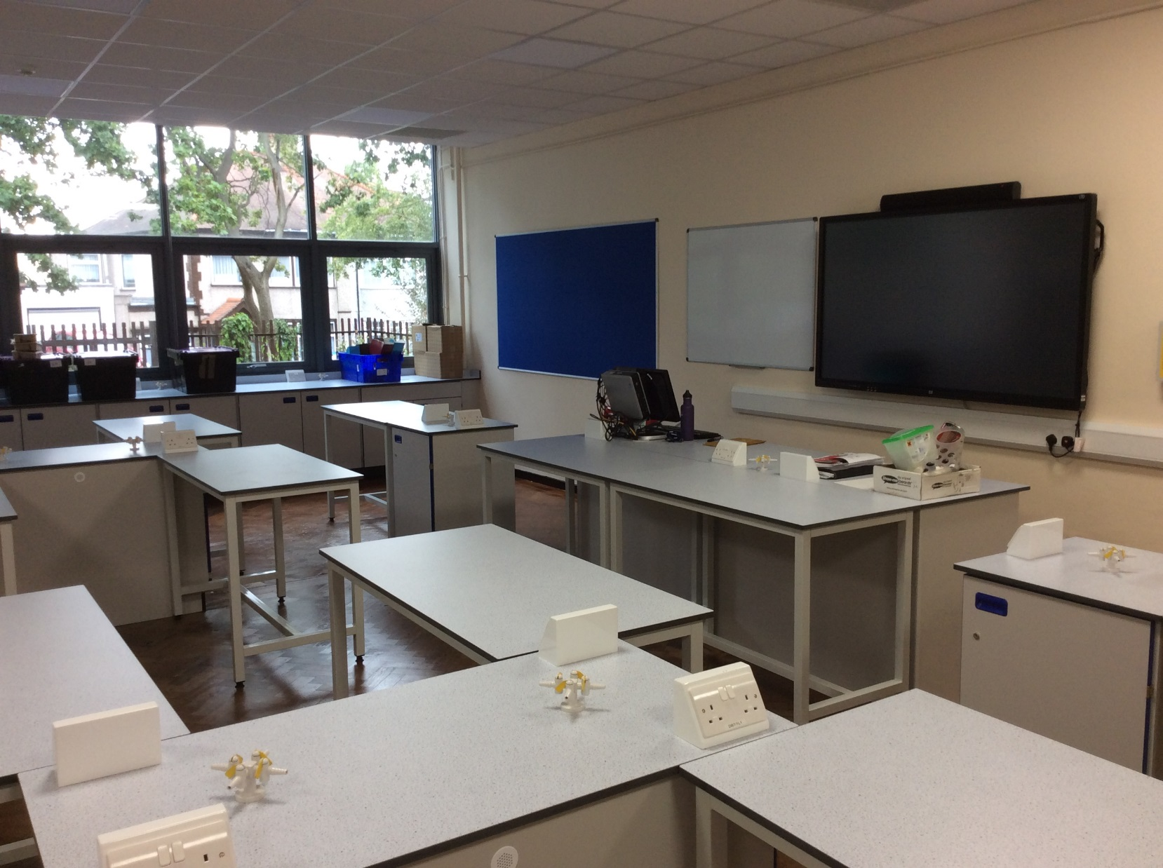
… or you will get a straight D1.
Tell your teacher immediately if you see any graffiti on the desks when you come in.

Slide 4
C/W
Leave 2 pages for contents pages.
09/09/2020
8Ia1 The particle model
In pairs use your coins to show how particles are arranged in a solid, liquid and gas.
Which one do many students get wrong & how?
solid
liquid
gas

Slide 5
Draw 3 boxes of the same size and complete the particle diagrams as we go through the PhET simulation.
solid
liquid
gas
Which one do many students get wrong & how?

Slide 6
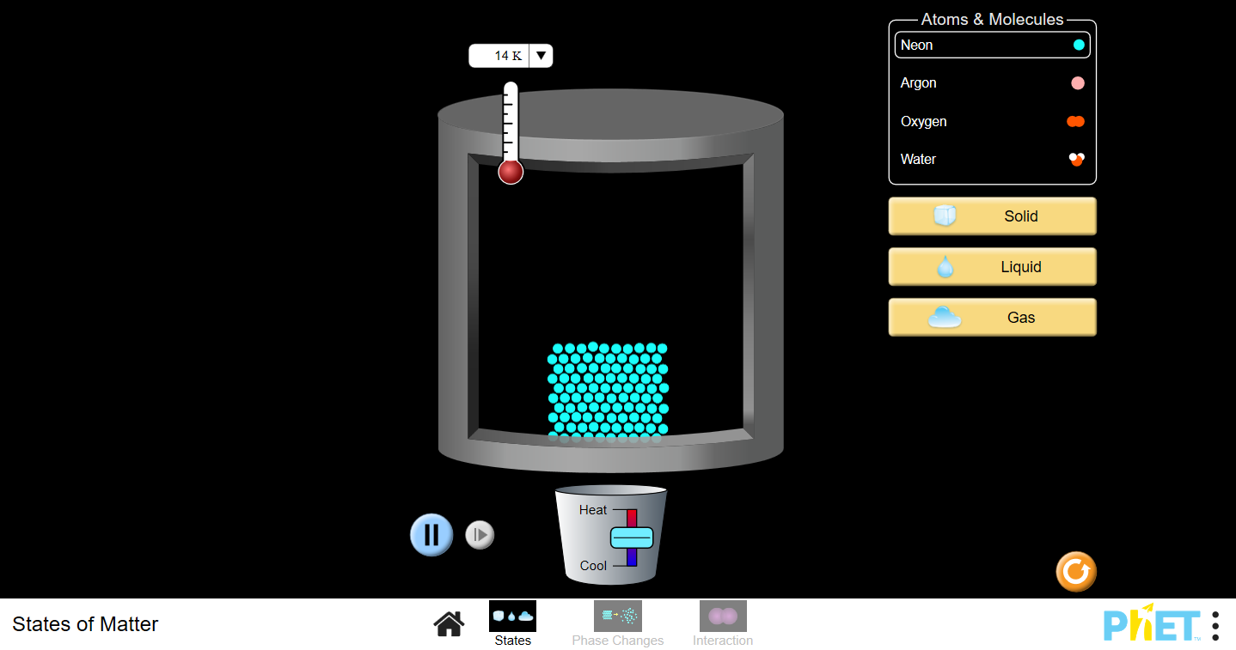

Slide 7
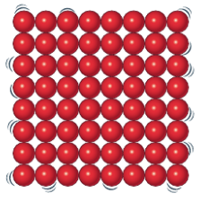
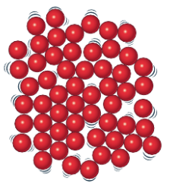
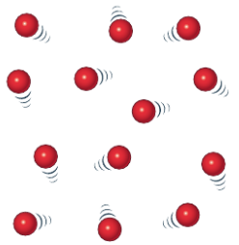
Draw 3 boxes of the same size and complete the particle diagrams as we go through.
solid
liquid
gas
most particles should be touching

Slide 8
Copy & complete the notes below. Use the TWIG video and samples of solids, liquids and gases to help as needed.
Solids keep their _______and ________; they cannot flow and are difficult to __________.
Liquids keep their ________but not their _______; they can flow and are difficult to _________.
Gases can change their_______ and ________; they spread out and are easy to __________.
volume shape compress

Slide 9
Copy & complete the notes below. Use the TWIG video and samples of solids, liquids and gases to help as needed.
shape
volume
Solids keep their _______and ________; they cannot flow and are difficult to __________.
compress
volume
shape
Liquids keep their ________but not their _______; they can flow and are difficult to _________.
compress
shape
volume
Gases can change their_______ and ________; they spread out and are easy to __________.
compress
volume shape compress

Slide 10
How does the particle model explain these properties?
Why can you squash a gas but not a liquid or solid?
Why can liquids & gases flow but not solids?

Slide 11
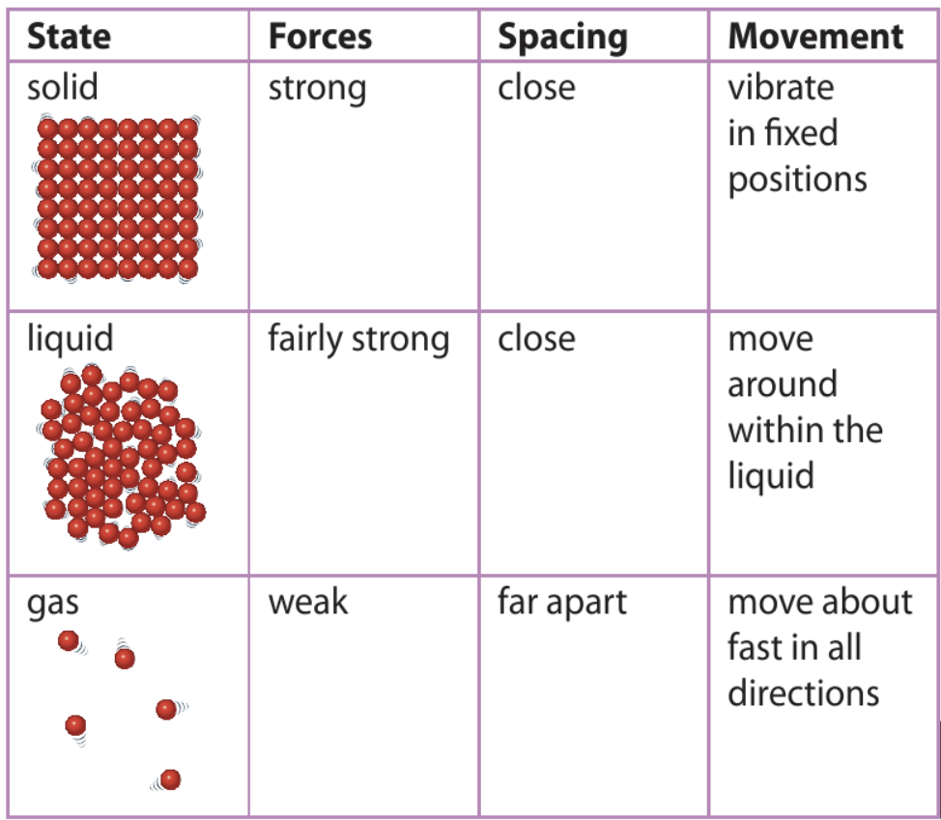
Copy or stick in the table and fill in any blank sections you can.

Slide 12
Add a description of the forces and movement of particles for each state from the animation.

Slide 13
Can you improve the spacing descriptions?
(all particles touching neighbours)
What other observations does the particle model explain?
(most particles touching neighbours)
What did Einstein explain using particles?

Slide 14
My Learning Journey……
Completed
Developing | Securing | Exceeding
Describe the 3 states of matter in terms of shape, volume and compressibility.
Identify some consequences of changing an objects temperature.
State what is meant by diffusion, contraction and expansion.
Use quantitative information on expansion and contraction.
Use the particle model to explain properties of solids, liquids and gases and how temperature affects them.
Describe how the volume of a substance changes at different temperatures.
Use the particle model to explain expansion and contraction and different temperatures.

Slide 15
https://www.youtube.com/watch?v=-zvCUmeoHpw

Slide 16
https://www.youtube.com/watch?v=-zvCUmeoHpw

Slide 17
Brownian motion: tiny specks of dust in air or water can be seen jiggling around as they are ___ by moving air or water ________.
hit
particles
How do smells travel?
How fast do they travel?

Slide 18
How does he particle model explain this?
If I make a smell (!) here, when will you notice it?

Slide 19
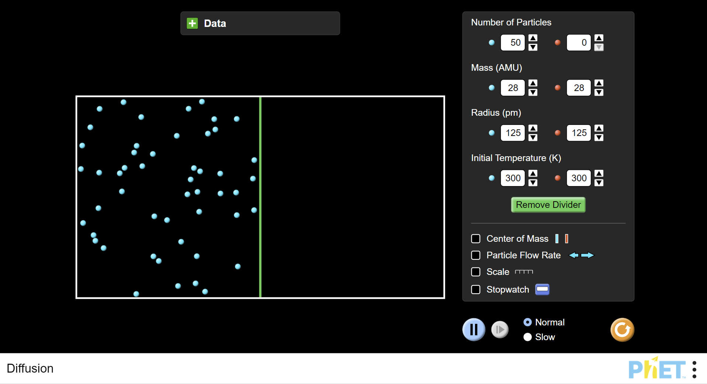

Slide 20
Diffusion: gases or liquids mix because the particles are always _______.
moving
How does a thermometer work?

Slide 21
Why is there a gap in this road?
At what time of year might the gap be smaller?

Slide 22
Expansion & Contraction
Copy and complete.
expand
Materials ________ when heated because particles get hotter and move faster, so take up more space.
contract
Materials ________ when cooled because the particles get colder and move slower, so take up less space.
What happens to the density?
How could we act this out using you as particles?

Slide 23
What has happened to the density of this solid?

Slide 24
Expansion & Contraction
Add what happens to the density.
expand
Materials ________ when heated because particles get hotter and move faster, so take up more space.
Density decreases.
contract
Materials ________ when cooled because the particles get colder and move slower, so take up less space.
Density increases.

Slide 25
Why is there a gap in this road?
At what time of year might the gap be smaller?

Slide 26
My Learning Journey……
Completed
Developing | Securing | Exceeding
Describe the 3 states of matter in terms of shape, volume and compressibility.
Identify some consequences of changing an objects temperature.
State what is meant by diffusion, contraction and expansion.
Use quantitative information on expansion and contraction.
Use the particle model to explain properties of solids, liquids and gases and how temperature affects them.
Describe how the volume of a substance changes at different temperatures.
Use the particle model to explain expansion and contraction and different temperatures.

Slide 27
Hot seat
 Give a clue or definition for these keywords.
Particle model

Slide 28
Hot seat
 Give a clue or definition for these keywords.
Expansion

Slide 29
Hot seat
 Give a clue or definition for these keywords.
Diffusion

Slide 30
Hot seat
 Give a clue or definition for these keywords.
Compress

Slide 31
Hot seat
 Give a clue or definition for these keywords.
Contraction

Slide 32
Hot seat
 Give a clue or definition for these keywords.
States of matter

Slide 33
Reqs
Class practical
15 x Small cup of copper coins (approx. 10 per cup)
Sealed syringes filled with sand, water & air.
Demo
Bottle of perfume/deodorant to demo diffusion.

