Slide 1
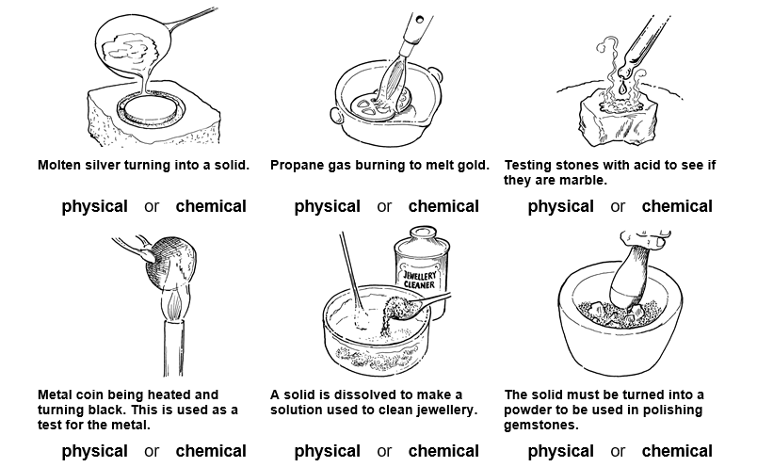
8Fb1: Chemical Properties
Do Now:
Which of these pictures show a chemical change?
1
2
3
4
5
6

Slide 2
Resources
Worksheets
8Fb2 – chemical physical changes practical sheet
Practical
8Fb2 run as circus
Teacher Demos

Slide 3
Objectives
Recall that different elements have different physical properties.
Identify the chemical symbols for some common elements and vice versa.
Record two letter symbols correctly.
Describe Dalton’s ideas about atoms.
Use a simple (Dalton’s) atomic model to describe an element.
Use a simple (Dalton’s) atomic model to describe a compound.
Use the idea of atoms to explain why different elements have different physical properties.
Use information about reaction ratios to calculate atomic masses.

Slide 4
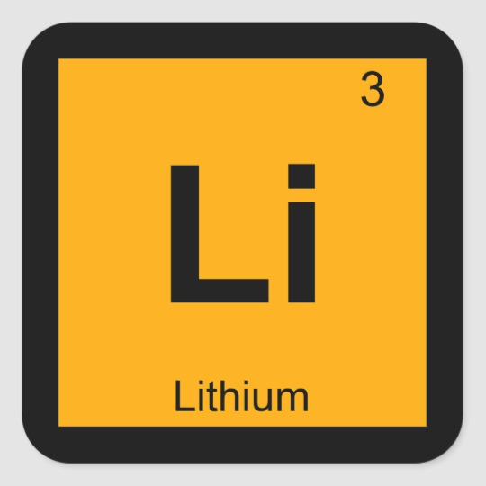
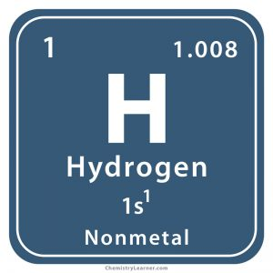
Elements and their Symbols
Using the Periodic Table – write down the symbols for Helium, Oxygen and Boron.
Looking at your Periodic Table – can you find any elements that have symbols you wouldn’t expect?

Slide 5
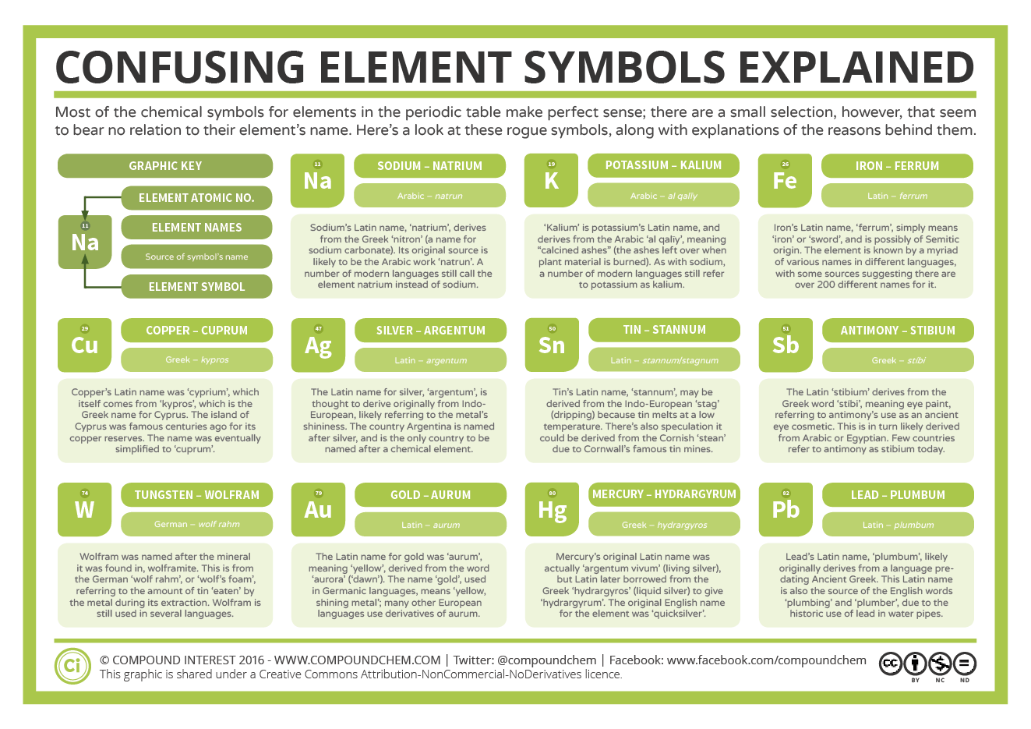

Slide 6
Symbols for elements
Identify the element shown in each photo.
Give the symbol for the element.

Slide 7
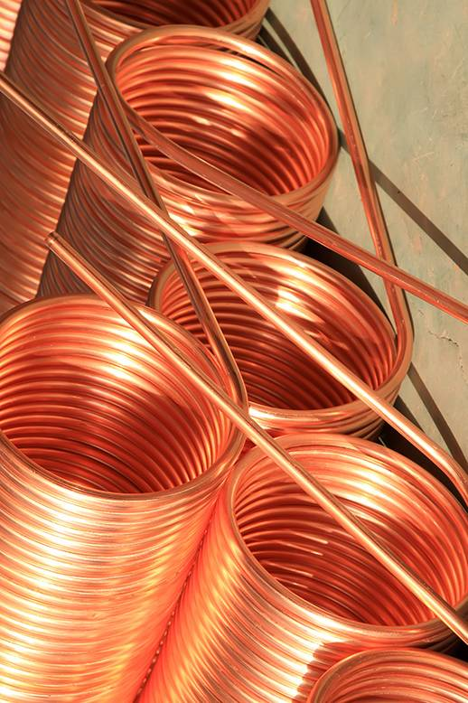
Symbols for elements
What element is this?
Answer:
What is its symbol?
Answer:
Copper
Cu

Slide 8
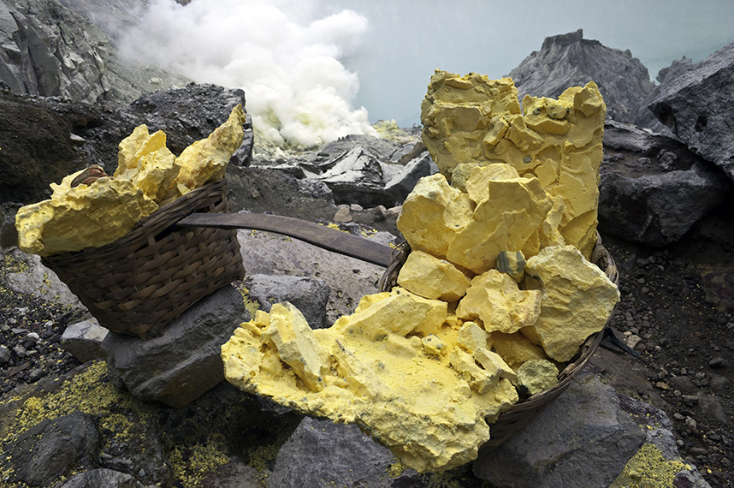
What element is this? Answer:
What is its symbol? Answer:
Sulfur
S
© Pearson Education Ltd 2014. Copying permitted for purchasing institution only. This material is not copyright free.
Notes:
8

Slide 9
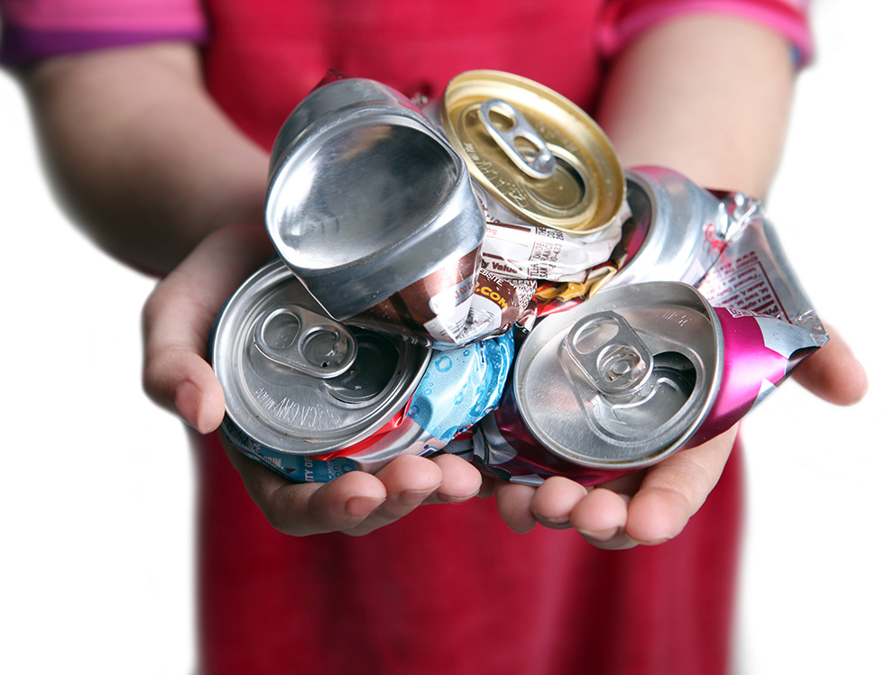
What element is this? Answer:
What is its symbol? Answer:
Aluminium
Al
© Pearson Education Ltd 2014. Copying permitted for purchasing institution only. This material is not copyright free.
Notes:
9

Slide 10
What element is this?
Answer:
What is its symbol?
Answer:
Carbon (graphite)
C
© Pearson Education Ltd 2014. Copying permitted for purchasing institution only. This material is not copyright free.
Notes:
10

Slide 11
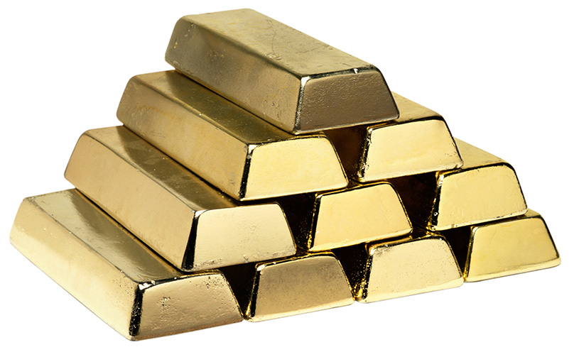
What element is this? Answer:
What is its symbol? Answer:
Gold
Au
© Pearson Education Ltd 2014. Copying permitted for purchasing institution only. This material is not copyright free.
Notes:
11

Slide 12
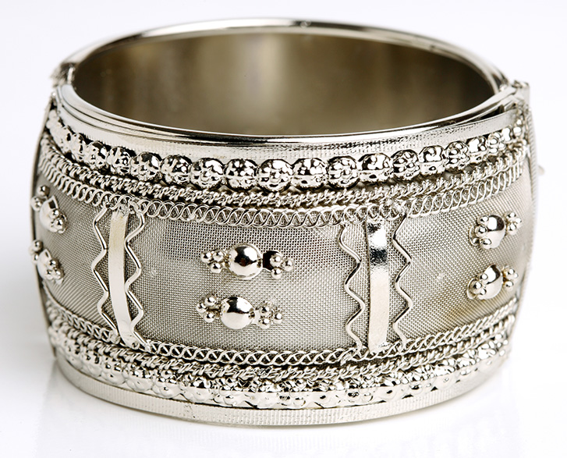
What element is this? Answer:
What is its symbol? Answer:
Silver
Ag
© Pearson Education Ltd 2014. Copying permitted for purchasing institution only. This material is not copyright free.
Notes:
12

Slide 13
What element is this?
Answer:
What is its symbol?
Answer:
Iron
Fe
© Pearson Education Ltd 2014. Copying permitted for purchasing institution only. This material is not copyright free.
Notes:
13

Slide 14
What element is this? Answer:
What is its symbol? Answer:
Mercury
Hg
© Pearson Education Ltd 2014. Copying permitted for purchasing institution only. This material is not copyright free.
Notes:
14

Slide 15
Symbols for Elements
Copy & Complete
All the elements have a symbol. If the symbol is just one letter, it is a __________. If the symbol has two letters, the second letter is __________.
Some elements have symbols based on their old _______ names. The old latin name for iron is ferrum and its symbol is ______.
capital
lower case
Latin
Fe
lower case Fe capital Latin

Slide 16
Answer these Questions in your book
What is all matter made up of?
Oxygen exists as molecules. What is a molecule?
What do all the particles in a particular element have in common?
How did Dalton describe a compound?
Calcium reacts with oxygen in a similar way to magnesium. Write a word equation for this reaction.

Slide 17
Peer Assess
What is all matter made up of? Atoms (1)
Oxygen exists as molecules. What is a molecule? A single unit of a compound (1)
What do all the particles in a particular element have in common? They’re identical (1)
How did Dalton describe a compound? Atoms of an element joined to a fixed number of other atoms (1)
Calcium reacts with oxygen in a similar way to magnesium. Write a word equation for this reaction.
calcium + oxygen → calcium oxide

Slide 18
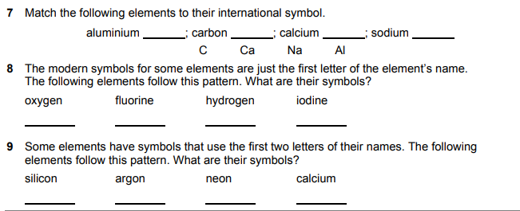
Al
C
Ca
Na
O
F
H
I
Si
Ar
Ne
Ca

Slide 19
All countries use the same symbols to represent elements, so that all scientists can communicate with each other, even though they may use different languages

Slide 20
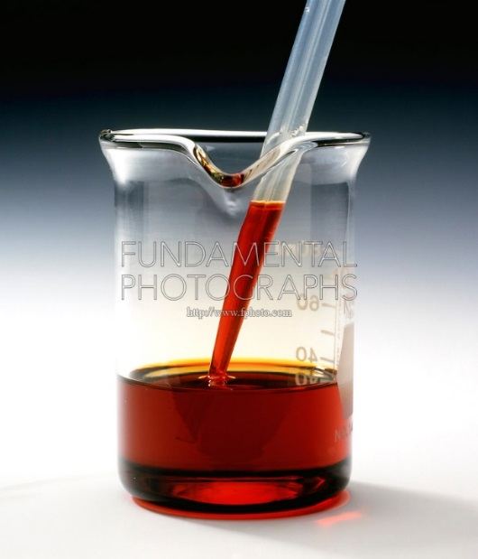
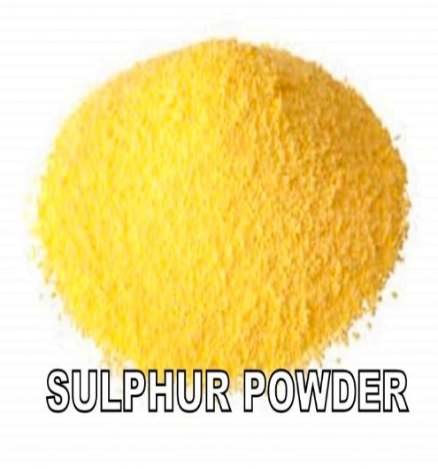
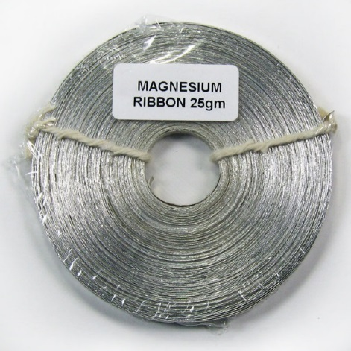
Physical Properties
These substances are all elements, how are they different from each other?
Bromine

Slide 21
Physical Properties
Write down all the physical properties you can think of for the following elements
The differences in the atoms give each element its own, distinct properties.
Oxygen | Copper | Iron

Slide 22
Physical Properties
The differences in the atoms give each element its own, distinct properties.
Oxygen | Copper | Iron
Gas Colourless Low Boiling Point Doesn’t conduct heat/electricity | Solid Brown (copper coloured) Tough- hard to cut High Melting & Boiling Point Conducts heat/electricity | Solid Grey High Melting & Boiling Point Conducts heat/electricity Magnetic

Slide 23
The differences in the atoms give each element its own, distinct properties, such as …
Colour
Melting Point
Boiling Point
Density
Strength
Flexibility
Conduction of heat
Conductions of electricity

Slide 24
Chemical Reactions
Copy & Complete
You might recognize that a chemical reaction is happening because the substances involved:
Change colour
Give off a gas
Get hot
Get cold
Give out light
Make smells
Form solids
New s_________ are formed in chemical reactions.
They are often difficult to r_____
The chemical p_________ of a substance describe how it r____ with other substances
reacts reverse
substances properties

Slide 25
Chemical Reactions
Answers
You might recognize that a chemical reaction is happening because the substances involved:
Change colour
Give off a gas
Get hot
Get cold
Give out light
Make smells
Form solids
New substances are formed in chemical reactions.
They are often difficult to reverse
The chemical properties of a substance describe how it reacts with other substances
reacts reverse
substances properties

Slide 26
Objectives
Explain how chemical reactions are different to physical changes.
Explain the difference between physical and chemical properties of a substance.
Use observations to decide whether a chemical reaction has taken place.
Model simple chemical reactions using word equations.
Use a simple (Dalton’s) model to describe a compound.
Model more complex chemical reactions using word equations.
Describe how atoms are rearranged in chemical reactions.
Write simple chemical formulae from information on structure.
Interpret formulae to identify the types of and ratio of atoms in a compound.
Give a simple description of the valency of an element and use these to deduce the formula of compounds (containing two main group elements).
© Pearson Education Ltd 2014. Copying permitted for purchasing institution only. This material is not copyright free.

Slide 27
Write Down
Exp 8Fb2 – Types of Change
Experiment | Observation | Physical or chemical?
1
2
3
4
5
6

Slide 28
Do Now: Complete the Table from your Experiment
Experiment | Observation | Physical or chemical?
1 | Wax: Wax melted | Physical (state change)
2 | HCl + Copper: Fizzed up | Chemical
3 | Salt + Water: Salt dissolved | Chemical
4 | Salt Water: Water Evaporates, salt behind | Physical
5 | Yellow ppt | chemical
6 | Copper Sulfate + Zinc: Temperature Rise | physical

Slide 29
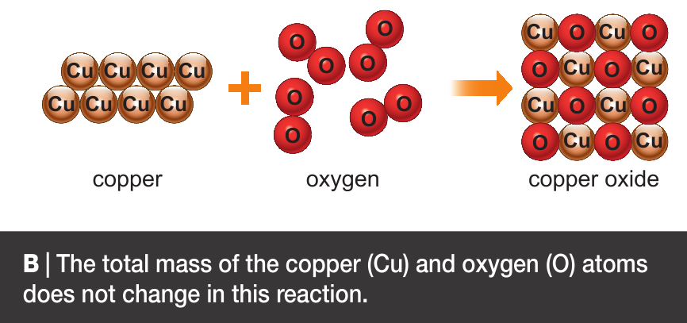
“Atoms are indestructible, cannot be created or destroyed”
Dalton used his theories to predict that:

Slide 30
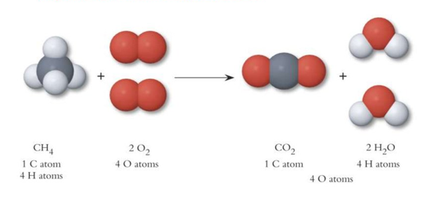
Mass during Chemical Reactions
Write Down
Mass of Reactants = Mass of Products
Atoms are rearranged during a chemical reaction i.e. they are joined together (bonded) in different combinations and shapes

Slide 31
Write Down
Word Equations
Word equations are used to represent chemical reactions
When carbon burns it combines with oxygen to form the compound carbon dioxide. Write a word equation for this reaction.
Carbon + Oxygen → Carbon Dioxide
Symbol equation using chemical formulae
C + O₂ → CO₂
Which equation gives you more information?

Slide 32
Write Down
Reading Chemical Formulae
What do the different parts of a Chemical Formula tell us?
The chemical formula tells you the ratio of the atom.
Here the ratio is
2 hydrogen : 1 oxygen
H₂O
The subscript (little) 2 tells you how many of each atom there are. If there are no subscript numbers, then there is only 1 atom.
The letters tell you which atoms are in the formula. In this case hydrogen & oxygen.

Slide 33
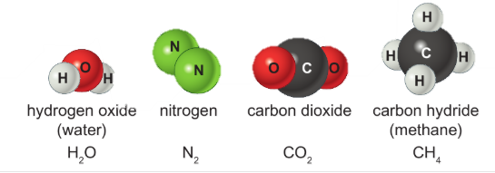
Chemical Formulae of Molecules
Some compounds and elements exist as molecules. The chemical formulae of these give the exact number of each atom in the molecule.

