Slide 1
8Fe: Chemical Trends
Do Now:
What happens when:
You put Mentos into Coca-Cola
You put a cork in water
You mix milk, eggs, flour and sugar, then heat it up
You mix vinegar and baking soda
You put copper metal in water
You mix table salt in water

Slide 2
Requisitions
Equipment | Worksheets
Teacher Demo 5 O2 gas jars and spoons with water & UI in bottom Mg ribbon, Fe wool, Sulphur powder & Carbon powder Class practical 8Fe2 Properties of oxides | changes of state graph

Slide 3
Watch and list the chemical and physical properties

Slide 4
Objectives
Describe the reactions of metals with oxygen.
Describe the reactions of non-metals with oxygen.
Describe the reactions of metals with water.
Use the reactions of some alkali metals with water to predict the reactions of other alkali metals with water (in terms of what happens, not reactivity).
© Pearson Education Ltd 2014. Copying permitted for purchasing institution only. This material is not copyright free.

Slide 5
Objectives
Compare the physical and chemical properties of metal and non-metal oxides.
Recall there is usually a regular gradation in chemical properties as you go down a group.
Use data to identify trends in chemical properties within a group.
Identify a pattern of reactivity in the reaction between some alkali metals and water and use this to predict the reactivity of other alkali metals.
State that atoms can be joined up to make molecules or giant lattice structures.
Describe the difference between molecules or giant lattice structures.
© Pearson Education Ltd 2014. Copying permitted for purchasing institution only. This material is not copyright free.

Slide 6
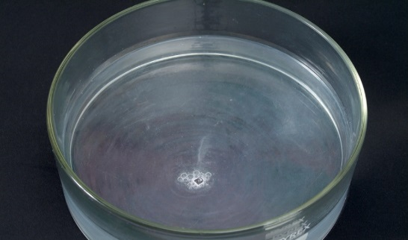
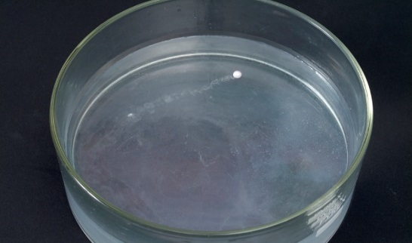
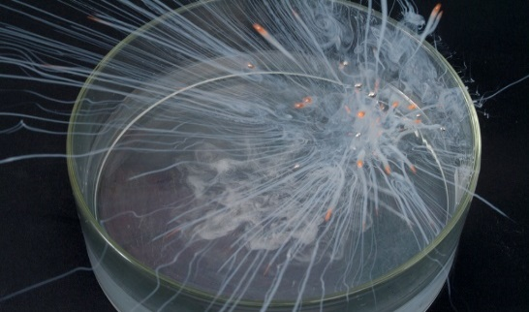
Write Down
All elements in a group have similar properties and reactions.
A trend means that the properties are similar but gradually change as you go down the group.
lithium sodium potassium
lithium sodium potassium
increasing speed of reaction

Slide 7
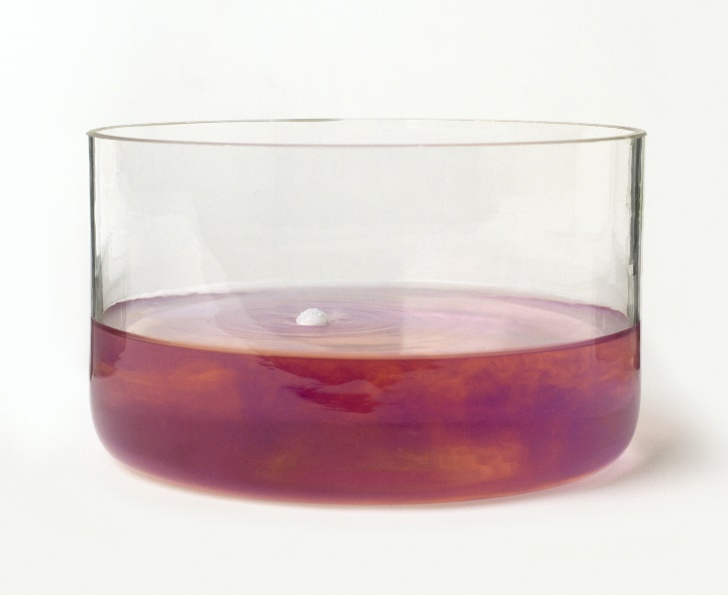
Write Down
The reaction produces a metal hydroxide and hydrogen gas.
sodium + water sodium hydroxide + hydrogen
Sodium reacting with water.
Litmus indicator in the water shows that an alkali is being produced.
© Pearson Education Ltd 2014. Copying permitted for purchasing institution only. This material is not copyright free.

Slide 8
Rubidium is the next alkali metal after potassium.
Predict:
What rubidium will look like?
How it will react with water?
The word equation for its reaction with water.
Rubidium is a soft, silver coloured metal.
It will react very violently with water to form hydrogen and rubidium hydroxide.
rubidium + water → rubidium hydroxide + hydrogen

Slide 9
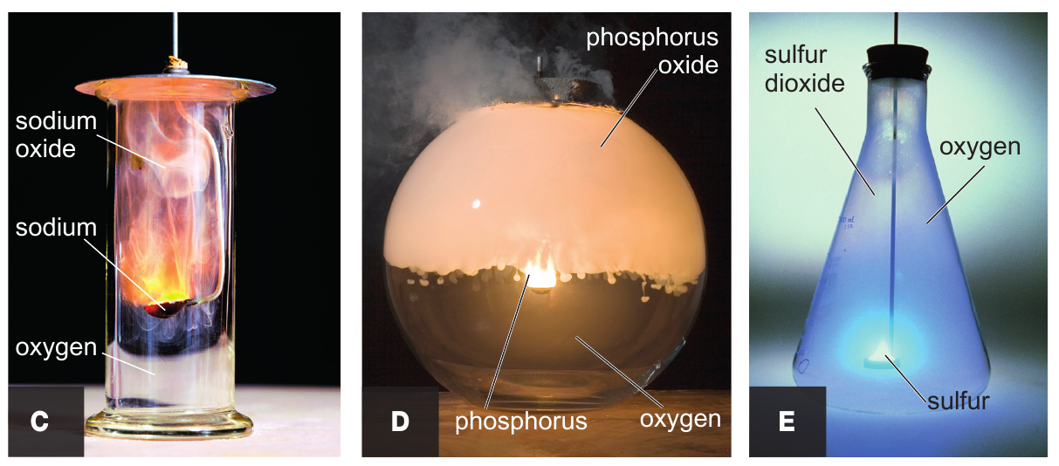
Write Down
Reaction with Oxygen (videos)
https://www.youtube.com/watch?v=hxrQrOlWGH0
https://www.youtube.com/watch?v=_7Om-pHYaDU
https://www.youtube.com/watch?v=V1sQO91UvFI
Elements react with oxygen to produce oxides
Write equations for the below pictures:

Slide 10
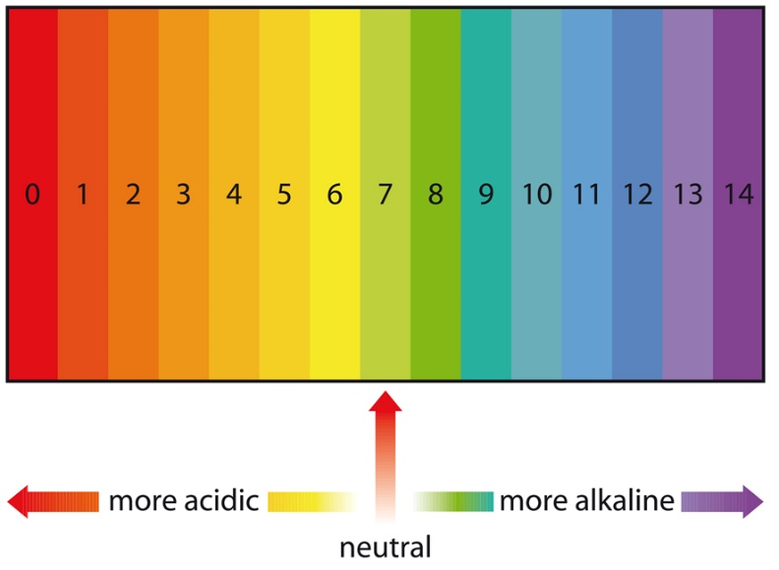
About Oxides
An acidic solution has a pH of less than 7.
A neutral solution has a pH of 7.
An alkaline solution has a pH of more than 7.

Slide 11
About Oxides
Metal oxides such as sodium oxide react with water to form a solution.
The solution has a pH of 12 so it is alkaline.

Slide 12
About Oxides
Metal oxides form an alkaline solution when they react with water

Slide 13
About Oxides
What do you think will happen when potassium oxide is added to water?
Potassium and sodium are both Group 1 metals in the periodic table.
Therefore, we would expect their oxides to react in a similar way.

Slide 14
About Oxides
Potassium oxide reacts with water to form a solution.
The solution has a pH of 12 so it is alkaline.
© Pearson Education Ltd 2014. Copying permitted for purchasing institution only. This material is not copyright free.
Notes:
14

Slide 15
About Oxides
Non-metal oxides such as nitrogen dioxide reacts with water to form a solution.
The solution has a pH of 2 so it is acidic.
© Pearson Education Ltd 2014. Copying permitted for purchasing institution only. This material is not copyright free.
Notes:
15

Slide 16
About Oxides
What do you think will happen when phosphorus oxide is added to water?
Phosphorus and nitrogen are both Group 5 non-metals in the periodic table.
Therefore, we would expect their oxides to react in a similar way.
© Pearson Education Ltd 2014. Copying permitted for purchasing institution only. This material is not copyright free.
Notes:
16

Slide 17
About Oxides
Phosphorus oxide reacts with water to form a solution.
The solution has a pH of 2 so it is acidic.
© Pearson Education Ltd 2014. Copying permitted for purchasing institution only. This material is not copyright free.
Notes:
17

Slide 18
Write Down
pH of oxides
Soluble metal oxides form alkaline solution (pH>7).
Insoluble non metal oxides form acidic solution (pH<7).
What would the pH of Hydrogen oxide & an insoluble oxide in water?
pH = 7

Slide 19
Questions
Write word equations for the formation of the oxides of calcium and phosphorus.
How does the indicator colour tell you if a solution is acidic, alkaline or neutral?
What are the ranges of pH values for
acids
alkalis
neutral solutions?
Which pH values are: a most acidic b most alkaline?

