Slide 1
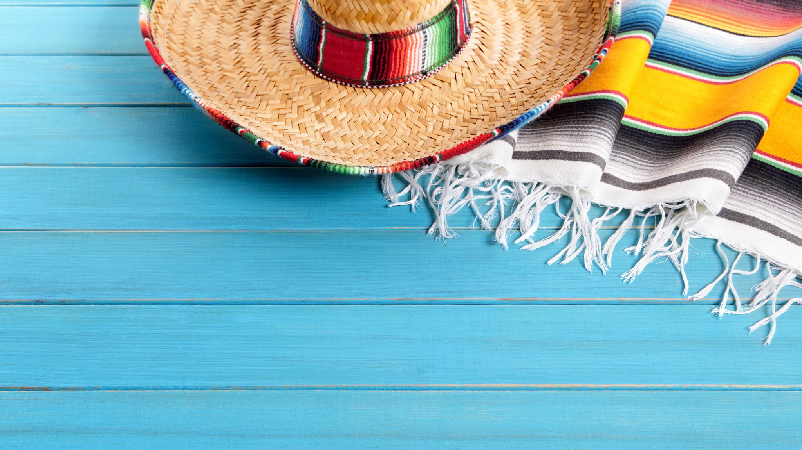
Spain - España
By Rosie RHODES MALPASS - 12B2

Slide 2
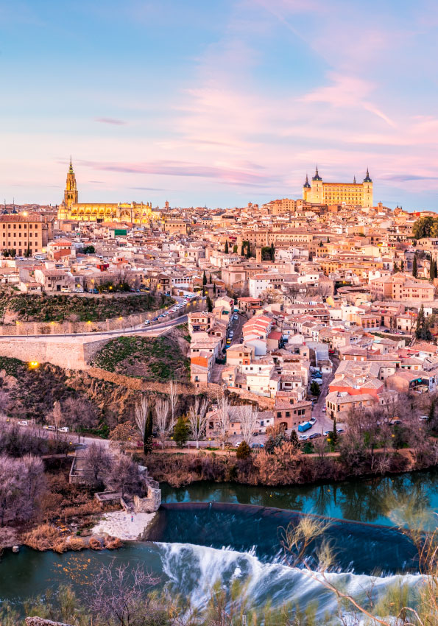
About Spain
Spain or Kingdom of Spain is a transcontinental country in southwestern Europe with parts of territory in the Atlantic Ocean and across the Mediterranean Sea.
Spain's capital and largest city is Madrid; other major urban areas include Barcelona, Valencia, Seville, Zaragoza, Málaga, Murcia, Palma de Mallorca, Las Palmas de Gran Canaria and Bilbao.
Spanish art, music, literature and cuisine have been influential worldwide, particularly in Western Europe and the Americas. As a reflection of its large cultural wealth, Spain is the world's second-most visited country. Its cultural influence extends over 570 million Hispanophones, making Spanish the world's second-most spoken native language.

Slide 3
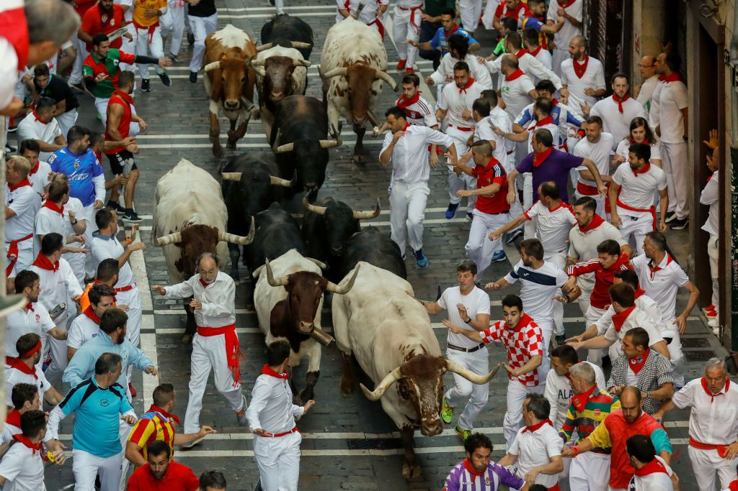
Public holidays and festivals
Public holidays celebrated in Spain include a mix of religious , national and local observances. Each municipality is allowed to declare a maximum of 14 public holidays per year; up to nine of these are chosen by the national government and at least two are chosen locally
One of the most famous is San Fermín, in Pamplona. While its most famous event is the encierro, or the running of the bulls, which happens at 8:00 am from 7 to 14 July, the seven days-long celebration involves many other traditional and folkloric events
Other festivals include: La Tomatina tomato festival in Buñol, Valencia, the Falles in Valencia or the Holy Week in Andalusia and Castile and León.

Slide 4
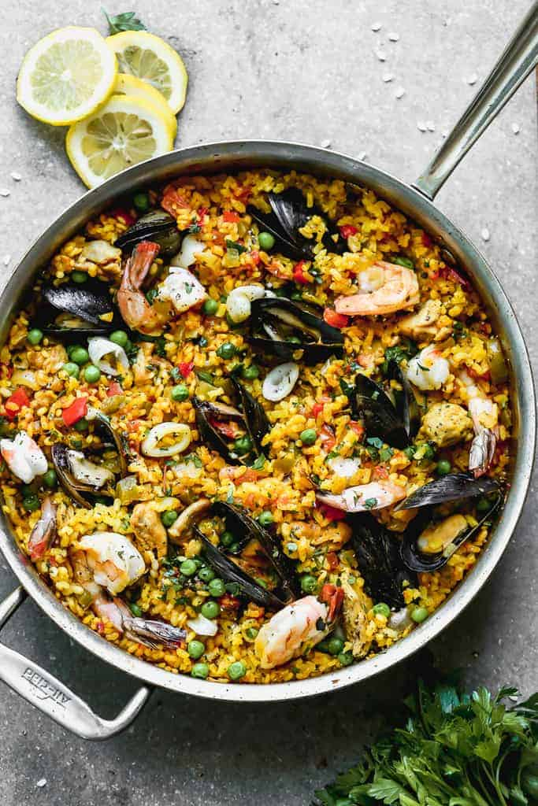
Cuisine
Spanish cuisine consists of a great variety of dishes which stem from differences in geography, culture and climate. It is heavily influenced by seafood available from the waters that surround the country and reflects the country's deep Mediterranean roots.
Mediterranean Spain – heavy use of seafood, such as pescaíto frito (fried fish); several cold soups like gazpacho; and many rice-based dishes like paella from Valencia and arròs negre (black rice) from Catalonia.
Inner Spain – hot, thick soups such as the bread and garlic-based Castilian soup, along with substantial stews such as cocido madrileño. Food is traditionally conserved by salting, such as Spanish ham, or immersed in olive oil, such as Manchego cheese.
Atlantic Spain – vegetable and fish-based stews like caldo gallego and marmitako. Also, the lightly cured lacón ham. The best-known cuisine of the northern countries often rely on ocean seafood, as in the Basque-style cod, albacore or anchovy or the Galician octopus-based polbo á feira and shellfish dishes.

Slide 5
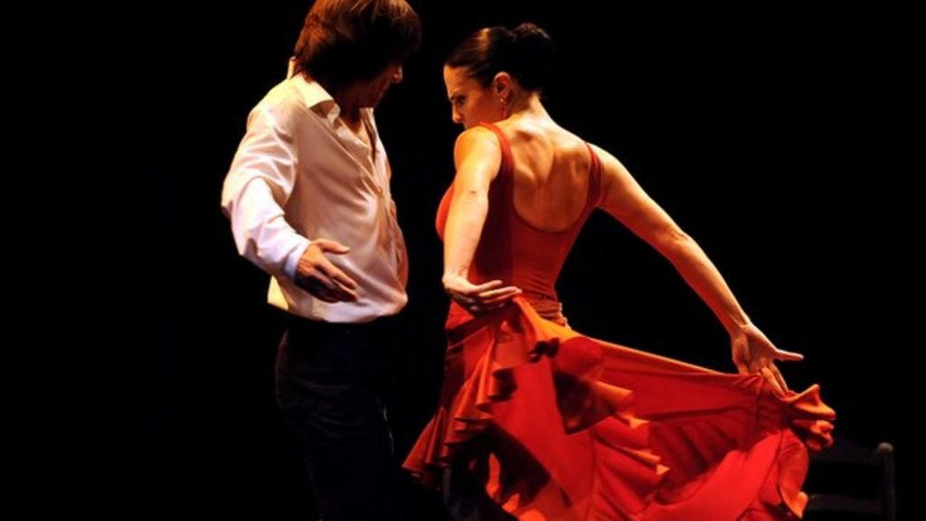
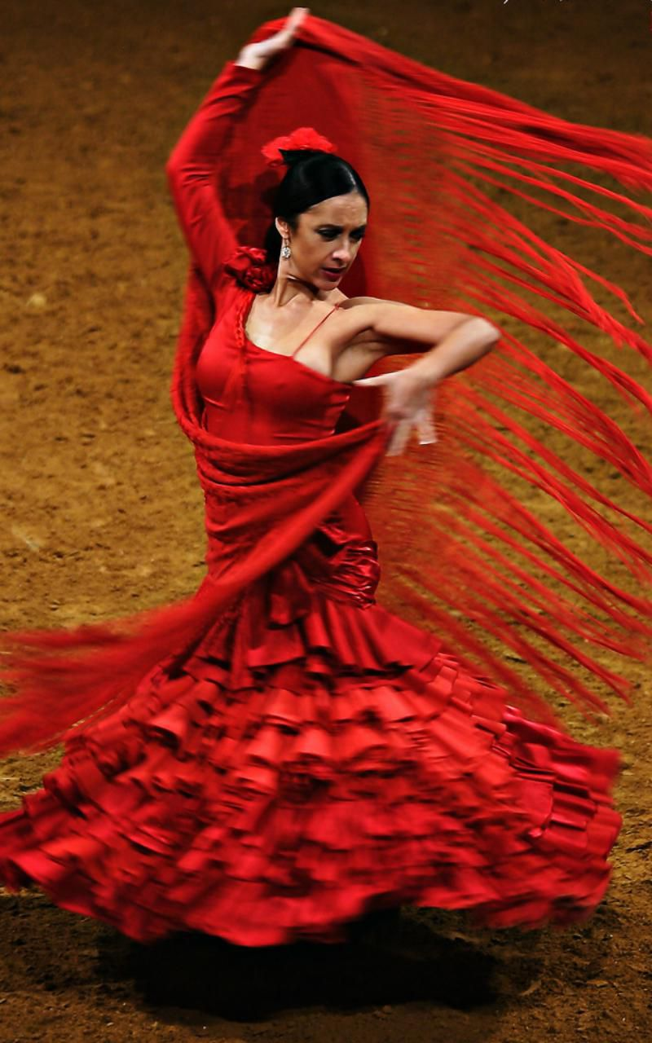
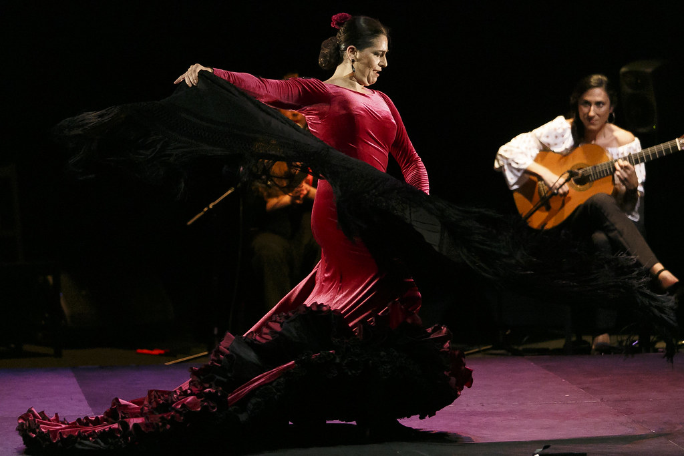
Music and dance
Spanish music is often considered abroad to be synonymous with flamenco. Various regional styles of folk music abound in Aragon, Catalonia, Valencia, Castile, the Basque Country, Galicia, Cantabria and Asturias.
The most popular traditional musical instrument, the guitar, originated in Spain. Typical of the north are the traditional bag pipers or gaiteros (pipers), mainly in Asturias and Galicia.

Slide 6
The end

