Slide 1
8Eb: Oxidation
CW
Do Now:
What is combustion?
What is a hydrocarbon?
Name two products of combustion
Describe tests that could be used to identify the products
Write a word equation for the combustion of methane (natural gas)

Slide 2
Requisitions
Equipment | Worksheets
8Eb2 Burning Magnesium Practical Magnesium Ribbon Crucibles Clay Pipe Triangles Mass Balances | Practical Worksheet

Slide 3
Objectives
State what happens to mass in a chemical reaction.
State the meaning of: oxidation.
Describe the reactions of metals with oxygen.
Identify and explain the products formed by the oxidation of metals.
Explain the change in mass seen in reactions.
Compare and contrast the oxygen and phlogiston theories for combustion.
Evaluate the evidence used to displace the phlogiston theory of combustion.
Model simple reactions using symbol equations.

Slide 5
After watching the video, answer the following questions;
What kind of reaction is happening? Neutralisation, oxidation, or revision
Which gas from the air does magnesium react with? Nitrogen, oxygen, or carbon dioxide
Write a word equation to describe what happened in the reaction
When copper metal reacts with oxygen, copper oxide is formed. Write a word equation for this reaction.

Slide 6
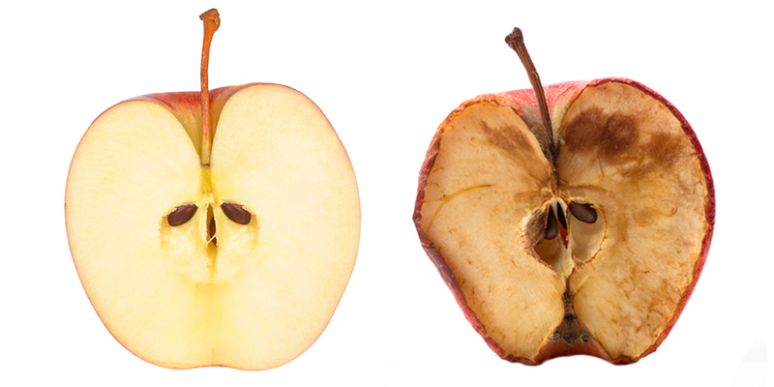
Oxidation
A substance reacts with oxygen and gains oxygen atoms
Both metals and non metals will under go oxidation reaction.

Slide 7
Metal + Oxygen → Metal Oxide
Magnesium + Oxygen → Magnesium Oxide
2Mg + O₂ → 2MgO

Slide 8
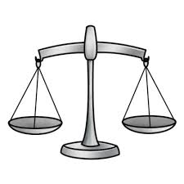
Question
If the mass of copper and the mass of oxygen were measured before the reaction, what would be the mass of copper oxide formed?
The same as the mass of copper added to the mass of oxygen.
More than the mass of copper added to the mass of oxygen.
Less than the mass of copper added to the mass of oxygen.

Slide 9
The Conservation of Mass
Mass is never gained or lost in a chemical reaction. No new atoms are created or no atoms are destroyed. The atoms in the reactants are just rearranged to form different substances.
Total mass of reactants = Total mass of products

Slide 10
Question
If the mass of copper and the mass of oxygen were measured before the reaction, what would be the mass of copper oxide formed?
The same as the mass of copper added to the mass of oxygen.
More than the mass of copper added to the mass of oxygen.
Less than the mass of copper added to the mass of oxygen.

Slide 11
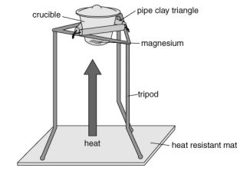
8Eb2: Changing Mass Practical
Aim To measure the change in mass when magnesium is burnt in air
Reaction
Magnesium + _____ → _____
Apparatus Magnesium Ribbon, Pipe clay triangle, Bunsen burner, tongs, crucible with lid, tripod, emery paper

Slide 12
Method:
Measure the mass of the crucible and lid to two decimal places. Record on results table
Twist the magnesium ribbon into a loose coil and place it in the crucible. Measure the total mass and record.
Set up apparatus as shown, light the Bunsen, and heat the crucible
Use tongs to lift the lid slightly and let air in
Keep burning the magnesium until there is no further reaction.
Turn off Bunsen and allow everything to cool.
Measure the total mass again and record.

Slide 13
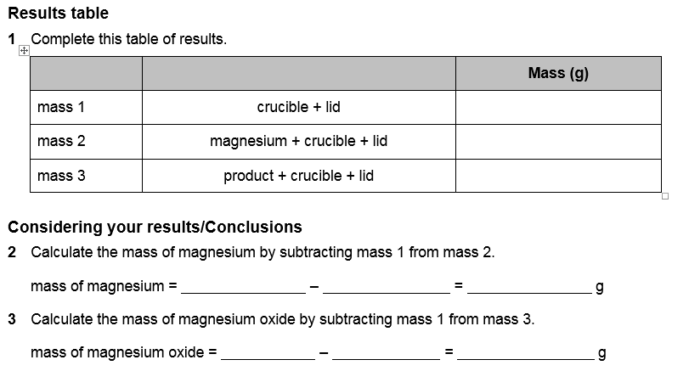

Slide 15
The mass of magnesium oxide is greater than the mass of magnesium.
The gain in mass of the magnesium oxide is the mass of oxygen that reacted with the magnesium during the oxidation reaction.
Repeat the experiment and average the results.

