Slide 1
Resources
Worksheets
7Gd-2; 7Gd-3 or 7Gd-4 - practicals
7Gd-5 & 6 modelling diffusion
h/w recommendation 7Fa7,8, 9 or 10
Practical
7Gd2, 3 or 4 see teacher & tech notes
Worksheets 7Gd-2; 7Gd-3.
250 cm3 beaker, water, something that dissolves in water with a strong colour (e.g. a spoonful of meat extract or yeast extract, a teabag, some food colouring with a small dropper), stop clock, thermometer, ruler, access to kettle.
Teacher Demos
Worksheet 7Gd-4. Equipment 2 stands and clamps, glass tube about 0.5 m long and 2 cm inside diameter (dimensions not critical), bungs to fit into the ends of the glass tube, cotton wool, tweezers/forceps, conc. hydrochloric acid, conc. ammonia solution (alternatively, cotton wool impregnated with each solution can be prepared and stored in a small, stoppered container that will fit inside the glass tube), eye protection, protective gloves.

Slide 2
Objectives
Describe diffusion as the movement of one substance through another without any external mixing.
Recall some everyday examples of diffusion.
Make a prediction about diffusion.
Explain how diffusion occurs in terms of movement of particles.
Explain why the speed of diffusion in gases is faster than in liquids.
Recognise examples of diffusion causing problems.
Carry out a calculation to work out the speed of diffusion

Slide 3
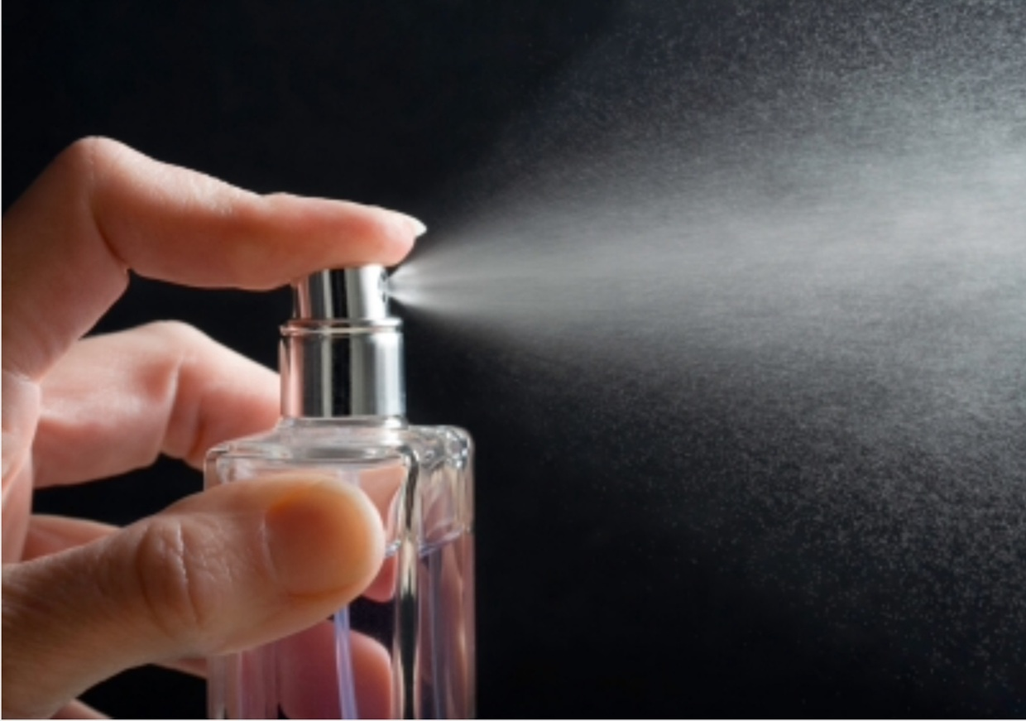
CW
7Gd Diffusion
Who will smell the perfume first?
Who will smell the perfume last?
Why?
@hpscience

Slide 4
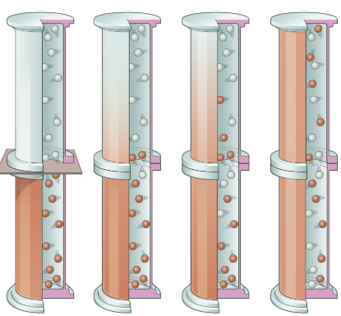
Watch video presentation on p106 of the active book.
Diffusion is when particles spread and mix with each other without anything moving them.
Write definition of diffusion and stick in the picture.

Slide 5
Use the particle model to describe diffusion.
Or use 7Gd-5 & 6 modelling diffusion
In substances there are spaces between the particles. Liquid and gas particles are free to move into these spaces, causing the mixing of the two substances.
Which will diffusion more quickly – gas or liquid?

Slide 6
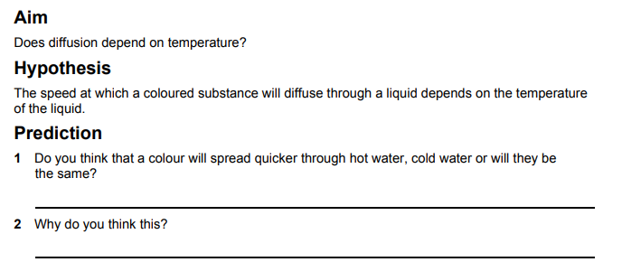
Speed of diffusion
use 7Gd-2, 3 or 4

Slide 7
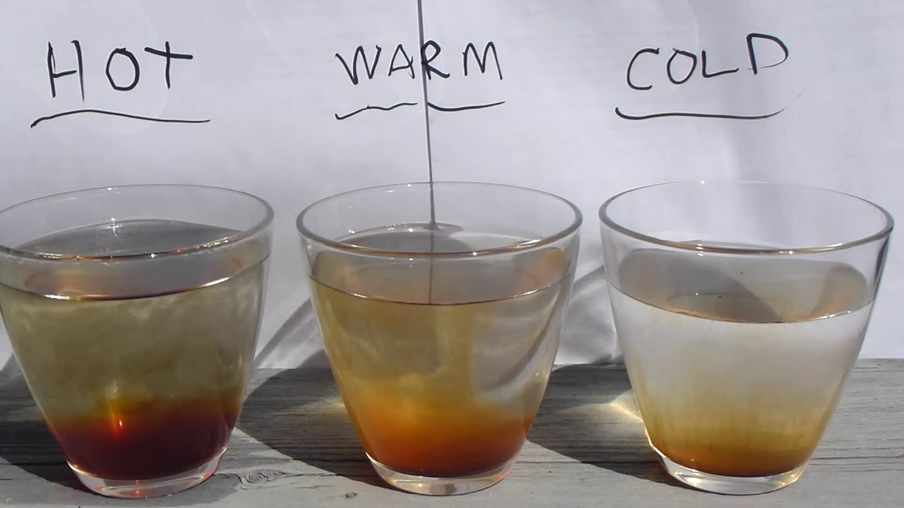
use 7Gd-2

Slide 8
use 7Gd-2

Slide 9
use 7Gd-2

Slide 10
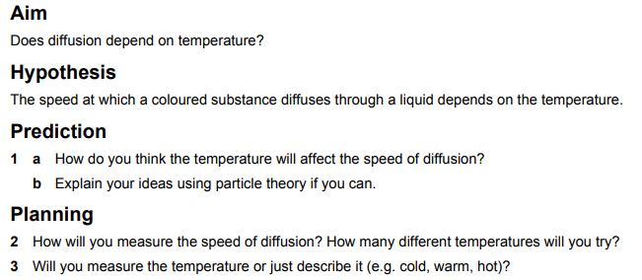
use 7Gd-3

Slide 14
Use experimental data or the above picture

Slide 17
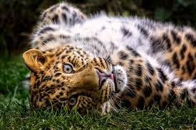
Homework:
w/s 7Gd 7 – Speed of diffusion, w/s 7Gd 8 or 9 – Theory
7Gd 10 – random movement
Exercises 7Gd developing, secure & exceeding
Date due:

Slide 18
Key words

Slide 19
Objectives
Describe diffusion as the movement of one substance through another without any external mixing.
Recall some everyday examples of diffusion.
Make a prediction about diffusion.
Explain how diffusion occurs in terms of movement of particles.
Explain why the speed of diffusion in gases is faster than in liquids.
Recognise examples of diffusion causing problems.
Carry out a calculation to work out the speed of diffusion

