Slide 1
Culture day presentation
By bilal musakhan 10B2

Slide 2
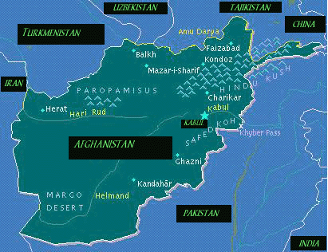
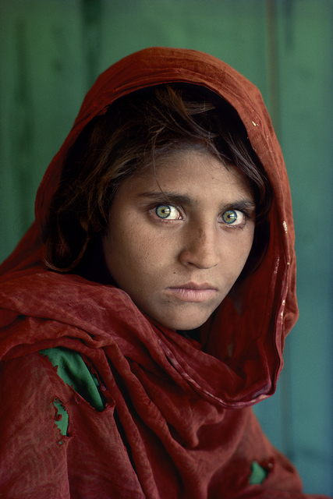
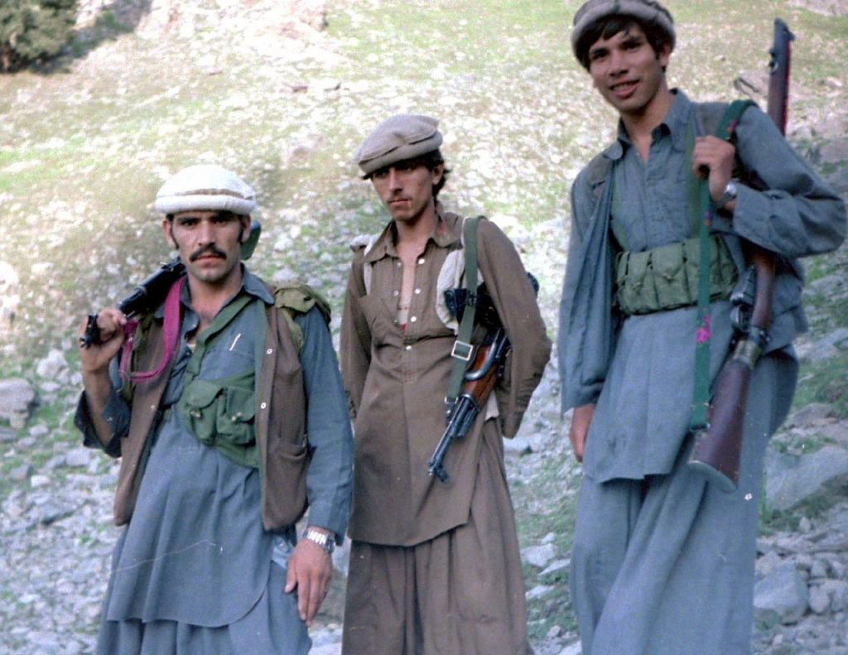
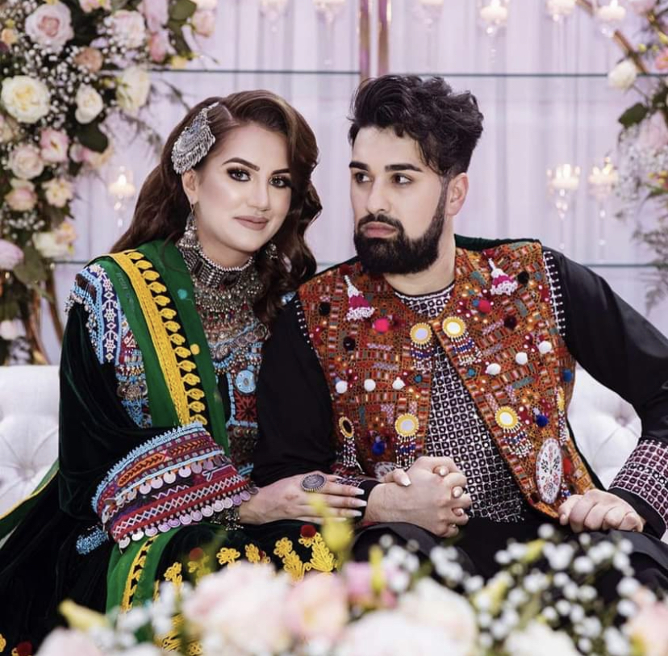
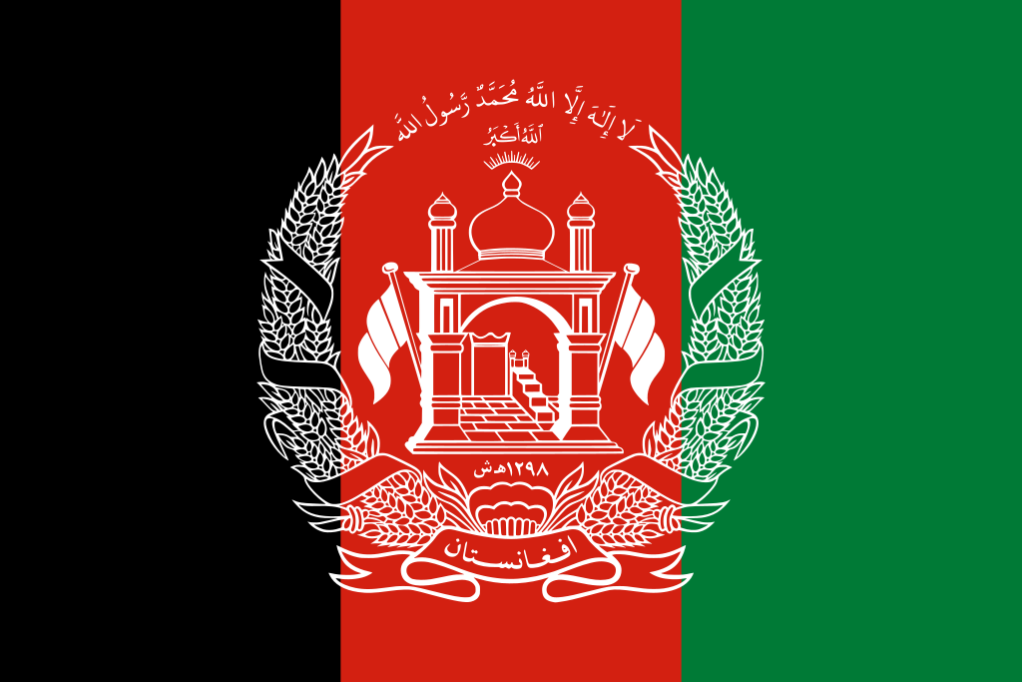
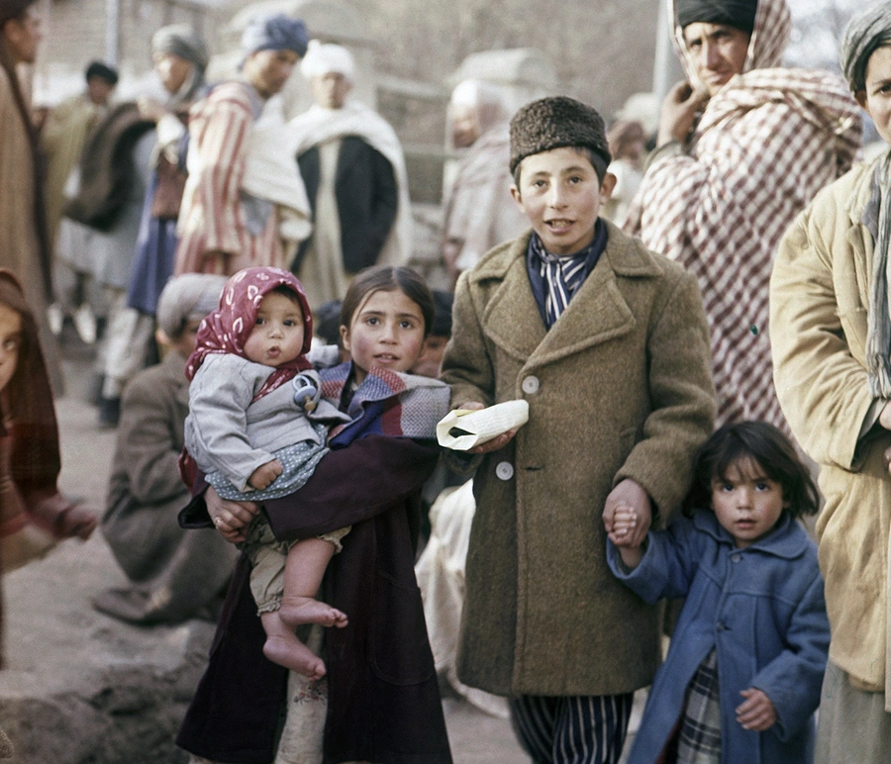
Afghanistan🇦🇫

Slide 3
About Afghanistan
Afghanistan is a mountainous region landlocked in Asia.
It is full of rich culture and diversity which ranges from iranics to turkics to dardics.
It is made up of the pashtuns, Tajiks, hazaras, uzbeks, turkmen, aimaq, nuristanis and many other ethnic groups.
It is famous for it’s geography, pomegranates, war and History.
It is constantly referred to as “The Graveyard of Empires”.
It is currently governed by the Taliban, and referred to as “The Islamic Emirate of Afghanistan”

Slide 4
Afghanistan’s history
Afghanistan has so far beat the British during Anglo-Afghan wars, the Russians when the Soviet Union invaded and America during it’s “war on terror”. It’s also defeated other superpowers including the Mongolian Empire to which it is referred to “Graveyard of Empires”
Afghanistan holds borders to countries within east Asia, South Asia, Central Asia and the Middle East. It’s borders are with Pakistan, China, Tajikistan, Iran, Turkmenistan and Uzbekistan
Alexander the Great spent years in Afghanistan after failing to conquer it.
Afghanistan is top 5 countries impossible to conquer and one of the best to conquer as it’s rich resources have a worth of over $2.2trillion and its geography enables closer ties to Russia, India, Pakistan, Iran and China.
Afghanistan is “the heart of Asia”

Slide 5
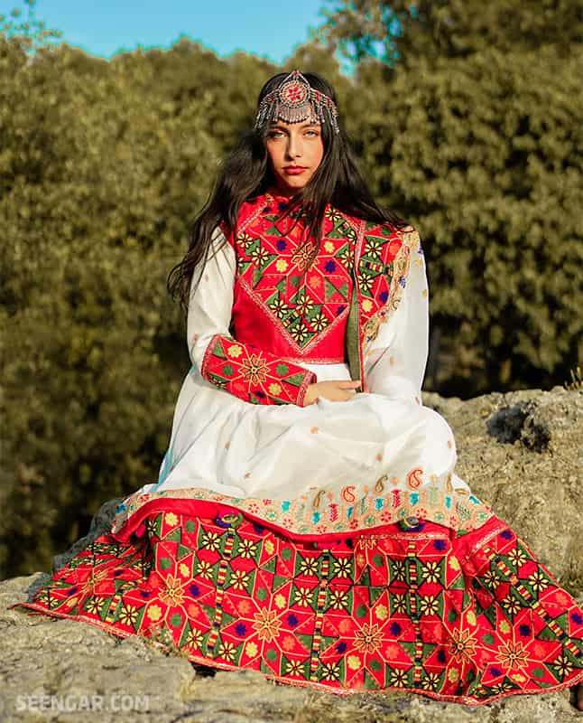
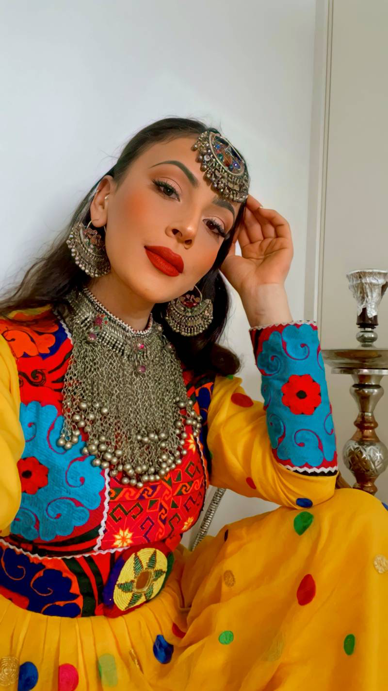
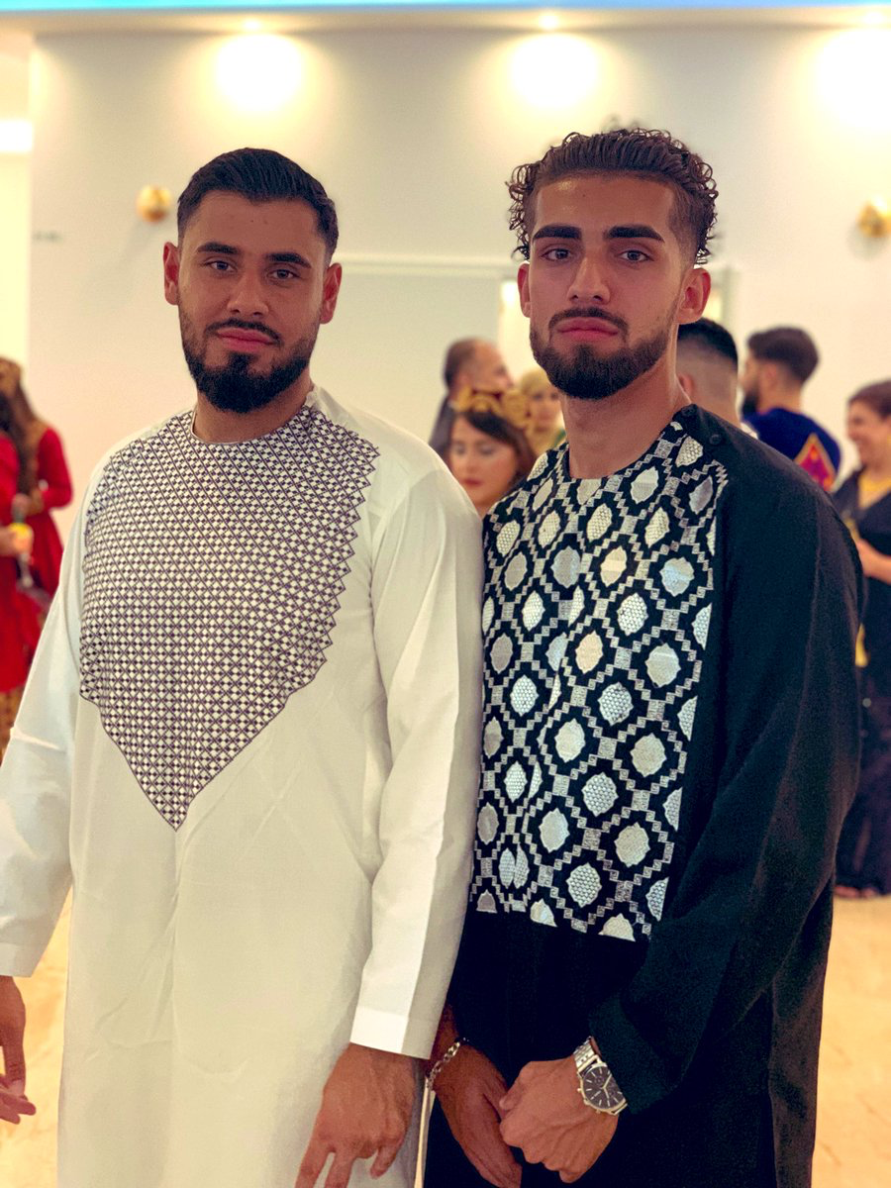
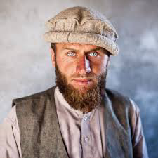
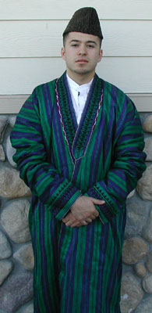
Afghan clothing
Afghanistan’s culture is very diverse and the women’s traditional clothing is “Afghan ghand” and the Men’s “kameez”
Pakol is a traditional Afghan hat.

Slide 6
Thank you for watching

