Slide 1
Objectives
State what happens to mass in a chemical reaction.
State the meaning of: oxidation.
Describe the reactions of metals with oxygen.
Identify and explain the products formed by the oxidation of metals.
Explain the change in mass seen in reactions.
Compare and contrast the oxygen and phlogiston theories for combustion.
Evaluate the evidence used to displace the phlogiston theory of combustion.
Model simple reactions using symbol equations.

Slide 2
Requisitions
Demo:
Mg ribbon & piece of Cu burning in air
worksheets:
8Eb-4 Metal reactions
8Eb-2 changing mass
Possibly use
8Eb-3 Phlogiston
H/w
8Eb-1 or 8Eb-3
Class practical:
8Eb -2
Burning Mg ribbon in a crucible
Extension:
This could be done with different lengths of ribbon

Slide 3
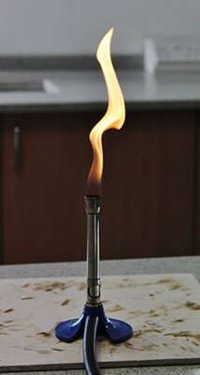
CW
8Eb Oxidation
What type of reaction is this?
@hpscience

Slide 4
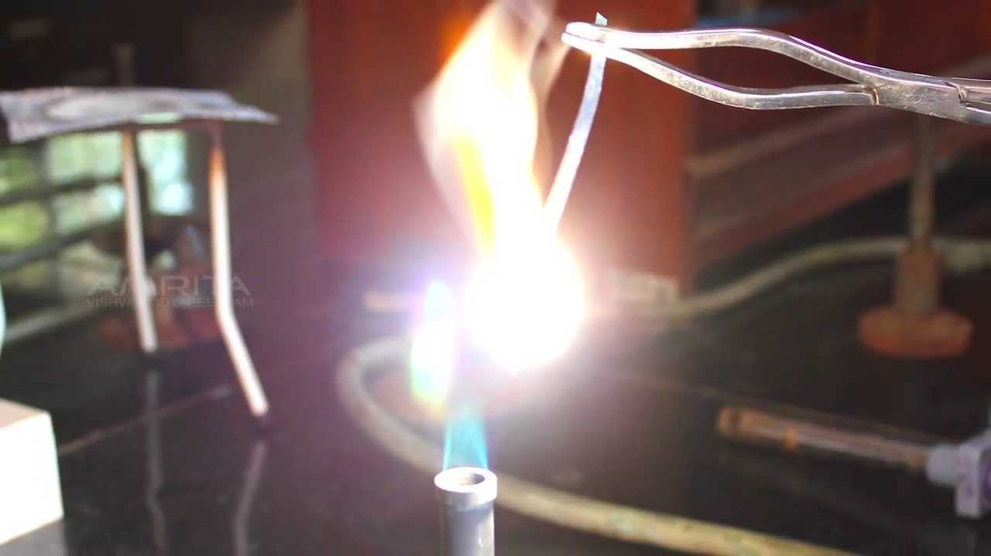
Demo Mg & Cu burning in air or show video
https://www.youtube.com/watch?v=mniCp1u8UB4
https://www.youtube.com/watch?v=myFJYGDk0Us
Watch this demo and answer Q1-5 (8Eb-4)

Slide 5



Slide 6
Magnesium
Oxygen
Magnesium oxide
Copper + oxygen → copper oxide

Slide 7
Write a definition for the word ‘oxidation’
A substance reacts with oxygen and gains oxygen atoms
Both metals and non metals will under go oxidation reaction.

Slide 8
General word equation
Metal + Oxygen → metal oxide
word equation
magnesium + oxygen → magnesium oxide
What can be used to write this equation?
Balanced Symbol equation
2Mg + O₂ → 2MgO
Hint: Periodic table

Slide 9
Learning Objectives
Developing | Securing | Exceeding
Must… | Should… | Could…
State what happens to mass in a chemical reaction. State the meaning of: oxidation. Describe the reactions of metals with oxygen. Identify and explain the products formed by the oxidation of metals. | Explain the change in mass seen in reactions. Compare and contrast the oxygen and phlogiston theories for combustion. | Evaluate the evidence used to displace the phlogiston theory of combustion. Model simple reactions using symbol equations.

Slide 10
Now answer Q6 (8Eb-4)


Slide 11
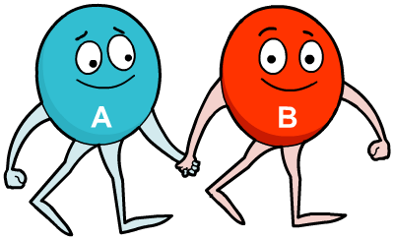
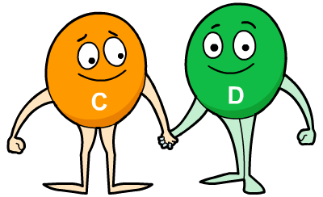
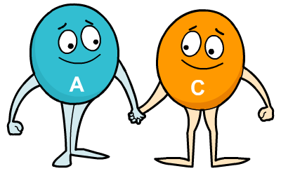
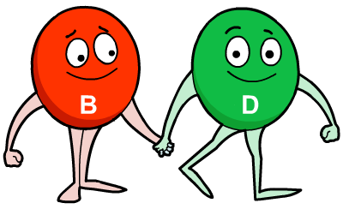
The law of conservation of mass
Copy
Mass is never gained or lost in a chemical reaction. No new atoms are created or no atoms are destroyed. The atoms in the reactants are just rearranged to form different substances.
+
+
Total mass of reactants = Total mass of products

Slide 12
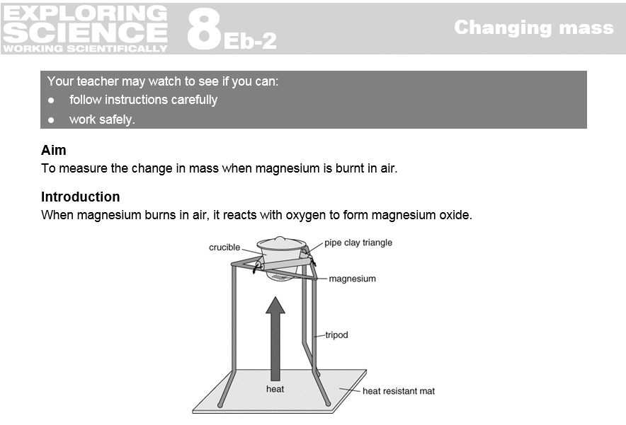
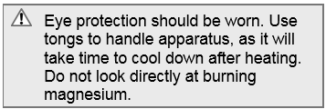
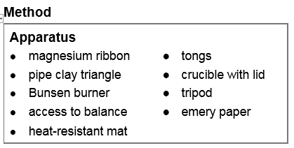
Either
Practical 8b2 – Changing Mass burning Mg in crucible, this can be done using a different lengths/masses of ribbon and using the spreadsheet 1 on active learn (also downloaded to firefly page)
Edexcel slides at end of presentation and possibly use spreadsheet 2 on active learn (also downloaded to firefly page)
doddle animation at end of presentation

Slide 13
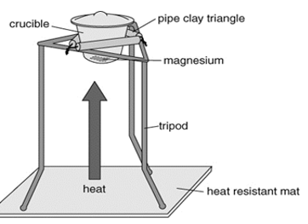

Slide 14
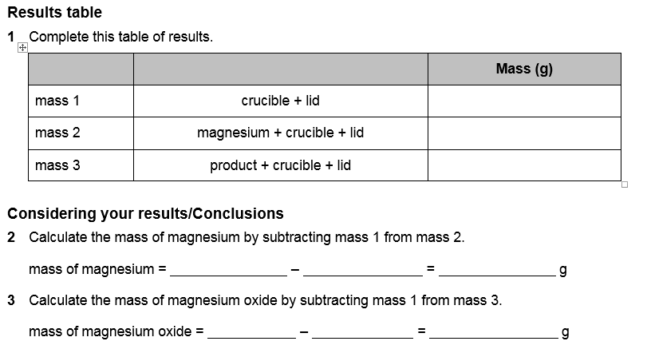

Slide 15
The mass of magnesium oxide is greater than the mass of magnesium.
The gain in mass of the magnesium oxide is the mass of oxygen that reacted with the magnesium during the oxidation reaction.
Repeat the experiment and average the results.

Slide 16
Learning Objectives
Developing | Securing | Exceeding
Must… | Should… | Could…
State what happens to mass in a chemical reaction. State the meaning of: oxidation. Describe the reactions of metals with oxygen. Identify and explain the products formed by the oxidation of metals. | Explain the change in mass seen in reactions. Compare and contrast the oxygen and phlogiston theories for combustion. | Evaluate the evidence used to displace the phlogiston theory of combustion. Model simple reactions using symbol equations.

Slide 17
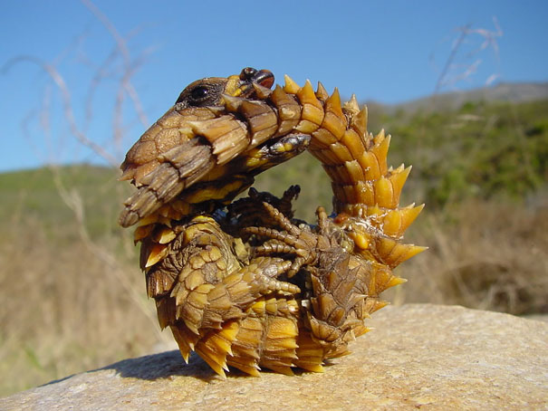
Homework:
w/s 8Eb1 – oxidation
Active learn: Exercises 8Eb developing, secure & exceeding
Date due:
Thorny Dragon
Coloured in camouflaging shades of desert browns, this lizard has a “false” head, which he presents to his predators by dipping the real one.
www.boredpanda.com

Slide 18
Theories of burning
The main theories for combustion

Slide 19
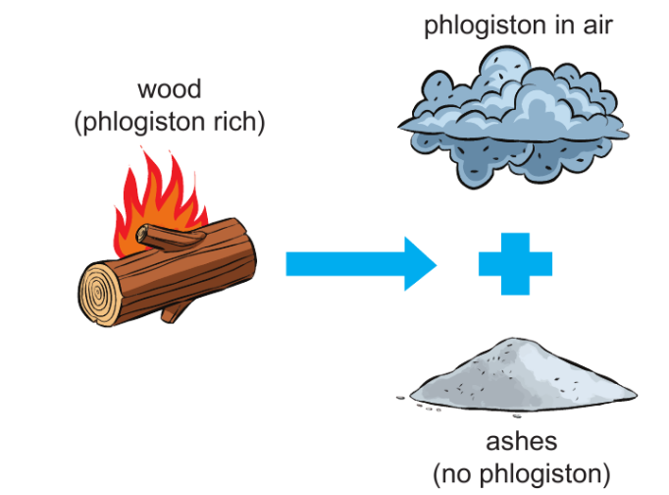
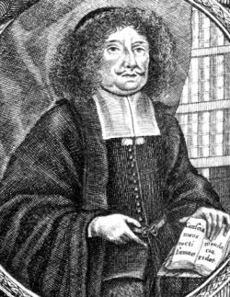
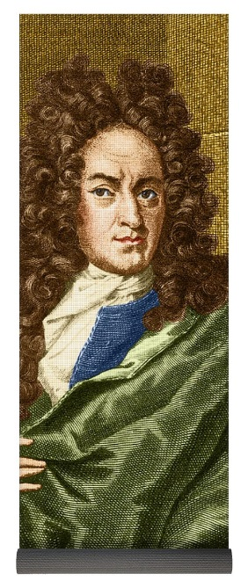
Phlogiston theory – until1722
Anything that burns contains phlogiston, and combustion releases the phlogiston into the air leaving a solid calx.
The more phlogiston a substance contains, the more completely it burns.
Air is needed for combustion because it absorbs the phlogiston – it becomes phlogisticated air.
Metals heated strongly in air also release phlogiston, leaving the metal calx. The lack of flame shows that the phlogiston is released more slowly.
Johann Joachim Becher
Georg Ernst Stahl

Slide 20
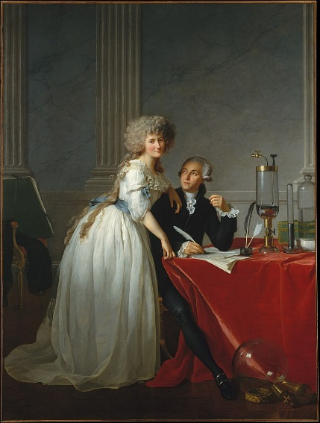
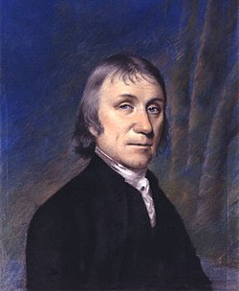
Oxygen theory - 1778
Antoine Lavoisier
Air contains oxygen.
When a substance burns, the atoms react with oxygen from the air.
Carbon atoms form carbon dioxide or carbon monoxide, which are gases.
Hydrogen atoms form water vapour.
Metal atoms form metal oxides, which are solids.
Joseph Priestley
© Pearson Education Ltd 2014. Copying permitted for purchasing institution only. This material is not copyright free.
Notes:
20

Slide 21
Theories of burning
Hexane, C₆H₁₄, is a liquid. It burns in air until there is nothing left.
How does the phlogiston theory explain these observations?
Hexane contains phlogiston and when it burns, it releases the phlogiston into the air.
Hexane must contain a lot of phlogiston as it completely burns away.
© Pearson Education Ltd 2014. Copying permitted for purchasing institution only. This material is not copyright free.
Notes:
21

Slide 22
Theories of burning
Hexane, C₆H₁₄, is a liquid. It burns in air until there is nothing left.
Is there any observation that you cannot explain using the phlogiston theory?
There is nothing left behind when hexane burns.
The phlogiston theory states that a solid calx should be left behind.
© Pearson Education Ltd 2014. Copying permitted for purchasing institution only. This material is not copyright free.
Notes:
22

Slide 23
Theories of burning
Hexane, C₆H₁₄, is a liquid. It burns in air until there is nothing left.
How do we explain these observations now?
Hexane is a hydrocarbon.
When it burns, the carbon atoms combine with oxygen to form carbon dioxide, which is a gas that escapes.
The hydrogen atoms combine with oxygen to form water.
The heat of the flame means that water is formed as water vapour, which is released into the air.
© Pearson Education Ltd 2014. Copying permitted for purchasing institution only. This material is not copyright free.
Notes:
23

Slide 24
Theories of burning
When 1.2 g of magnesium burns, it formed a white ash with a mass of 2.0 g.
How does the phlogiston theory explain these observations?
Magnesium contains phlogiston and when it burns, the phlogiston is released into the air.
The white ash is a solid calx.
© Pearson Education Ltd 2014. Copying permitted for purchasing institution only. This material is not copyright free.
Notes:
24

Slide 25
Theories of burning
When 1.2 g of magnesium burns, it formed a white ash with a mass of 2.0 g.
Is there any observation that you cannot explain using the phlogiston theory?
The phlogiston theory does not explain why the mass increases.
If phlogiston is lost, the mass should decrease.
© Pearson Education Ltd 2014. Copying permitted for purchasing institution only. This material is not copyright free.
Notes:
25

Slide 26
Theories of burning
When 1.2 g of magnesium burns, it formed a white ash with a mass of 2.0 g.
How do we explain these observations now?
When magnesium burns, it combines with oxygen from the air to form magnesium oxide, a solid white ash.
Mass is conserved in reactions which means that the mass of magnesium plus the mass of oxygen must equal the mass of magnesium oxide.
We can work out the mass of the oxygen used from the air: 2.0 g of magnesium oxide minus 1.2 g of magnesium means that 0.8 g oxygen must have been used from the air.
© Pearson Education Ltd 2014. Copying permitted for purchasing institution only. This material is not copyright free.
Notes:
26

Slide 28
Learning Objectives
Developing | Securing | Exceeding
Must… | Should… | Could…
State what happens to mass in a chemical reaction. State the meaning of: oxidation. Describe the reactions of metals with oxygen. Identify and explain the products formed by the oxidation of metals. | Explain the change in mass seen in reactions. Compare and contrast the oxygen and phlogiston theories for combustion. | Evaluate the evidence used to displace the phlogiston theory of combustion. Model simple reactions using symbol equations.

Slide 29
And finally . . .
What part of today’s lesson do you think you’ll remember the most?
Can you explain why?

Slide 30
Mass in reactions
How mass changes in reactions

Slide 31
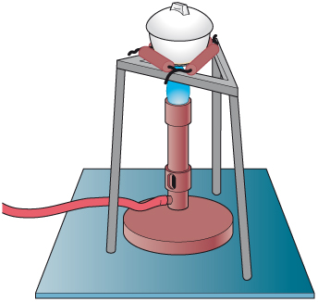
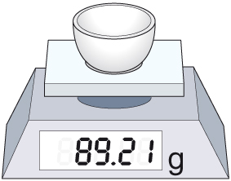
Mass in reactions
The crucible is heated using a Bunsen burner.
The mass of a crucible and a piece of zinc is measured.
The zinc reacts with oxygen from the air.
What compound will be formed when the zinc reacts?
zinc + oxygen
zinc oxide
Wear eye protection

Slide 32
Mass in reactions
The mass of the crucible and its contents is measured after heating.
Will the mass have gone up or down? Explain your answer.
The mass will go up.
The zinc oxide includes the original zinc atoms plus some oxygen atoms from the air.
Wear eye protection
© Pearson Education Ltd 2014. Copying permitted for purchasing institution only. This material is not copyright free.
Notes:
32

Slide 33
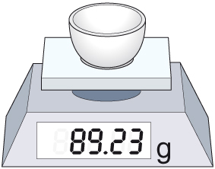
Mass in reactions
The mass of a crucible and a piece of zinc is measured.
The mass of the crucible and the zinc oxide after heating.
What mass of oxygen has reacted with the zinc?
0.02 g (89.23 g – 89.21 g = 0.02 g)
© Pearson Education Ltd 2014. Copying permitted for purchasing institution only. This material is not copyright free.
Notes:
33

Slide 34
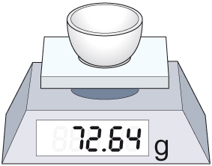
Mass in reactions
The crucible is heated using a Bunsen burner.
The mass of a crucible and a piece of magnesium is measured.
Wear eye protection
What will happen? Explain in as much detail as you can.
The magnesium will react with oxygen from the air.
It will form magnesium oxide.
The mass of the crucible and its contents will go up, because of the oxygen that is now part of the compound in the crucible.
© Pearson Education Ltd 2014. Copying permitted for purchasing institution only. This material is not copyright free.
Notes:
34

Slide 35
What happens to the mass?
https://www.doddlelearn.co.uk/app/teacher/launch-content/c5f7606a-1897-4bed-95e9-fe67dfdbd4f4

