Slide 1
Black History Month: Challenging existing narratives

Slide 2
DO NOW: Draw a Roman

Slide 3
Watch this – does it challenge your ideas of a ‘Roman’?
Watch the clip
125AD-240AD

Slide 4
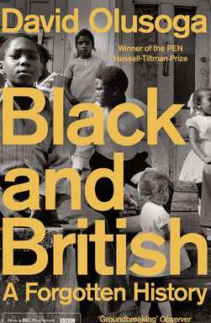
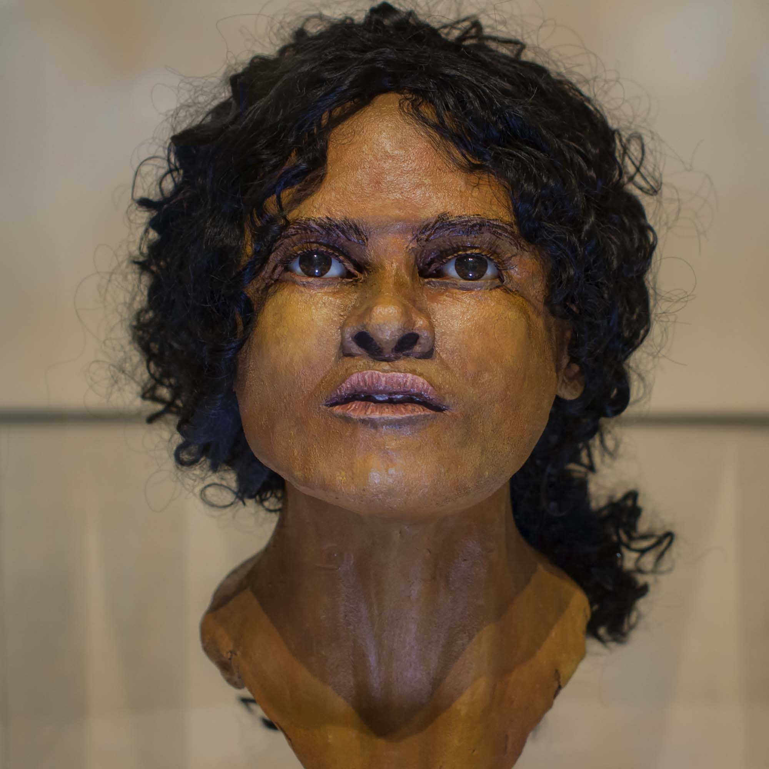
‘Beachy Head Lady’
Another equally remarkable discovery was recently made in the seaside town of Eastbourne, on the south coast of England. In 2012 local archaeologists began to work their way through a collection of skeletons excavated between 1900 and 1990. One skeleton was stored in a box labelled ‘Beachy Head’. The remains were those of a young woman, around five feet tall and probably in her early twenties. The archaeologists arranged for forensic facial reconstruction to be carried out by Professor Caroline Wilkinson, a leading figure in the field. Professor Wilkinson was able to tell, merely by looking at the skull, that the skull of the Beachy Head Lady was that of a sub-Saharan African. Radiocarbon dating [test to discover the age of bones] placed the lady as having lived around AD 125-245 and the results of the radioisotope analysis confirmed she had spent much of her childhood in the south east of England. The Beachy Head Lady was therefore a second-or third-century AfroRoman who had been brought up in the south of England and had either been born in that region or was brought there very young possibly from Africa. Over a millennium before the British people began their ‘years of distant wandering’ and empire-building the Beachy Head Lady – the first black Briton known to us – had lived and died in rural East Sussex, by the English Channel coast with its white cliffs and green rolling hills.

Slide 5
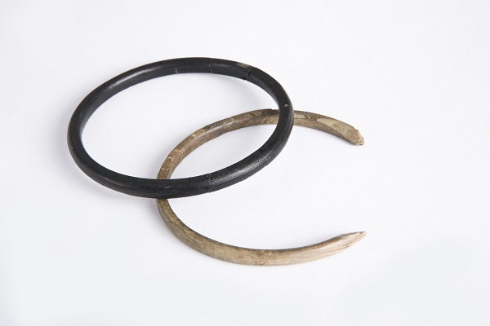
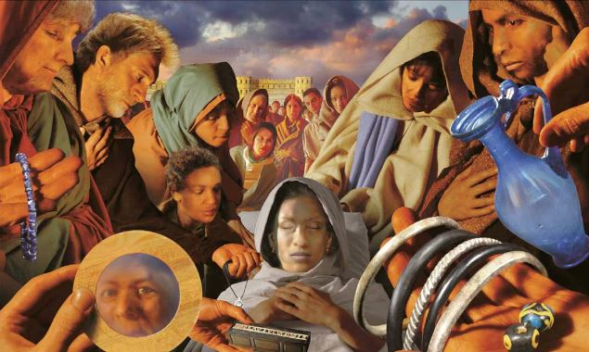
‘Ivory Bangle Lady’
Archaeologists have discovered that the Ivory Bangle Lady, or her ancestors, were from Africa. More specifically, it has been proved that the Ivory Bangle Lady, or her ancestors were from sub-Saharan Africa (from a country below the Sahara Desert). Along with the Ivory Bangle Lady, archaeologists found roughly 200 Roman skeletons buried near Sycamore Terrace in York. Radioisotope analysis has proved that 12% of the skeletons found were immigrants from Africa, mostly North Africa.

Slide 6
More evidence of African migrants to Roman Britain was found in 1934, in a village called Beaumont in Cumbria (coloured red on the map). A stone was found underneath an old cottage that was being demolished (knocked down). There was an inscription (writing) on the stone in Latin (the language spoken by the Romans). It said that a unit (small army) ‘of Aurelian Moors’ had been based at the nearby Roman fortress of Aballava. The Aurelian Moors were a group of soldiers from North Africa, probably Libya, Tunisia or Algeria. Two Roman Emperors were named on the stone – Valerian and Gallienus. This evidence means we can work out the rough date the stone was made – somewhere between 253 and 258 AD. This means that Africans were definitely living in Britain at that time. The fortress at Aballava was part of Hadrian’s Wall, a 6 metre high wall that stretched 84 miles across the boarder between England and Scotland. There was a fortress every mile along the wall. Most historians believe that the soldiers who manned the fortresses were from North Africa, or the Middle East, countries such as Syria, Iraq or Iran. There is also evidence of immigrants from modern day France, Italy, Spain and other European nations living in Roman Britain – it was a very diverse place. This isn’t really a surprise. Rome (in modern Italy) controlled a huge Empire in Europe, Africa and Asia.

Slide 7
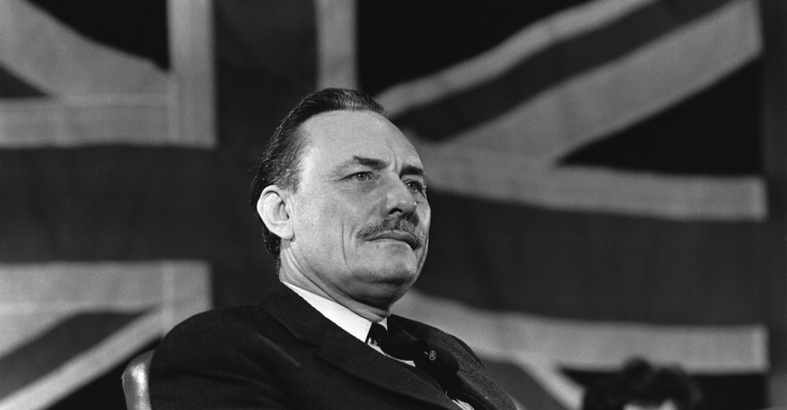
How would it challenge this person’s ideas?
‘The unbroken life of the English nation over a thousand years or more is a phenomenon unique in history … the continuity of her existence was unbroken when the connections that linked her to distant continents and strange races fell away.’ (Powell 22nd April 1961)
‘The English can revert [return] to being the people we were before the ships of Elizabethan and Stuart England set off to forge the first British Empire in the Americas.’

Slide 8
Revision recap: ‘Rivers of Blood’ speech
Date?
Context?
Impact?

Slide 9
Revision recap: ‘Rivers of Blood’ speech
Date? 1968
Context?
1968 Race Relations’ Act – outlaws discrimination in housing and employment
1968 Commonwealth Immigration Act –
Restricted U.K. citizenship to those born in the U.K. and their children or grandchildren. Those living in the ex-colonies without a direct family connection to the U.K. were no longer entitled to enter the country.
‘Restrictions and assimilation’
Impact of speech?
Enables the private racism of some of the public. Support for Powell but also huge backlash against him – divisions. Powell is sacked from the Shadow Cabinet (by Conservative leader Edward Heath).
Notes:
https://www.bbc.co.uk/bitesize/clips/zp48sg8

Slide 10
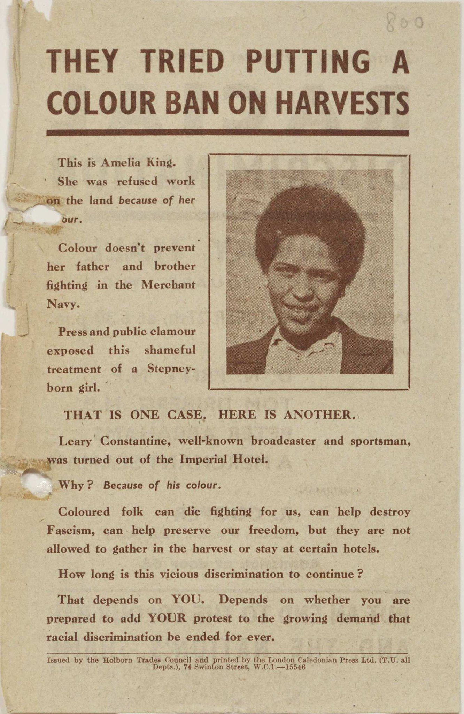
Lesser known stories of Black Britons.....
What is the ‘story’ here?
What narrative does this challenge?

Slide 11
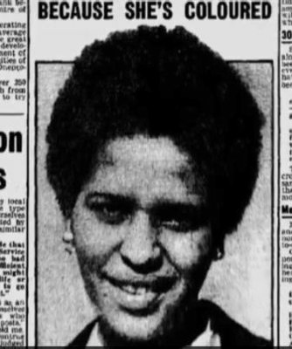
The case of Amelia King
A black London-born woman who was refused employment by the WWII Land Army (the Essex county committee) on the grounds that no white farmer would want a black person on the farm. She was told to find other work. Her father was a merchant seaman and her brother was in the navy. Rather than taking this dismissal quietly King took her case to her local MP and the matter was raised in parliament in 1943.
The Minister for Agriculture said ‘… she was advised to find other war work where her services could be more speedily utilised’…
One MP replied that the case would affect the 'integrity of the British people’
A mass observation poll found that ‘even those who did not entirely believe in colour equality were against this particular case of colour prejudice which was regarded as detrimental to the war effort’ (Fryer, p.370)
King won her case.

Slide 12
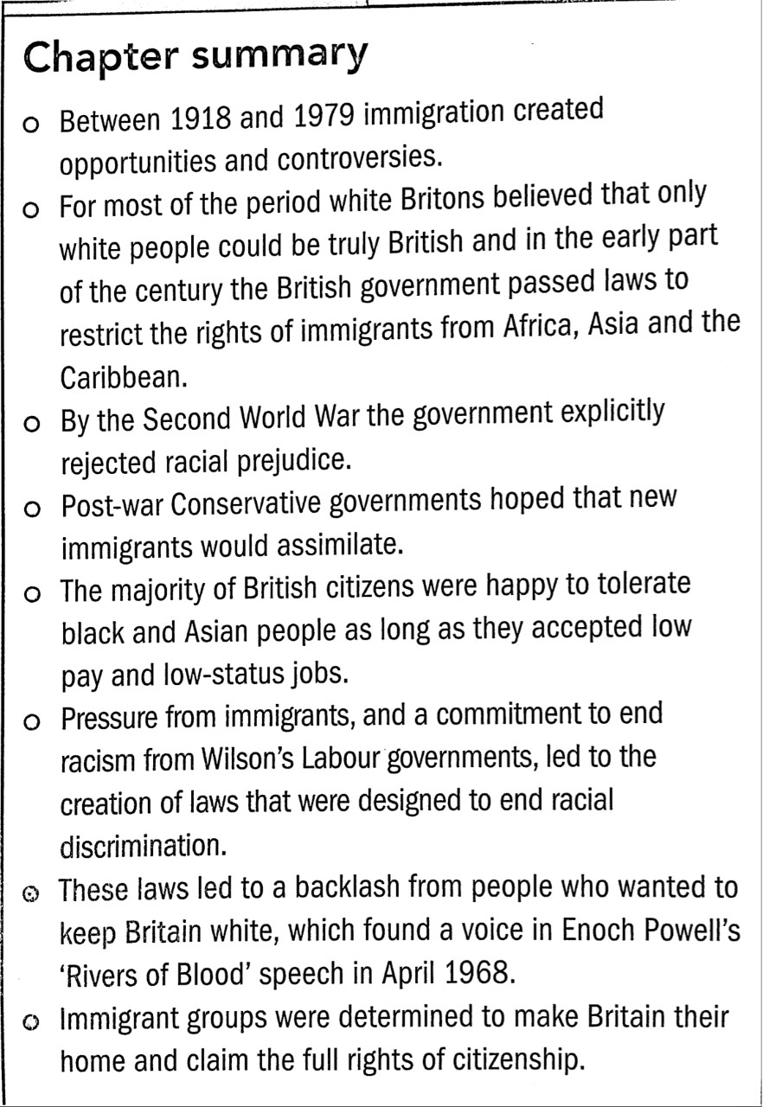
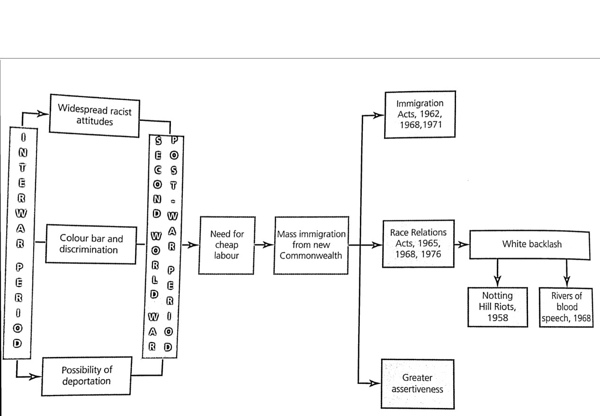
Revision over half-term: Immigration and race relations 1918-79

Slide 13
Black History Month: Challenging existing narratives

