Slide 1
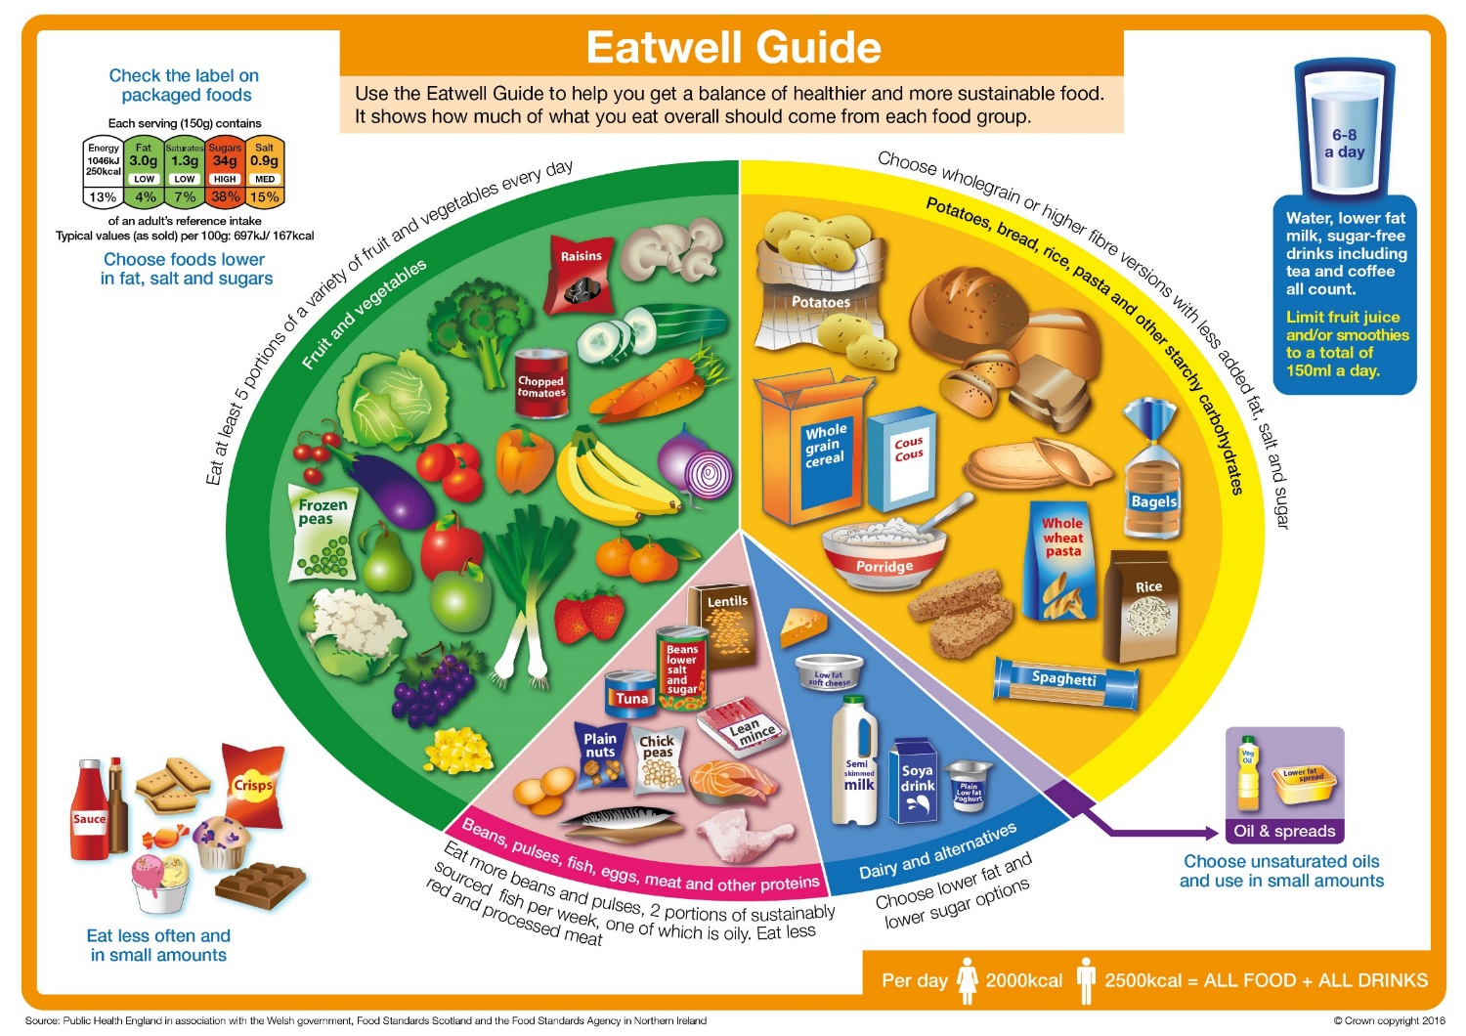
CW
8Ac Balanced Diets
In the back of your books create me an “unhealthy” dinner.
I don’t care what I eat, as long as it tastes good and there’s lots of it.
@hpscience

Slide 2
A balanced diet means eating the right types of food in the right amounts so that the body gets the nutrients it needs.
You need to eat a variety of foods to have a balanced diet.
If you eat too much or too little of a nutrient, you may suffer from m________.
alnutrition

Slide 3
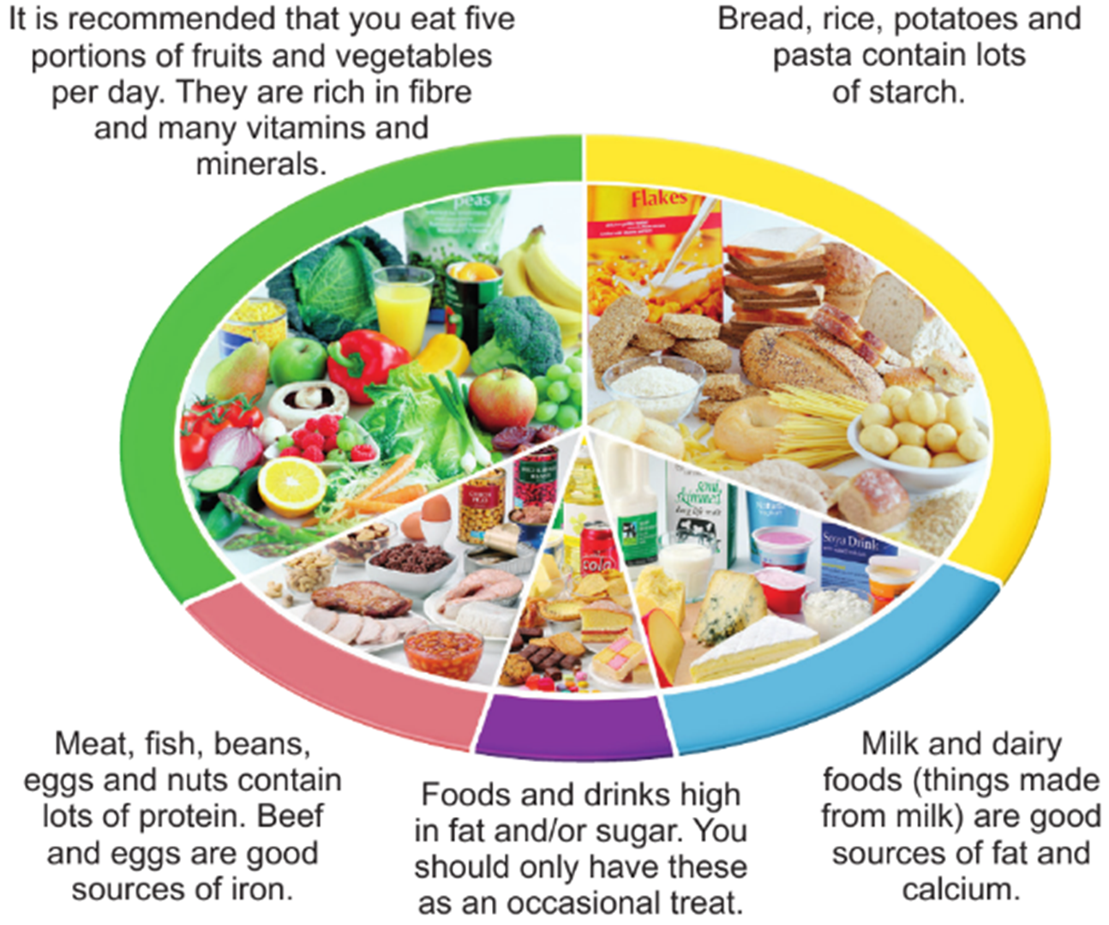
The Eat Well guide shows you what types of food to eat and in what proportions.
It shows that we need to eat mostly starchy foods and fruit and vegetables and take it easy on the sweets.
Notes:
Teacher notes
This section has cross curricula links with Food Technology (D&T) and PE.

Slide 4
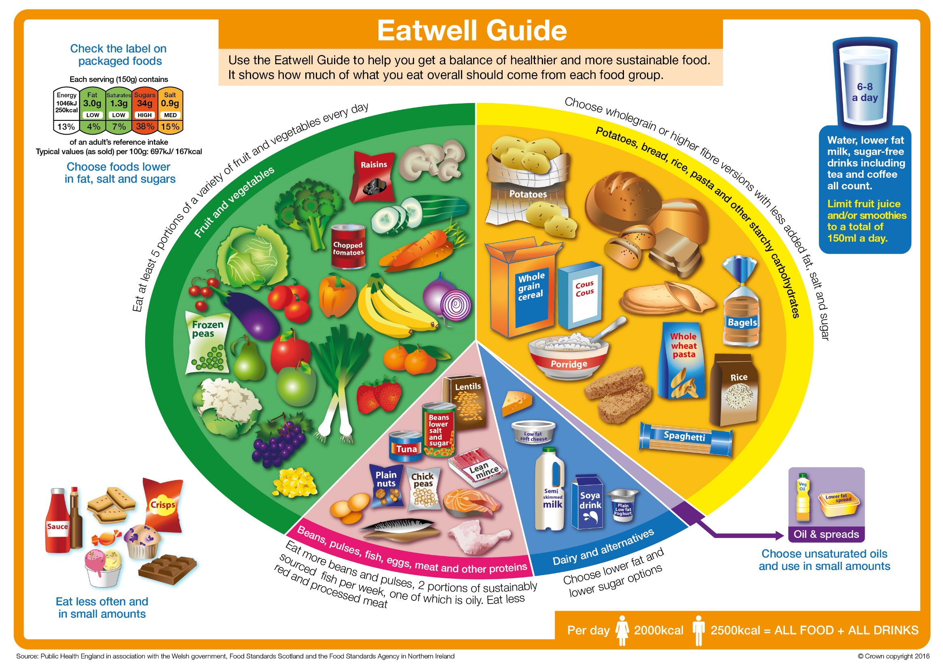

Slide 5
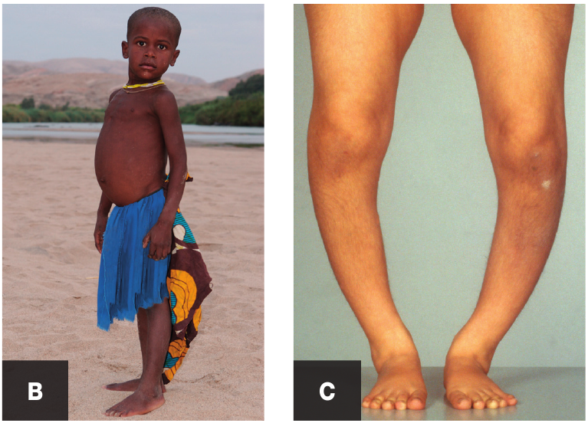
Deficiency Diseases
Deficiency disease - a disease caused by the lack of a nutrient in the diet.

Slide 6
Deficiency Diseases
Deficiency disease - a disease caused by the lack of a nutrient in the diet.
The most severe form of malnutrition is starvation.
9 million people a year die from deficiency diseases every year.
Play video
https://www.activeteachonline.com/default/player/video/id/350358/external/0

Slide 7
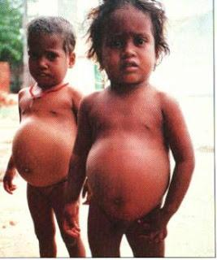
Kwashiorkor
Caused by a lack of protein.
Seen in very poor countries.
Causes fluid to build up in around the belly (abdomen) and it swells up.
It can be very painful and leads to death.
It can easily treated if you have you have the money to buy food containing protein.

Slide 8
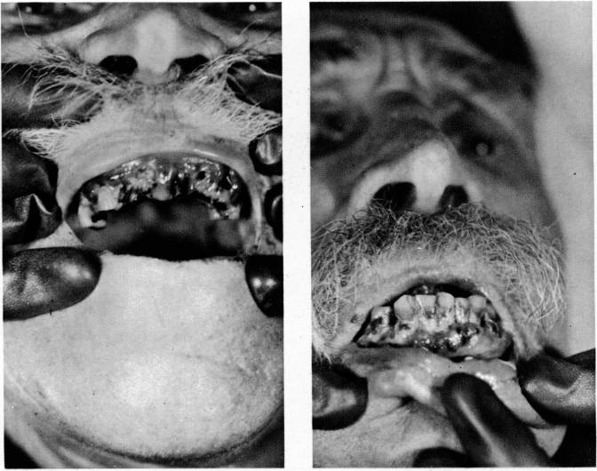
Scurvy
Caused by a lack of vitamin C
Causes painful joints and your gums bleed as the tissues breakdown.

Slide 9
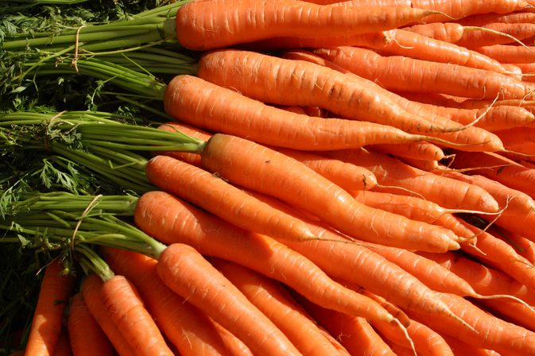
Night blindness
Caused by a lack of vitamin A
Difficult to see in dim light
Carrots are a good source of vitamin A
Do carrots help you see in the dark?

Slide 10
Anaemia
Caused by a lack of iron (a mineral)
Causes tiredness and shortness of breath*.
(*not the same as finding it hard to breath or being out of breath)

Slide 11
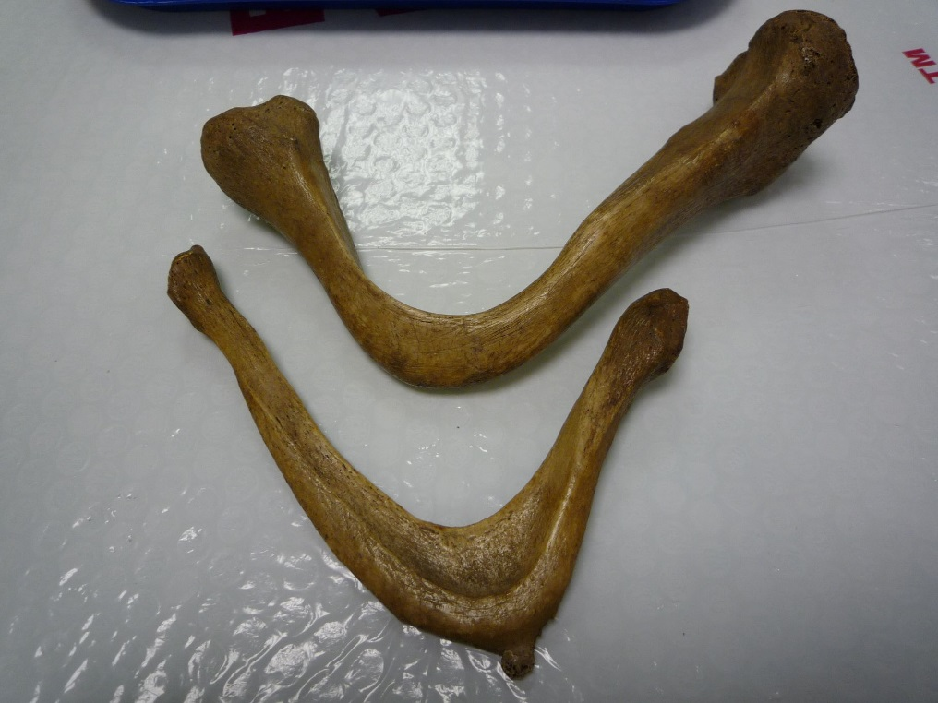
Ricketts
Caused by a lack of calcium and vitamin D.
Causes weak bones that do not grow properly

Slide 12
Eating too much
If the food you eat contains more energy than you use, you will store the excess energy as fat and become overweight.
If you consume less energy than you use then you will lose weight.

Slide 13
What 2 bits of advice would you give someone who wants to lose weight?
If a person wants to lose weight they should;
1. Eat less food
2. Do more exercise

Slide 14
Being overweight can cause many health problems;
H____ disease
eart
iabetes
Type 2 d______
Strokes
Kidney damage

Slide 15
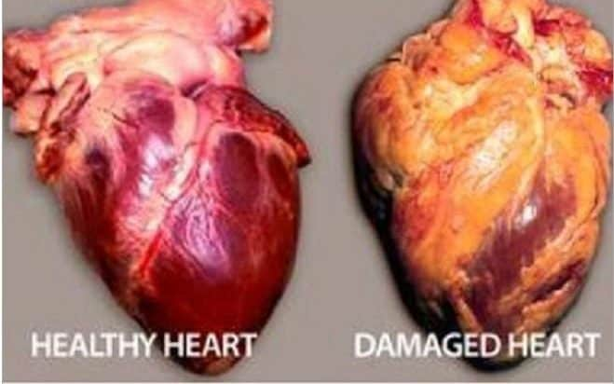
Heart disease
When a person becomes overweight they store more fat around their body.
This fat may also clog the blood vessels that supply the heart with o_____ and g______ for r_________.
This may lead to heart disease,
where the heart muscle tissue
becomes damaged, and even
cause a h____ a_____.
xygen
lucose
espiration
eart
ttack

Slide 16
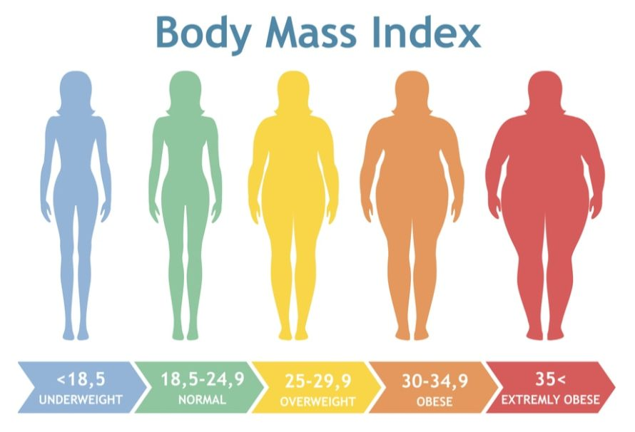
Obesity
https://www.activeteachonline.com/default/player/video/id/350359/external/0
If a person is very overweight they are said to be obese.
Obesity is not a disease in itself but significantly increases the risk of many diseases.

Slide 17
Units of length
Units of mass
Meter (m)
Millimeter (mm)
Micrometer (μm)
1
1 000
1 000 000
Gram (g)
Milligram (mg)
Microgram (μg)
What is the next unit up from meters and grams?

Slide 18
Practice these test questions.
Think about the language you use.
Try to be clear and scientific.

Slide 19
Match these up
Lack of vitamin C
Lack of Protein
Lack of vitamin D
Lack of vitamin A
Kwashiorkor
Ricketts
Night blindness
Scurvy

Slide 20
Explain how the diet for a professional footballer may be different to a person who works in an office?
The footballer needs to eat more meat and fish for protein to repair and grow more muscle.
They also need more starch (carbohydrate) because they use more energy.

Slide 21
A slightly overweight 40 year old male teacher wants to lose some weight so that he looks buff on the beach. What advice would you give him?
He should eat less fatty / high energy food and do more exercise.

Slide 22
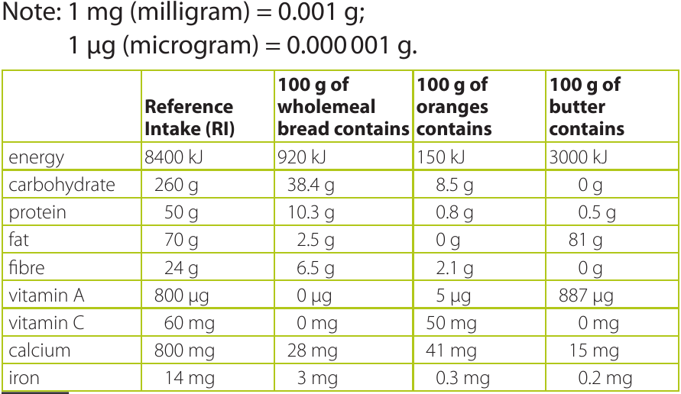
How much butter do I need to eat to get my recommended intake (RI) of protein?
Reference intake (RI) – A recommended daily amount.

Slide 23
Objectives
Recall what is meant by a balanced diet.
Explain the benefits of a balanced diet and correctly use the term: malnutrition.
Explain how deficiency diseases are caused.
Describe the factors that may lead to obesity.

Slide 24
Describe the effects of obesity on health.
Use dietary advice and nutrition information to design a healthy diet.
Recall and identify examples of deficiency diseases (kwashiorkor, scurvy, rickets).
Explain the links between specific forms of malnutrition, diet and lifestyle.

