Slide 1
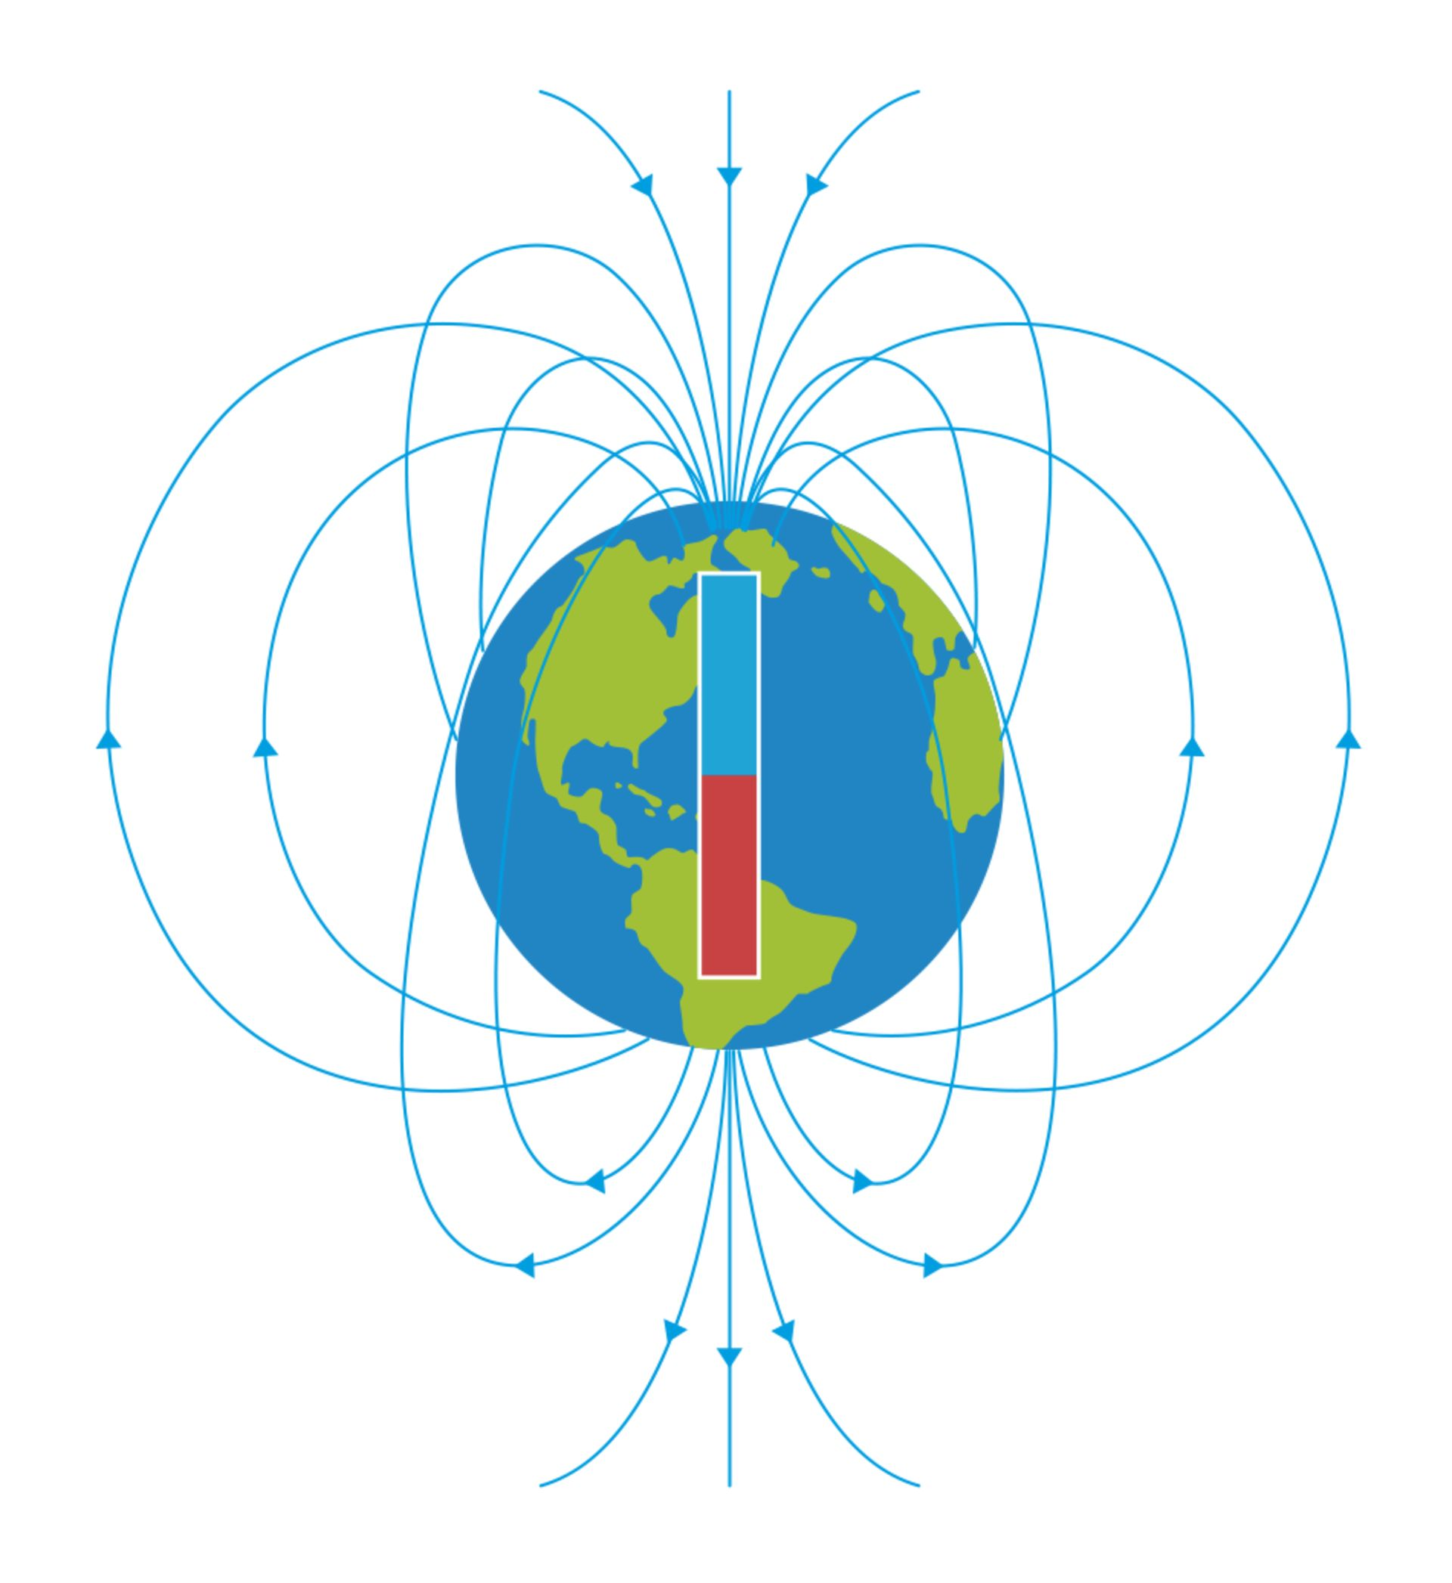
8Lc Magnetic Earth
CW
Do Now:
What direction does a compass point?

Slide 2
Requisitions
Equipment | Worksheets

Slide 3
Copy & Complete
The Earth is surrounded by a magnetic field.
A magnetic field is the region around a magnet where a ________ force acts.
It shows the direction of the _____ on a north pole.
magnetic
force
Why does a compass point north?
Will compasses always point north?!

Slide 4
Objectives
State what is meant by a magnetic field, and recall the shape of the field of a bar magnet.
Describe the effect of the Earth’s magnetic field on compass needles.
Explain how to arrange two magnets so that they attract or repel each other.
Recall the direction of a magnet’s magnetic field.
Explain how a compass can be used together with maps for navigation
Explain how a plotting compass can be used to show the shape and direction of a magnetic field.
Describe the Earth’s magnetic field and explain why a magnetic compass points north.
Describe the shape of the magnetic field between two bar magnets in different arrangements.
Use ideas about the Earth’s magnetic field to explain variation, dip and deviation.

Slide 5
Use your compass to find north.
Investigate attraction and repulsion of magnets.
See what happens to your compass near a magnet.
What direction is north?
Do all our compasses agree?

Slide 6
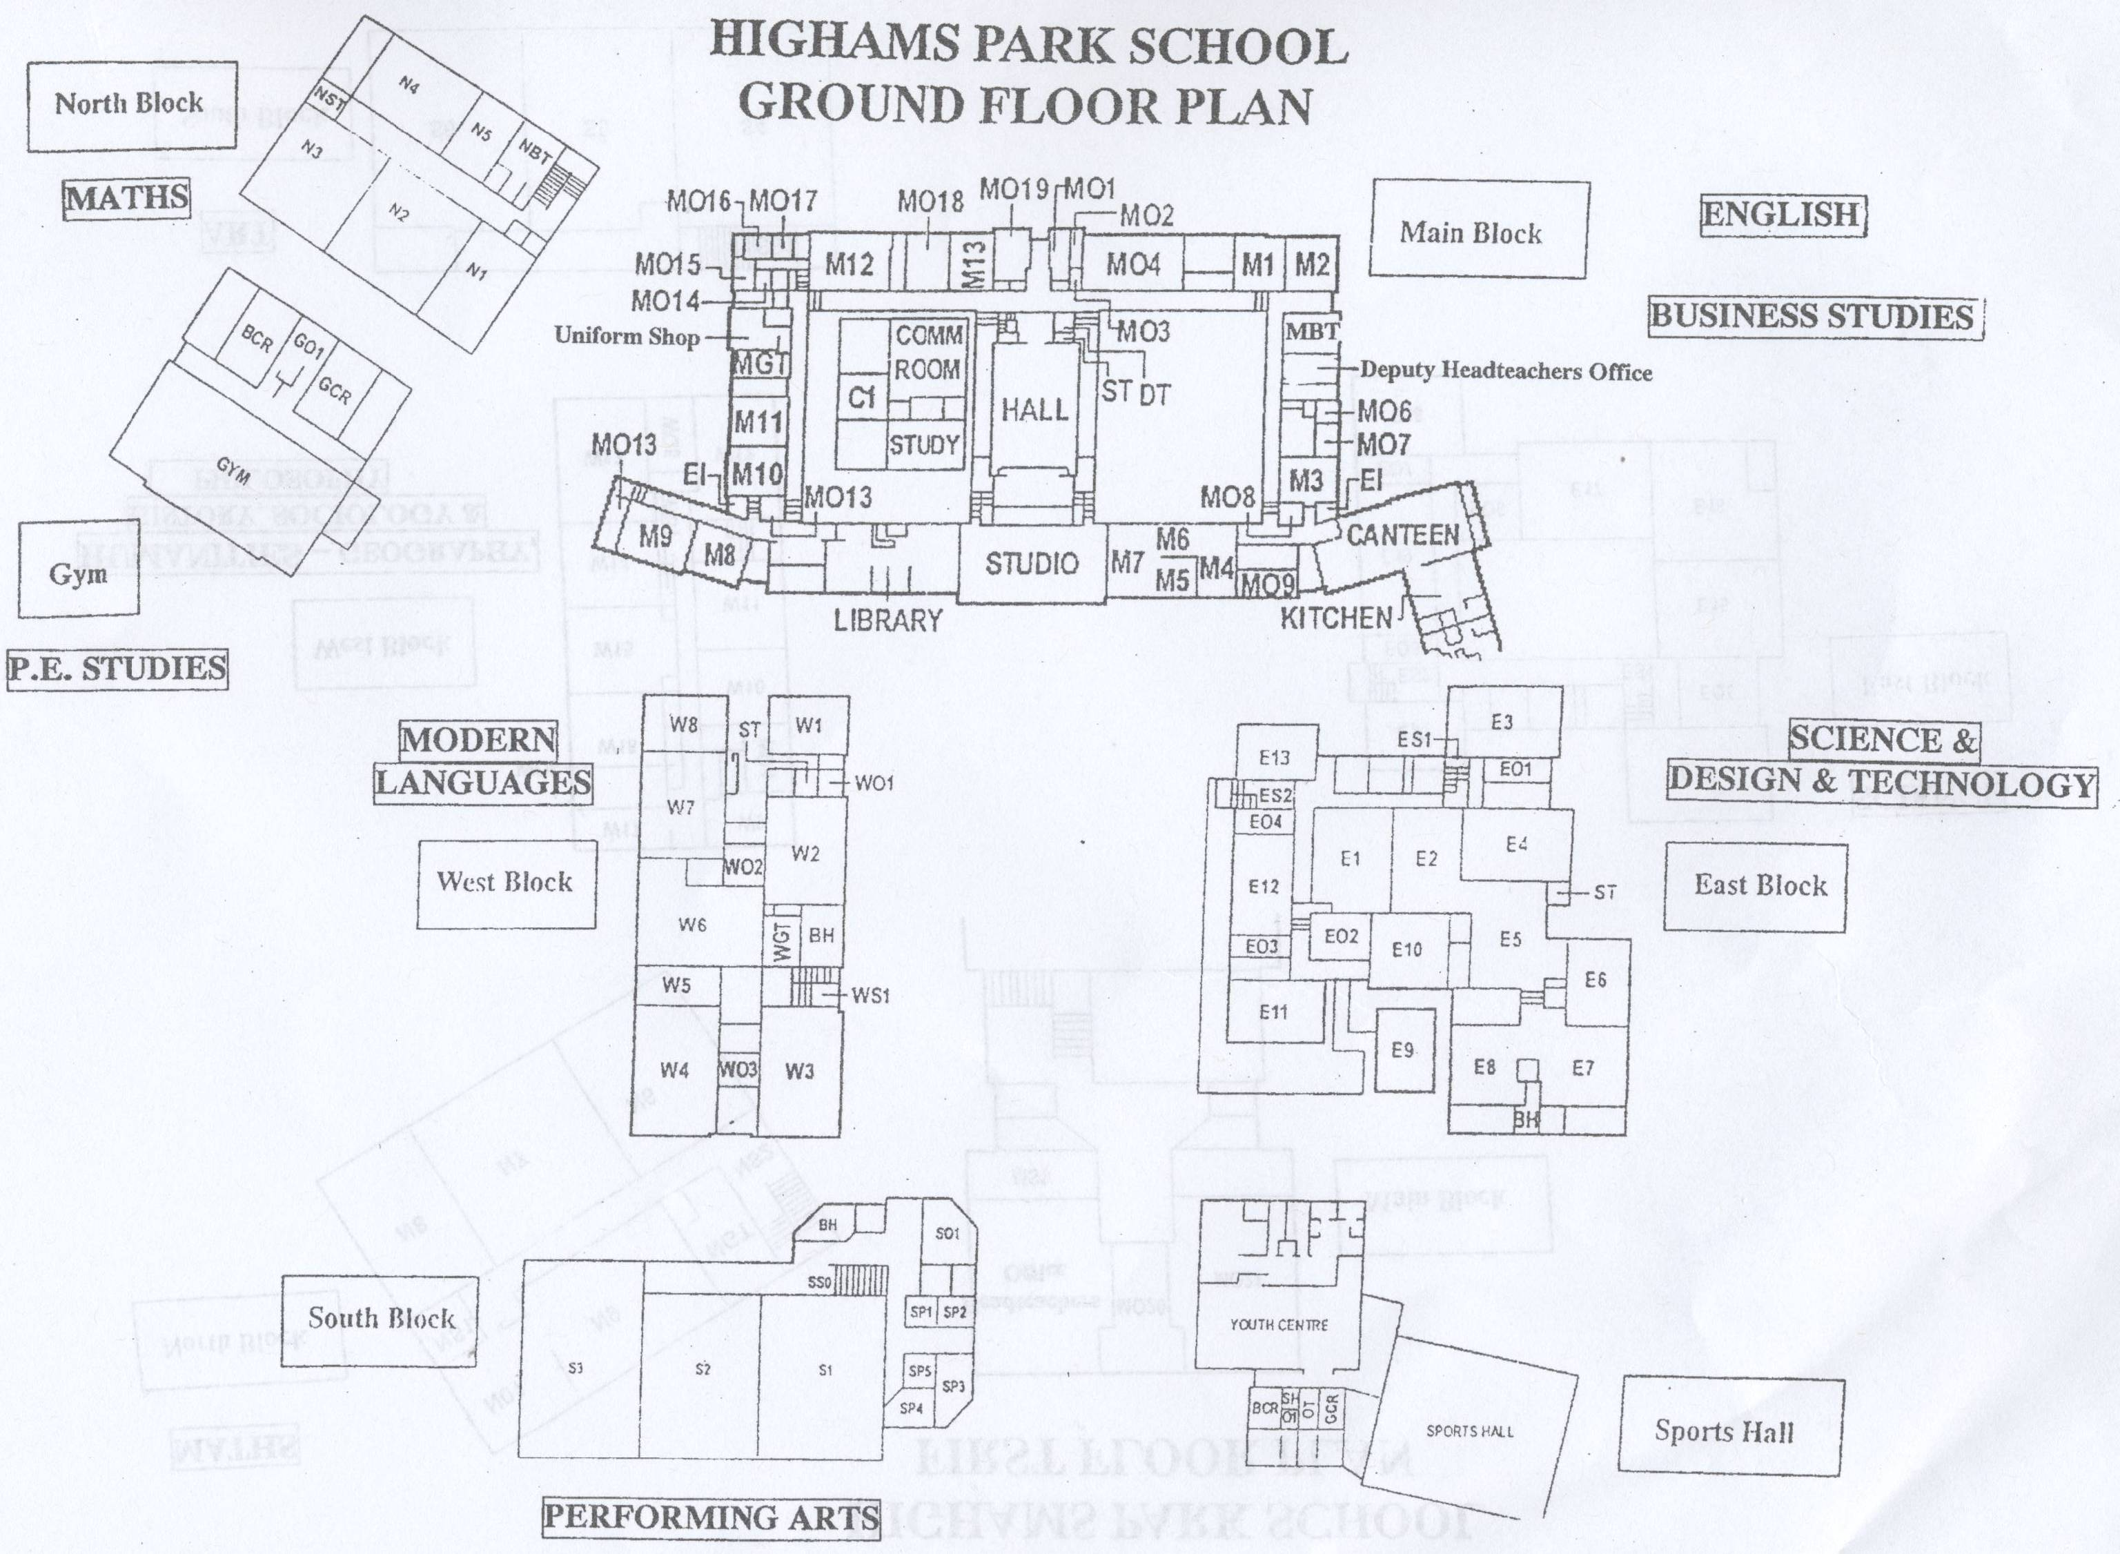
N
Why is the N block called the ‘North Block’?!

Slide 7
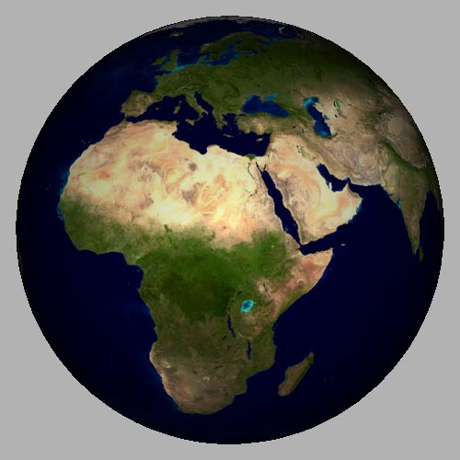
If the north pole of a compass points North, what type of magnetic pole must be at the geographical North pole?!
Why is the ‘magnet’ shown at an angle?
N
S
N
S

Slide 8
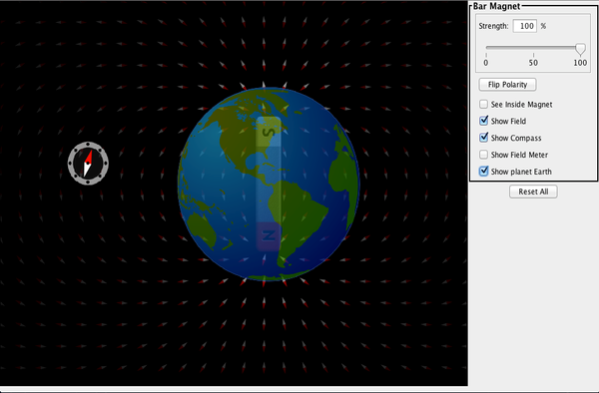
 Click image to run simulation.

Slide 9
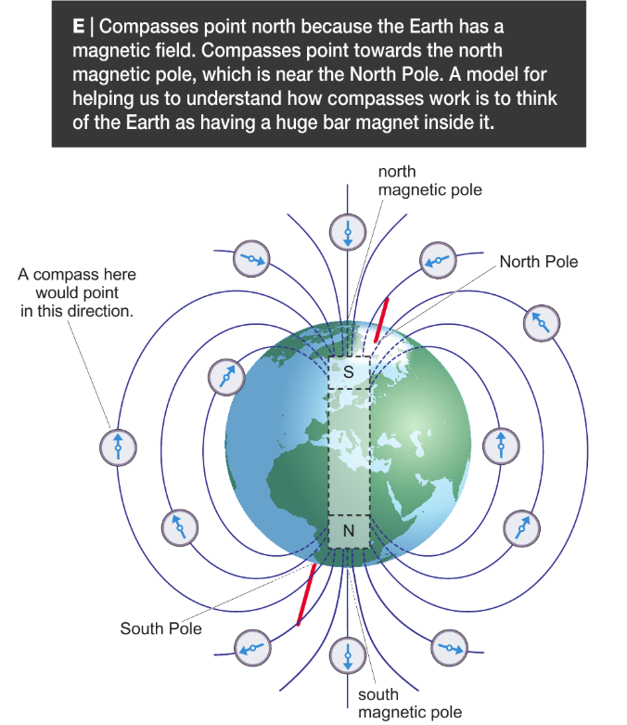
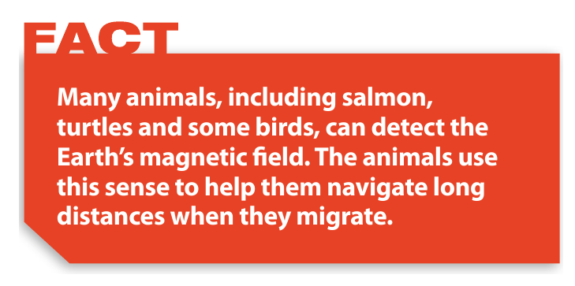

Slide 10
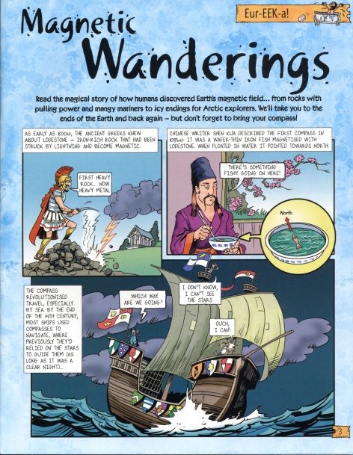
Copy & Complete
Like poles _____ and opposite poles attract.
The “north-seeking pole” (or just “north pole”) of a magnet is attracted to a _____ pole.
So we can model the Earth as having a huge bar magnet inside it, with a magnetic _____ pole near the geographic North pole (& vice versa)!
repel
south
south
north south attract repel
Read the comic strip.

Slide 12
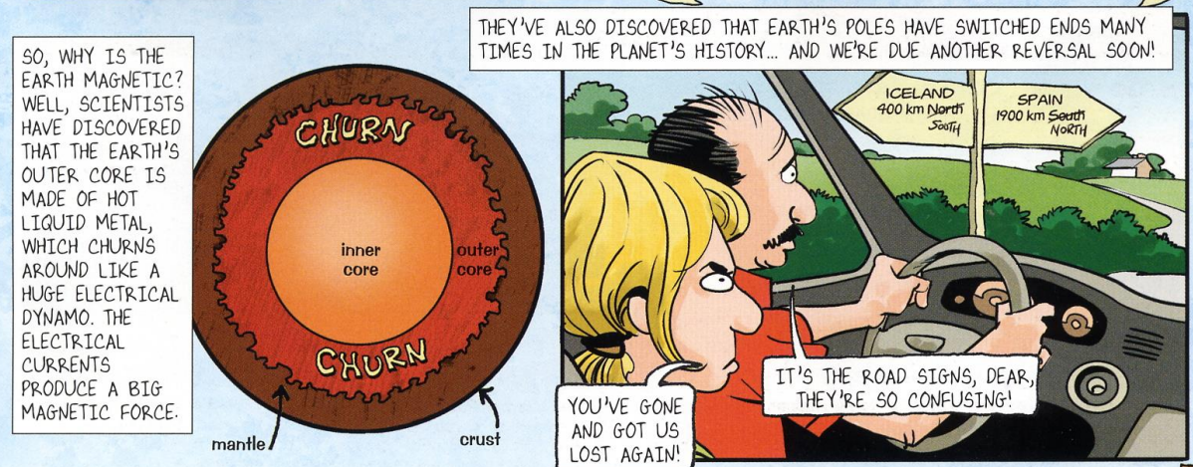

Slide 13
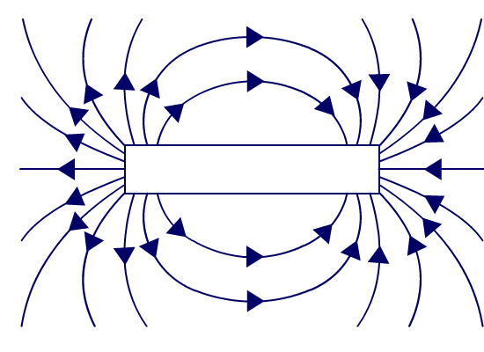
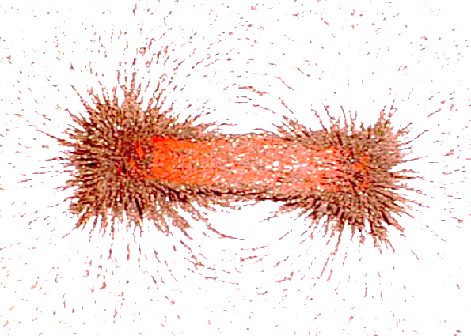
Where is the magnetic field strongest?
The magnetic field around a bar magnet
strong
The closer the field lines the ______er the field.
N
S
strongest field
at poles
How can we plot the shape of this field?
weakest field further away from poles

Slide 15
Place a magnet between your 2 exercise books with an OHT over the top.
Carefully sprinkle iron filings over it.
Tap gently to get a better pattern.
Carefully lift the OHT and drag the iron filings about by moving the magnet.
Pour ALL iron filings back into the pot.
How can we work out the direction of the field?
Can you see the 3D shape of the field?

Slide 16
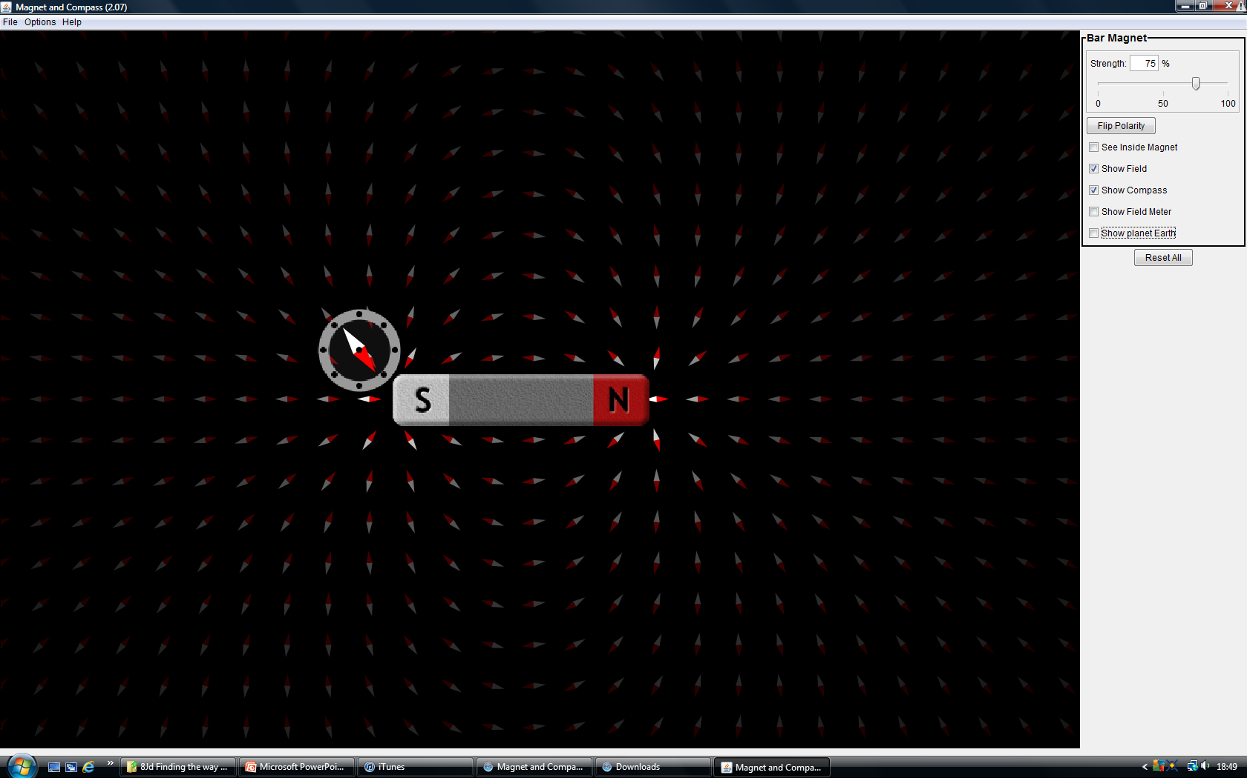
 Click image to run simulation.

Slide 17
What direction would these compasses point?

Slide 18
Plotting the magnetic field with a compass
Blu-tac your magnet in the middle of your A4 sheet & draw round it.
Draw dots around your N pole (red) as shown:
Place your compass so that its tail is over one of the dots.
Draw another dot where the arrow head points, remove the compass & join up with a straight line.
Place the tail of the compass over this last dot & repeat until it goes off the page or joins up to the magnet again.
S
5 dots along end & 2 round each corner – keep it symmetrical!
N

Slide 19
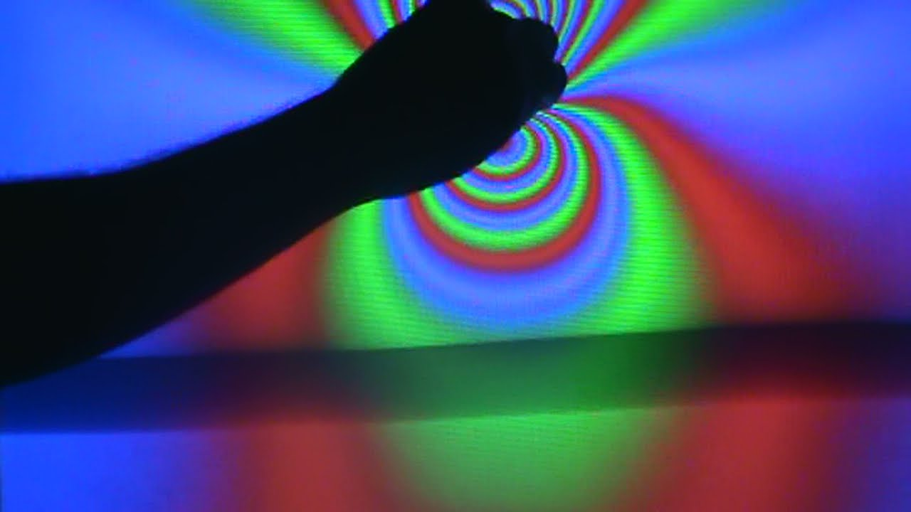
What happens if you put a magnet near an old TV screen?!
DO NOT try this at home!

Slide 20
https://www.youtube.com/watch?v=-zvCUmeoHpw
Notes:
https://www.youtube.com/watch?v=LdQ6gPbrqa0

Slide 21
 Give a clue or definition for these keywords.
Hot seat
compass

Slide 22
 Give a clue or definition for these keywords.
Hot seat
north-seeking pole

Slide 23
 Give a clue or definition for these keywords.
Hot seat
attract

Slide 24
 Give a clue or definition for these keywords.
Hot seat
magnetic field

Slide 25
 Give a clue or definition for these keywords.
Hot seat
repel

