Slide 1
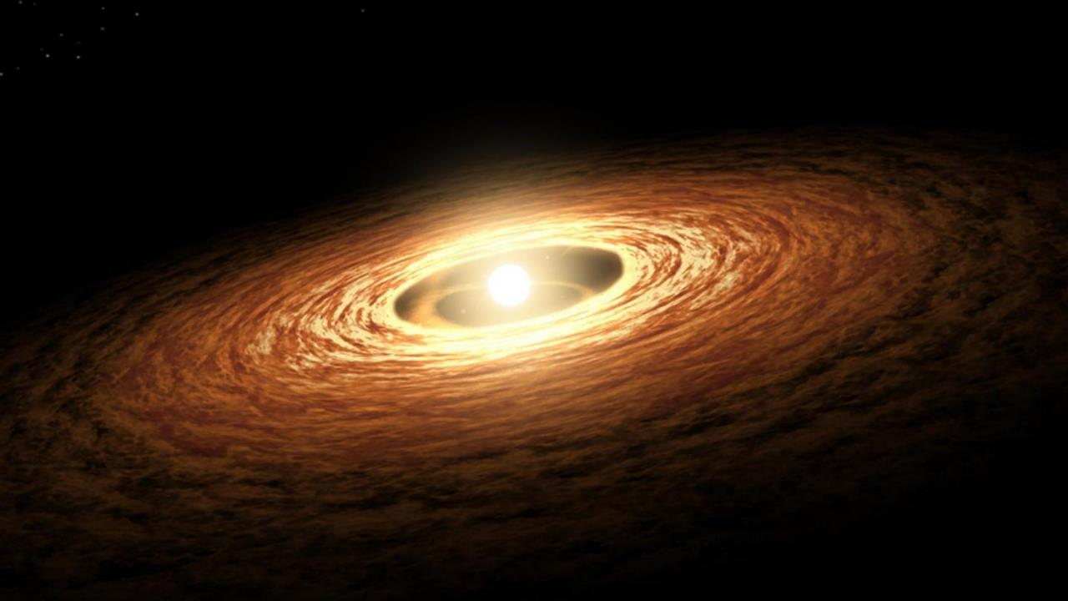
Planetary Formation and Protoplanetary Disks

Slide 2
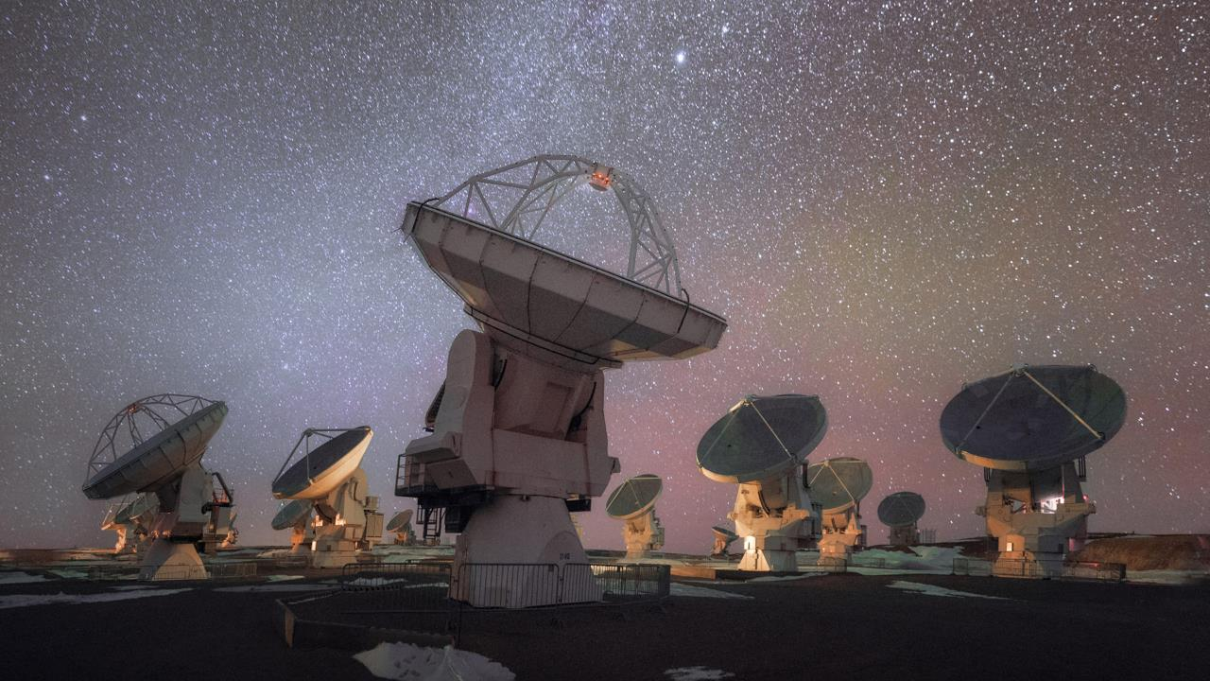
ALMA
Atacama Large (sub)Millimetre Array

Slide 3
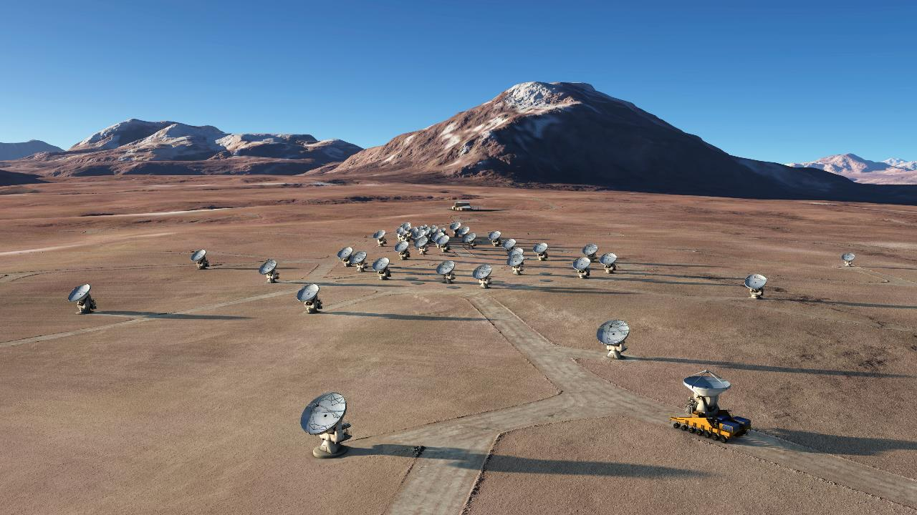
ALMA
Atacama Large (sub)Millimetre Array

Slide 4
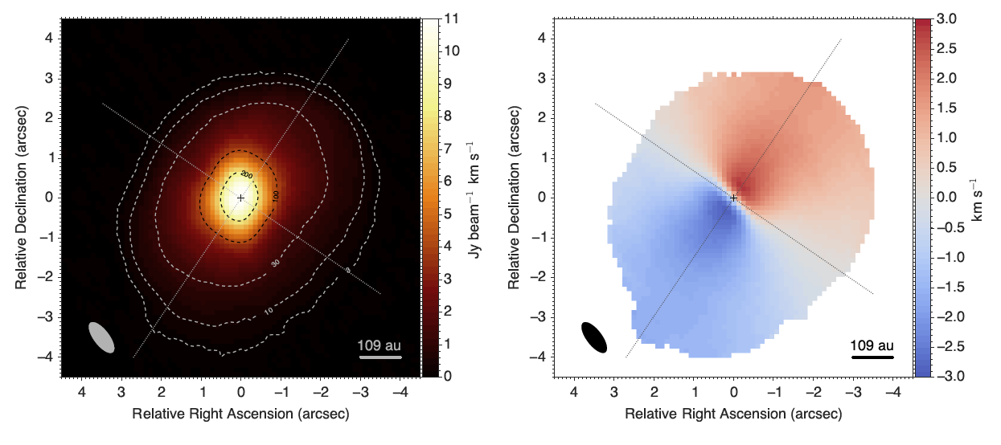
Data from the ALMA archive

Slide 5
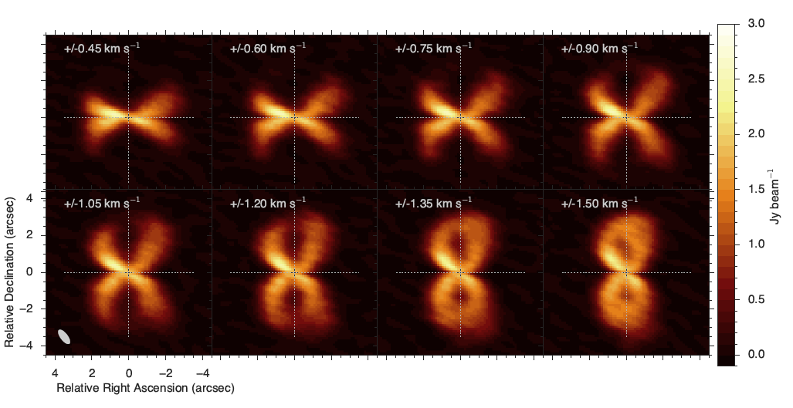
Data from the ALMA archive

Slide 6
Data from the ALMA archive

Slide 7
Data from the ALMA archive

Slide 8
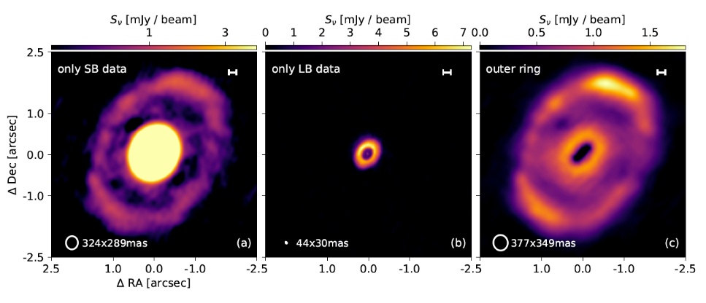
Data from the ALMA archive

Slide 9
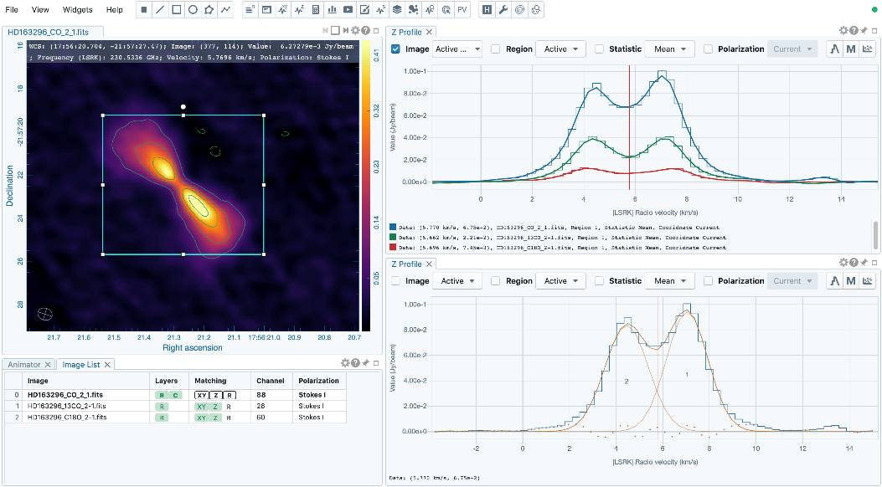

Slide 10
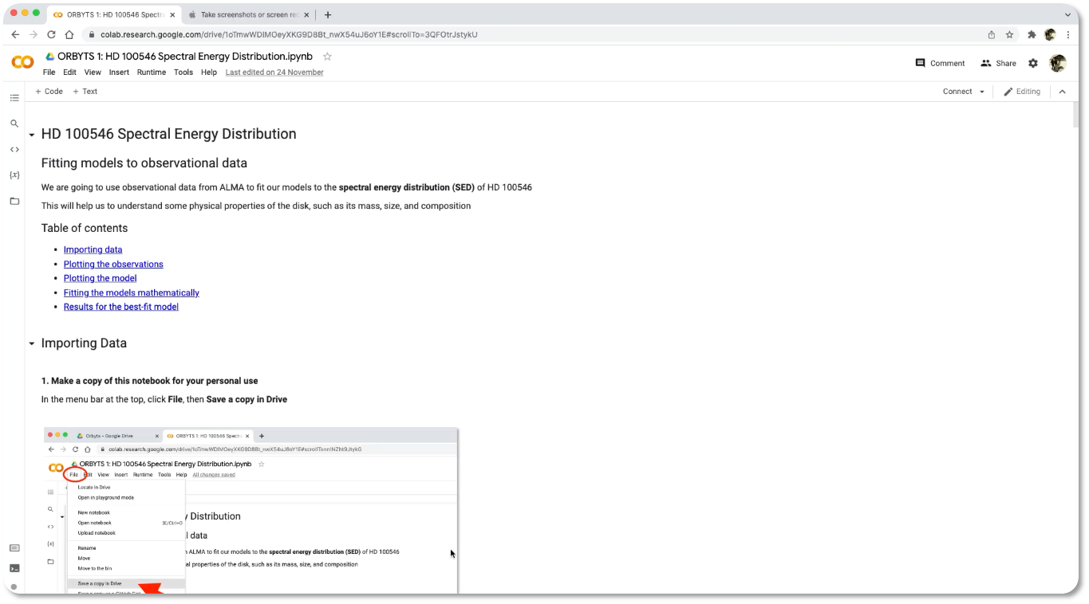

Slide 11
What is a planet?

Slide 12
What is a planet?
A planet is a celestial body that…
is in orbit around the Sun
has sufficient mass for it’s self-gravity to overcome rigid body forces so that is assumes hydrostatic equilibrium
has cleared the neighborhood around its orbit
(ie. its round!)

Slide 13
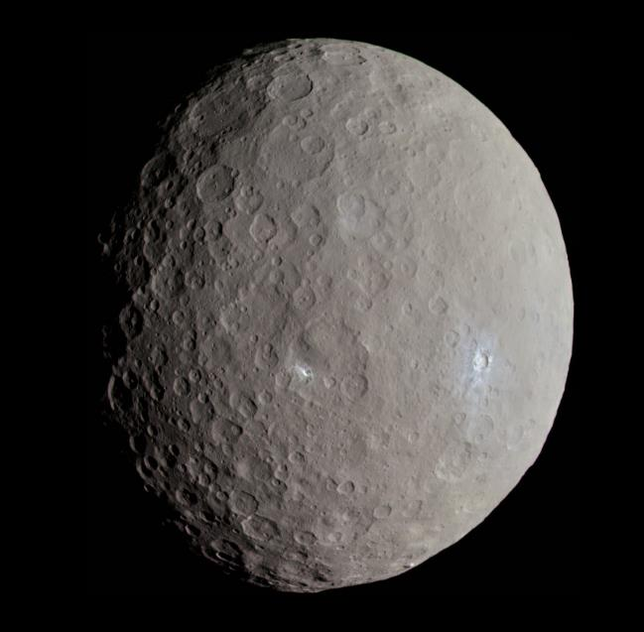

Slide 14
What is a exoplanet?
Same definition, but orbiting a different star
First exoplanet discovered in 1992
4575 exoplanets discovered so far!
Every star in our galaxy has >1 planet on average
We expect to have more than 2 trillion planets in our Galaxy!

Slide 15
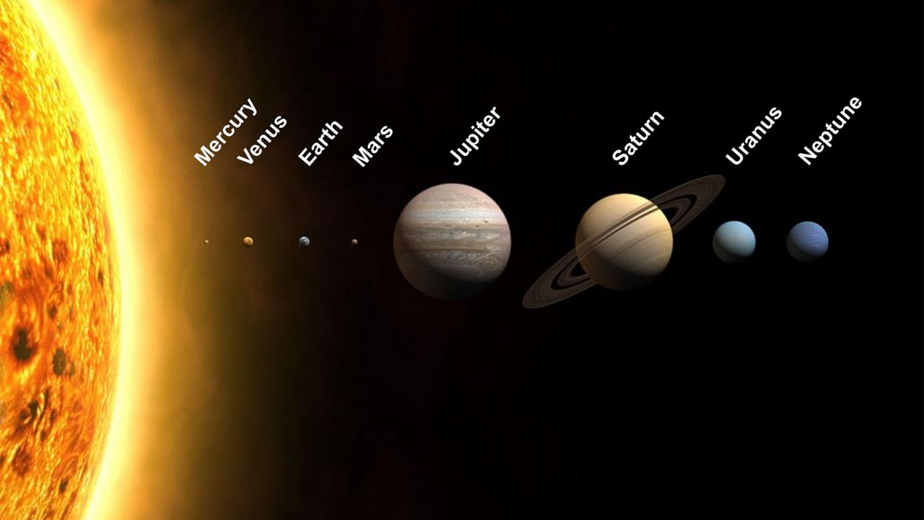
Solar System

Slide 16
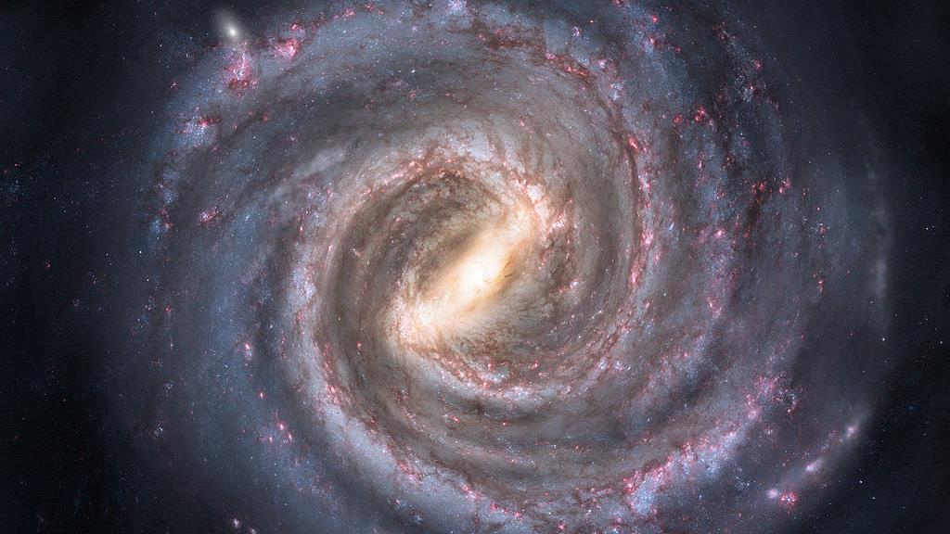
solar system
Milky Way

Slide 17
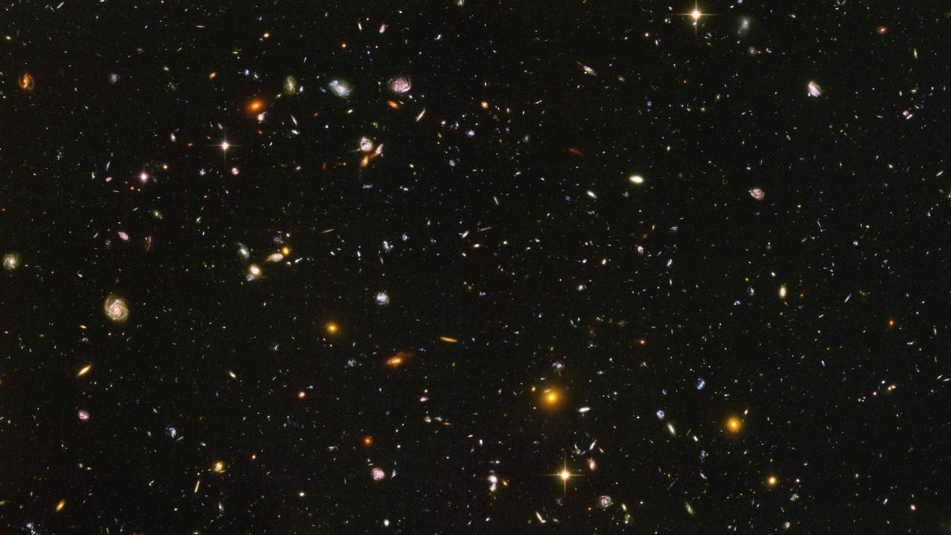
Radial Velocity
Hubble Deep Field

Slide 18
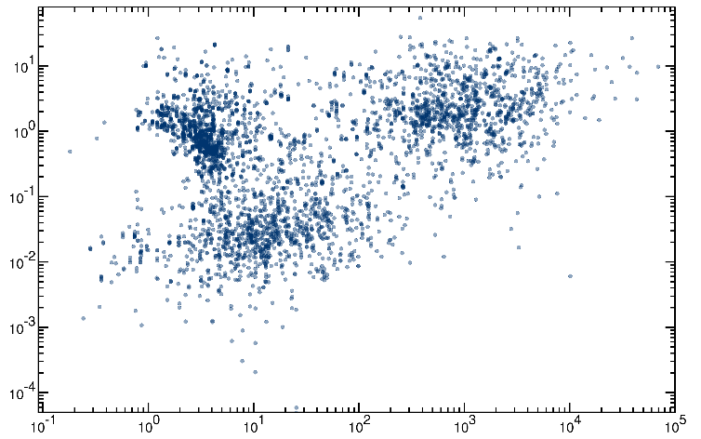
Exoplanets
Radial Velocity
mass (M_{J})
orbital period (days)

Slide 19
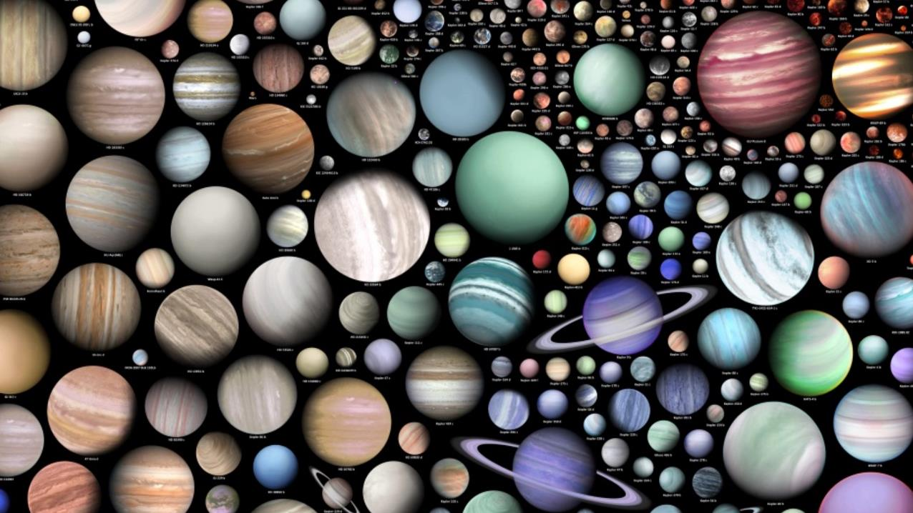

Slide 20
Planetary Formation

Slide 21
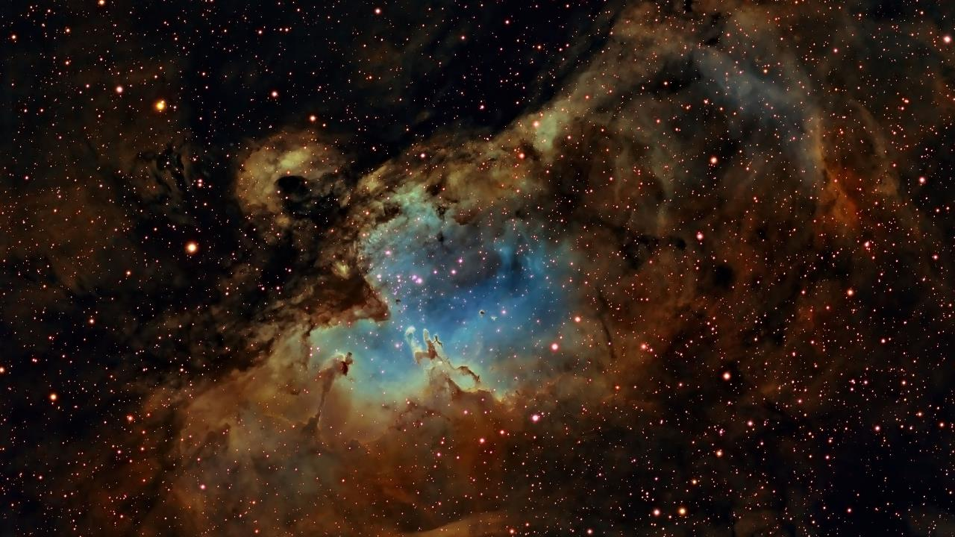
Molecular Cloud
The Eagle Nebula
70 light years
(662,000,000,000,000 km)

Slide 22
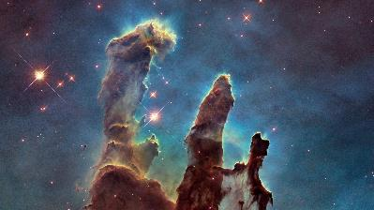
Molecular Cloud
The Eagle Nebula

Slide 23
Filaments
Pillars of Creation
4 light years
(37,000,000,000,000 km)

Slide 24
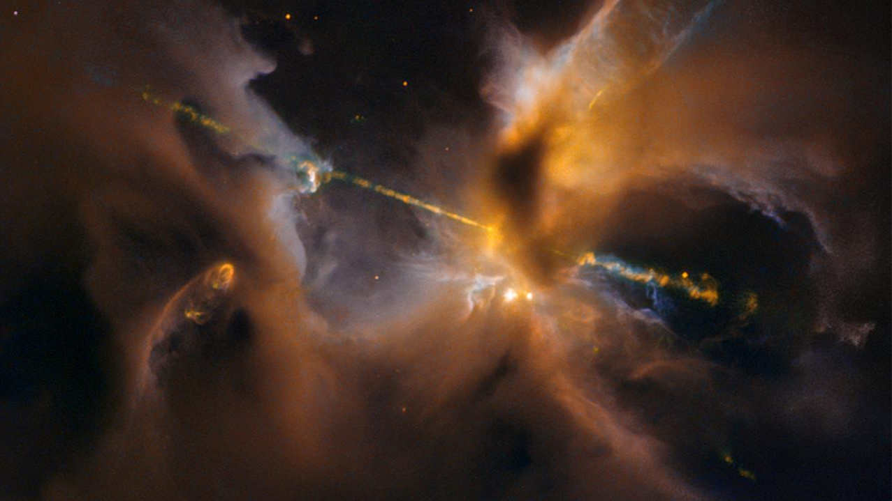
Protostar
HH24

Slide 25
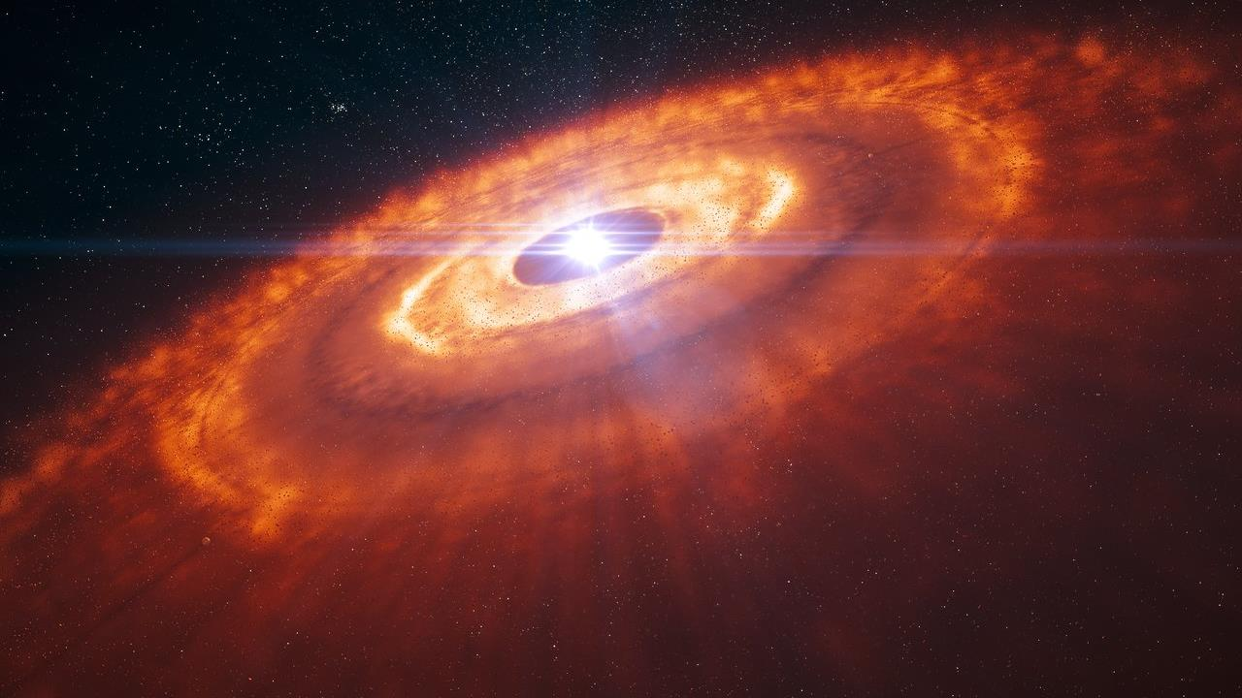
Protoplanetary disk

Slide 26
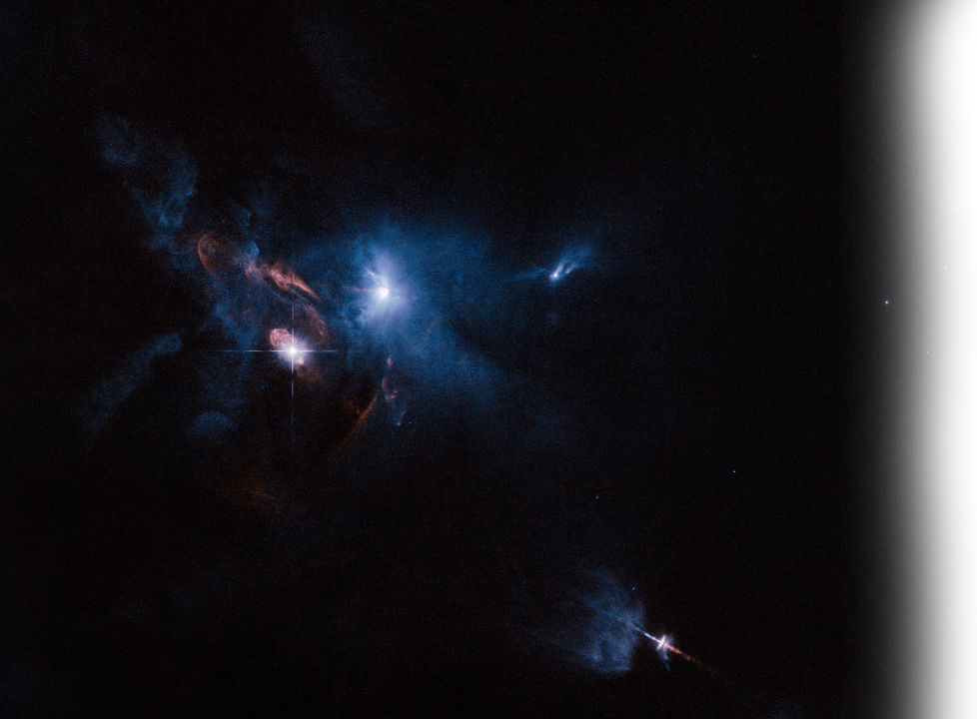
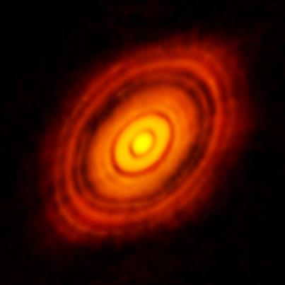
HL Tauri

Slide 27
Star Formation Stages
1
2
3
4
5

Slide 28
Star Formation Stages
1
2
3
4
5
1 Giant molecular cloud
- huge expanse of gas and dust in interstellar space
- gradually collapses into many ‘filaments’ due to gravity

Slide 29
Star Formation Stages
1
2
3
4
5
2 Prestellar core
- the filaments continue to collapse due to self-gravity
- a dense core forms at the centre
- surrounded by an envelope of less dense material

Slide 30
Star Formation Stages
1
2
3
4
5
3 Protostar
- continuing collapse heats up the centre and forms a protostar
- material in envelope accretes on to the protostar
- material may also ‘outflow’ from the protostar as it grows

Slide 31
Star Formation Stages
1
2
3
4
5
4 Protoplanetary disk
- outer envelope material eventually disperses
- remaining material forms a disk of gas and dust
- environment for planet formation

Slide 32
Star Formation Stages
1
2
3
4
5
5 Star/planetary system
- disk material fully incorporated in planets/star or dispersed
- can be stable for billions of years

