Slide 1
Highams Park School International Literacy Week
26-30 September 2022

Slide 2
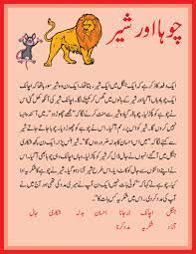
HPS International Literacy Week
26-30th September 2021
Can you speak, read or write in another language?
In International Literacy Week we are going to celebrate the variety of languages that are used by staff and students at HPS to communicate, to learn and for entertainment.
We want you to produce documents for display and/or a video recording.
You could fundraise for Bookaid.org
Please hand documents to Mrs Taylor in the Learning Centre or email them to ktaylor@highamsparkschool.co.uk by Monday 26th September and recordings to be uploaded to one drive and shared with Mrs Piggin at spiggin@highamsparkschool.co.uk by Tuesday 27th September

Slide 3
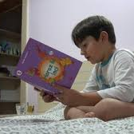
For display:
Here are some ideas of the kind of thing you could produce:
A photograph of you reading or writing in an additional language
An image of a book cover of a text you've enjoyed reading. You could add explanation of what the story is, who introduced it to you and how the story has impacted you.
A collage of texts which have been read to you or you've read independently
An autobiographic profile of how international texts have been introduced to you, what the texts have been and the importance of being literate in another language
An image and profile of a successful writer who uses an additional language
A translation of a song or poem and, perhaps an explanation of how you are familiar with this song
A copy of the alphabet with explanation of how to produce the sounds

Slide 4
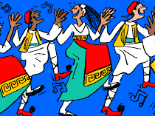
A recording
A video or voice recording of you, or a member of your family, doing any of the following in another language. (Make sure they know they've being recorded)
Reading an extract from a story
Singing a song
Reading a poem or song lyrics
Reading from a newspaper
Recording an autobiographical history and explanation of the use of English in another language
Explanation of differences in sounds from one language to another

Slide 5
https://bookaid.org/
Despite the steady rise in literacy rates over the past 50 years, there are still 773 million illiterate adults around the world, most of whom are women. (UNESCO)
Perhaps you and some friends could fundraise for Bookaid:
Bake sale
Used book sale
Jobs for cash (not in school)
Sponsored event
Craft items for sale
….

