Slide 1
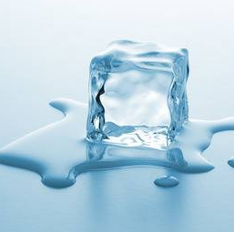
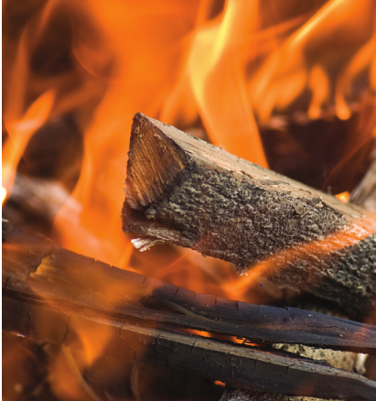
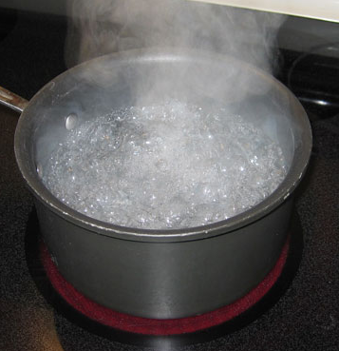
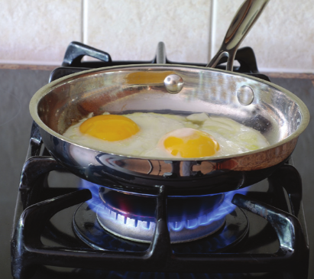
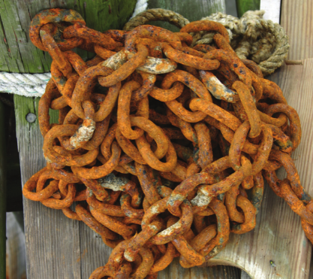
7He Chemical Reactions
CW
Reversible or irreversible changes
Melting ice
Breaking glass
Burning wood
Boiling water
Cooking eggs
Rusting iron

Slide 2
Requisitions
Equipment | Worksheets
For DEMO: Lead Nitrate and Potassium Iodide Ignition tubes for glucose Copper Carbonate Class Practical (as circus): Sodium hydroxide 0.4M Hydrochloric acid 1.0M Copper sulphate <1.0M Magnesium ribbon Calcium Carbonate Test tube holders for glucose and copper sulphate Tongs for magnesium ribbon

Slide 3
Write Down
Chemical reactions are irreversible changes.
New products are formed.
Chemical reactions are described in word equations.
reactants → products

Slide 4
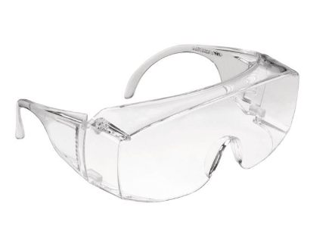
Practical
In this practical there are a number of hazards
Your teacher will instruct you on how to perform the practical safely.
Always where goggles

Slide 5
Recognising chemical reactions
Reaction | Observations
1. lead nitrate + potassium iodide (demonstration)
2. magnesium + oxygen
3. sodium hydroxide + copper sulphate
4. copper sulphate + magnesium
5. hydrochloric acid + sodium hydroxide
6. Heating glucose (demo)
7. Heating copper carbonate (demo)
8. hydrochloric acid + calcium carbonate

Slide 6
Recognising chemical reactions
During a chemical reaction there may be:
Fizzing (gas made)
A solid forms (a precipitate)
A temperature change
A colour change
Indication | Reaction
fizzing
solid forms
temperature change
colour change

Slide 7
Some reactions need some heat energy to get them started.
Some reactions need a constant supply of energy to continue.
Which reactions needed a constant supply of energy to continue?
7 & 8
Which reaction needed an initial energy input to start?
2

Slide 8
Reactions and word equations
In reaction 2, magnesium reacted with oxygen to form a substance called magnesium oxide
magnesium + oxygen → magnesium oxide
reactants
products
Name a product
Name a reactant
Magnesium and oxygen are elements
A compound is magnesium oxide
Name an element
Name a compound

Slide 9
Magnesium + sulphur →
Iron + chlorine →
Aluminium + bromine →
Tin + nitrogen →
Magnesium sulphide
Iron chloride
Aluminium bromide
Tin nitride

Slide 10
What elements are in the following compounds?
Copper carbonate
Lead sulfate
Aluminium nitrate
Iron phosphate
Copper, carbon and oxygen
Lead, sulfur and oxygen
Aluminium, nitrogen and oxygen
Iron, phosphorous and oxygen

Slide 11
Reaction 7 is an example of thermal decomposition
Thermal decomposition is a reaction where a compound is heated and breaks down into simpler substances.
Copper carbonate is heated and breaks down into copper oxide and carbon dioxide.
Write this as a word equation.
copper carbonate → copper oxide + carbon dioxide
The reactants are on the left of the equation and the products that are formed are on the right

Slide 12
Reaction 8
Calcium chloride, carbon dioxide and water are formed when hydrochloric acid reacts with calcium carbonate.
Write this as a word equation.
hydrochloric acid + calcium carbonate → calcium chloride + carbon dioxide + water

Slide 13
Recognising chemical reactions
Reaction | Observations
1. lead nitrate + potassium iodide (demonstration)
2. Magnesium + oxygen
3. Sodium hydroxide + copper sulphate
4. Copper sulphate + magnesium
5. Hydrochloric acid + sodium hydroxide
6. Heating glucose
7. Heating copper carbonate
8. Hydrochloric acid + calcium carbonate

