Slide 1
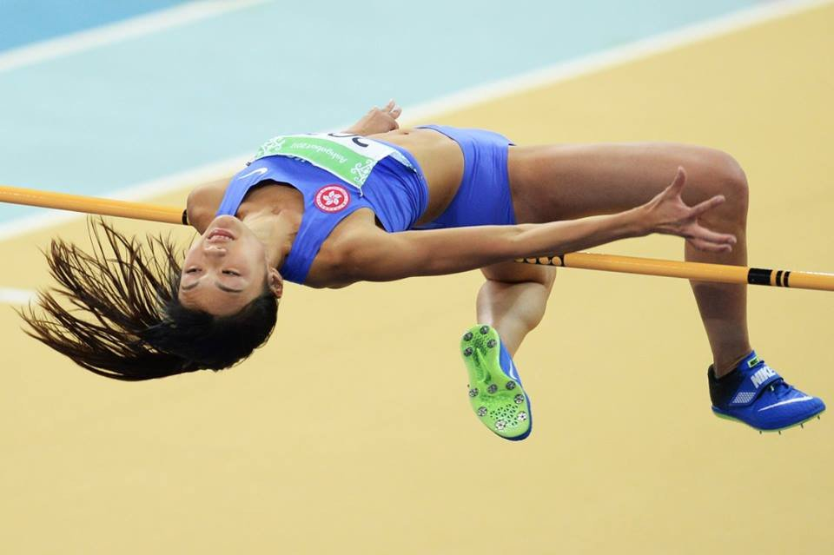
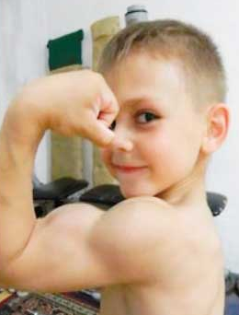
CW
7Cd Muscles and moving
What are the names of the two main muscles in the upper arm?
What connects muscle to bone?
Biceps and triceps
Tendons
@hpscience

Slide 2
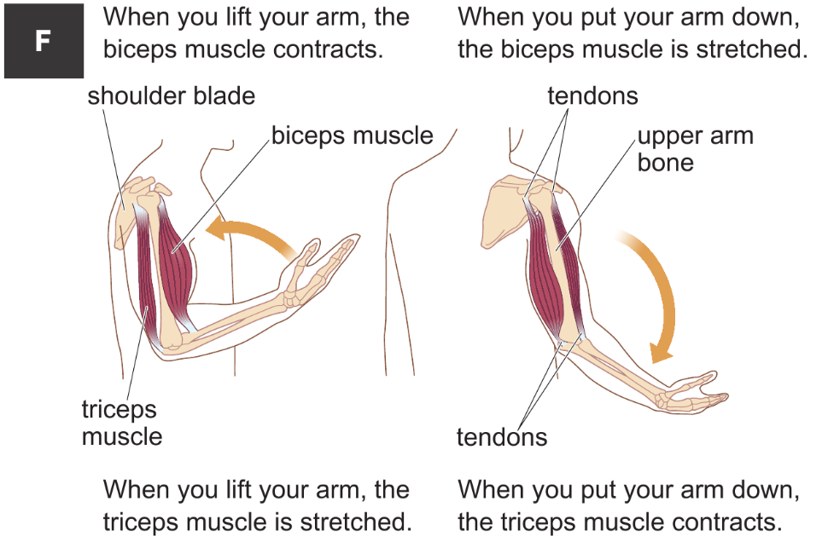

Slide 3
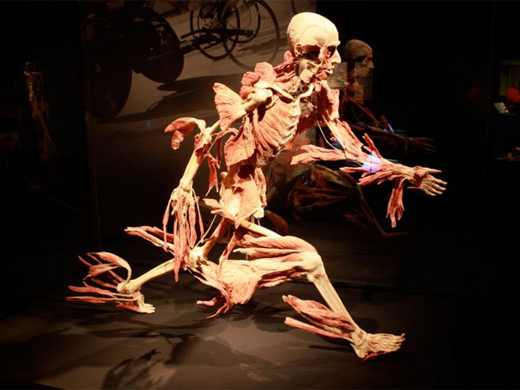
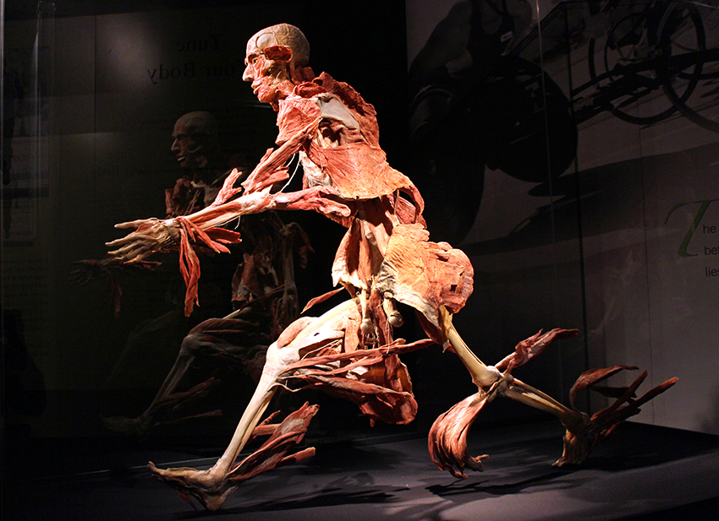
Locomotor system – Organ system that contains all your muscles and bones and allows you to move.
(This looks like a complex sentence)
Images from the Body Worlds Exhibition

Slide 4
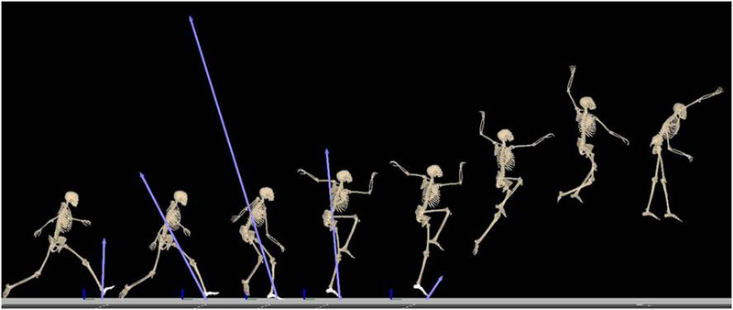
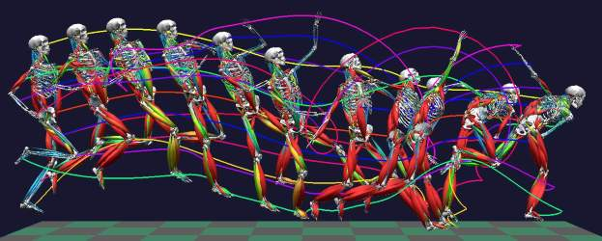
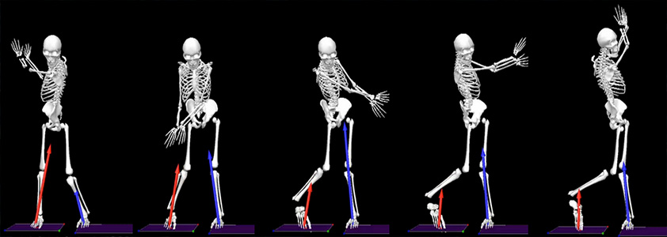
Biomechanics - The study of how muscles and bones work together to move your body.
Can you guess the sports?

Slide 5
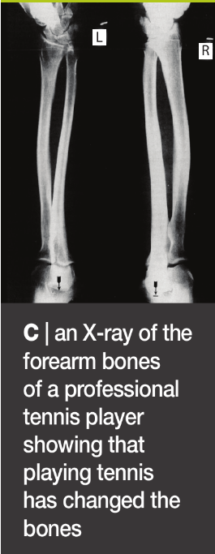
This is an x-ray of the left and right arm of a right-handed tennis player.
The bones in the right arm have grown thicker and stronger in response the demands placed on it.
Bigger muscles require bigger bones to support them.
Remember – bones are living tissue.

Slide 6
https://www.activeteachonline.com/default/player/video/id/270282/external/0
Sprinting

Slide 7
Muscles
Muscles are o_____ that can c______.
When muscles c______, they become s______ and f____.
If a muscle attached to a bone c_______, it will pull on the bone and move it.
rgans
ontract
ontract
horter
atter
ontracts

Slide 8
The arm acts as a lever.
The bicep muscle generates a force and pulls the forearm towards it.
This force can be measured in N______ (N).
ewtons
What are you doing?

Slide 9
Antagonistic muscles
To move the arm back in the opposite direction we need a muscle to work in the opposite direction.
Muscles that work in opposite directions are known as antagonistic pairs.
Question - Muscles cannot push on bones.
How do we move our arm back in the opposite direction?

Slide 10
Video
https://www.activeteachonline.com/default/player/interactive/id/312549/external/0
Stick the diagram in your book
To antagonise means to work against.

Slide 11
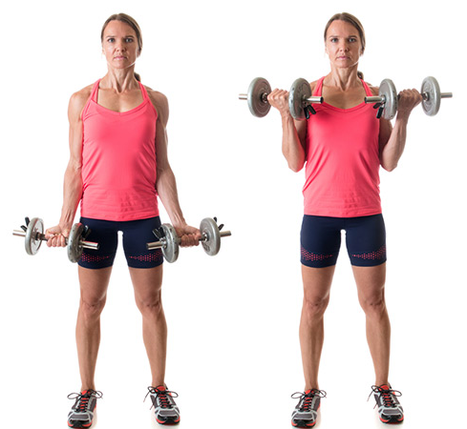
Describe how the muscles in the arm work as this person lifts these weight. (3 marks)
Discuss in pairs, how will you get 3 marks, write a rough answer in the back of your books.
The bicep contracts and the tricep relaxes.
As the bicep contracts, it get shorter and fatter and pulls the arm upwards.
The bicep and tricep work against each other as an antagonistic pair.
Increasing difficulty
Copy the model answer into the front of your books.

Slide 12
Control
The b___ controls movement by controlling muscles.
The brain sends electrical impulses down the spinal cord and on to the nerves (neurones) attached to muscles.
rain

Slide 13
Energy
Muscles need lots of energy to work.
Energy is released during respiration.
Respiration takes place in m_________ .
Therefore, muscle cells have lots of m_________ to provide lots of energy for movement.
itochondria
itochondria

