Slide 1
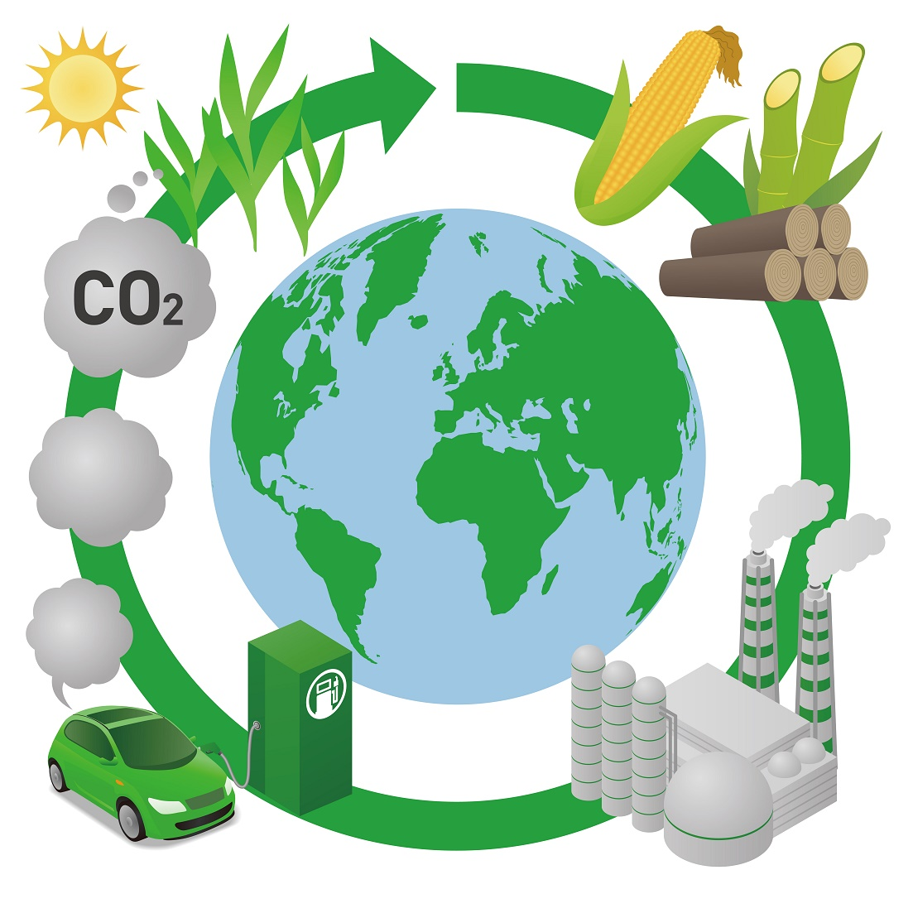
7Id: Burning Fuels
Do Now:
Write down what you think a biofuel is and give an example.

Slide 2
Requisitions
Equipment | Worksheets
Burning Fuels EXP

Slide 3
Fair Testing

Slide 4
Variables
Write Down
A variable is a quantity or characteristic that can take different values. Every investigation involves three types of variable:
Independent Variable - The thing you change
Dependant Variable - The thing you measure
Control Variables - The things you keep the same

Slide 5
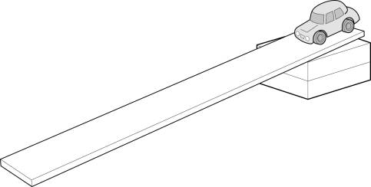
Aim: to investigate the effect of ramp height on distance travelled for a toy car

Slide 6
Which variables, apart from the height of the ramp, could vary in a way that affects the distance travelled?
What could be done to control these variables, so that they don’t affect the distance travelled?

Slide 7
Risk Assessment
What hazards do we need to consider?

Slide 8
Risk Assessment
Hair Tied Back | Tie Tucked in
Bags under desks | No sitting down
Seats tucked under | Wear Goggles
Lit splints allowed to extinguish on heat mat | Take care to ensure boiling tubes don’t roll off desk
Do not touch broken glass- alert teacher

Slide 9
Burning Fuels Experiment
Aim
To compare the energy released by different fuels.
Hypothesis
Different fuels release different amounts of energy when they burn.
Method
Label this diagram using words from the apparatus list

Slide 10
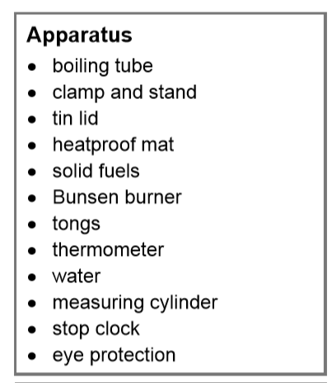

Slide 12
Swap and Peer Assess ( /8)
heat
boiling
same
measuring cylinder
Bunsen burner
thermometer
distance
fuels

Slide 13
Calculating Temperature Change
Fuel | Start Temp | Temp after 5 min | Change in Temp

Slide 14
Calculating Temperature Change
Fuel | Start Temp | Temp after 5 min | Change in Temp
Wood | 20°C | 50°C
Coal | 20°C | 70°C
Oil | 20°C | 130°C

Slide 15
7Id: Burning Fuels Experiment
Do Now:
Fill in the blacks on the table
Fuel | Start Temp | Temp after 5 min | Change in Temp
Butane | 23°C | 50°C
Propane |  | 70°C | 34°C
Butanol | 19°C | 62°C

Slide 16
Burning Fuels Experiment
Set up equipment as demonstrated
Fill boiling tube with 20ml of water using a measuring cylinder
Record the temperature of the water, then remove the thermometer
Place the fuel under the boiling tube, light the burner using a wooden splint and start the timer (put the wooden splint out on the heatproof mat
Allow the fuel to heat the water for 5 minutes
Record the final temperature of the water
Put out the burner using the lid
Repeat steps 2-7 using a different fuel.
Tidy away all equipment – careful of anything that’s hot, used glassware goes in the big sink

Slide 17
Results
Fuel | Initial Temp (°C) | Final Temp (°C) | Change in Temp (°C)
Pentane | 22 | 33 | 11
Butane | 21 | 53 | 32
Ethanol | 25 | 34 | 9
Pentanol | 22 | 36 | 14

Slide 19
