Slide 1
8Ea: Combustion
CW
Do Now What causes a bus to move?

Slide 2
Requisitions
Equipment | Worksheets
Combustion DEMO | 8Ea-1 8Ea-2

Slide 3
Objectives
State the meaning of fuel, combustion.
State the meaning of hydrocarbon.
Describe the combustion of hydrocarbons (in terms of reactants and products).
Identify the products and reactants using a word equation.
Describe the tests for carbon dioxide and water.
Recall the fuel used in a fuel cell.
Model reactions using word equations.
Explain the formation of the products when hydrocarbons burn.
Describe how rocket engines obtain enough oxygen in space to explode by using oxidising agents.

Slide 4
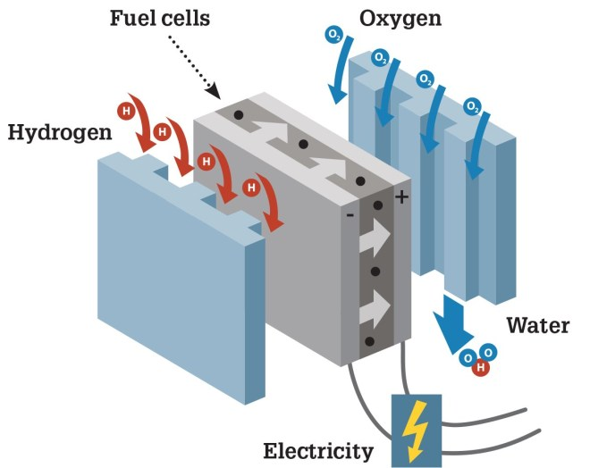
Fuel: A substance that contains stored energy that can be transferred to make things happen.
In a fuel cell, hydrogen is the fuel used.

Slide 5
Combustion Burning, usually in air. The reaction gives out energy, which is transferred to the surrounds by heating or light.
Notes:
https://www.youtube.com/watch?v=zX9x0piJ_Vo

Slide 6
Combustion Reaction
Hydrogen + Oxygen → Water
Reactants: Hydrogen, Oxygen
Product: Water

Slide 7
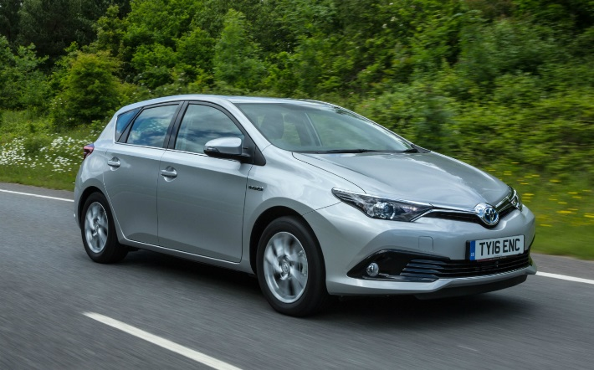
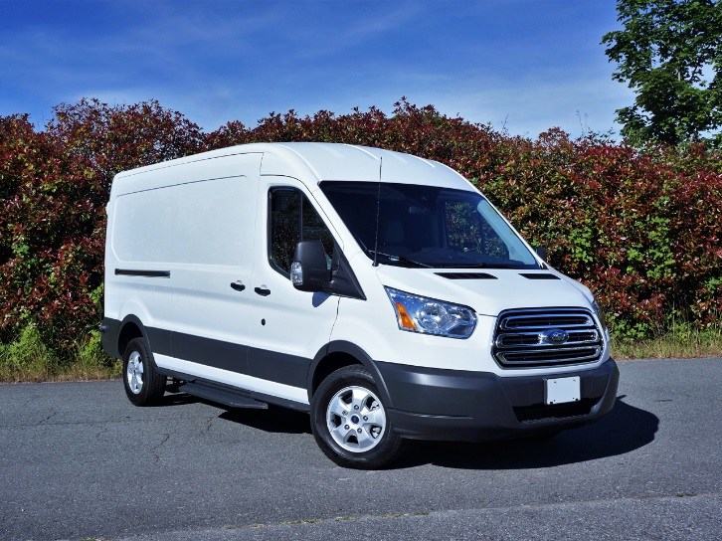
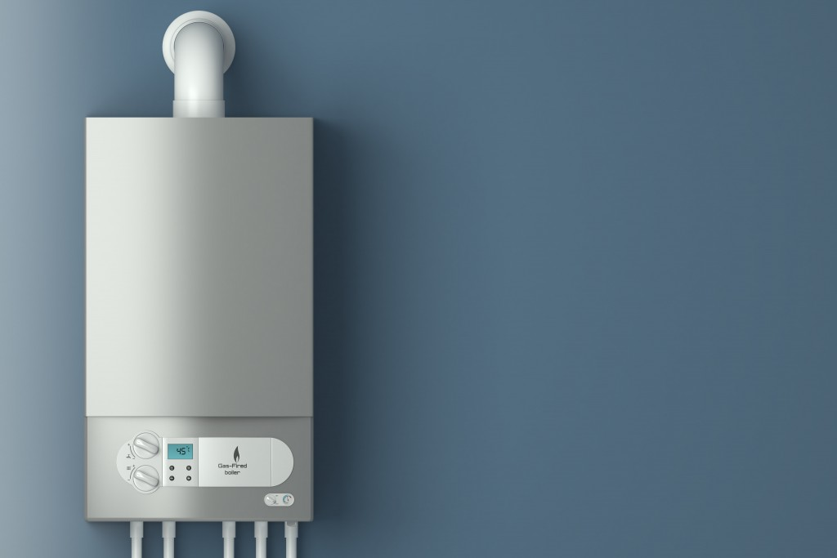
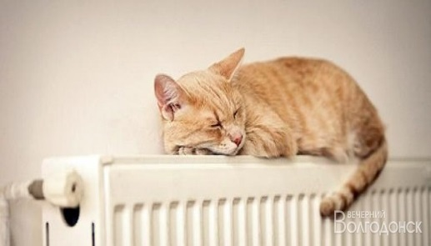
Hydrocarbons
Petrol
Diesel
Natural gas
Hydrocarbon are substances which contain only carbon and hydrogen atoms e.g. Methane, CH₄
These are often called fossil fuels. Why?
When methane reacts with O2 what gases will be produced?

Slide 8
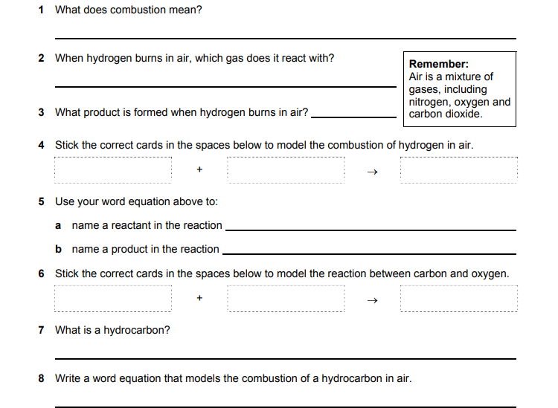
Notes:
8Ea-1

Slide 9
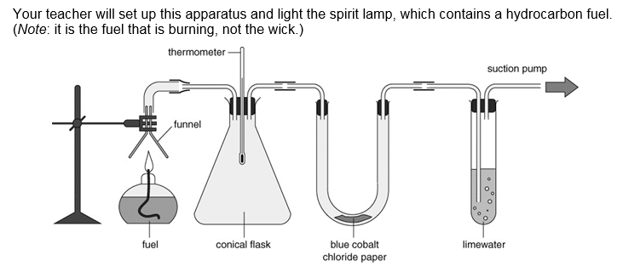
Demonstration ​Exploding hydrogen balloon​: Products of Combustion

Slide 10
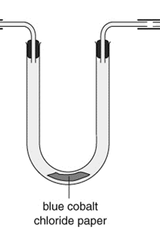
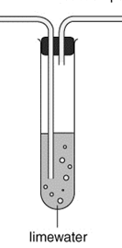
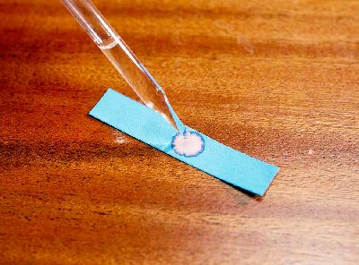
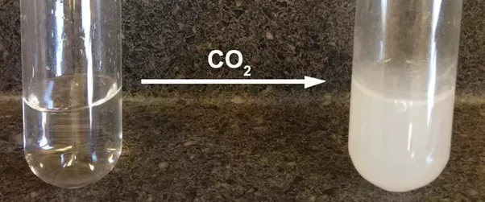
Cobalt Chloride Test
Limewater Test
H₂O
Turns from blue to pink when water is present
Turns cloudy when carbon dioxide is present

Slide 11
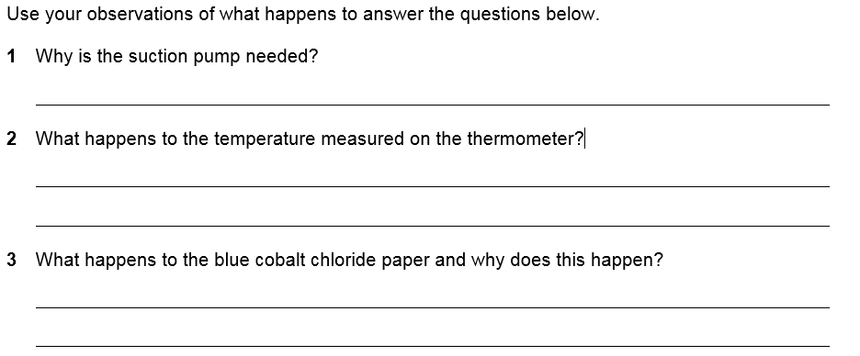
To draw the products of the combustion reaction through the equipment.
It rises.
It turns pink, because water is present.

Slide 12
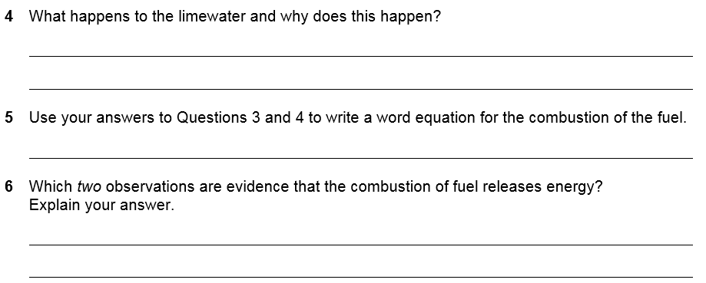
It goes cloudy, because carbon dioxide is present.
hydrocarbon + oxygen → carbon dioxide + water
The rise in temperature shows energy is transferred by heating.
The brightness of the flame shows energy is transferred by light.

Slide 13
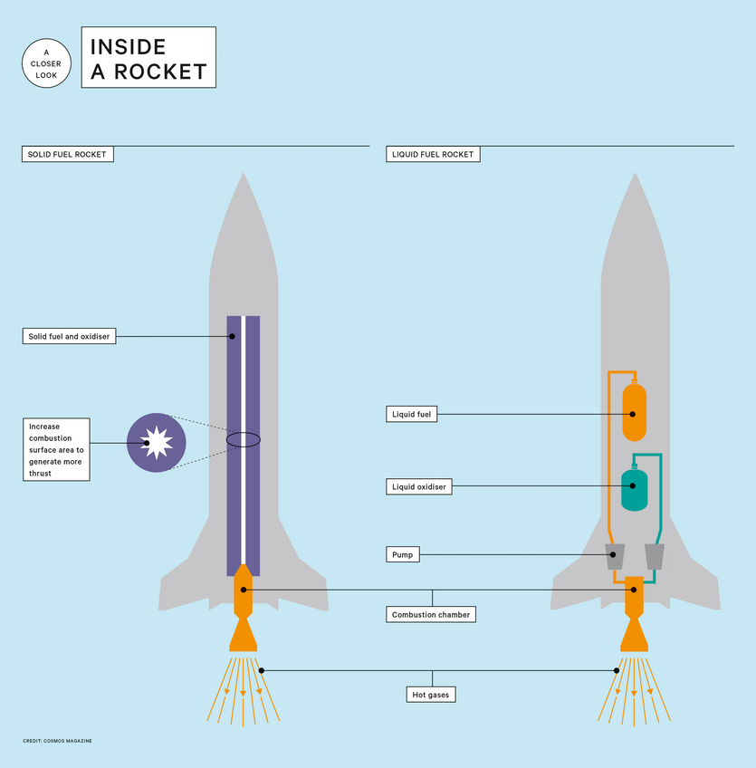
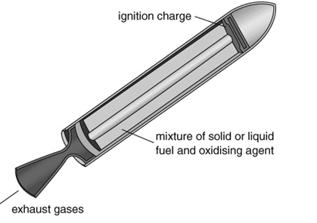
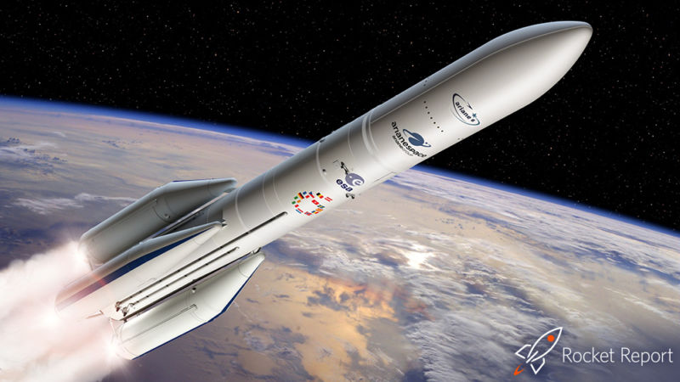
Why would a space rocket need an oxidiser as part of the fuel?

Slide 14
Learning Objectives
Developing | Securing | Exceeding
Must… | Should… | Could…
State the meaning of: fuel, combustion. State the meaning of hydrocarbon. Describe the combustion of hydrocarbons (in terms of reactants and products). Identify the products and reactants using a word equation. Describe the tests for carbon dioxide and water. | Recall the fuel used in a fuel cell. Model reactions using word equations. Explain the formation of the products when hydrocarbons burn. | Describe how rocket engines obtain enough oxygen in space to explode using oxidising agents.

Slide 15
Burning fuel
What is produced by burning fuel?

Slide 16
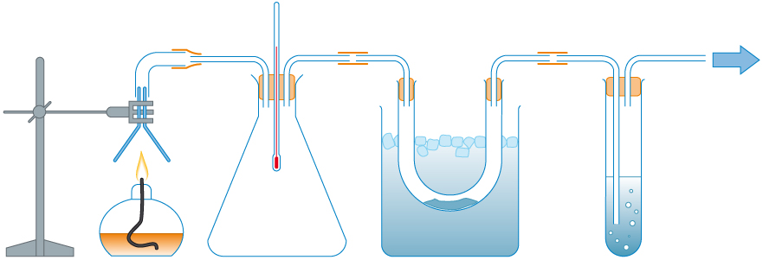
This apparatus shows us what is produced when fuel burns.
Can you see the mistakes in the labels?
What should they say?
The thermometer shows that heat energy is absorbed in the reaction.
The oxygen will condense inside this tube, because it is warm.
The salt water in this tube will show that one of the gases is carbon monoxide.
The spirit burner produces carbon monoxide and oxygen.
© Pearson Education Ltd 2014. Copying permitted for purchasing institution only. This material is not copyright free.

Slide 17
The spirit burner produces carbon and
monoxide
oxygen.
dioxide
water.
© Pearson Education Ltd 2014. Copying permitted for purchasing institution only. This material is not copyright free.

Slide 18
The thermometer shows that heat energy is in the reaction.
released
absorbed
The spirit burner produces carbon and
dioxide
water.
© Pearson Education Ltd 2014. Copying permitted for purchasing institution only. This material is not copyright free.

Slide 19
The thermometer shows that heat energy is in the reaction.
water
The will condense inside this tube, because it is
oxygen
released
warm.
cold.
The spirit burner produces carbon and
dioxide
water.
© Pearson Education Ltd 2014. Copying permitted for purchasing institution only. This material is not copyright free.

Slide 20
The thermometer shows that heat energy is in the reaction.
water
The will condense inside this tube, because it is
released
cold.
The in this tube will show that one of the gases is carbon
salt water
limewater
The spirit burner produces carbon and
monoxide.
dioxide
water.
dioxide.
© Pearson Education Ltd 2014. Copying permitted for purchasing institution only. This material is not copyright free.

