Slide 1
Resources
Worksheets
7Ga5 summary of properties
Complete w/s 7Gb-1 particle theory
h/w recommendation
7Gb8 or 9 – Applying theories to matter or What’s the matter
Active Learn exercises
Practical
7Ga2 see teacher & tech notes
run as a circus
Equipment (per station)
Solids: range of solid materials such as wooden block, iron (metal) block, rock, syringe with solid inside.
Liquids: range of liquids such as water, ethanol, cooking oil, assorted items of glassware (boiling tubes, small beakers, Petri dishes), syringe full of coloured water with sealed end.
Gases: syringe full of air with sealed end, large plastic bag full of air (tied tightly), open bottle of air freshener or perfume.
Teacher Demos

Slide 2
Objectives
Describe different types of observations and data that can be used as evidence.
Identify scientific questions, hypotheses and predictions.
Describe how evidence and observations are used to develop a hypothesis into a theory.
Explain how evidence and observations support or do not support a certain theory.

Slide 3
Objectives
State that all materials are made from particles.
Describe, draw and recognise the arrangement of particles in solids, liquids and gases.
Correctly use the words: data, evidence, observation, hypothesis, prediction, theory and particle.
Describe how the movement and spacing of the particles is different in solids, liquids and gases.
Use the particle theory to explain the properties of solids, liquids and gases.
Use the particle model to explain other observations about matter.

Slide 4
7Gb Particles
CW
Write down the properties of solids, liquids and gases?
Solids
Liquids
Gases
Or use 7Ga5
@hpscience

Slide 5
Pick one observation and try to explain it.
Property | Solids | Liquids | Gases
Have a fixed shape
Can change shape
Have a fixed volume
Volume can change
Can easily be compressed
Cannot easily be compressed
Can flow easily









What is your theory?



Slide 6
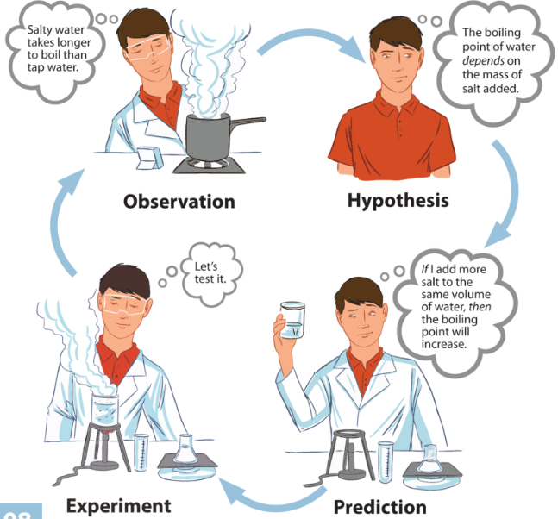
Scientific Method
A Theory
Definition
A hypothesis or set of hypothesis that explains how and why something happens. The predictions made using a theory should have been tested on several occasions and always found to work.
Write definitions for the following words
observation, hypothesis, prediction and experiment.

Slide 7
Observation:
Something that you see happening
Hypothesis:
An idea about how something works that can be tested using experiments. Plural = hypotheses
Prediction:
What you think will happen in an experiment
Experiment:
A scientific procedure

Slide 8
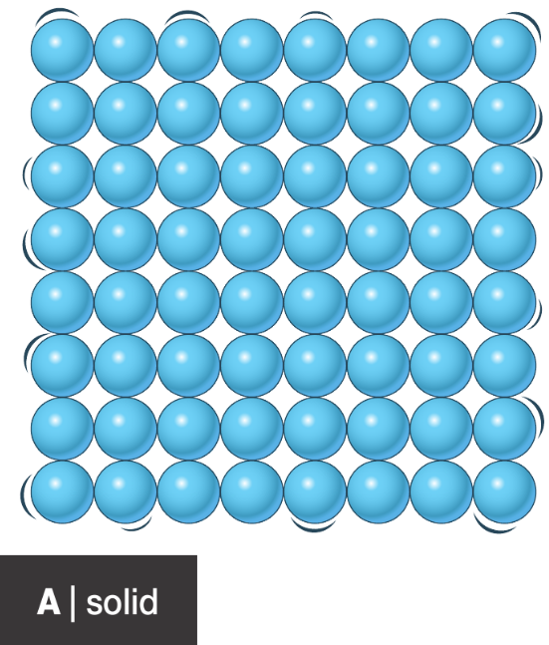
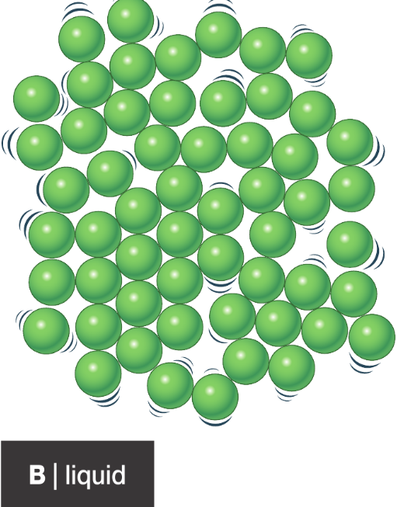
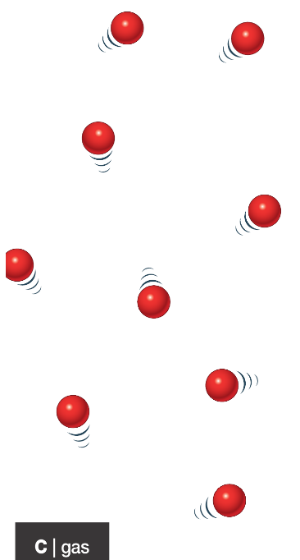
Use presentation on p110 in active book or twig video states of matter
The Particle theory
Complete w/s 7Gb-1 & 7Gb-7 Q4 & 5

Slide 9
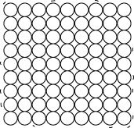
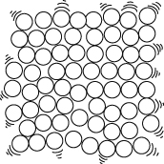
State of matter
Theory
Picture
Observations explained
Describe the forces of attraction in a liquid?

Slide 10
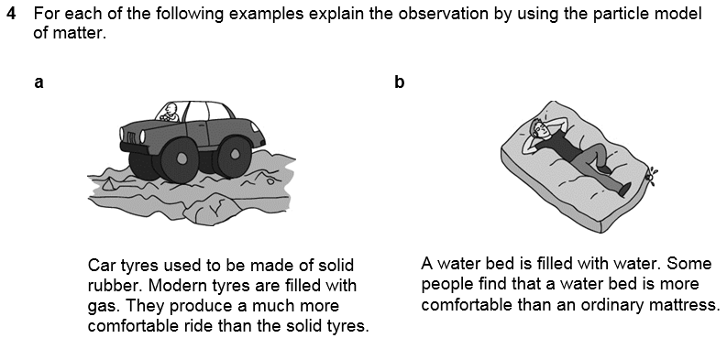

Slide 12
Homework:
7Gb8 or 9 – Applying theories to matter or What’s the matter
Active learn:
Exercises 7Gb developing, secure & exceeding
Exercises 7Gb working scientifically
Date due:

Slide 13
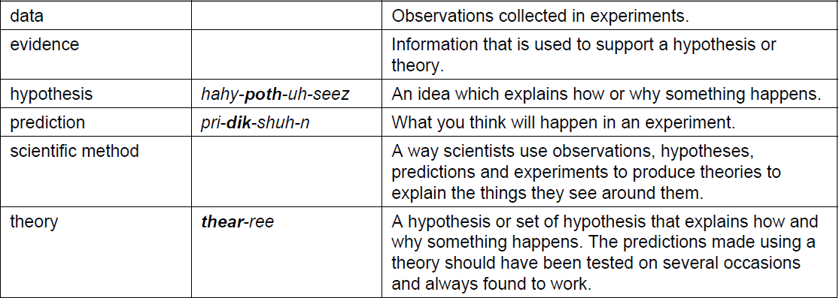
Key words

Slide 14
Thinking skills
Hypotheses and theories – Particles

Slide 15
Which is the odd one out in this list?
Sand Stone Wood
Possible answers
Next question
© Pearson Education Ltd 2014. Copying permitted for purchasing institution only. This material is not copyright free.

Slide 16
Which is the odd one out in this list?
Sand Stone Wood
Sand is the only solid that can flow (because it is in tiny pieces).
Wood is the only one that came from living things.
Possible answers
Next question
© Pearson Education Ltd 2014. Copying permitted for purchasing institution only. This material is not copyright free.

Slide 17
Which is the odd one out in this list?
Ice Water Stone
Possible answers
Next question
© Pearson Education Ltd 2014. Copying permitted for purchasing institution only. This material is not copyright free.

Slide 18
Which is the odd one out in this list?
Ice Water Stone
Stone, as ice and water are the same substances.
Ice is the only one that doesn’t exist at room temperature.
Possible answers
Next question
© Pearson Education Ltd 2014. Copying permitted for purchasing institution only. This material is not copyright free.

Slide 19
Which is the odd one out in this list?
Water Honey Petrol Wood
Possible answers
End show
© Pearson Education Ltd 2014. Copying permitted for purchasing institution only. This material is not copyright free.

Slide 20
Which is the odd one out in this list?
Water Honey Petrol Wood
Petrol because it can’t be found in nature.
Wood is the only solid.
Possible answers
Back to start
End show
© Pearson Education Ltd 2014. Copying permitted for purchasing institution only. This material is not copyright free.

Slide 21
Objectives
Describe different types of observations and data that can be used as evidence.
Identify scientific questions, hypotheses and predictions.
Describe how evidence and observations are used to develop a hypothesis into a theory.
Explain how evidence and observations support or do not support a certain theory.

Slide 22
Objectives
State that all materials are made from particles.
Describe, draw and recognise the arrangement of particles in solids, liquids and gases.
Correctly use the words: data, evidence, observation, hypothesis, prediction, theory and particle.
Describe how the movement and spacing of the particles is different in solids, liquids and gases.
Use the particle theory to explain the properties of solids, liquids and gases.
Use the particle model to explain other observations about matter.

