Slide 1
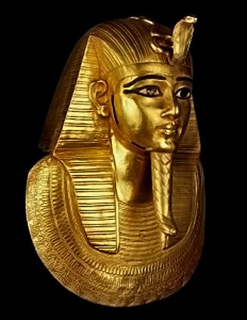
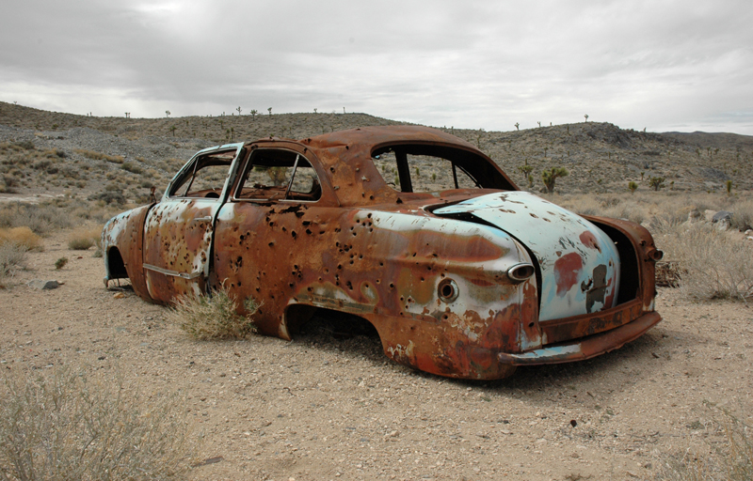
8Gc: Metals and Water
CW
List these metals in order of reactivity:
Copper, Iron, Gold
Gold -> copper -> iron

Slide 2
Requisitions
Equipment | Worksheets
DEMO: Alkali Metals Magnesium Strip Calcium Granules | 8Gc6 Reactivity Series Printout

Slide 3
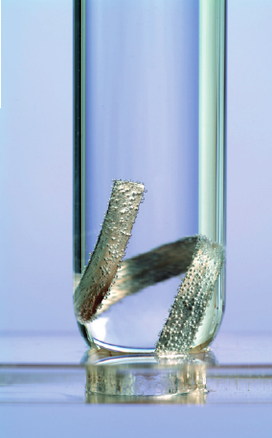
Investigating Metals: Magnesium
Fill a test tube with water, place some magnesium ribbon in it.
Put your thumb over the top and place it upside down in a beaker half full of water.
Next week you will look at the test tubes and observe any changes.

Slide 4
Investigating Metals: Calcium
Use the tweezers and place a granule of calcium in a test tube of water.
Put your thumb over the top and wait for about 30s, then test the gas with a burning splint.
Record your observation:
Calcium with water : ___________

Slide 5
Write Down
Some metals cannot be used in building as they react too quickly with water. Look at the diagram and complete the sentences.
The metal is called __________
The gas formed is called ___________
A better metal for water papers would be _________

Slide 6
Demonstration – Alkali Metals with Water
What do you think you will see?

Slide 7
Fill in the table
Metal | Reaction with water | Order of Reactivity
Potassium
Lithium
Sodium

Slide 8
Fill in the table
Metal | Reaction with water | Order of Reactivity
Potassium | Purple flame, fizzing, moving | 1
Lithium | Fizzing, moving slowly | 3
Sodium | Fizzing, moving quickly, forms ball | 2

Slide 9
General Equation
Write Down
Metals react with water to form hydrogen and a metal hydroxide
$$metal+water →hydrogen+metal hydroxide$$

Slide 10
True or False?
Hands up for true
Hydrogen is a solid at room temperature.
Hydrogen is a liquid at room temperature.
Hydrogen is a gas at room temperature.
Hydrogen puts out a burning splint.
Hydrogen burns with a ‘squeaky pop’ when lit.

Slide 11
Do Worksheet 8Gc6 (Print Out)

Slide 12
fizz
hydrogen
alkali
most
flames
calcium
melt
hydrogen
alkali

Slide 13
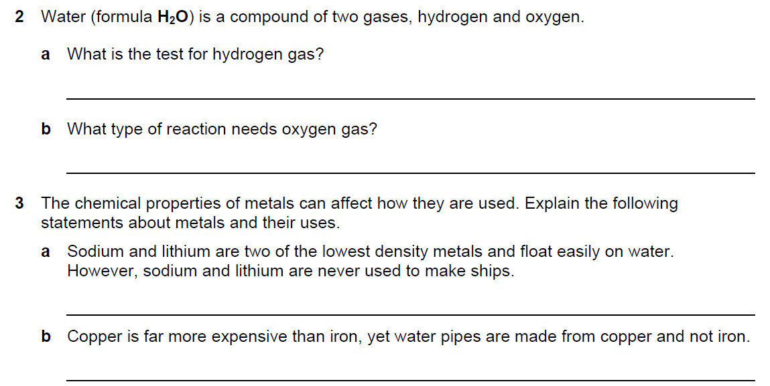
Ignite it with a burning splint
An oxidation reaction
They react quickly with water
Copper is less reactive than iron.

Slide 14
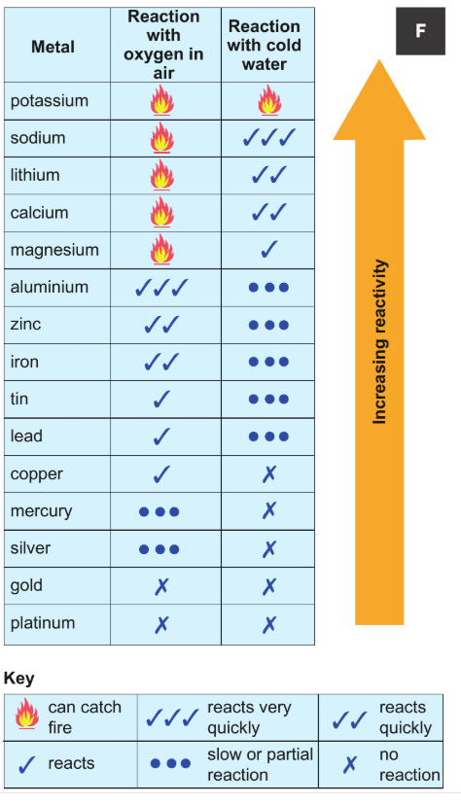
The Reactivity Series
1. Name an element that is more reactive than calcium.
2. Name an element that is more reactive than lead and have a quick reaction with water.
3. Name an element that is less reactive than lithium which can catch fire in air?

