Slide 1
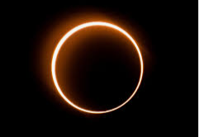
The 2021 Solar Eclipse By Assan, Callum & Freddie

Slide 2
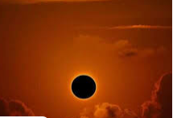
Facts
The solar eclipse happened on the 10 of June
It is referred to as to as the “ring of fire” eclipse.

Slide 3
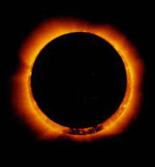
The June Eclipse
This eclipse was a partial so it didn’t fully cover the sun
This is what it looked like

Slide 4
What cause a solar eclipse
It is when the moon comes in-between the earth and the sun.

