Slide 1
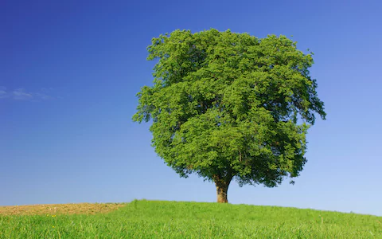
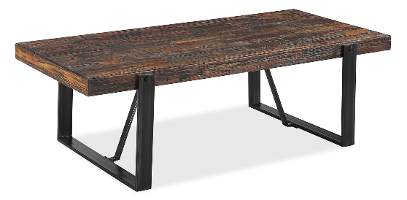
7Aa Life processes
Recall and describe life processes
Explain the differences between organisms and non-living things
In the back of your exercise books, explain why a tree is alive but the table is not.

Slide 2
Learning outcomes
Developing | Secure | Exceeding
Must… | Should… | Could…
Identify things as being alive or not. Recall the life processes: movement, reproduction, sensitivity, growth, respiration, excretion, nutrition. State the meaning of and correctly use the word: organism. | Describe the life processes. Use life processes to justify whether something is an organism or is non-living. | Identify ways in which an organism shows each life process. Compare life processes in a range of plants and animals.

Slide 3
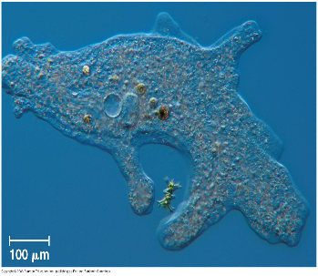
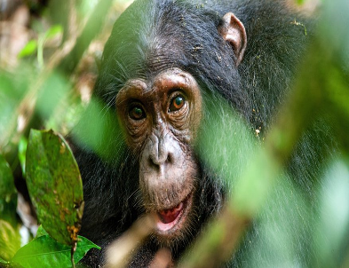
Organisms
Copy the text below.
A living thing is called an organism.
All organisms must carry out 7 life processes to be li.
What are the seven life processes?
Notes:
Answer:
Movement
Respiration
Sensitivity
Growth
Reproduction
Excretion
Nutrition

Slide 4
Seven life processes
Copy the text below.
Movement
Respiration
Sensitivity
Growth
Reproduction
Excretion
Nutrition
What mnemonic (see below) is spelt out by the first letters of the life processes?
https://www.youtube.com/watch?v=Q2HDJP10qSQ
https://www.activeteachonline.com/product/view/id/295/page/8/mode/dps?modal=/default/player/video/id/245995/external/0
A mnemonic is word or phrase helps you remember a list. It usually made using the first letters of the words in a list.
Notes:
Answer: MRS GREN

Slide 5
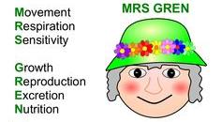
Seven life processes

Slide 6
Learning outcomes
Developing | Secure | Exceeding
Must… | Should… | Could…
Identify things as being alive or not. Recall the life processes: movement, reproduction, sensitivity, growth, respiration, excretion, nutrition. State the meaning of and correctly use the word: organism. | Describe the life processes. Use life processes to justify whether something is an organism or is non-living. | Identify ways in which an organism shows each life process. Compare life processes in a range of plants and animals.

Slide 7
Copy the table below. (To be completed through following slides)
Life process | Meaning
Movement
Respiration
Sensitivity
Growth
Reproduction
Excretion
Nutrition

Slide 8
Movement
Fill in the table.
-Able to move the from place to place or move parts of themselves.

Slide 9
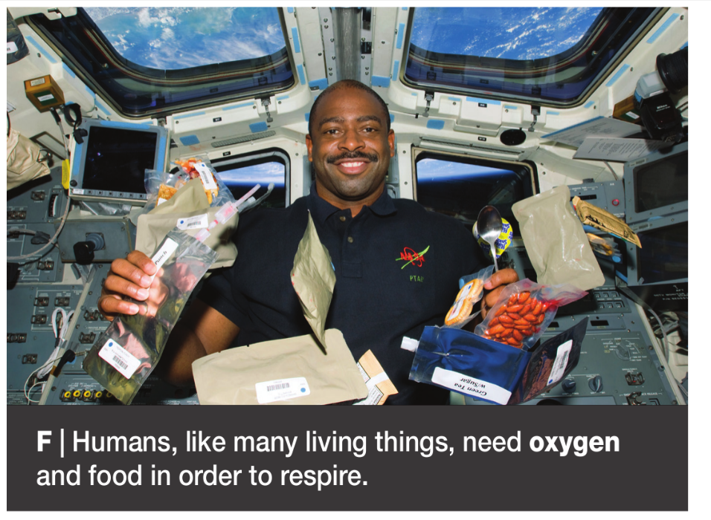
Respiration
Fill in the table.
-Process that releases energy from the break down of glucose. Requires oxygen.

Slide 10
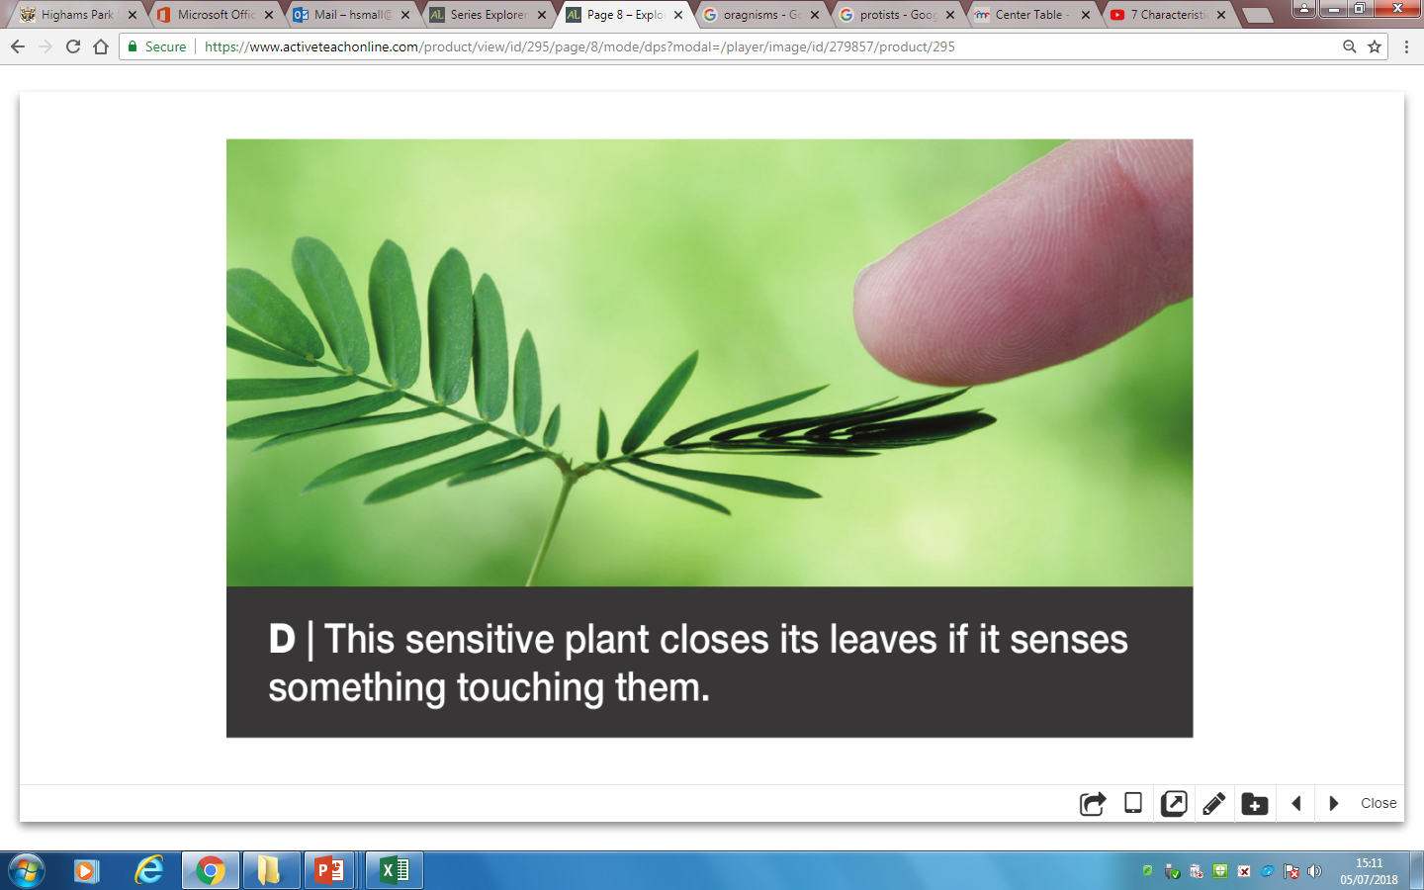
Sensitivity
Fill in the table.
-Ability to sense and react to things in the surroundings.

Slide 11
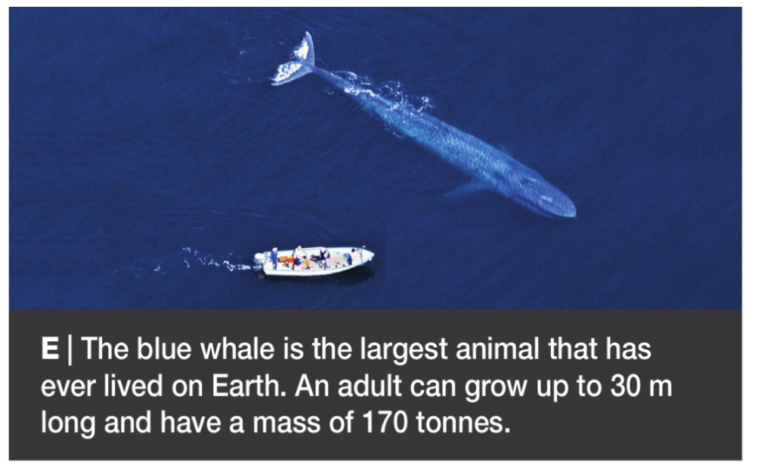
Growth
Fill in the table.
-Ability to grow in size.

Slide 12
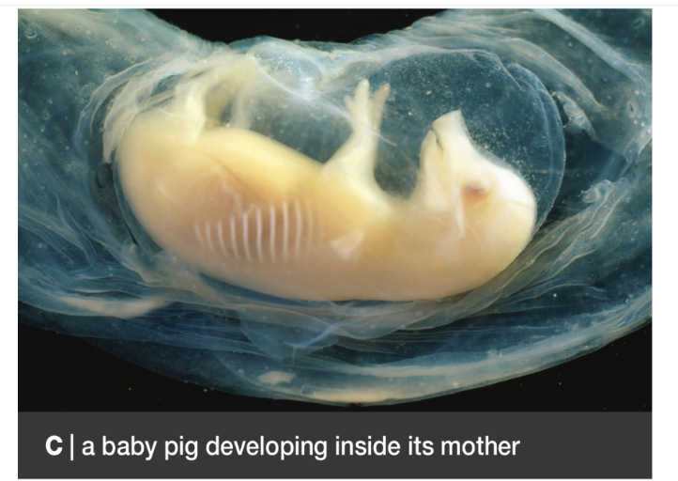
Reproduction
Fill in the table.
-Ability to make more living things like themselves.

Slide 13
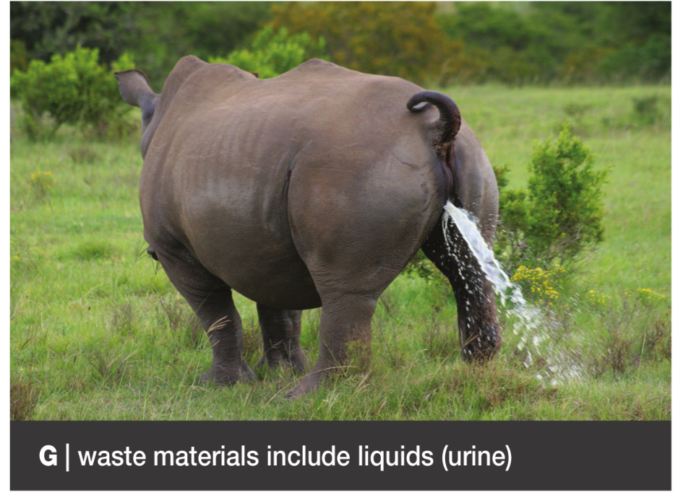
Excretion
Fill in the table.
-Getting rid of the waste materials that are made from the organism.

Slide 14
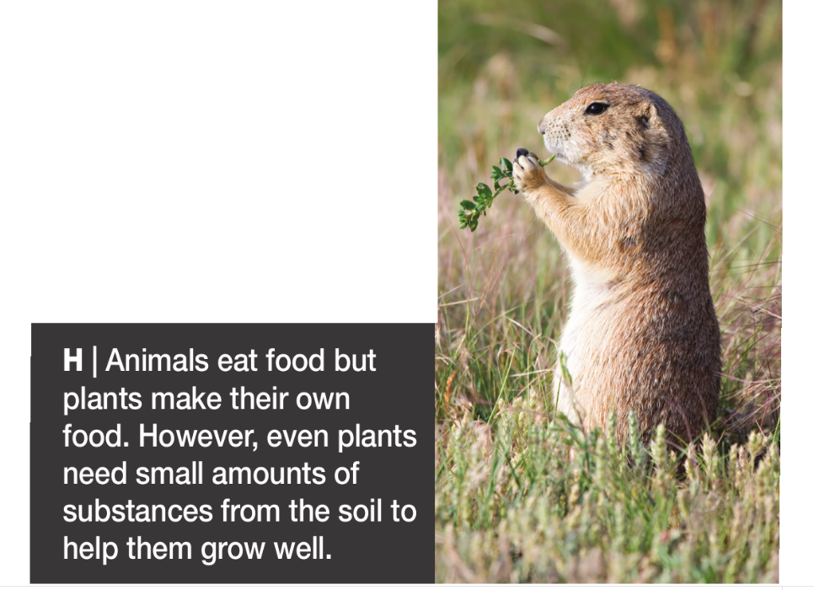
Nutrition
Fill in the table.
-Various substances needed to help carry out life processes in and organism.

Slide 15
What are the seven life processes?

Slide 16
Learning outcomes
Developing | Secure | Exceeding
Must… | Should… | Could…
Identify things as being alive or not. Recall the life processes: movement, reproduction, sensitivity, growth, respiration, excretion, nutrition. State the meaning of and correctly use the word: organism. | Describe the life processes. Use life processes to justify whether something is an organism or is non-living. | Identify ways in which an organism shows each life process. Compare life processes in a range of plants and animals.

Slide 17
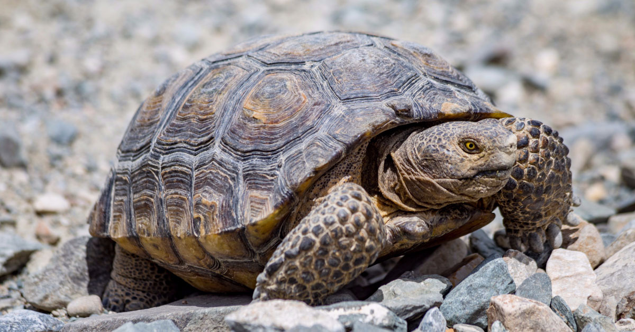
Is a tortoise an organism or a non-living thing? Why?

Slide 18
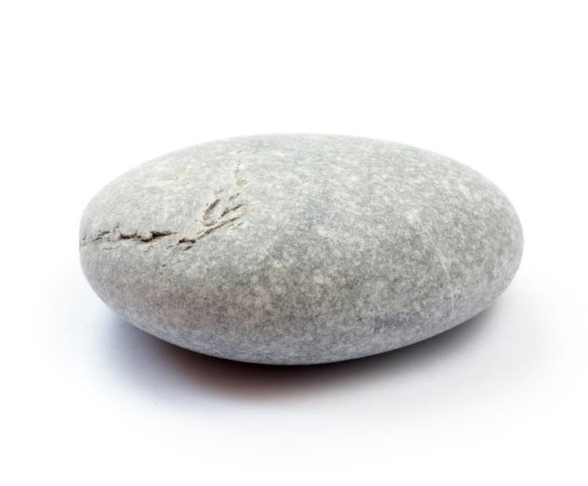
Is a stone an organism or a non-living thing? Why?

Slide 19
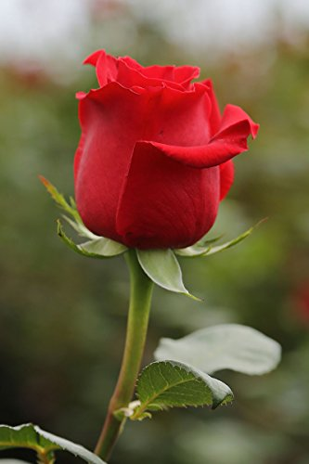
Is a rose an organism or a non-living thing? Why?

Slide 20
Complete the task.
Task:
Extension: Pick a non-living organism from your table and explain why it is non-living.

Slide 21
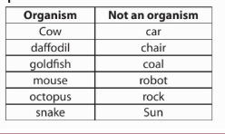
Use green pens to correct your answers.

Slide 22
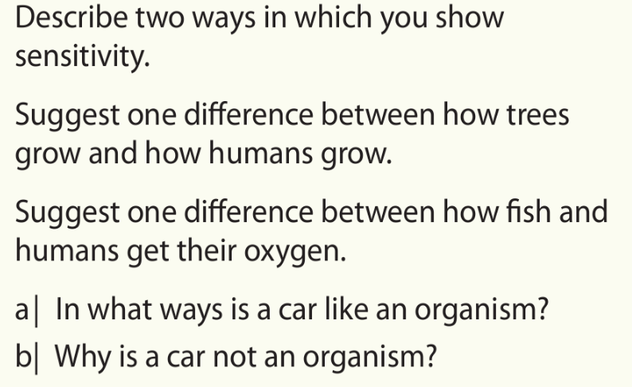
Answer the questions below
1
2
3
4

Slide 23
Use green pens to correct your answers.
1
2
3
4
4

Slide 24
Learning outcomes
Developing | Secure | Exceeding
Must… | Should… | Could…
Identify things as being alive or not. Recall the life processes: movement, reproduction, sensitivity, growth, respiration, excretion, nutrition. State the meaning of and correctly use the word: organism. | Describe the life processes. Use life processes to justify whether something is an organism or is non-living. | Identify ways in which an organism shows each life process. Compare life processes in a range of plants and animals.

Slide 25
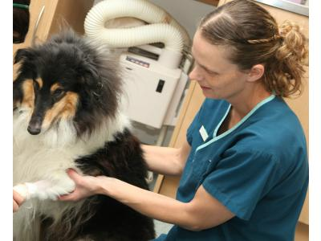
Veterinary/ Animal Care Assistant
Veterinary care assistants are important
members of today's modern
veterinary team.
Duties include
-exercising, grooming and feeding
hospitalised animals (inpatients)
-monitoring and providing supportive care to inpatients
Qualifications
-Level 2 Diploma for Veterinary Care Assistants
Reference: http://www.millenniumvets.co.uk/staff-profile.aspx?s=1889&clientId=20107

Slide 26
Thinking skills
Life processes

Slide 27
Which is the odd one out in this list?
Growth Reproduction Respiration
Possible answers
Next question
© Pearson Education Ltd 2014. Copying permitted for purchasing institution only. This material is not copyright free.

Slide 28
Which is the odd one out in this list?
Growth Reproduction Respiration
Respiration releases energy, the other two use energy.
Organisms reproduce and respire in different ways, but they all grow by getting bigger.
Growth does not begin with ‘r’.
Possible answers
Next question
© Pearson Education Ltd 2014. Copying permitted for purchasing institution only. This material is not copyright free.

Slide 29
Consider all the possible answers to this statement:
It has four legs.
Possible answers
Next question
© Pearson Education Ltd 2014. Copying permitted for purchasing institution only. This material is not copyright free.

Slide 30
Consider all the possible answers to this statement:
It has four legs.
It is an animal with four legs.
It is an animal that had more than four legs but lost some.
It is a ‘couple’.
It is a table.
Possible answers
Next question
© Pearson Education Ltd 2014. Copying permitted for purchasing institution only. This material is not copyright free.

Slide 31
Think of a Plus, a Minus and an Interesting point about this statement:
Humans need nutrition.
Possible answers
Back to start
End show
© Pearson Education Ltd 2014. Copying permitted for purchasing institution only. This material is not copyright free.

Slide 32
Think of a Plus, a Minus and an Interesting point about this statement:
Humans need nutrition.
Plus: We enjoy eating food.
Minus: Food can be expensive; we could do more things if we didn’t have to stop to eat.
Interesting: How much food is wasted? Some reports say that we waste up to half of the world’s food.
Possible answers
Back to start
End show
© Pearson Education Ltd 2014. Copying permitted for purchasing institution only. This material is not copyright free.

Slide 33
Practical: 7Aa-2 Life processes in seedlings (SEE FIREFLY)
Equipment per group:
● bung ● conical flask ● cotton wool
● eye protection ● limewater ● measuring cylinder
● muslin bag ● seeds

Slide 34
Worksheet: 7aa1-Life processes, 7aa3-sorting items, 7aa4-Evidence sheet, 7aa5- living or non-living, 7aa6-rees or growth and 7aa7-life processes and robots

