Slide 1
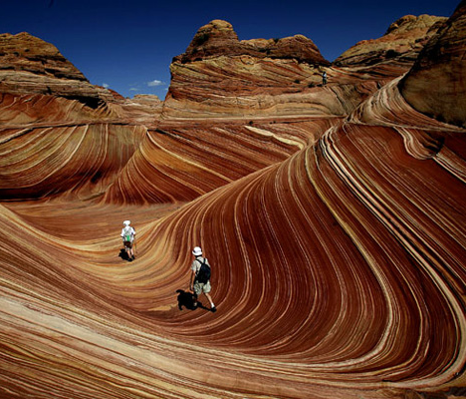
8Hd Sedimentary Rocks
CW
Do Now:
What is the source of igneous and metamorphic rocks?
How else might a rock form?

Slide 2
Requisitions
Period | Set | Room | SoW Ref | Equipment | Worksheets
 |  |  |  |  | Deposition worksheet Fossil table worksheet Rock Cycle diagram Extension: W/S 8Hd-7

Slide 3
Objectives
Recall the names of some sedimentary and metamorphic rocks.
Describe the textures and properties of sedimentary rocks.
Describe how sedimentary rocks are formed.
Describe how fossils are formed.
Describe the link between the size of rock fragments deposited and the water or wind speed.
Relate the grain size and roundness to transport history.
Compare quantitative data about the effect of speed on the size of grain that can be transported.
Use the rock cycle model to link the formation of igneous, sedimentary and metamorphic rocks.
Appreciate the different timescales involved in different rock cycle processes, and give examples of fast and slow processes.

Slide 4
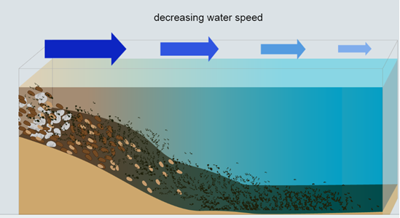
What is a sedimentary rock?
Stick In
Watch the video then complete the activity. As you complete the activity, label your diagrams. Include details about water clarity and how big the sediment that settles to the bottom is at each stage.
What does water clarity tell us about the movement of the water and sediments?

Slide 5
Sedimentary Rock
Copy & Complete
A sedimentary rock is created by the build-up of layers of sediment over time.
These types of rocks are made from grains, not interlocking crystals.
When moving air or water _____ ____, it deposits any sediments it is carrying.
As debris builds up, the lower levels are put under ________ pressure, and the sediment is squashed together.
This compression changes the ________ to ____; this process is called compaction.
slows down
increasing
sediment
rock

Slide 6
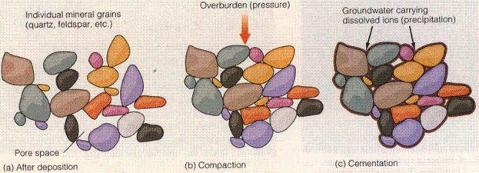
Cementation
Write Down
Dissolved minerals can get trapped in between the sediment grains. This then acts as a sort of glue which holds the rock together.

Slide 7
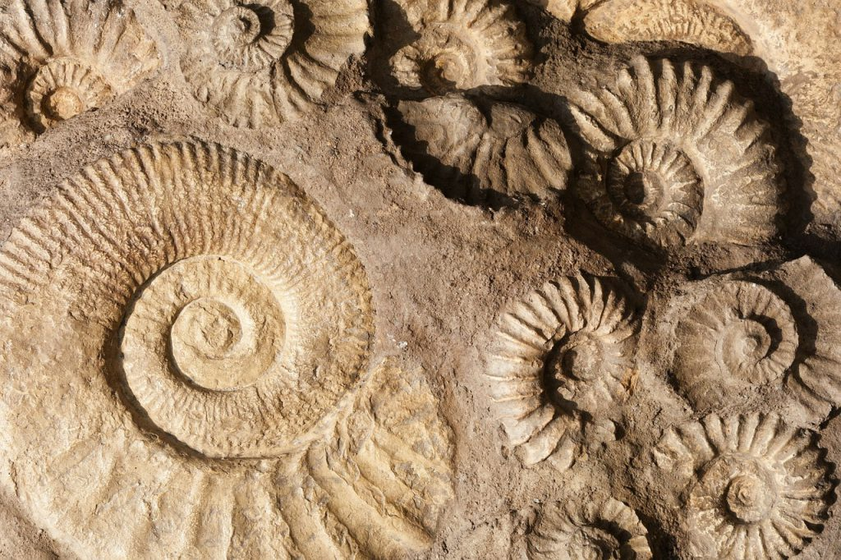
Fossils
Over the next slides, write a list of the steps of fossilisation to go along with your images
Fossils can form when dead plants and animals become caught up in these rock forming processes before they rot away.
When the sediments surrounding the organism are turned into sedimentary rock, the organism turns to rock too.

Slide 8
Fossils
Stick In
Write Down
1. Fossils may form when a dead plant or animal falls into the sea bed or into a swamp.

Slide 9
Write Down
2. The fleshy parts usually decay, leaving only the bones or shells

Slide 10
Write Down
3. The bones or shells become covered by layers of sediment.
Over millions of years the shell or bones may be buried under many metres of sediment

Slide 11
Write Down
4. Eventually the fossil may be exposed as a result of weathering and erosion of the rock around it.

Slide 12
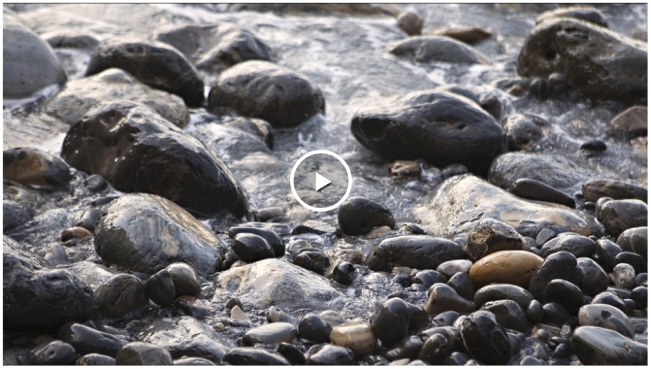

Slide 13
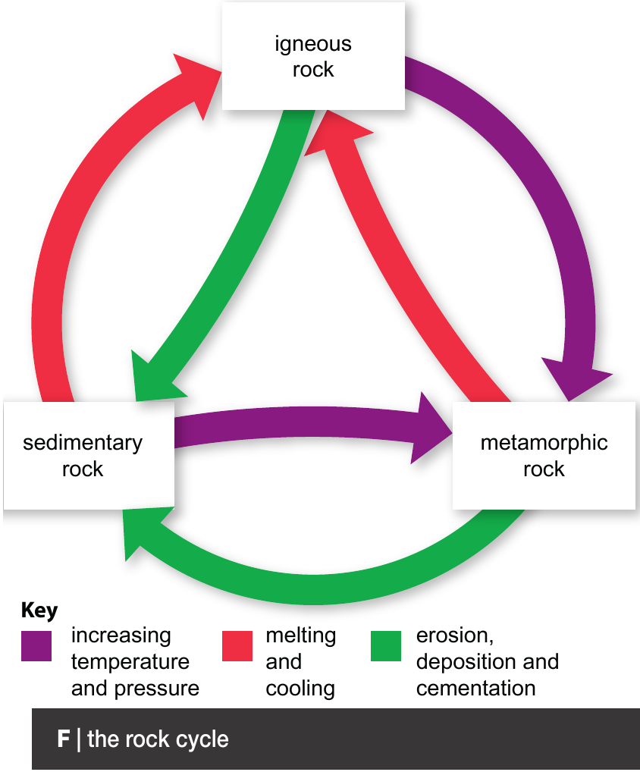
Rock Cycle
Stick In Middle
Write Down
Over geological time, rocks tend to change form. This can happen fast or slowly and is known as the rock cycle.

Slide 16
Write Down
Rock Cycle
When sedimentary and igneous rocks are heated or compressed they can turn into a metamorphic rock.
For example, mudstone can turn to slate when heated and compressed.
It becomes harder and can spilt into layers.

Slide 17
Write Down
Rock Cycle
When sedimentary or metamorphic rocks are buried, they can form molten rock and be reformed into an igneous rock.
Igneous and metamorphic rocks can also be broken down into sediment which can then form new sedimentary rocks

Slide 19
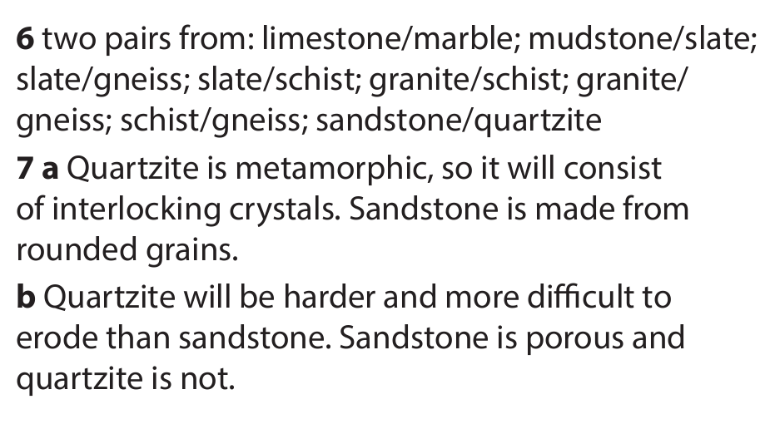

Slide 21
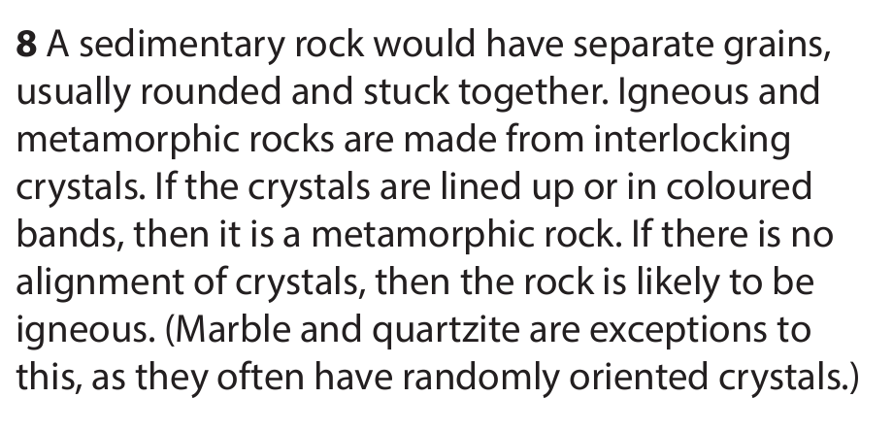

Slide 22
Extension/ H/W
Complete W/S 8Hd7

Slide 24
 Give a clue or definition for these keywords.
Hot Seat

Slide 25
Hot seat
 Give a clue or definition for these keywords.
Sedimentary

Slide 26
Hot seat
 Give a clue or definition for these keywords.
Deposit

Slide 27
Hot seat
 Give a clue or definition for these keywords.
Compaction

Slide 28
Hot seat
 Give a clue or definition for these keywords.
Concretion

Slide 29
Hot seat
 Give a clue or definition for these keywords.
Rock Cycle

Slide 30
Hot seat
 Give a clue or definition for these keywords.
Fossil

