Slide 1
Reqs
Freeze thaw worksheet
Extension/Homework
W/S 8Hc-5

Slide 2
Objectives
Recall some examples of physical changes and of chemical changes.
Describe the effect of physical and biological weathering on rocks.
Explain why rainwater is slightly acidic.
Describe the effect of chemical weathering on rocks.
Recall how weathered rocks are eroded and explain how fragments get worn down during transport.
Describe the link between the size of rock fragments carried and the water speed.
Describe how weathering can break up rocks.
Compare the fragment sizes that can be transported by wind, water and ice.

Slide 3
C/W
10/02/2019
8Hc – Weathering and Erosion
Why are there gaps in the limestone?
How has this happened?

Slide 4
Watch the video.
What are the 3 types of weathering?
Physical
Chemical
Biological

Slide 5
Physical Weathering
Use the text below to annotate your worksheet
Freeze-thaw action
Freeze-thaw weathering starts with a tiny dip or crack in a rock.
Rain gets into the crack and when the temperature drops below 0 °C the water freezes.
The expanding ice pushes on the sides of the crack.

Slide 6
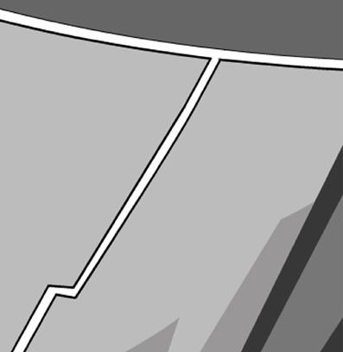
Use the text below to annotate your worksheet
The force from the expanding ice makes the crack wider and longer.
After many cycles of freezing and thawing, the crack may get so big that the rock breaks up completely.

Slide 7
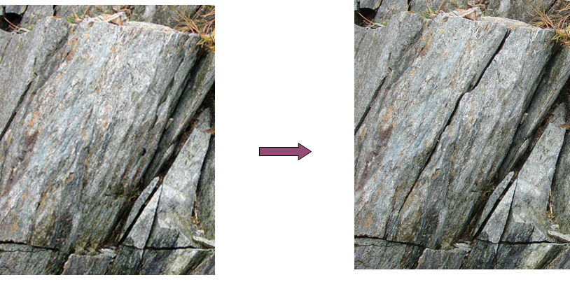

Slide 8
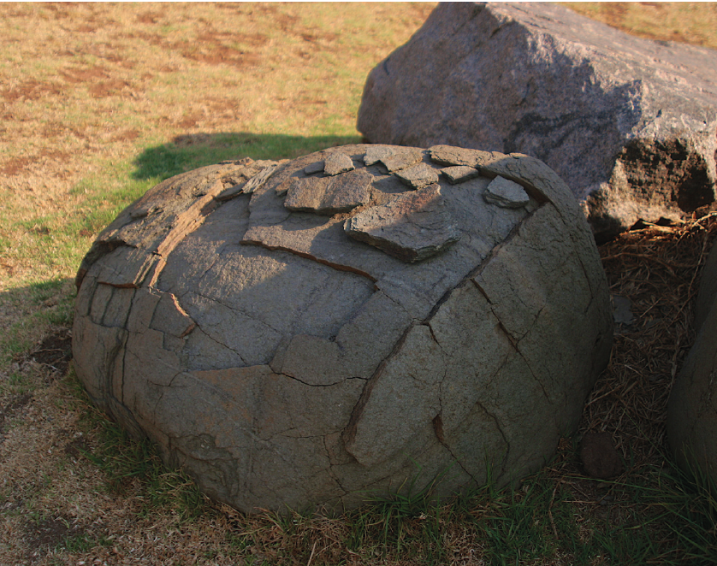
Copy the text below
Onion-Skin Weathering
The Sun heats up the outer layers of the rock which expand slightly compared to the cooler inner layers. This can cause the outer layer to crack.
At night, the outer layers of the rock contract again as they cool down. This may cause further cracks to appear in the outer layer.
This continues until the outer layers may crack so much that they fall away.

Slide 9
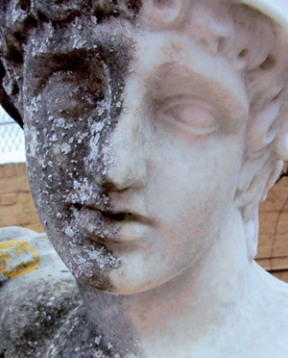
Chemical Weathering
Copy the text below
Rain contains dissolved gases which make it slightly acidic.
When this rain falls onto rocks it can react with minerals to cause chemical weathering.
The reaction with these minerals creates new minerals which are often weaker or more soluble.
This means that they will wear away easily.

Slide 10
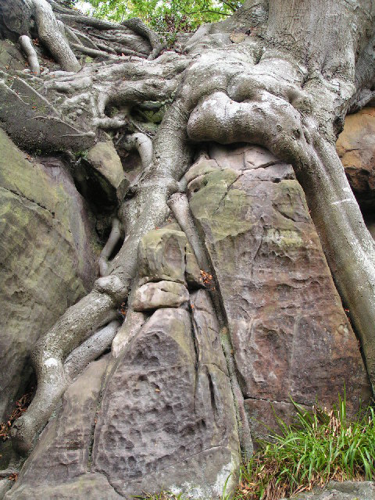
Biological Weathering
Copy the text below
Weathering can be caused by animals and plants.
Plants roots can grow into cracks within rocks. As these plants grow, the roots become larger and fracture the rock further.

Slide 11
Erosion
Watch the video.
Complete the wordfill below
The wearing away of rock and the removal of w_______ debris and soil. Erosion typically occurs by the action of rivers, g_______ , waves, wind and even animals.
Not to be confused with w__________ , which is the breaking down of rock by c________ and p__________ processes

Slide 12
Transport
Play the activity
Complete the wordfill below
Rivers and wind can transport rocks and sediment long distances. The ______ the water or wind moves, the _______ the bits of rock and sediment it can transport.
During transport, rocks can collide into each other, breaking apart. This is called ________.
The longer a rock of bit of sediment is transported, the smaller and rounder it becomes.
Notes:
https://www.activeteachonline.com/product/view/id/335/page/124/mode/dps?modal=/player/animation/id/390823

Slide 13
Glaciers
Copy the text below
Glaciers are large rivers of ice that move slowly and can transport large sediment and rocks.
These rocks can scrape away at the land they move over and abrade them until they become small particles.
Watch the video to see what this looks like in action.
Notes:
https://www.youtube.com/watch?v=loI584OFVpE

Slide 14
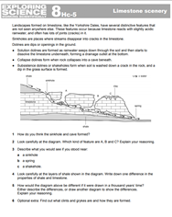
Extension/ H/W
Complete W/S 8Hc-5

Slide 15
 Give a clue or definition for these keywords.
Hot Seat

Slide 16
Hot seat
 Give a clue or definition for these keywords.
Chemical weathering

Slide 17
Hot seat
 Give a clue or definition for these keywords.
Freeze Thaw

Slide 18
Hot seat
 Give a clue or definition for these keywords.
Biological weathering

Slide 19
Hot seat
 Give a clue or definition for these keywords.
Abrasion

Slide 20
Hot seat
 Give a clue or definition for these keywords.
Onion skin weathering

Slide 21
Hot seat
 Give a clue or definition for these keywords.
Acid rain

