Slide 1
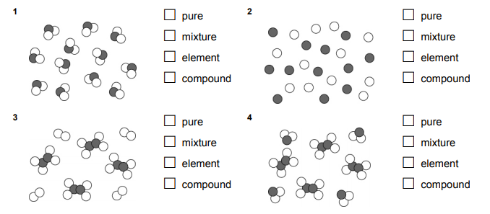
7Hd Making Compounds
There is more than one tick per question.
✔
Pure
Mixture
Elements
Compounds
Pure
Mixture
Elements
Compounds
✔
✔
✔
Pure
Mixture
Elements
Compounds
Pure
Mixture
Elements
Compounds
✔
✔
✔
✔
✔

Slide 2
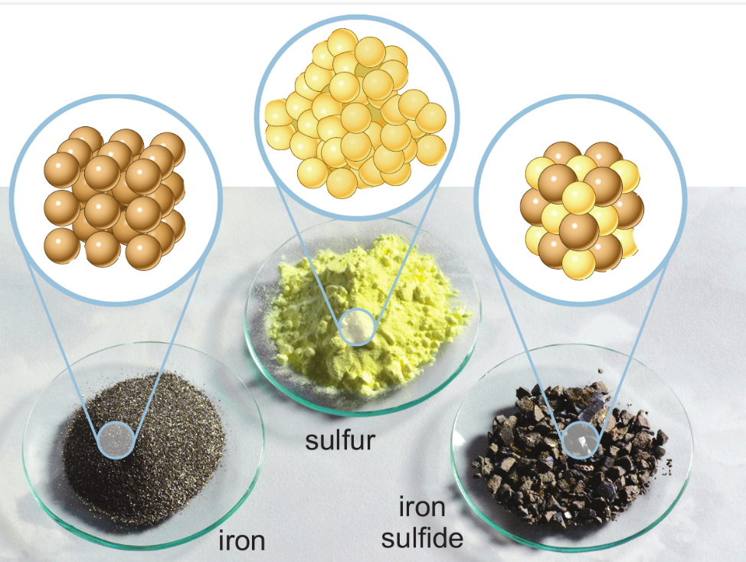
Iron and sulphur experiment

Slide 3
Alternative experiment
Element | Appearance of element | Element | Appearance of element | Compound | Appearance Of compound
copper |  | oxygen
zinc |  | oxygen
iron |  | oxygen
iron |  | sulphur
Describe the appearance of the elements and compounds.
Hold the metals

Slide 4
mixture joined compound between inside
iron + sulphur → iron sulphide

Slide 5
Naming compounds
iron + sulphur →
iron + oxygen →
sodium + chlorine →
aluminium + bromine →
tin + fluorine →
iron sulphide
iron oxide
sodium chloride
aluminium bromide
tin fluoride

Slide 6
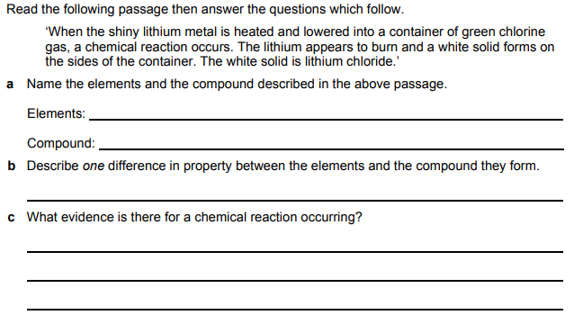
lithium and chlorine
lithium chloride
colour change
The product of the chemical reaction has different properties

Slide 7
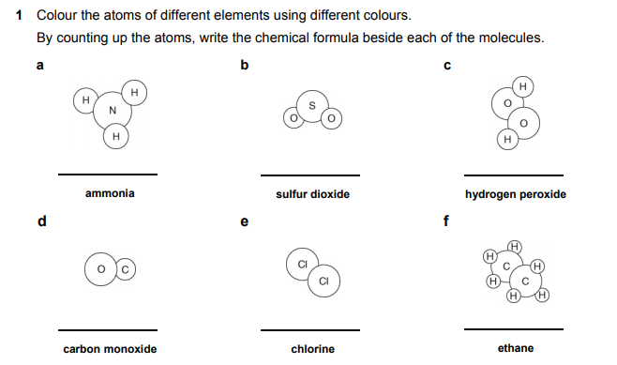
The formula for water is H₂0 because it is made of two hydrogen atoms and one oxygen
O
H
H
NH₃
SO₂
H₂O₂
CO
Cl₂
C₂H₆

Slide 8
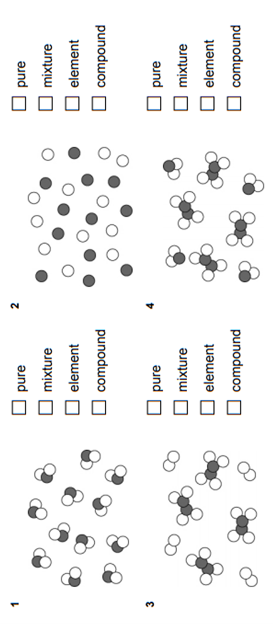
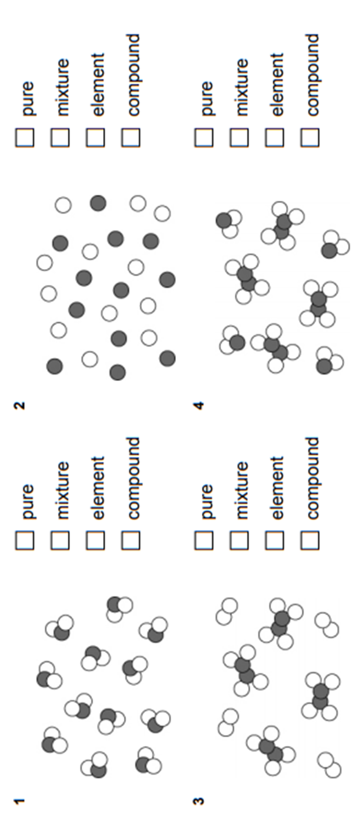

Slide 9
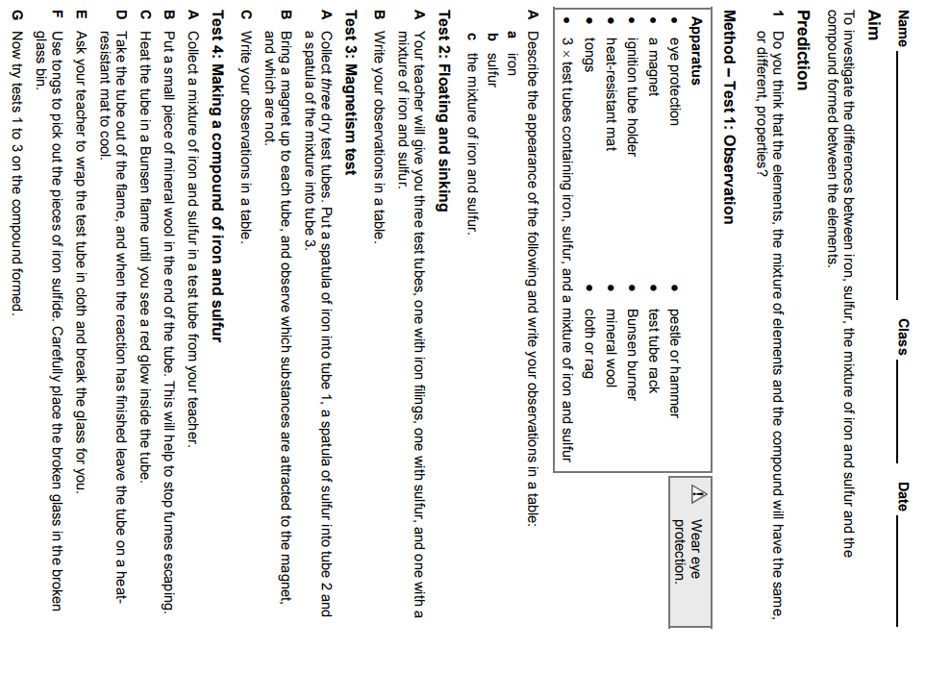

Slide 10
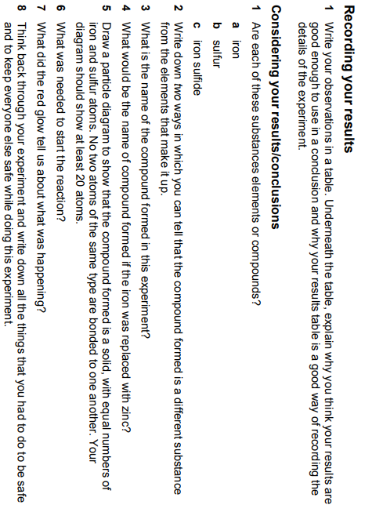

Slide 12
Element | Appearance of element | Element | Appearance of element | Compound | Appearance Of compound
copper |  | oxygen
zinc |  | oxygen
iron |  | oxygen
iron |  | sulphur
Element | Appearance of element | Element | Appearance of element | Compound | Appearance Of compound
copper |  | oxygen
zinc |  | oxygen
iron |  | oxygen
iron |  | sulphur

