Slide 1
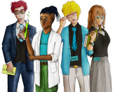
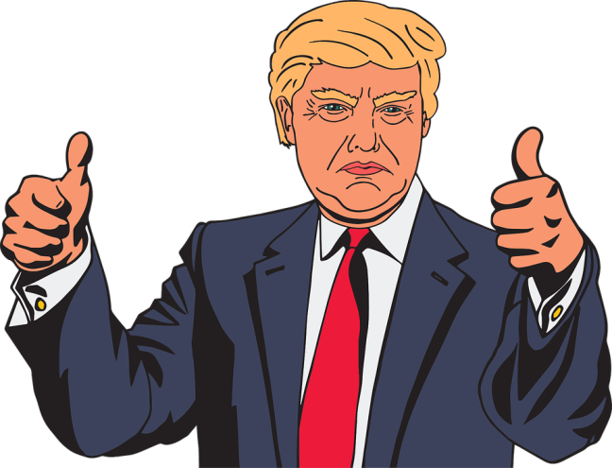
Critical Thinking & Fake News!
Copy
title
Knowledge, Skills & Actions
2018 World Press Freedom Index
Top 6 Ranked Countries
1. Norway
2. Sweden
3. Netherlands
4. Finland
5. Switzerland
6. Jamaica
The United Kingdom Is ranked 40th
Bottom 5 Ranked Countries
176. China
177. Syria
178. Turkmenistan
179. Eritrea
180. North Korea
To understand how to spot fake news
To explore the damaging consequences of Fake news
To understand why critical thinking is important
3 Minutes
What is fake news?
Why does Donald Trump talk about it a lot?
How can you spot fake news?
Did you know?
New Vocabulary
Fake News
Conspiracy Theories
People over 65 are the most likely to share fake news!
Tasks

Slide 2
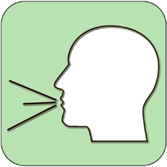
REFERENCE SLIDE
Teamwork
New Vocab
Discussion task
Play video
NEW
VOCABULARY
DISCUSSION TASK
THE LAW
EXPLAINED
TEAMWORK TASK
PROJECT
WORK
PLAY
VIDEO
Thoughts
Research
Extension
task
Tasks
Problem
solving
TASKS
EXTENSION
TASK
THOUGHTS
FURTHER RESEARCH
HOMEWORK
PROBLEM SOLVING
Feelings
Copy
information
Revision
Design Task
ASSESSMENT OPPORTUNITY
FEELINGS
REVISION
TASK
DESIGN
TASK
COPY INFORMATION
SENSITIVE ISSUE
WARNING
Notes:
TEACHER NOTES & IDEAS
This is a teacher reference slide - Icons will be used throughout Cre8tive Curriculum lessons to denote what students can do.
Could be printed and laminated on A3 and stuck up in the classroom

Slide 3
PSHE
Show respect
By listening
Not interrupting
Only 1 person talking at a time
Be open and honest but no personal comments – Discussions will be about ‘general situations’
Don’t make assumptions about people’s values, attitudes, behaviours, life experiences or feelings
PSHE CLASSROOM RULES
DEALING WITH SENSITIVE TOPICS
SAFEGUARDING YOUR WELFARE & HAVING YOUR INTERESTS AT HEART
You don’t have to say things about yourself if you don’t want to (You have the right to pass)
There are no stupid questions. A question box for anonymous Questions
It’s OK to get things wrong
Have a non-judgemental approach. No Put downs and challenge the opinion not the person
Enjoy the lesson, Challenge your perceptions and understand how to seek further advice and support
Use the agreed appropriate Language (Avoid slang terms)
Conversations stay in the room unless it is a safeguarding issue
Don’t show the fact you are embarrassed through silliness
Notes:
TEACHER NOTES & IDEAS
Reinforce ground rules at the start of every new topic / new term
Adapt this set of rules to suit your classroom and your teaching.
Display your agreed PSHE classroom rules in a prominent place so students have a constant reminder and when/if a student breaks a rule you can use as a prompt to get them back on track.
If behavior is an issue revisit the ground rules – Use raffle tickets , positive behavior management (look for the good behavior)
Reward the behavior you want to see, be consistent and fair with students.
Create a classroom charter with the students (optional)

Slide 4
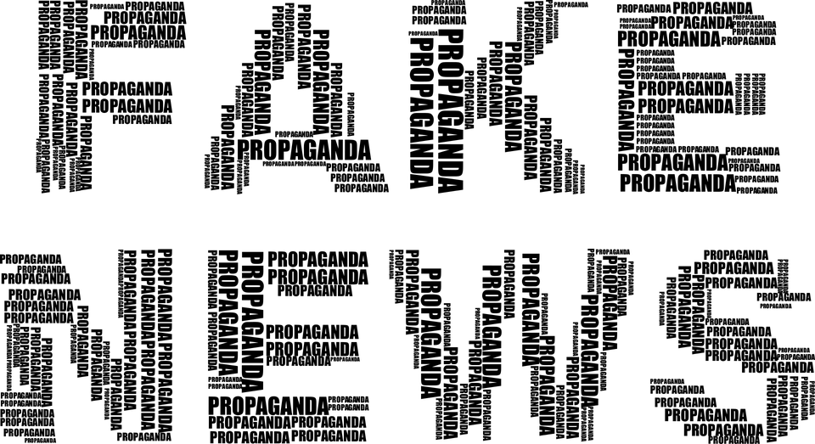
 | DID? | MIGHT? | COULD? | CAN? / WILL? | IS? DOES?
HOW?
WHAT?
WHERE?
WHO?
WHY?
SECOND
FIRST
Using the grid above come up with three questions about the image
Tasks
2 Minutes
Notes:
TEACHER NOTES & IDEAS
Get students to come up with questions using the prompts on the board
Try to get them to think of high level order questions and look past just the image
Extension – Have students try to come up with answers to other students questions
Adapt the image to something you think would be more engaging (We are restricted by Copyright)

Slide 5
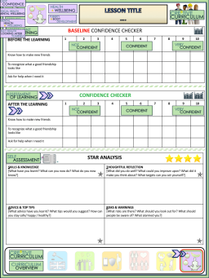
Critical Thinking & Fake News
BASELINE CONFIDENCE CHECKER
BEFORE THE LEARNING | 1 | 2 | 3 | 4 | 5 | 6 | 7 | 8 | 9 | 10
I can spot fake news
I understand the importance of critical thinking
I understand why fake news can be damaging
Complete a base line assessment of where you think you are at for this lesson
(Discussion or complete sheet)
2 Minutes
I’m not confident at all
I’m getting more confidence
Confident
Very
confident
Super
confident
Notes:
TEACHER NOTES & IDEAS
This could be done by writing a number down in the books
Show of fingers in the air. /Red amber Green Cards
Quick Partner Discussion
Print off the Assessment Opportunity Sheet – Fill in the Baseline Confidence Checker

Slide 6
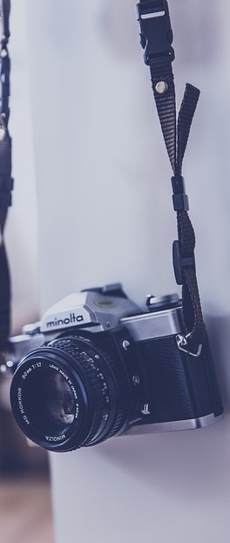
In a democracy, the media is relied upon to do many things. If a country has free press (e.g UK, USA, France, Germany etc.) then the media will be able to do the following:
Expose wrong doings and miscarriages of justice
Protect the public from dangers
Hold those in power to account for their actions
Uncover corruption at all levels in government
Stand up for those who do not have a voice
Campaign on behalf of the public
Reveal information that helps the public made important decisions
Prevent the spread of misinformation or disinformation from others
Media outlets free from government interference are seen by many as one of the building blocks upon which a democracy is built. The media not only helps to inform and influence public opinion but provides a safe forum for discussion/debating and exchange of different ideas. Ultimately, the media allows the public to keep a close watchful eye on those in power.

Slide 7
ROUND 3
HEADLINES REAL or FAKE NEWS
A
‘The Queen removes Obama from wedding list!’
E
‘More people watched England’s opening World Cup game than the Royal Wedding’
B
‘72 people killed during fire at Grenfell Tower’
F
‘NFL owner orders his players to stand during national anthem’
C
Pope Francis “God has instructed me to revise the 10 commandments”
G
‘450 patients died sooner than they should have due to doctors prescribing powerful pain killers’
D
‘Muslim refugee shoots 15 people in Ohio night club’
H
‘Trump’s health deteriorating as White House pressure Mounts’

Slide 8
ROUND 3
HEADLINES REAL or FAKE NEWS
A
‘The Queen removes Obama from wedding list!’
E
‘More people watched England’s opening World Cup game than the Royal Wedding’
REAL
NEWS
B
‘72 people killed during fire at Grenfell Tower’
F
‘NFL owner orders his players to stand during national anthem’
REAL
NEWS
C
Pope Francis “God has instructed me to revise the 10 commandments”
G
‘450 patients died sooner than they should have due to doctors prescribing powerful pain killers’
REAL
NEWS
D
‘Muslim refugee shoots 15 people in Ohio night club’
H
‘Trump’s health deteriorating as White House pressure Mounts’

Slide 9
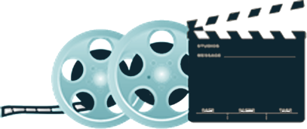
SPOTTING FAKE NEWS
Play video
What thinking is needed? next steps? Where are we now
what is wrong? Is it safe? can it be done?
Truth or Fake 2019
Task: Pick one or two colours and answer all the related questions
THINKING
JUDGEMENT
THINKING HATS
What facts do I know? What else do I need to know? What do I want to know?
How do I feel about this? What don’t I like about this? What do I like about this?
Can something be done? New ideas?
What are the solutions/ suggestions?
INFORMATION
FEELINGS
CREATIVITY
8 Minutes
Notes:
TEACHER NOTES & IDEAS
If the Video is short it may be worth playing it twice – 1st time let students watch carefully and 2nd time have students complete one or two of the hats
Short of Time – Play the video and Answer A few of the hats afterwards as a class
N.B This is a generic slide and sometimes the hats may not be appropriate for the video clip (if so delete or change accordingly to suit)
N.B Always check the video link is age appropriate to your class before showing student in the lesson.

Slide 10
Did you know?
KEY PRINCIPLES OF GOOD NEWS REPORTING
Research widely
Check the facts are correct
Talk to a wide variety of people involved
Find quotes
ONLY REPORT WHAT YOU KNOW TO BE TRUTH
Tips to spotting fake news articles
Why spread fake news?
To make money
To spread ideology
To cause mischief and spread disinformation
Can you think of an example of when this has been done?
Task
Create a Mindmap about the signs that something may be fake news
Notes:
TEACHER NOTES & IDEAS

Slide 11
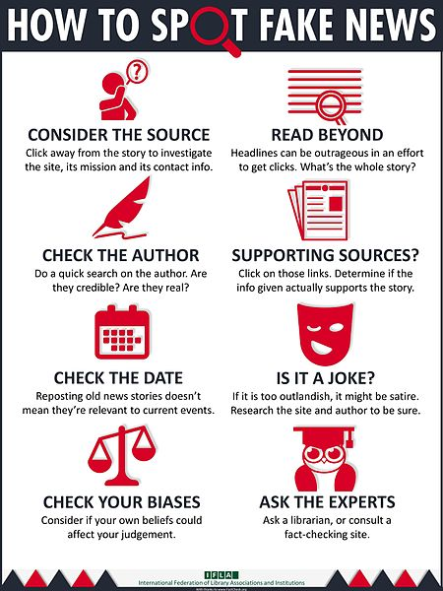
Task 1: Match up the titles with the descriptions opposite
Supporting Sources?
Check the author
Is it a joke?
Read beyond
Ask the Experts
Check your bias
Check the date
Consider the source
Why do you think people over 65 are most likely to share fake news?
Notes:
Author Attribution IFLA

Slide 12
CHECK YOUR ANSWERS….
Supporting Sources?
Check the author
Is it a joke?
Read beyond
Ask the Experts
Check your bias
Check the date
Consider the source
Why do you think people over 65 are most likely to share fake news?
Notes:
Author Attribution IFLA

Slide 13
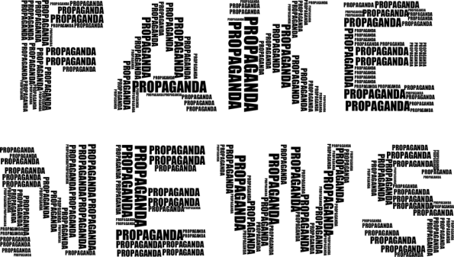
Signs it could be fake news
Have you heard of the organisation that has published it?
Does the website look unusual?
Spelling mistakes.
Is it based on rumour and speculation and appear to be very biased.
The news story is not being reported by any other organisations
The image used does not relate to the story being reported
Includes lots of informal phrases
Design of the news article look unusual
No quotes from any real sources. Are the facts not supported by any real evidence
Notes:
TEACHER NOTES & IDEAS

Slide 14
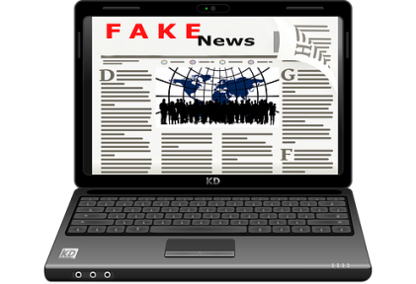
NEW KEY TERM
The Media and Society
PROPAGANDA
Information, especially of a biased or misleading nature, used to promote a political cause or point of view.
Synonym:
Bias Information promotion
In a sentence:
Russia has been accused of encouraging pro-government propaganda by involving itself in state television channels.
Exam technique:
How did Hitler use Propaganda during WW2?
How could governments use propaganda to control their citizens?
How can you spot propaganda?
NEW KEY TERM
The Media and Society
FAKE NEWS
A type of journalism that consists of deliberate misinformation or hoaxes. Often used to exaggerate, sensationalise or just make up headlines to grab attention
Synonym:
Misinformation
In a sentence:
Recently Donald Trump has attacked the media and accused news outlets like CNN for promoting fake news.
Exam technique:
What is fake news?
Why does Donald Trump have such an issue with fake news?
Are there different types of fake news?
Notes:
TEACHER NOTES & IDEAS

Slide 15
CRITICAL THINKING
Play video
What thinking is needed? next steps? Where are we now
what is wrong? Is it safe? can it be done?
What is critical thinking?
Task: Pick one or two colours and answer all the related questions
THINKING
JUDGEMENT
THINKING HATS
What facts do I know? What else do I need to know? What do I want to know?
How do I feel about this? What don’t I like about this? What do I like about this?
Can something be done? New ideas?
What are the solutions/ suggestions?
INFORMATION
FEELINGS
CREATIVITY
5 Minutes
Notes:
TEACHER NOTES & IDEAS
If the Video is short it may be worth playing it twice – 1st time let students watch carefully and 2nd time have students complete one or two of the hats
Short of Time – Play the video and Answer A few of the hats afterwards as a class
N.B This is a generic slide and sometimes the hats may not be appropriate for the video clip (if so delete or change accordingly to suit)
N.B Always check the video link is age appropriate to your class before showing student in the lesson.

Slide 16
WHY IS CRITICAL THINKING IMPORTANT?
Moves us away from
Moves us Towards
Rash Conclusions
Intellectual discipline
Mystifications and conspiracy theories
Clear expression of ideas
Reluctance to question wisdom, authority and tradition
Acceptance of personal responsibility for our own thinking
Notes:
TEACHER NOTES & IDEAS

Slide 17
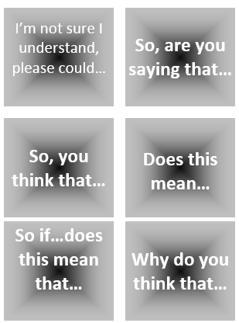
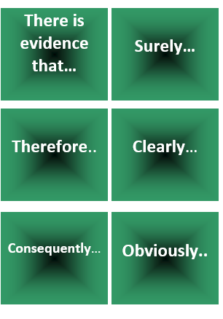
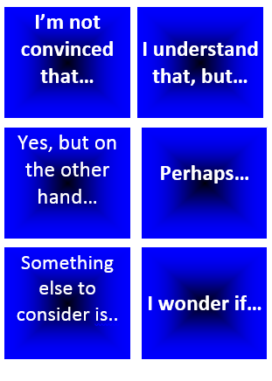
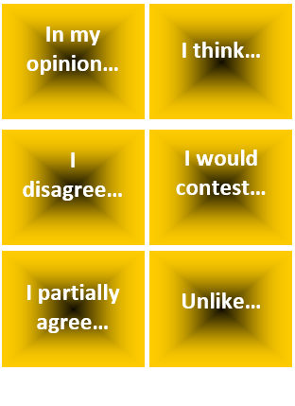
“The Spread of Fake News is the biggest problem facing young people in 2019”
Start with this card….
Or these cards….
Task 1: Discuss / Debate with your partner your own personal views towards this statement /idea
Extension: Can you think of specific examples of recent events that would support this statement and other specific examples that would go against this statement.
Discussion task
2-3 Minutes
Notes:
TEACHER NOTES & IDEAS
Pair student sup and have them use the sentence starter prompts on the board to help them (each colour represents a different set of prompts E.G Challenge, agree, build upon etc)
-Arrange for two confident students (or two pairs of students) to come to the front and have a debate challenge off with a timer
-Challenge a student to debate you (allow them to pick whether they will argue for the statement or against it)

Slide 18
Confidence Checker
AFTER THE LEARNING | 1 | 2 | 3 | 4 | 5 | 6 | 7 | 8 | 9 | 10
I can spot fake news
I understand the importance of critical thinking
I understand why fake news can be damaging
Complete the confidence checker of where you think you are at for this lesson (Discussion or complete sheet)
3 Minutes
Notes:
TEACHER NOTES & IDEAS
This could be done by writing a number down in the books – Compare to the start of the lesson
Show of fingers in the air or use Red Amber Green Cards
Quick Partner Discussion & reflect on before the lesson and progress made
Print off the Assessment Opportunity Sheet – Fill in the Confidence Checker / Compare with the baseline
Author Attribution :https://pixabay.com/en/traffic-lights-traffic-light-phases-2147790/

Slide 19
I know if I need further
support or help I could
speak to…. or contact…
Before I could/would say
and do ... but now I feel I
am able to say
Before I only knew ...
now I also know ...
I supported others by…
One thing I didn’t
realise was… now I know that…
The key words for
this lesson are…
I always knew ... but now
I can see how it connects to…
The most important thing I
have learnt today is…
I’m really proud of the
way I have…
I used to feel ...
but I now feel ..
One assumption of
mine that was
challenged was…
I would like to learn…
A question I
would like to
ask is…
Before I thought that ...
but now I realise..
Today I have tried to…
Next lesson I would like to..
Before I would have done…
Now I will …
Before I would have
said ... but now I will say…
2 Minutes
A problem I overcame
today was…
Notes:
TEACHER NOTES & IDEAS
: Have students pick either 1/2/3 tickets depending on their ability and tell a partner
Pick a few students at random to feedback to the class
As students leave the room have them tell you their reflection on the way out

