Slide 1
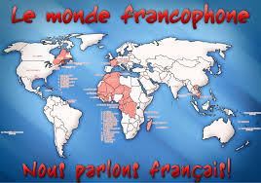
Les Pays Francophones

Slide 2
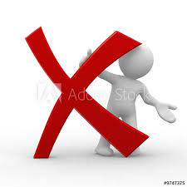
Starter- Negative structures
In listening and reading tests, always listen out for negative structures which can totally change the meaning!
Translate this sentence with your partner:
J’aime mon collège car les profs ne sont pas trop sévères et nous n’avons pas trop de devoirs
= I like my school because the teachers AREN’T TOO STRICT and we DON’T have too much homework
LISTEN OUT FOR THE NE & PAS!!!

Slide 3
Objectives
To learn about French speaking countries around the world.
To learn some popular sports in French speaking countries

Slide 5
Watch these videos which explain « LA FRANCOPHONIE »
https://www.youtube.com/watch?v=S_dlWdIciEE
https://www.youtube.com/watch?v=Mnq9-BhdSvw

Slide 7
La France

Slide 8
Jersey

Slide 9
La Belgique

Slide 10
La Suisse

Slide 11
La Tunisie

Slide 12
Madagascar

Slide 13
La Côte d’Ivoire

Slide 14
Le Sénégal

Slide 15
Le Maroc

Slide 16
Le Québec

Slide 17
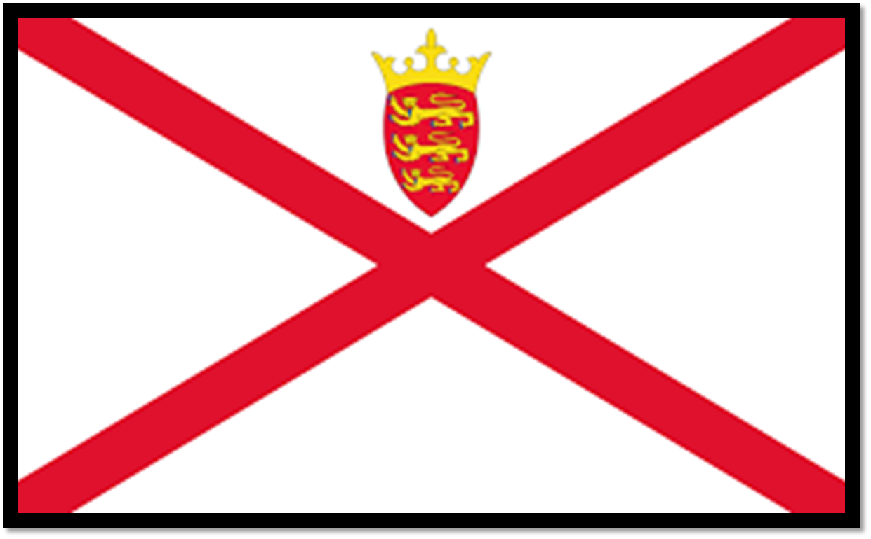
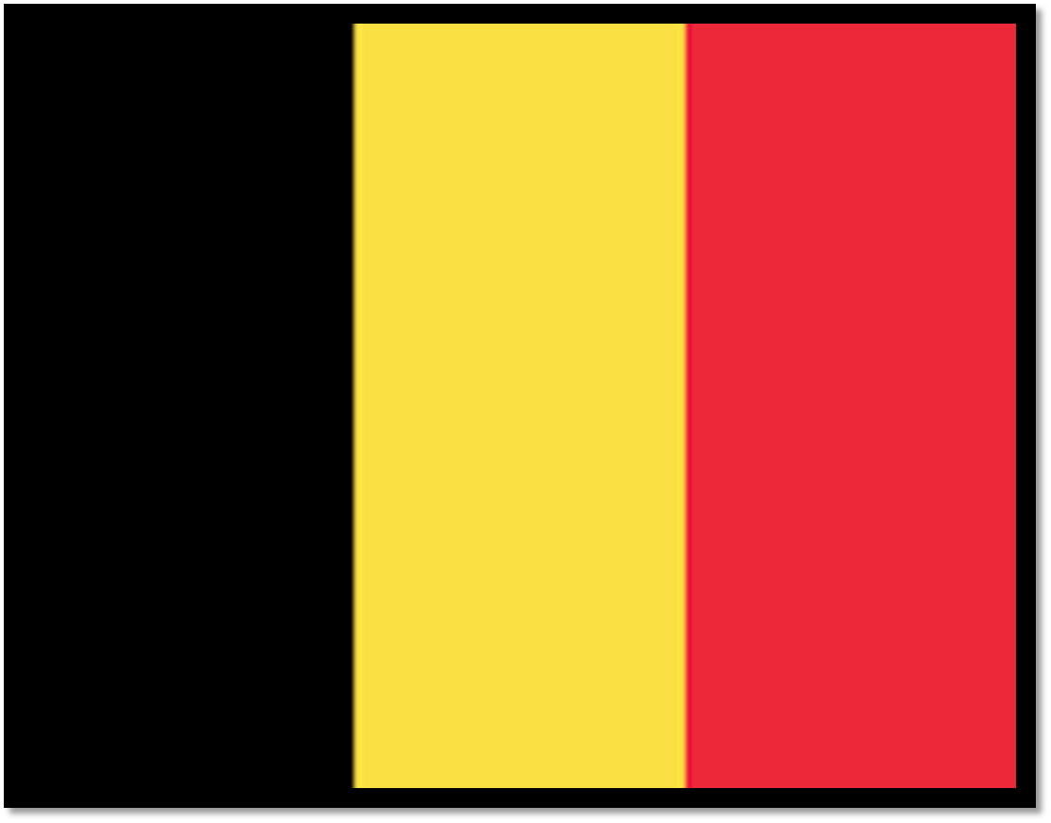
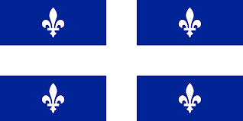
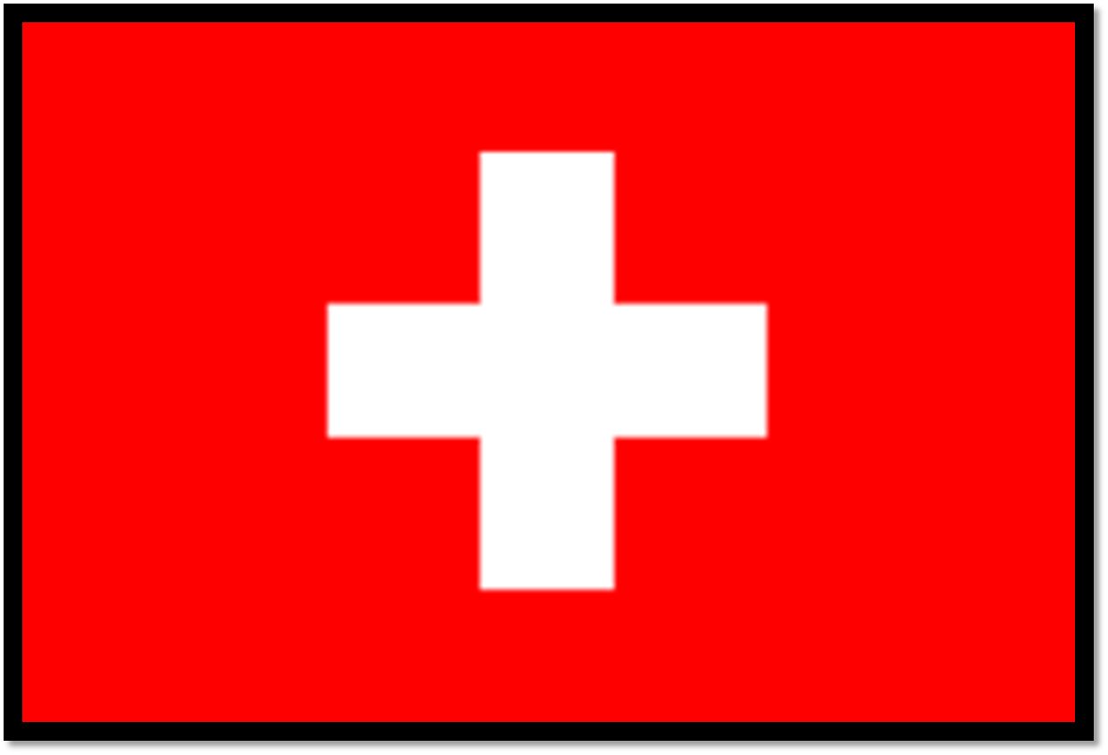
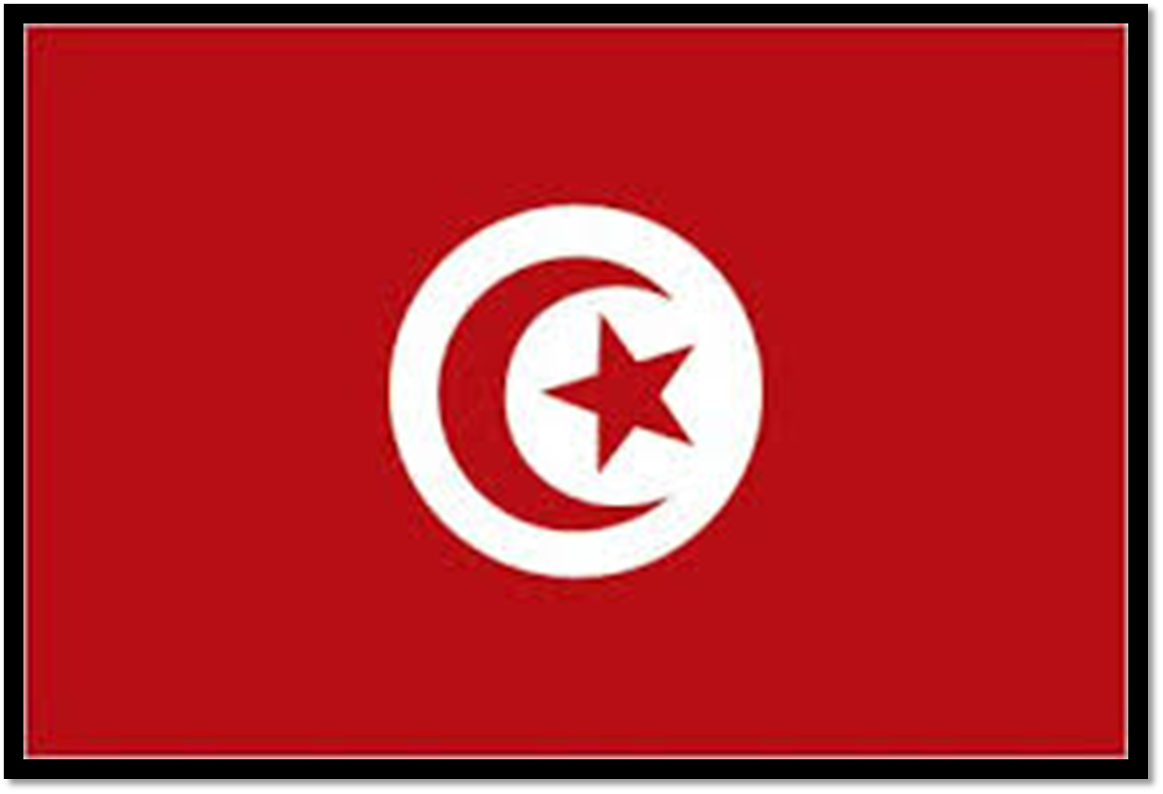
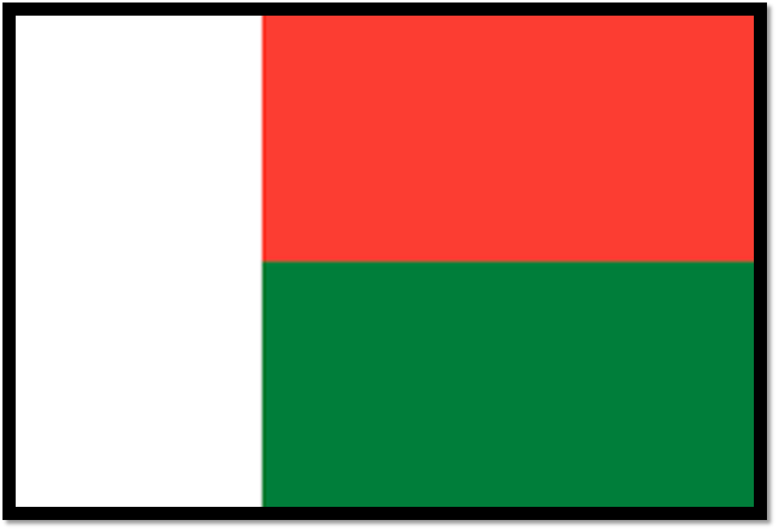
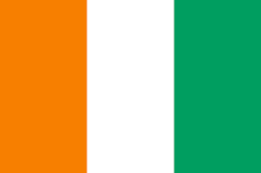
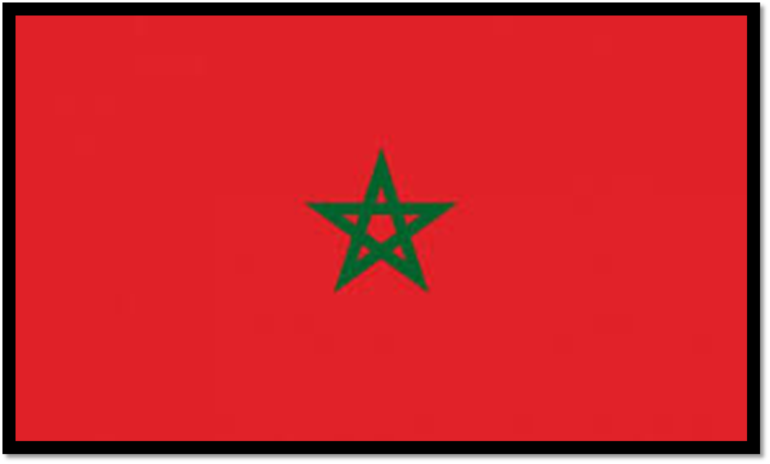
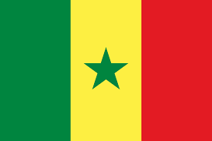

Slide 18
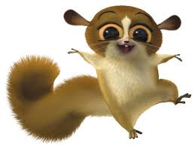
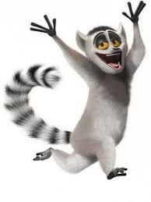
Copie et écris l’anglais
1. La France
2. Jersey
3. La Belgique
4. La Suisse
5. La Tunisie
6. Madagascar
7. la Côte d’Ivoire
8. le Sénégal
9. le Maroc
10. le Québec

Slide 19
Copie et écris l’anglais
1. La France
2. Jersey
3. La Belgique
4. La Suisse
5. La Tunisie
6. Madagascar
7. la Côte d’Ivoire
8. le Sénégal
9. le Maroc
10. le Québec
France
Jersey
Belgium
Switzerland
Tunisia
Madagascar
Ivory Coast (Côte d’Ivoire)
Senegal
Morocco
Quebec

Slide 20
Note on La Côte d’Ivoire
Cote d’Ivoire had long been translated literally into other languages,^{[d]}which the post-independence government considered increasingly troublesome whenever its international dealings extended beyond the Francophone sphere. Therefore, in April 1986, the government declared that Côte d'Ivoire (or, more fully, République de Côte d'Ivoire^{[22]}) would be its formal name for the purposes of diplomatic protocol, and since then officially refuses to recognize or accept any translation from French to another language in its international dealings.^{[21][23][24]}
Despite the Ivorian government's request, the English translation "Ivory Coast" (often "the Ivory Coast") is still frequently used in English by various media outlets and publications.^{[e][f]}

Slide 22
C’est a, b ou c?
1
2
3
a
b
b

Slide 24
C’est quel sport?
1
2
3
4
5
d
b
e
a
c

Slide 26
(It’s only represented in the summer olympics)

Slide 27
La pétanque:
The French game of pétanque, an institution in Provence
https://www.youtube.com/watch?v=kPn4mekXYn4

Slide 28
Le Tour de France - video

