Slide 1
Maths Residential trip
Higham Park School
July 2025

Slide 2
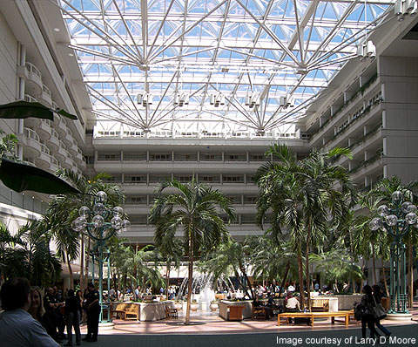
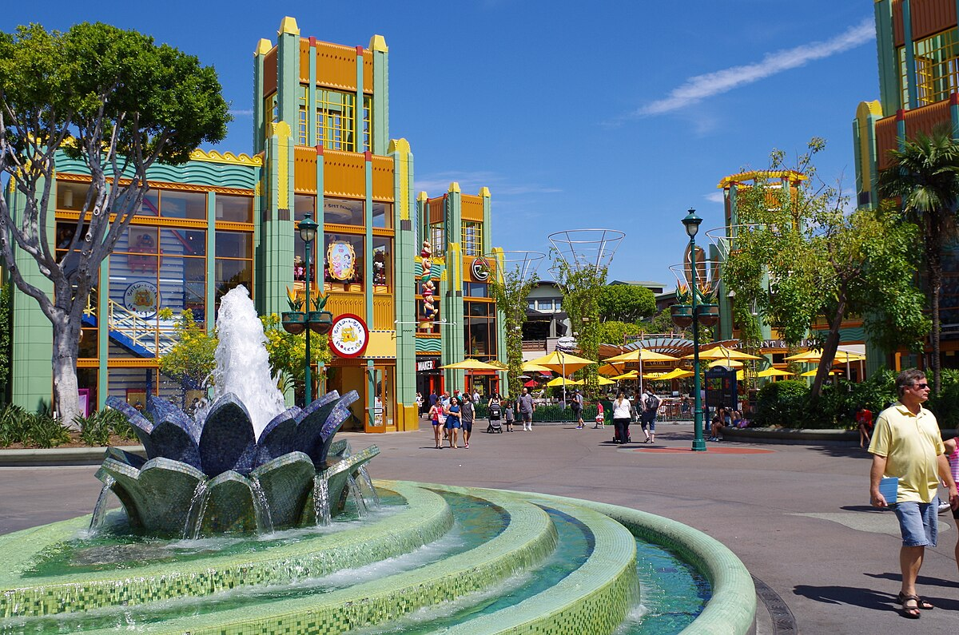
Day1 : Thurs 10th July
Depart from Gatwick on British Airways flight
Arrive in Orlando International airport in Florida, USA
Check in at hotel with some time in Disney’s Downtown district
A meal at a local restaurant in the evening
Notes:
Airport - Designed as emergency landing site for Space Shuttles
Downton – has lots of hotels, restaurants and shops including World of Disney
Restaurant – will be having dinner at a restaurant every evening

Slide 3
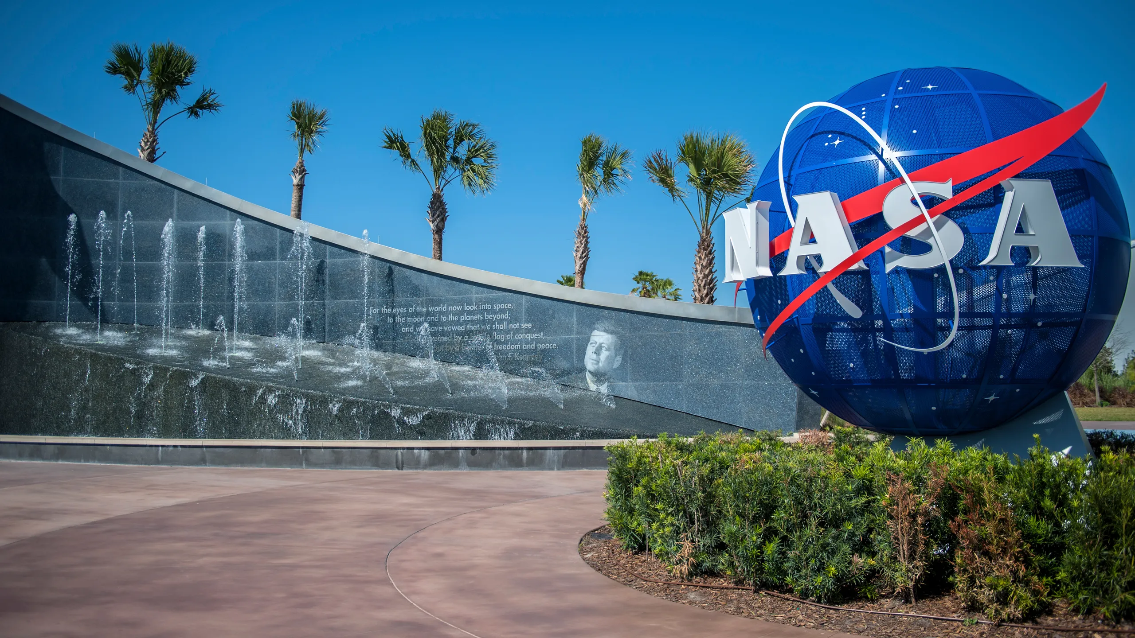
Day2 : Fri 11th July
Breakfast at the hotel
Then a day at the Kennedy Space Centre
Notes:
Breakfast – will be starting every day with breakfast at our hotel
Kennedy Space Centre – aka NASA. It’s the Main site for NASA and where all the most famous spacecraft have been launched from (Apollo, Sky Lab, Space Shuttles Atlantis Saturn etc)
Manages it’s robotic and crew missions from here
Whether you’re into Space or Sci-Fi fan this will be awe-inspiring

Slide 4
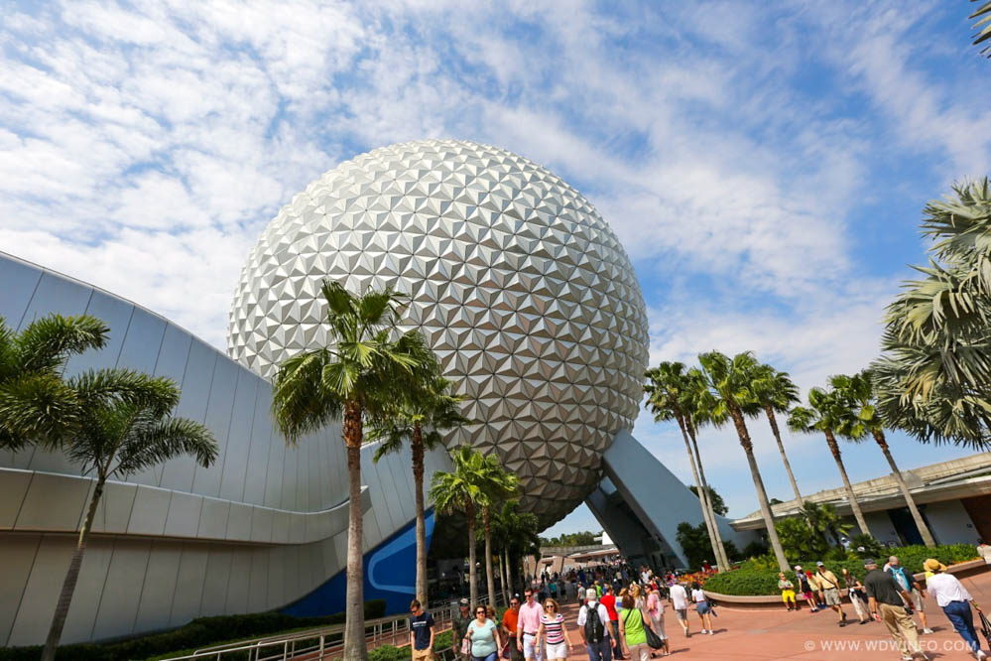
Day3 : Sat 12th July
First full day at Disney
Disney Imagination Campus
Disney’s EPCOT – explore the EPCOT two realms: Future World and World Showcase
Notes:
slip into the role of Disney Imagineer and explore the Maths and Science behind the theme park
EPCOT - Experimental Prototype Community of Tomorrow think the movie TomorrowLand
explore the EPCOT two realms: Future World which features tech innovations and World Showcase which features the culture and cuisine of 11 countries

Slide 5
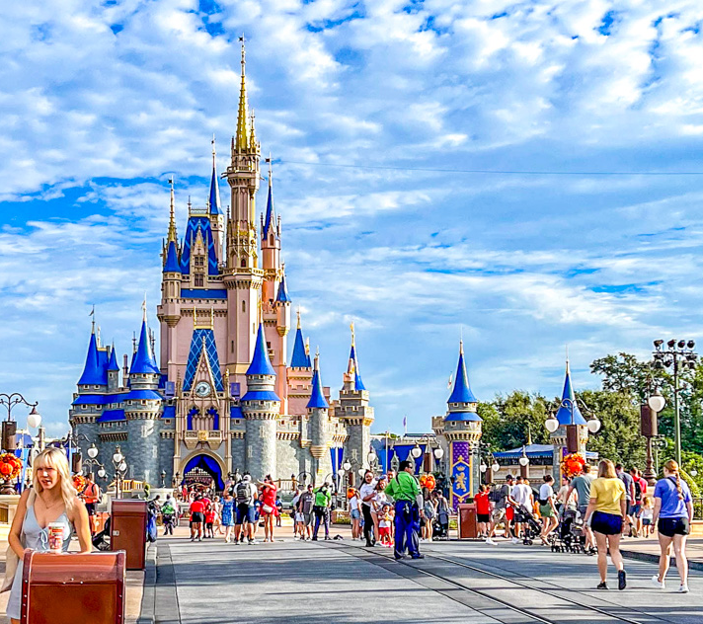
Day4 : Sun 13th July
A full day at Disney’s Magic Kingdom
Notes:
Do I need to say anymore!

Slide 6
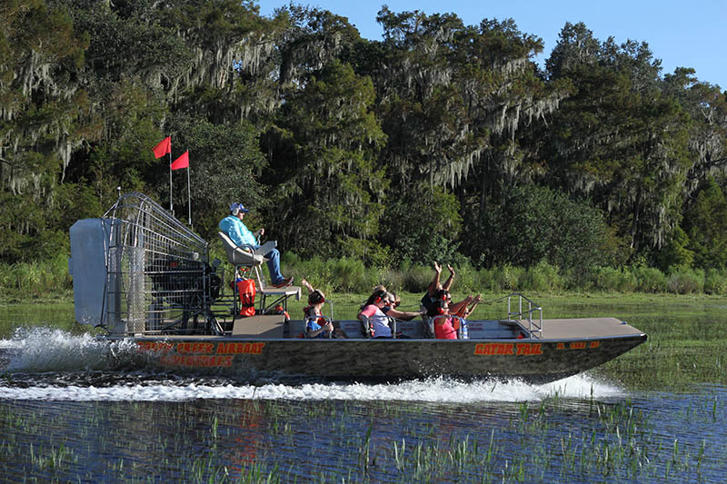
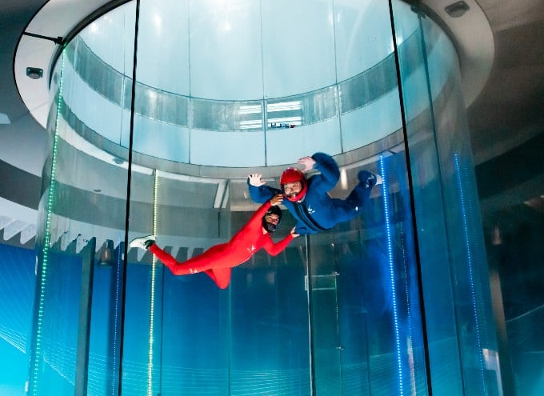
Day5 : Mon 14th July
In the morning, we’ll have a ride in Boggy Creek on an airboat
At lunchtime, you’ll have some free time at Florida Mall
And in the afternoon, you’ll fly in a state-of-the-art wind tunnel at iFly Orlando
Notes:
Boggy Creek – 32 acre nature park
It’s part of the massive Everglades National park which is a wetlands preserve
We’ll take an airboat along a natural canal
See turtles, birds and alligators in their natural habitat

Slide 7
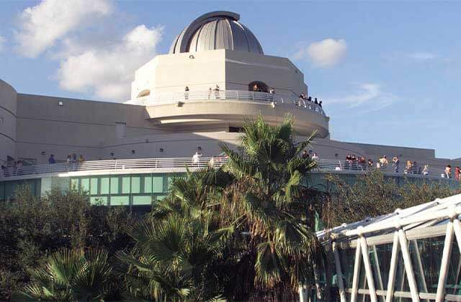
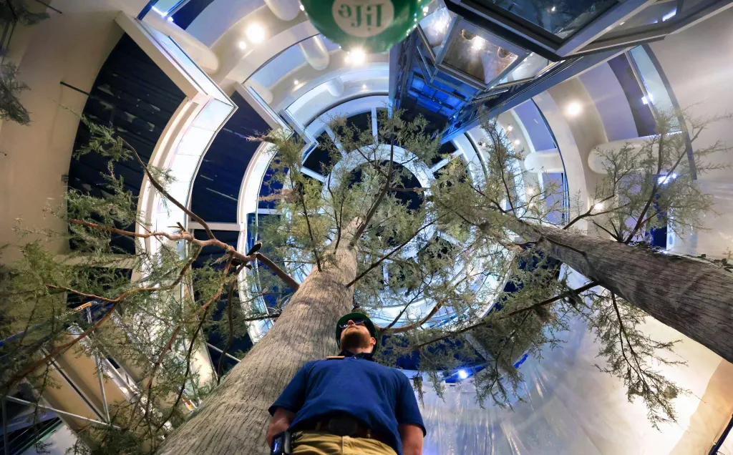
Day6 : Tue 15th July
A visit to Orlando Science Centre
After lunch we head back to Orlando International Airport to catch the flight home
Notes:
Orlando Science Centre – set out over 4 floors with a tree growing through the middle
Lots of exhibits, workshops and live programmes

Slide 8
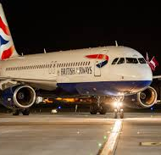
Day7 : Wed 16th July
It is an overnight flight, so we arrive back in the UK at 6.30am on Wednesday
So, you won’t miss out on your last School Walk on the Friday!

Slide 9
How much does it cost?
The best price we have secured so far is approximately £2500 per person
This will be paid in instalments over the months leading up to the trip

