Slide 1
Resources
Worksheets
7Ga6 solid or liquid
h/w recommendation 7Fa4 or 8 waste/ types of rubbish numerical/charts
Practical
7Ga2 see teacher & tech notes
run as a circus
Equipment (per station)
Solids: range of solid materials such as wooden block, iron (metal) block, rock, syringe with solid inside.
Liquids: range of liquids such as water, ethanol, cooking oil, assorted items of glassware (boiling tubes, small beakers, Petri dishes), syringe full of coloured water with sealed end.
Gases: syringe full of air with sealed end, large plastic bag full of air (tied tightly), open bottle of air freshener or perfume.
Teacher Demos

Slide 2
Objectives
Classify materials as solids, liquids and gases.
Record observations and describe simple properties of the three states of matter.
State what is meant by volume.
Appreciate that the properties of waste materials determine their disposal.
Describe the properties of the three states of matter in terms of shape, volume and compressibility.
Explain what a landfill site is and some of the problems they cause.
Appreciate that some substances are difficult to categorise.
© Pearson Education Ltd 2014. Copying permitted for purchasing institution only. This material is not copyright free.

Slide 3
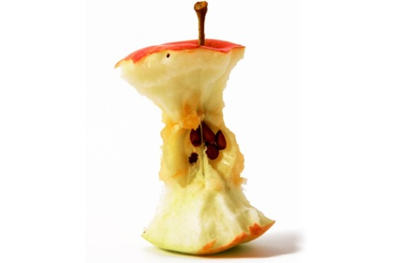
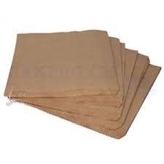
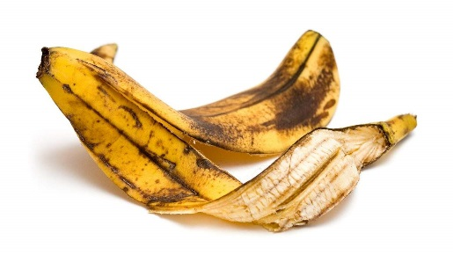
CW
Watch video p106
7Ga Solids, liquids & gases
A paper bag containing an apple core and a banana skin is dropped on the top of Ben Nevis, how fast does each break down?
2 months
Comparing is an important aspect of scientific investigations
1 month
2 years
@hpscience

Slide 4
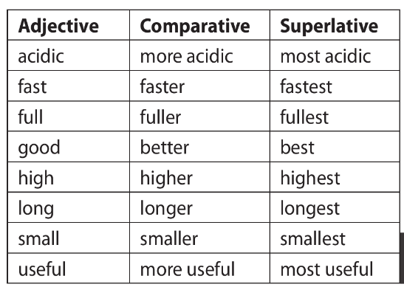
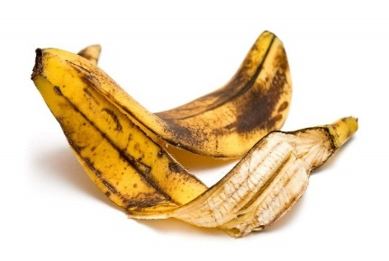
Comparative language
We use an adjective to describe observations or measurements.
Use a comparative adjective for comparing two observations or measurements.
Use a superlative adjective when we have three or more observations or measurements.
What do these words mean?
slow
slower
slowest

Slide 5
What is meant by volume?
Turn you book sideways and draw this table into your books. Use a whole page, make the spacing even.
Object name. | Is the shape fixed or can it change? | Does it flow? | Is it easy to squash? | Can you change its volume? | Does it feel heavy or light? | Solid, Liquid or Gas?
What makes something a solid liquid or gas?

Slide 6
You are going to investigate the properties of solids liquids and gases.
You will have 5 minutes at each table.
Work with the people on your table to help answer the questions.
Pick an object from the selection on your table.
Answer the questions in the table.
Decide if the object is solid, liquid or gas.
Try to observe three objects from each table.

Slide 7
Object name. | Is the shape fixed or can it change? | Does it flow? | Is it easy to squash? | Can you change its volume? | Does it feel heavy or light? | Solid, Liquid or Gas?

Slide 8
Copy and complete the sentences below.
Everything in the world is made of either solid, ______ or gas. These are called the states of_______. Solids are hard to change shape or volume and are ______ dense than both liquids and gas.
Liquids can change ______ and flow, but they cannot be compressed (squashed). They are more dense than gas, but _____ dense than solids.
Gases can______, change shape and be compressed. They are less ______ than solids and liquids.
liquid
matter
more
shape
less
flow
dense
Words to use: Liquid matter more shape less flow dense

Slide 9
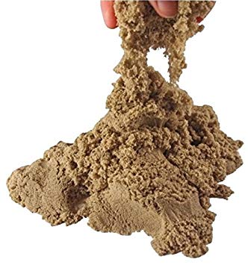
Some things are more difficult to classify
w/s 7Ga 6
1. Write down all the reasons why you might think sand is a solid.
2. Why might we also think that sand is a liquid?
keeps its shape; has a fixed volume; does not flow; is dense
A pile of sand can flow.

Slide 10
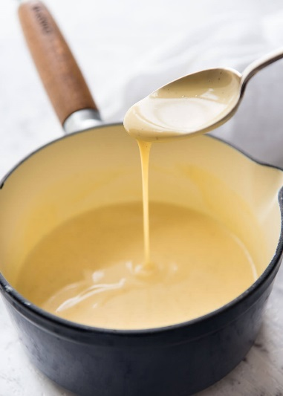
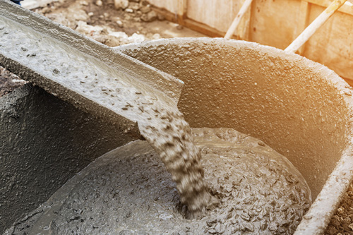
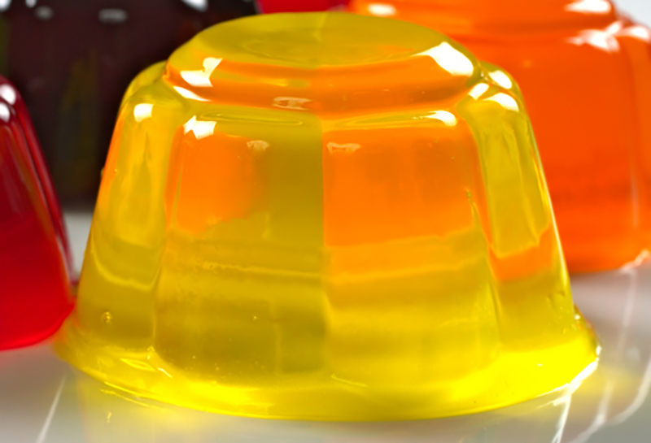
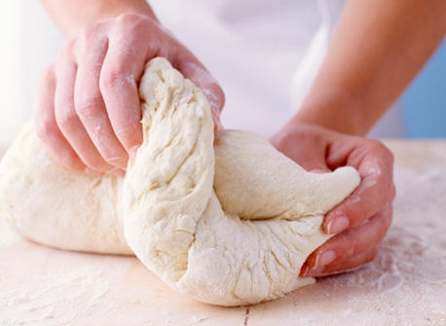

Slide 11
Homework:
7Ga comparative language powerpoint on firefly
w/s 7Ga 4 or 8 – Waste/Types of rubbish numerical & charts
Active learn:
Exercises 7Ga literacy
Exercises 7Ga developing, secure & exceeding
Date due:

Slide 12
Key words

Slide 13
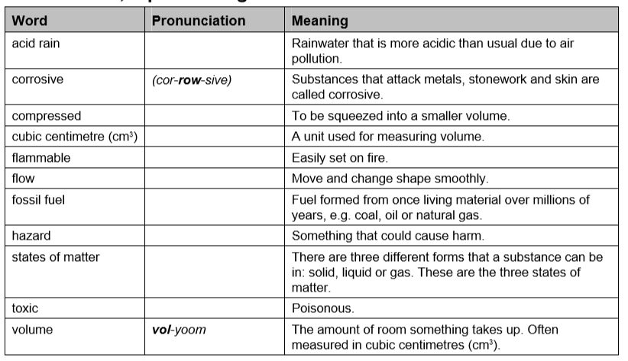
Key words

Slide 14
Think of a Plus, a Minus and an Interesting point about this statement:
All solids should be squashable.
Plus: It would be easier to get things into tight spaces.
Minus: It would be more difficult to walk as the ground would squash under your feet.
Interesting: Would there be less damage in a car accident if solids were squashable?
Possible answers
Next question
© Pearson Education Ltd 2014. Copying permitted for purchasing institution only. This material is not copyright free.

Slide 15
Consider all the possible answers to this statement:
A material is difficult to squash.
Possible answers
Next question

Slide 16
Consider all the possible answers to this statement:
A material is difficult to squash.
It is a solid or a liquid.
Possible answers
Next question
© Pearson Education Ltd 2014. Copying permitted for purchasing institution only. This material is not copyright free.

Slide 17
Which is the odd one out in this list?
Solid Liquid Gas
Possible answers
End show
© Pearson Education Ltd 2014. Copying permitted for purchasing institution only. This material is not copyright free.

Slide 18
Which is the odd one out in this list?
Solid Liquid Gas
Solids are the only substances that cannot flow.
Gases are the only substances that can be compressed.
Possible answers
Back to start
End show
© Pearson Education Ltd 2014. Copying permitted for purchasing institution only. This material is not copyright free.

Slide 19
Objectives
Classify materials as solids, liquids and gases.
Record observations and describe simple properties of the three states of matter.
State what is meant by volume.
Appreciate that the properties of waste materials determine their disposal.
Describe the properties of the three states of matter in terms of shape, volume and compressibility.
Explain what a landfill site is and some of the problems they cause.
Appreciate that some substances are difficult to categorise.
© Pearson Education Ltd 2014. Copying permitted for purchasing institution only. This material is not copyright free.

