Slide 1
8Ed Air Pollution
Copy and fill in the products you know
Reactant | Product | Type of Combustion/Source
Carbon + Oxygen →
Carbon + Oxygen →
Hydrogen + Oxygen →
Carbon + Oxygen →
Sulphur + Oxygen →
Nitrogen + Oxygen →

Slide 2
Requisitions
Equipment | Worksheets
 | 8Ed4

Slide 3
Copy and fill in the products you know
Reactant | Product | Type of Combustion/Source
Carbon + Oxygen →
Carbon + Oxygen →
Hydrogen + Oxygen →
Carbon + Oxygen →
Sulphur + Oxygen →
Nitrogen + Oxygen →
Carbon Dioxide
Carbon Monoxide
Hydrogen Oxide (Water Vapour)
Carbon (soot)
Sulphur Dioxide
Nitrogen Oxide

Slide 4
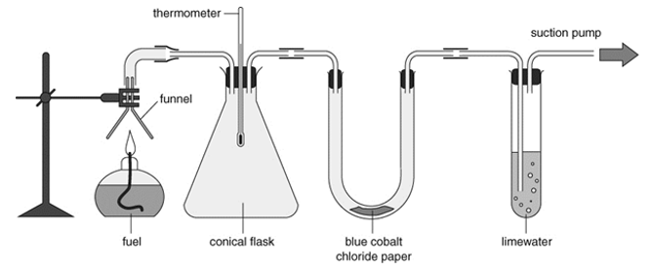
What oxides are produced in a complete combustion of hydrocarbon fuels?

Slide 5
What oxides are produced in a complete combustion of hydrocarbon fuels?
Carbon dioxide
Hydrogen oxide (water vapour)

Slide 6
Copy and fill in the products you know
Reactant | Product | Type of Combustion/Source
Carbon + Oxygen →
Carbon + Oxygen →
Hydrogen + Oxygen →
Carbon + Oxygen →
Sulphur + Oxygen →
Nitrogen + Oxygen →
Carbon Dioxide
Complete
Carbon Monoxide
Hydrogen Oxide (Water Vapour)
Complete
Carbon (soot)
Sulphur Dioxide
Nitrogen Oxide

Slide 7
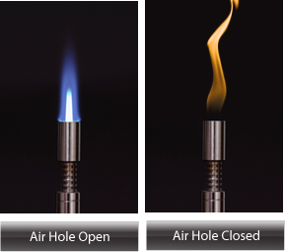
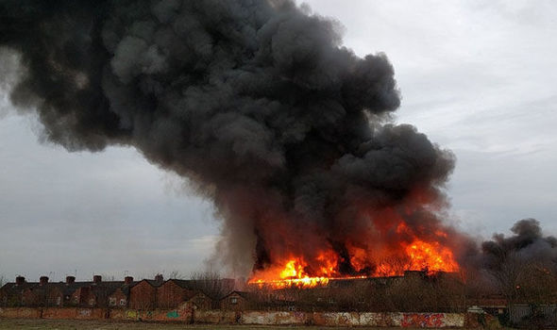
What happens when there is not enough oxygen? Incomplete combustion of hydrocarbon fuels
What causes the smoke to be black?

Slide 8
Copy and fill in the products you know
Reactant | Product | Type of Combustion/Source
Carbon + Oxygen →
Carbon + Oxygen →
Hydrogen + Oxygen →
Carbon + Oxygen →
Sulphur + Oxygen →
Nitrogen + Oxygen →
Carbon Dioxide
Complete
Carbon Monoxide
Incomplete
Hydrogen Oxide (Water Vapour)
Complete
Carbon (soot)
Incomplete
Sulphur Dioxide
Nitrogen Oxide

Slide 9
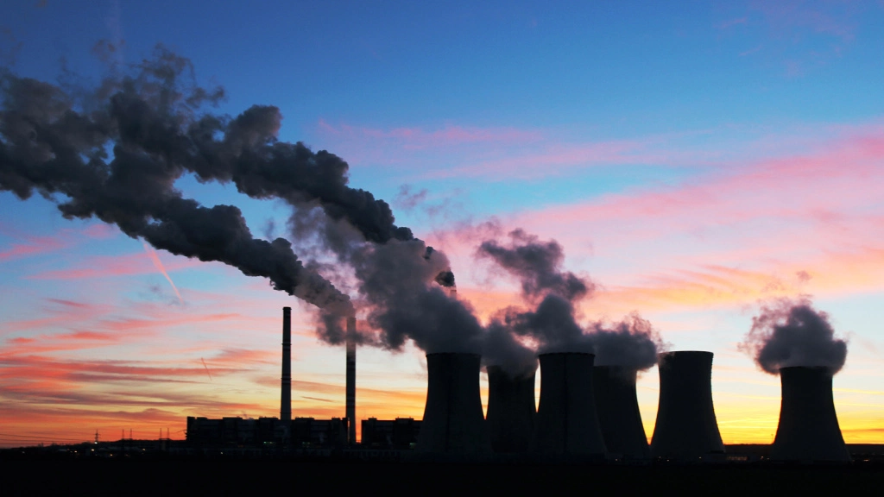
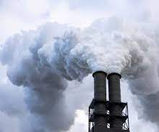
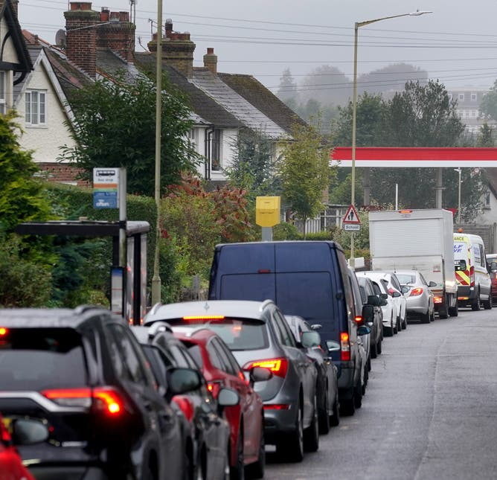
Some fuel contain impurities

Slide 10
Copy and fill in the products you know
Reactant | Product | Type of Combustion/Source
Carbon + Oxygen →
Carbon + Oxygen →
Hydrogen + Oxygen →
Carbon + Oxygen →
Sulphur + Oxygen →
Nitrogen + Oxygen →
Carbon Dioxide
Complete
Carbon Monoxide
Incomplete
Hydrogen Oxide (Water Vapour)
Complete
Carbon (soot)
Incomplete
Sulphur Dioxide
Impurities in fuels
Nitrogen Oxide

Slide 11
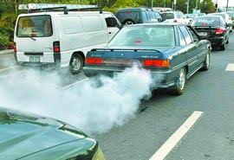
Nitrogen oxides are produces in the high temperatures of an engine
Where does the nitrogen and oxygen come from?

Slide 12
Copy and fill in the products you know
Reactant | Product | Type of Combustion/Source
Carbon + Oxygen →
Carbon + Oxygen →
Hydrogen + Oxygen →
Carbon + Oxygen →
Sulphur + Oxygen →
Nitrogen + Oxygen →
Carbon Dioxide
Complete
Carbon Monoxide
Incomplete
Hydrogen Oxide (Water Vapour)
Complete
Carbon (soot)
Incomplete
Sulphur Dioxide
Impurities in fuels
Nitrogen Oxide
Air in engines

Slide 13
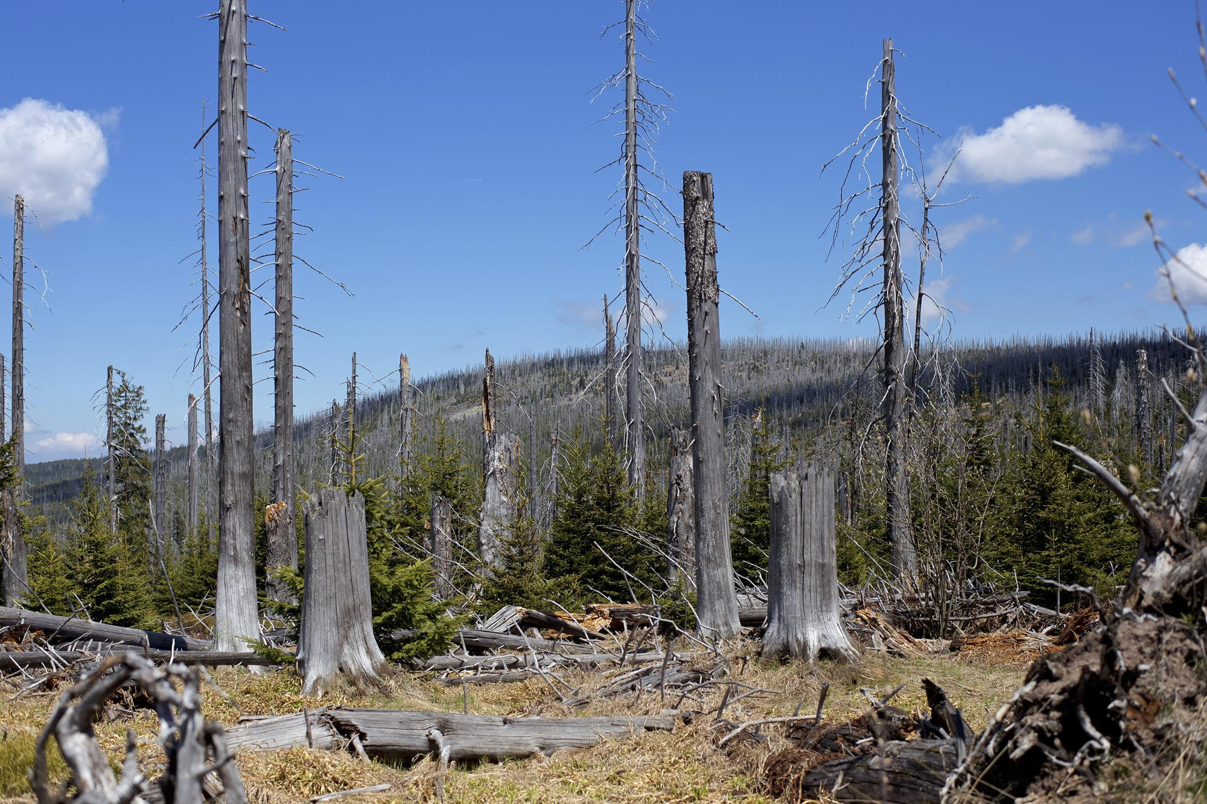
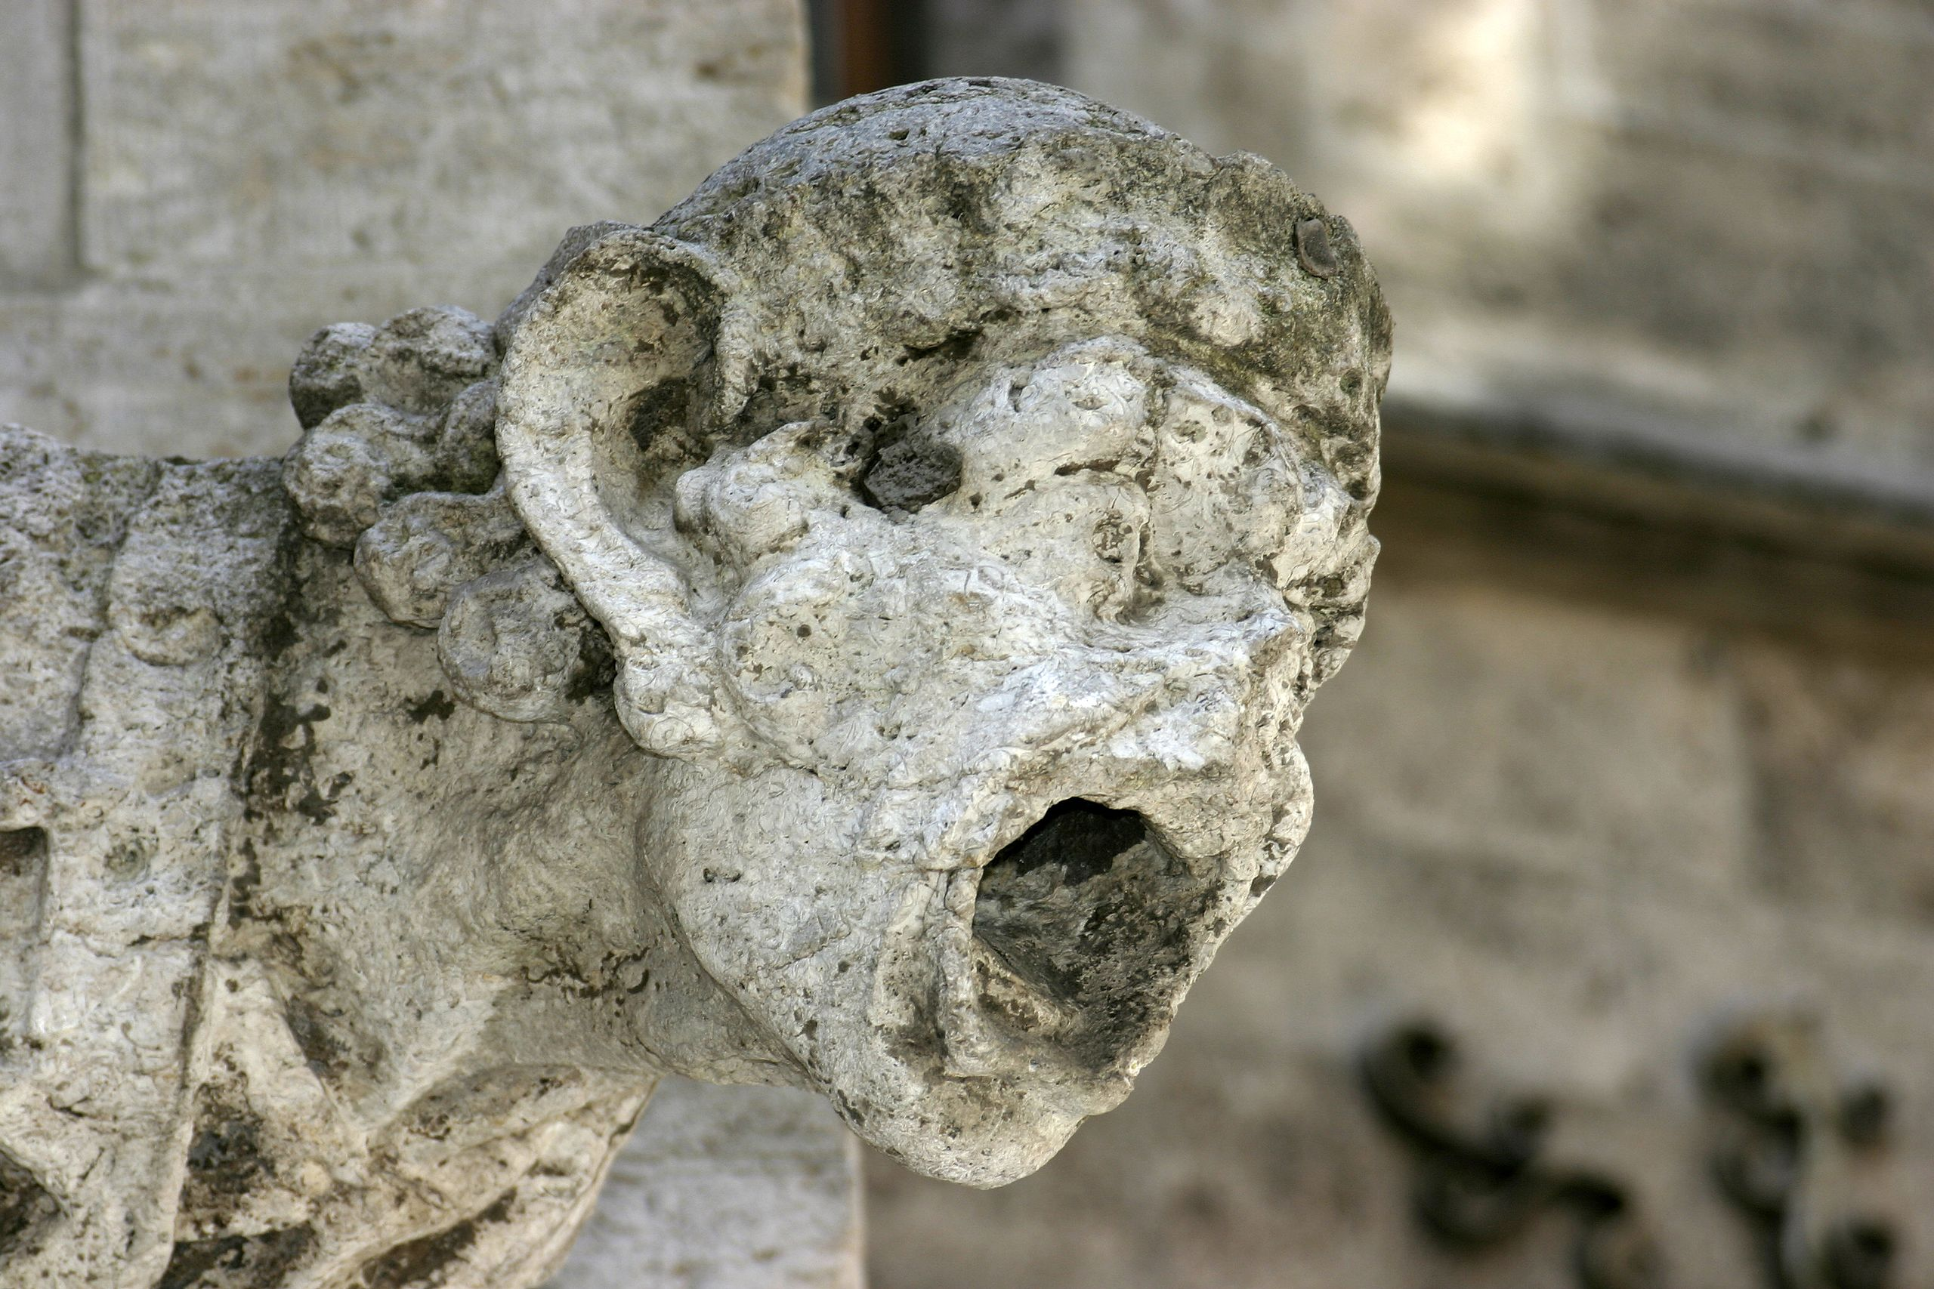
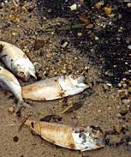
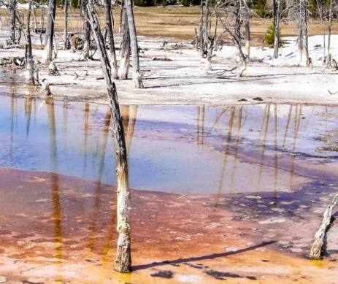
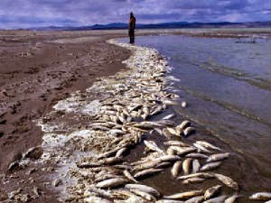
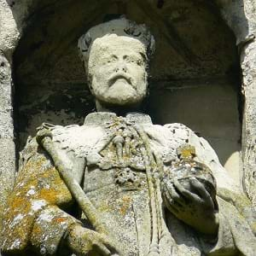
What causes this?

Slide 14
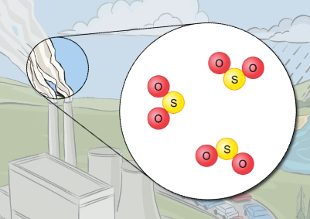
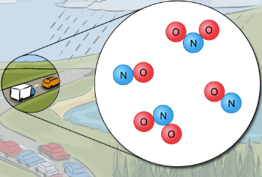
Acid Rain
Write Down
(animation)
Where do the gases come from?
Sulphur dioxide (${SO}_{2}$) is released from power stations and factories
Nitrogen oxide ($NO and {NO}_{2}$) are released from vehicle exhausts

Slide 15
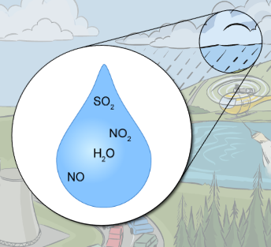
Write Down
How does acid rain form?
Sulphur dioxide and nitrogen oxides react with water vapour in the clouds
Forming sulphuric acid and nitric acid, making the rain acidic

Slide 16
Write Down
What are the problems caused?
In lakes, fish cannot live in water that is too acidic
When soil is too acidic, it can damage trees’ roots
Acid rain can burn leaves and damage buildings

Slide 17
Worksheet 8Ed.4
(video)

Slide 18
A Fish Die in Acidic Lakes | B Acidic gases dissolve in moisture in the air | C Acid rain reacts with chemicals in the soil to release poisonous compounds | D Nitrogen oxides are produced by car engines | E The dissolved gases make rain more acidic
F Acid Rain falls onto the land and runs into lakes and rivers | G Plants become unhealthy | H Acid Rain speeds up the weathering (breaking down) of rocks) | I Burning fossil fuels, such as petrol and diesel, produce carbon dioxide, sulfur dioxide and nitrogen oxides | J Acid rain washes some mineral salts out of the soil

Slide 19
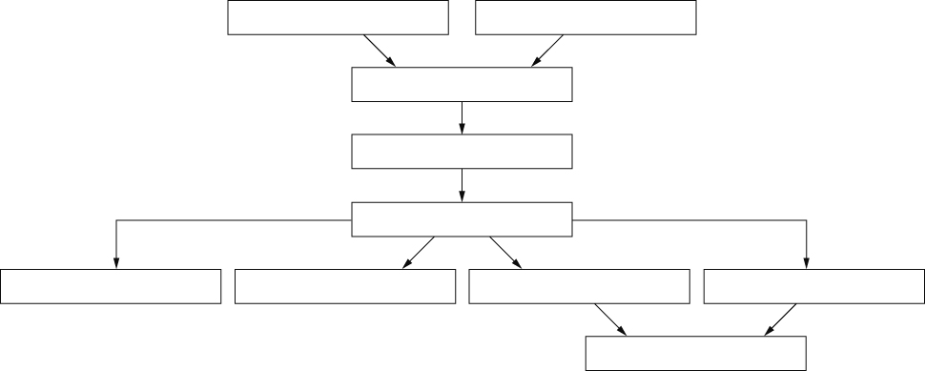
I Burning fossil fuels, such as petrol and diesel, produces carbon dioxide, sulphur dioxide and nitrogen oxides.
D Nitrogen oxides are produced by car engines.
B Acidic gases dissolve in moisture in the air
E The dissolved gases make rain more acidic.
F Acid rain falls onto the land and runs into lakes and rivers.
J Acid rain washes some mineral salts out of the soil.
C Acid rain reacts with chemicals in the soil to release poisonous compounds
A Fish die in acidic lakes.
H Acid rain speeds up the weathering (breaking down) of rocks.
G Plants become unhealthy.

Slide 20
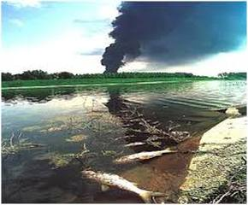
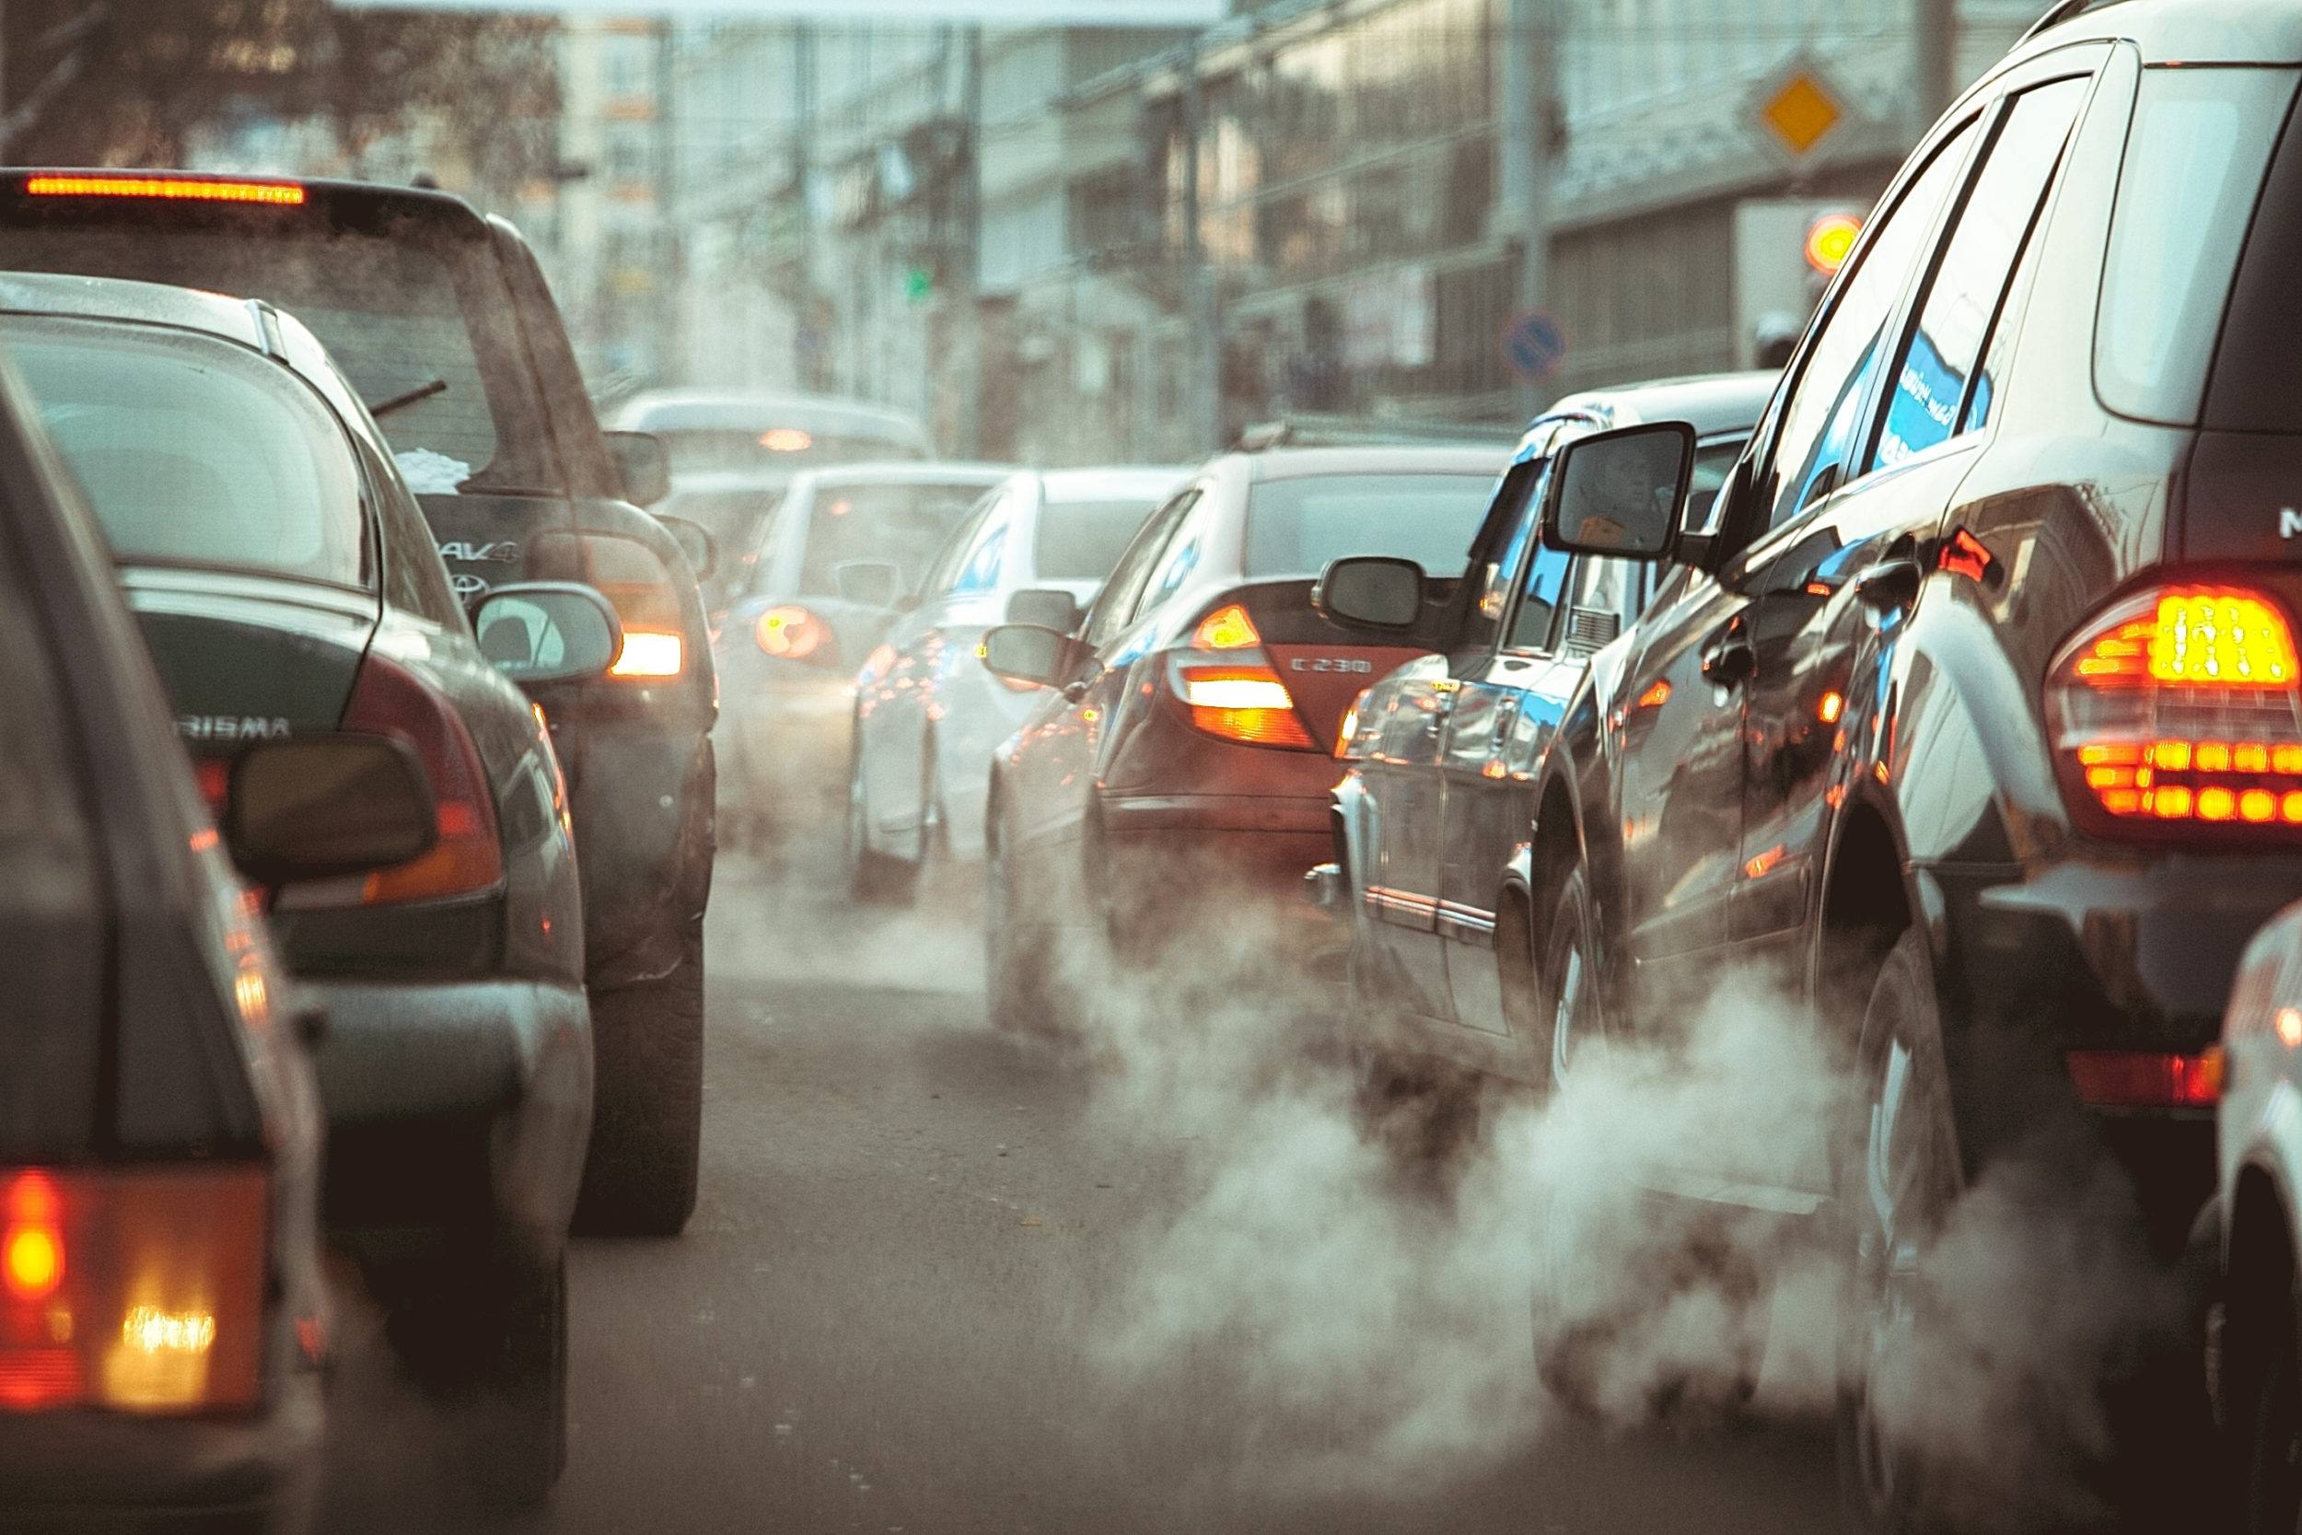
How are pollutants reduced?

Slide 21
Reducing Pollution
Modern cars have a catalytic converter to change polluting gas and a filter to remove carbon particles (soot).
It converts harmful gases into less harmful ones.

Slide 22
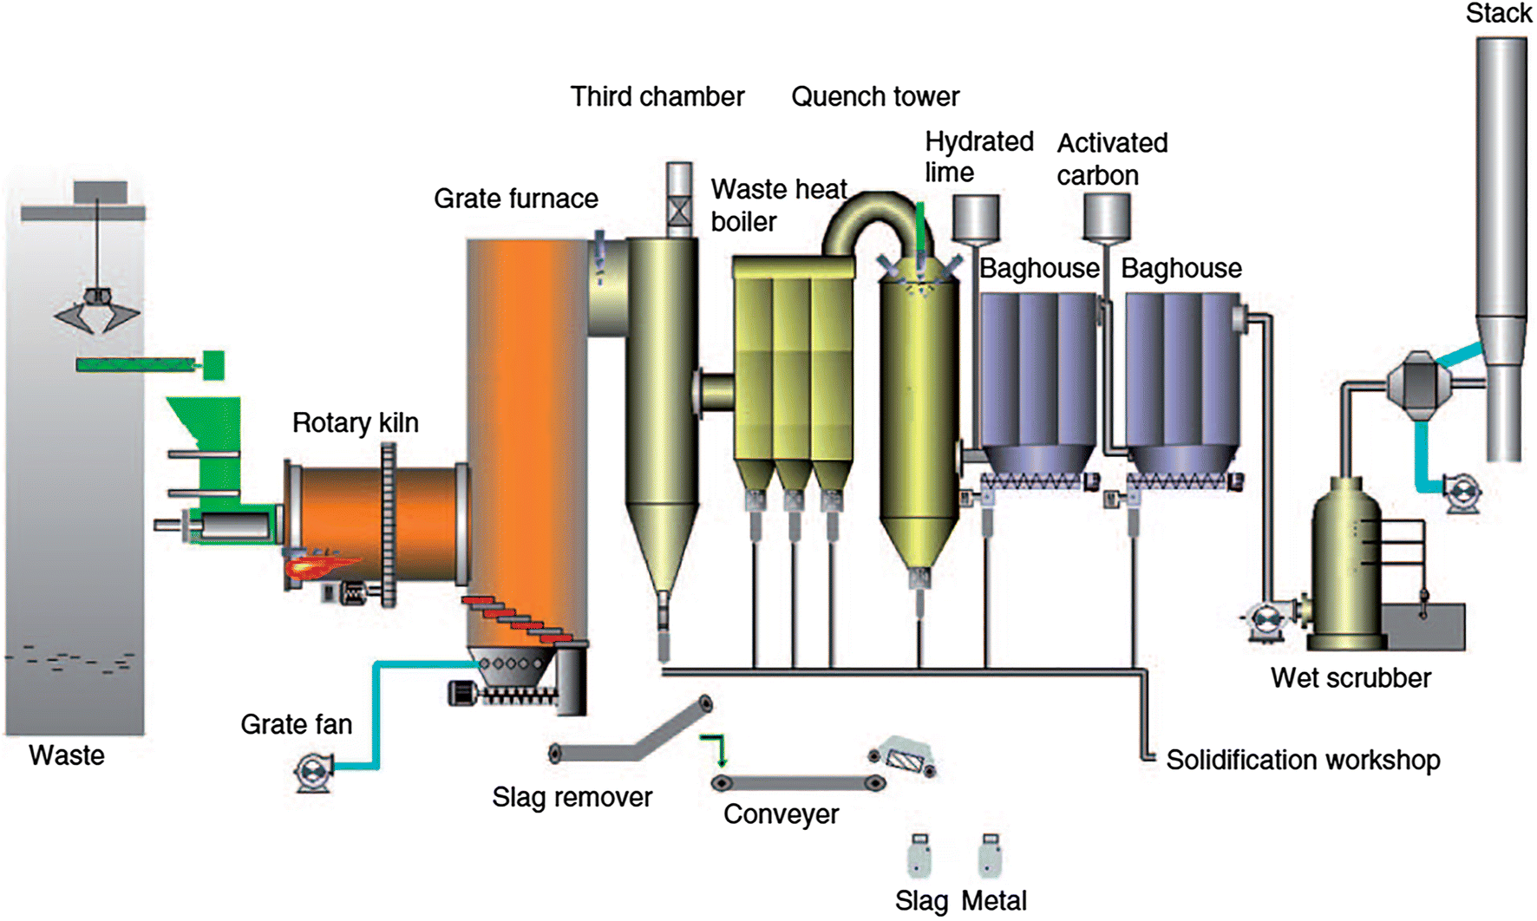
Neutralisation reactions are used to remove the acidic gases from chimney smoke.

Slide 23
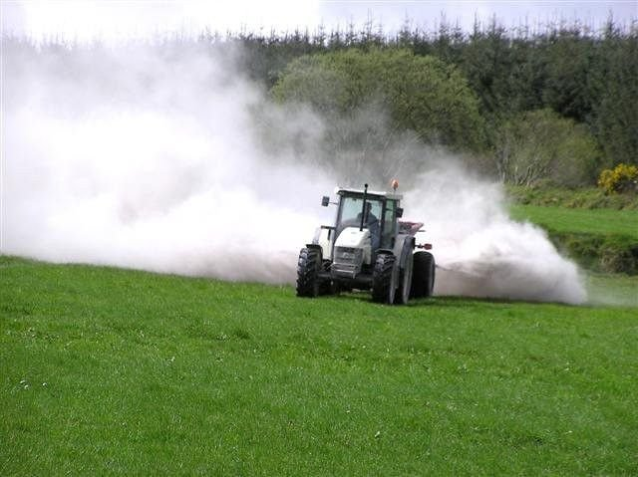
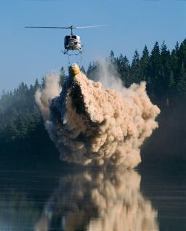
Write Down
How can we reduce the problem?
Neutralise the acidic gases and soil using limestone
Use a catalytic converter to remove harmful gases

Slide 24
Alkali substances such as calcium carbonate (lime) are used to neutralise acidic soil and waterways.

