Slide 1
8Ec2 Fire Safety
Do Now:
1.What are the three things needed for fire? 2.Name three methods of putting out a fire

Slide 2
Requisitions
Equipment | Worksheets
Fire Extinguisher DEMO Comparing Fuels PRACT | Safety Symbols Fire Triangles

Slide 3
Safety Symbols
What do these hazard symbols mean?

Slide 4
Safety Symbols
What do these hazard symbols mean?
Flammable Oxidising Explosive
Easily bursts into flame releases oxygen contains stored energy

Slide 5
What is required to keep a fire going?

Slide 6
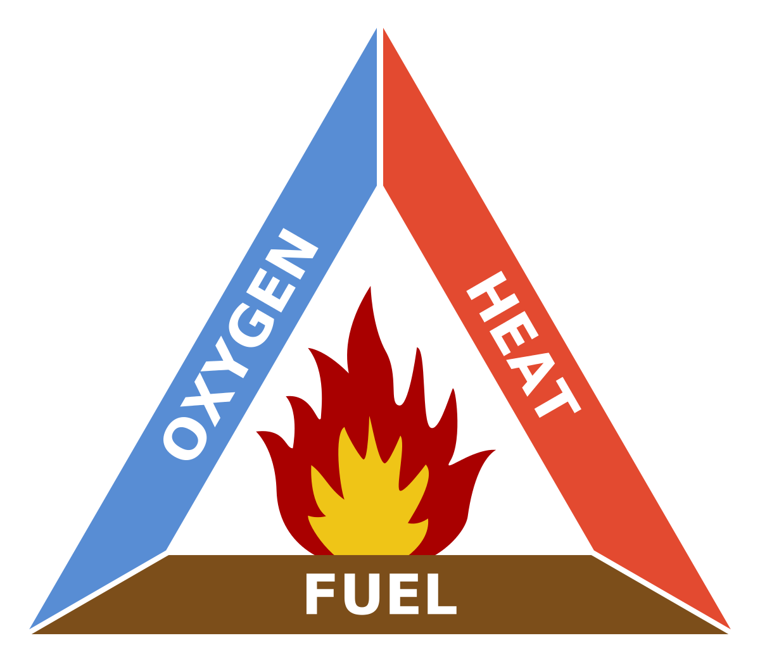
Fire Triangle
What is required to keep a fire going?
Fuel
Oxygen
Heat

Slide 7
The gas in the air that is needed for things to burn
Energy needed to start a fire
A water extinguisher cools the fire and takes this away
Taken away if you smoother a fire with a fire blanket
A substance that contains a store of energy
Cutting down trees in a forest takes this away

Slide 8
How should you put out the following fires: 1. Electrical Fire 2. Wood Fire 3. Grease Fire

Slide 9
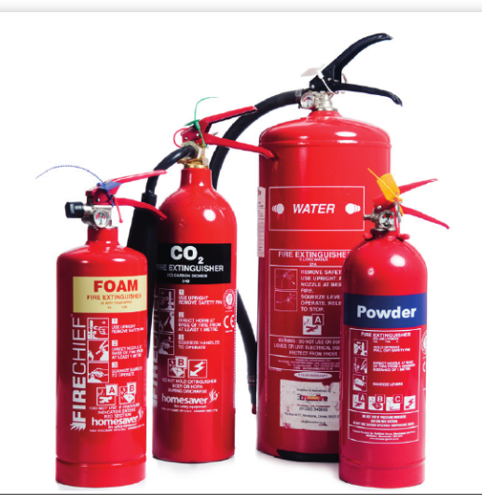
Fire Extinguishers
Why should a water extinguisher not be used on:
An oil fire?
An electrical fire?

Slide 10
Combustion
Combustion is an exothermic reaction.
Exothermic reactions release energy that we can feel as heat.
This release of energy will increase the temperature of the surroundings.
Different fuels release different amounts of energy.

Slide 11
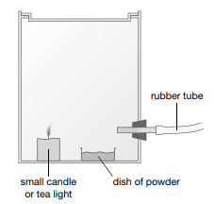
Demonstration
Watch the following demo and take notes on what you observe.

Slide 12
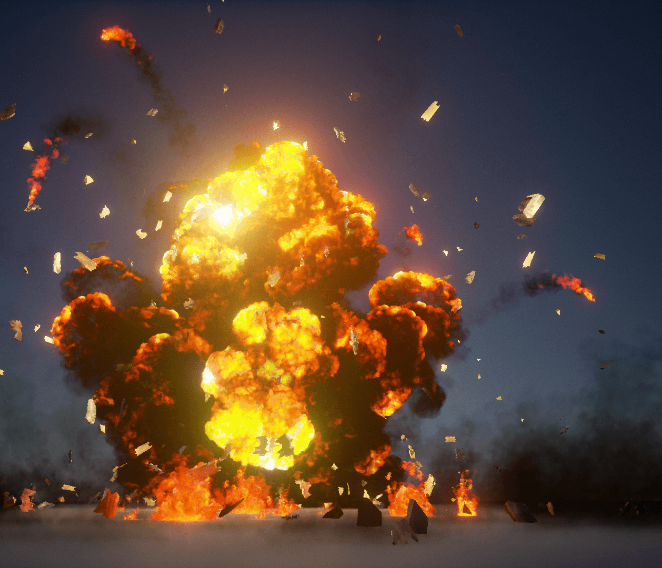
Explosions
An Explosion is a rapid increase in volume and release of energy in an extreme manner, usually with the generation of high temperatures and the release of gases.

Slide 13
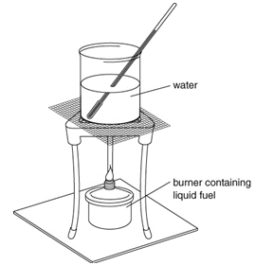
8Ec.3 Comparing Fuels
What investigation could we carry out to compare 4 different fuels using the equipment shown?
Write a method and draw a results table before starting your experiment.
Draw a conclusion from your results.

Slide 14
Fuel | Initial Mass | Final Mass | Change in Mass | Burning Time | Initial Temperature | Final Temperature | Temperature Change

Slide 15
1. What is the independent and dependant variable?
2. How is the dependant variable related to the energy released?
3. For each variable (mass of water, volume of beaker, mass of fuel, time allowed to burn, height of beaker) consider
a)how it might affect the results
b)whether it needs to be controlled
c) how it should be controlled
4. Suggest other variables and how they should be controlled

