Slide 1
Objectives
Give examples of where distillation is used.
Describe how distillation can separate mixtures.
Explain how distillation works.
Identify factors that could affect distillation.
Explain how fractional distillation is used in making perfumes.

Slide 2
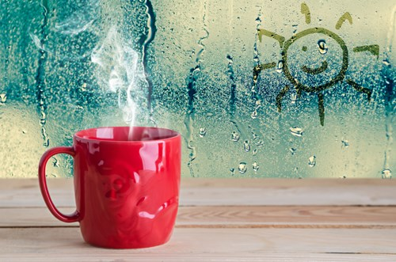
CW
7Ee distillation
What happens to steam when it is cooled? What is this called?
@hpscience
Notes:
condensation

Slide 3
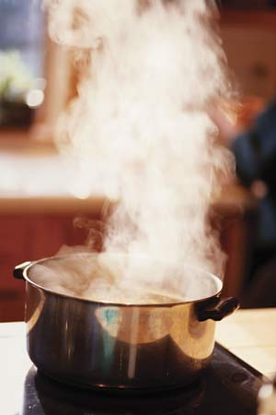
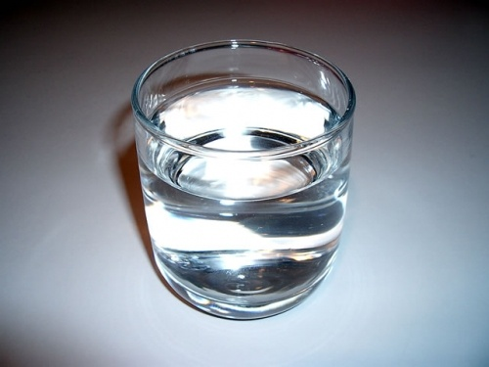
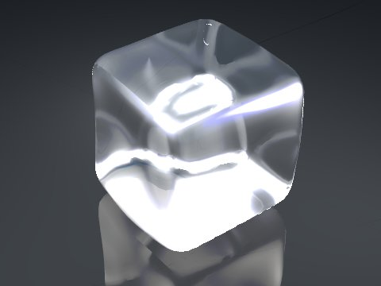
gas
Condensing
Boiling or evaporation
cool down
Heat up
liquid
Melting
Freezing
cool down
Heat up
solid
Notes:
3

Slide 4
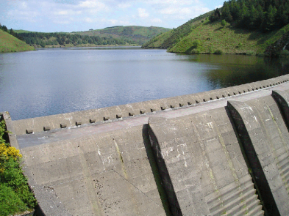
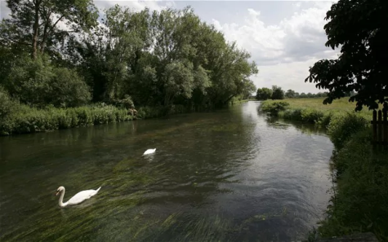
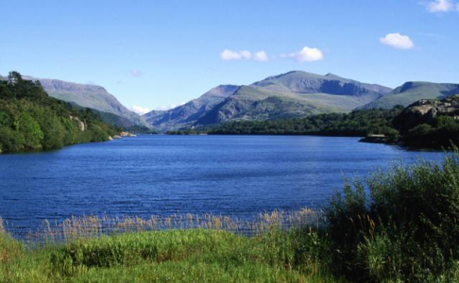
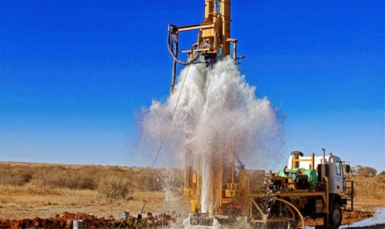
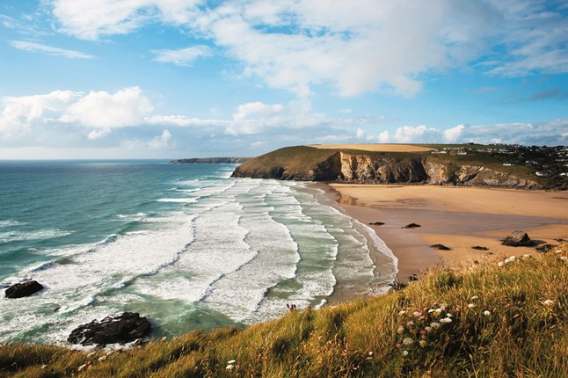
Where does our drinking water come from?
Drinking water can come from:
Reservoirs
Rivers
Lakes
Aquifers (rocks containing water)
The sea

Slide 5
Answer the questions in full sentences
What does desalination mean?
It removes salt from sea water.
Why are desalination plants usually built next to the sea?
They use sea water to produce fresh water by desalination

Slide 6
How can we make sea water drinkable?
steam
Seawater is heated so the water evaporates to form ___________.
The steam is collected and __________ so that it ____________ back into liquid water.
This leaves us with ________ water, as the solutes in the sea cannot evaporate and are left behind.
cooled
condenses
pure

Slide 7
Distillation demo

Slide 8
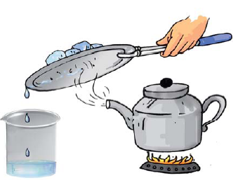
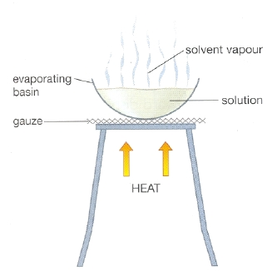
Demo evaporation of salt water
Combining evaporation & condensation together in this way is called distillation

Slide 9
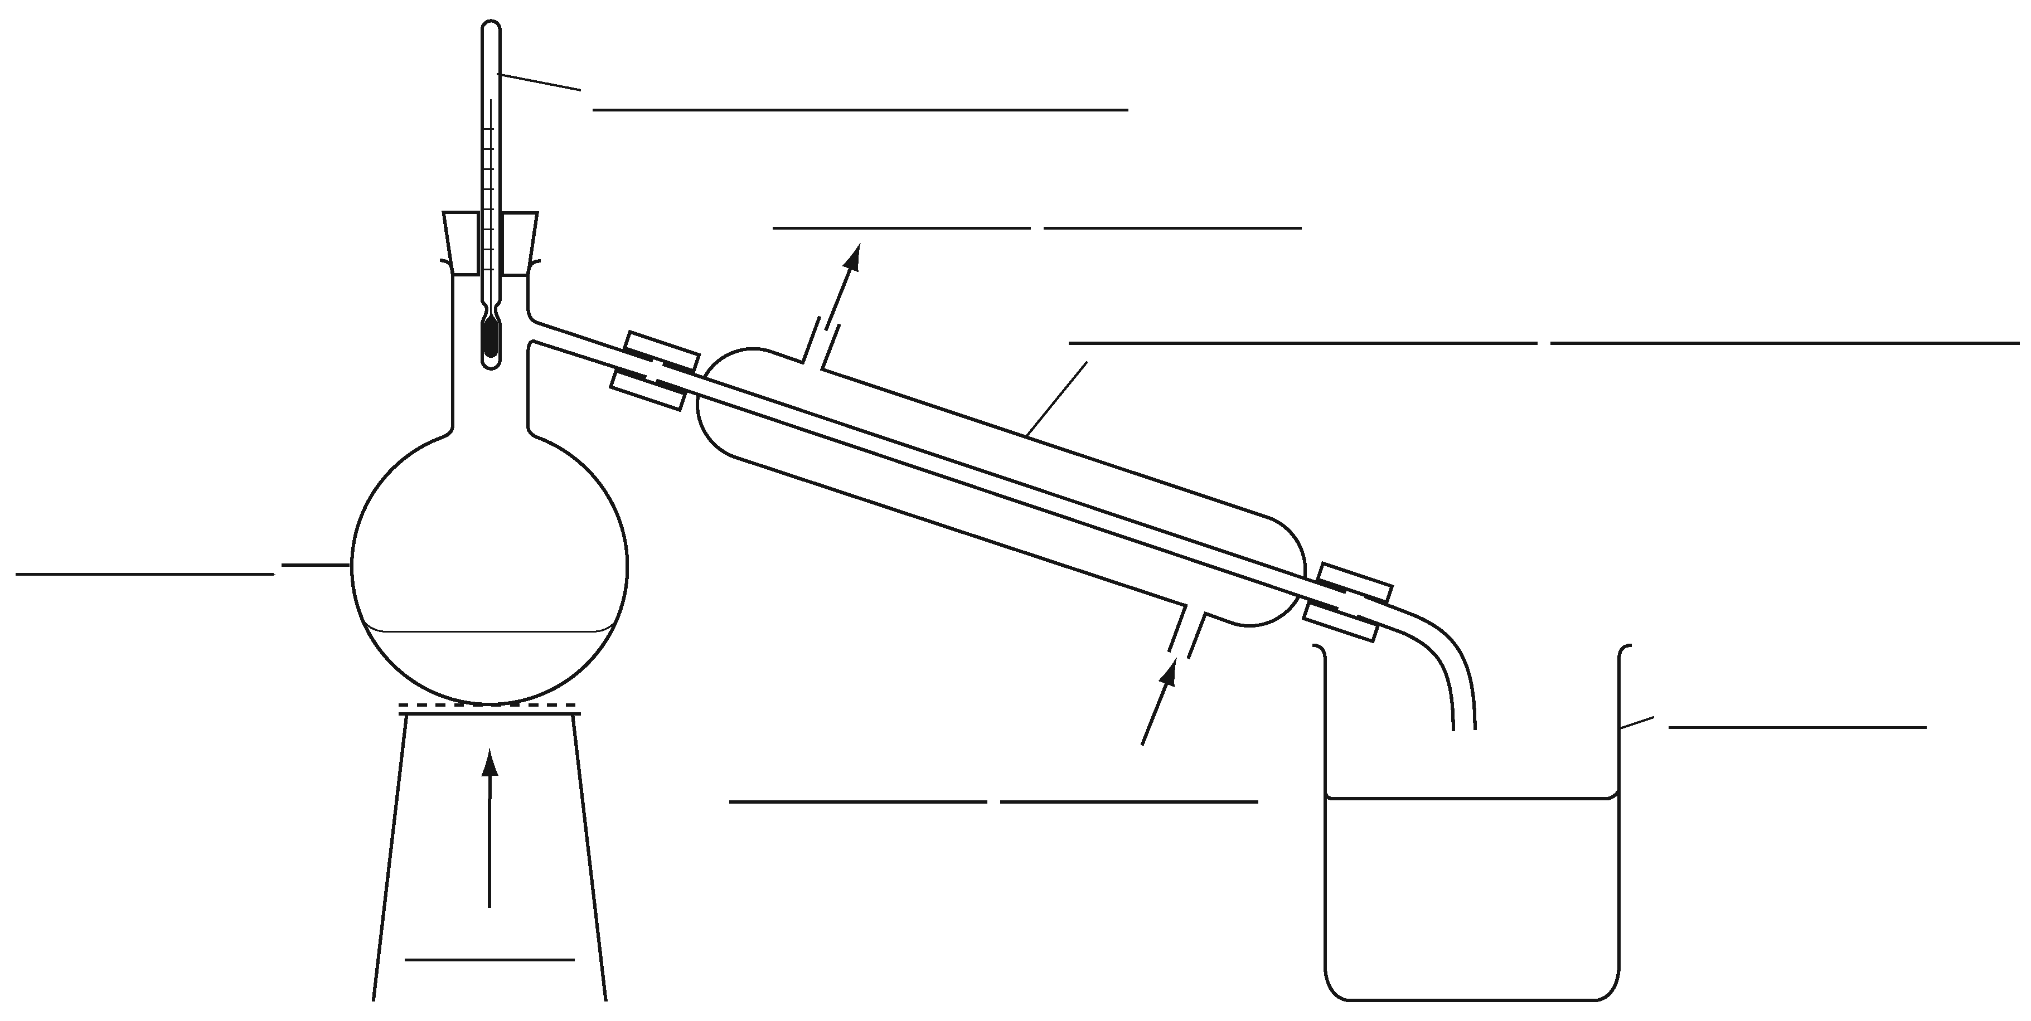
We use evaporation & condensation together when we distil impure water
Look at w/s 7Ee(1). This shows the distillation of a ink & water mix.
The mixture of ink and w___ is put into the flask.
The mixture is h_____.
The water e_______ and forms steam. The ink does not evaporate
The steam goes into the condenser.
The cold water flowing around the outside of the c________ cools the steam.
The steam condenses to form p____ w_____.
The water runs into the b______.

Slide 10
We use evaporation & condensation together when we distil impure water
Look at w/s 7Ee(1). This shows the distillation of a ink & water mix.
The mixture of ink and water is put into the flask.
The mixture is heated.
The water evaporates and forms steam. The ink does not evaporate.
The steam goes into the condenser.
The cold water flowing around the outside of the condenses cools the steam.
The steam condenses to form pure water.
The water runs into the beaker.

Slide 11
Can you describe what’s happening in this diagram?

Slide 13
Write out the questions leaving a couple of lines between each one. Answer the questions while Watching this video
Questions
What state of matter (solid, liquid or gas) were the substances that were trying to be separated?
What property allowed the substances to be separated?
What type of special distillation is normally used to is this situation?
Notes:
https://www.youtube.com/watch?v=V5ep0-ojPGw

Slide 14
Questions
What state of matter (solid, liquid or gas) were the substances that were trying to be separated?
liquids.
What property allowed the substances to be separated?
The liquids had different boiling points.
What type of special distillation is normally used to is this situation?
Fractional distillation.
Notes:
https://www.youtube.com/watch?v=V5ep0-ojPGw

