Slide 1
Institutional racism in businesses

Slide 2
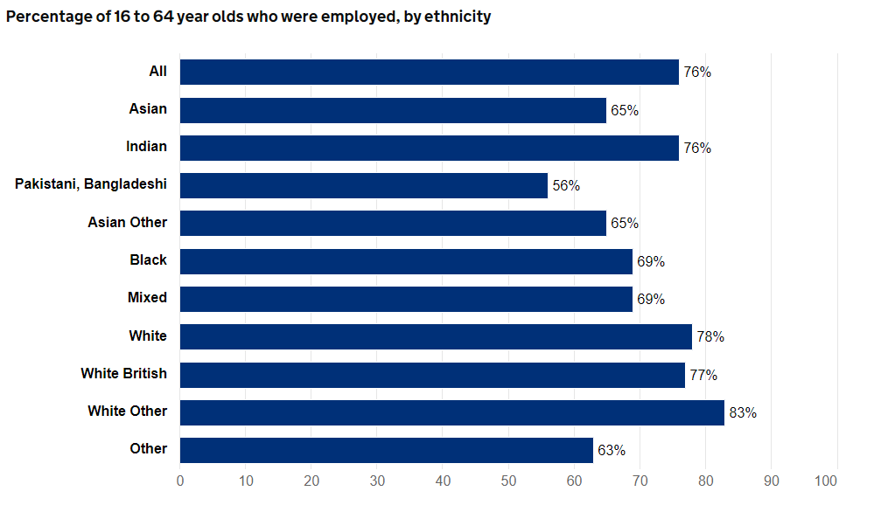
How does institutional racism feed into employment practices?
Structural racism operates at the societal level and is the power used by the dominant group to provide members of the group with advantages, while disadvantaging the nondominant group. The dominant group uses structural racism not only to obtain resources, such as employment and wages, but also to limit the nondominant group's access to these resources.
During the Jim Crow era, structural racism sponsored by the federal and state governments explicitly created advantages for Caucasians and disadvantages for African Americans. Structural racism still exists after the Jim Crow era.
The pre-pandemic employment rate for White British was 77% in 2019. The rate for people from the Indian ethnic group was just lower, at 76%, while most other minority groups had a lower employment rate: 69% for Black people and 56% for people in the combined Pakistani and Bangladeshi ethnic group.
- A third of non-white workers reported that they had been bullied and/or subjected to insensitive questioning - Almost 15% of women and 8% of men stated that racial discrimination had caused them to leave their job - 28% of participants who reported experiencing racism at work reported having to take a period of sick leave - Part time or non-permanent employees were more likely to report racial harassment and discrimination

Slide 3
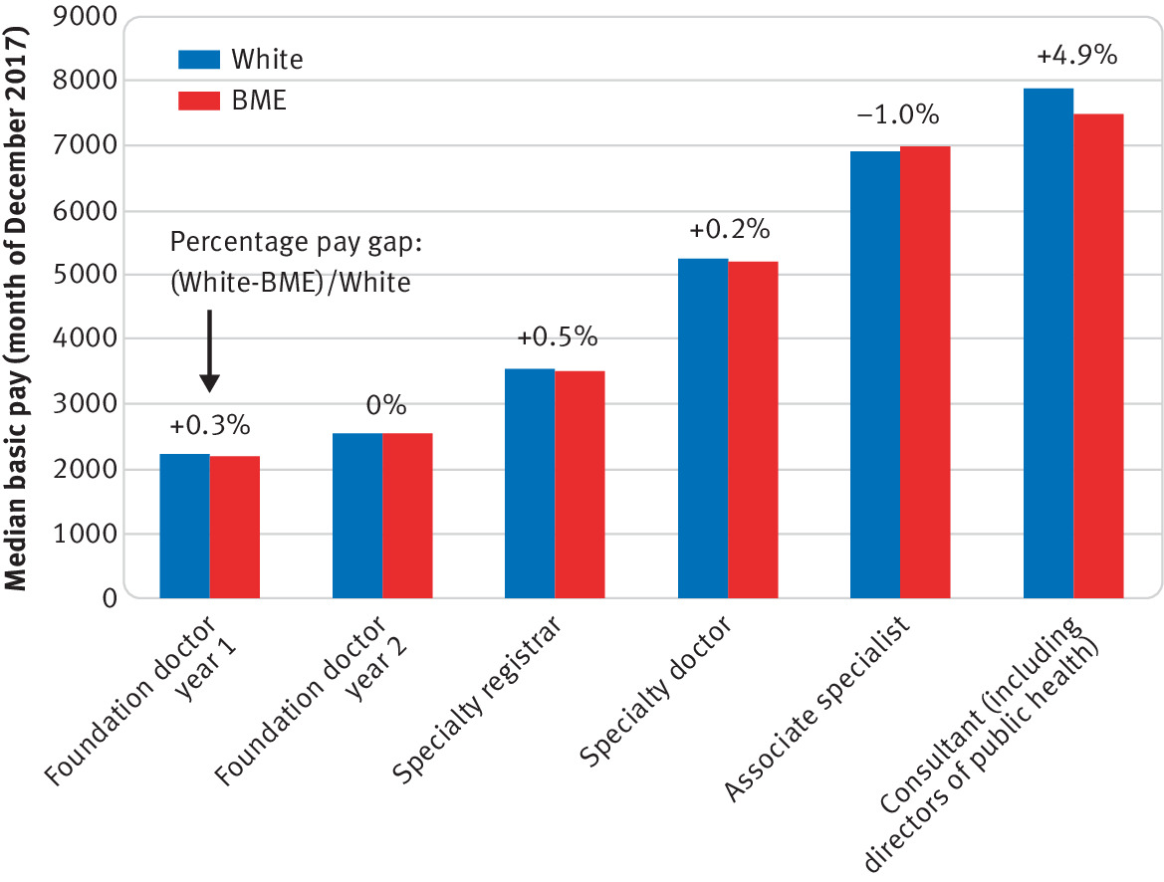
What is the ethnicity pay gap?
Ethnic Pay gap among NHS Doctors:
The ethnicity pay gap is the difference between average hourly pay rates for black, Asian and minority ethic (BAME) employees compared to white colleagues.
In May 2020:
only staff from the Black ethnic group had lower monthly basic pay than White staff – Black men were paid 84p for every £1 paid to White men, and Black women were paid 93p for every £1 paid to White women
monthly basic pay for medical staff was highest for the White ethnic group (£6,329 for men and £5,580 for women) and was lowest for the Black ethnic group (£5,041 for men and £4,465 for women)

Slide 4
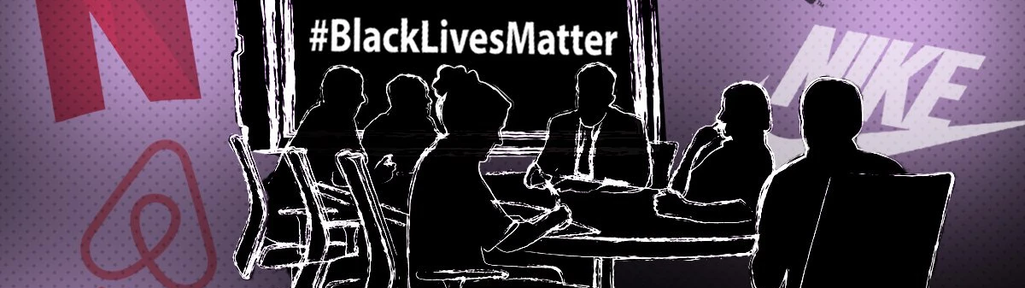
How did companies respond back to the BLM movement?
The Quaker Oats Company, a subsidiary of PepsiCo, announced it was ending its Aunt Jemima breakfast foods brand.
PepsiCo also announced a five-year, $400 million initiative that includes the goal of increasing Black managerial representation by 30% and more than doubling business with Black-owned suppliers.
PayPal is committing $530 million to supporting Black-owned and minority-owned businesses in the U.S., as well as bolstering its internal diversity and inclusion practices

