Slide 1
CODE TITLE PAGE LESSONS
8C Breathing and respiration
8Ca Aerobic respiration 38 1
8Cb Gas exchange system 40 2
8Cb Means and ranges (WS) 42 3
8Cc Getting oxygen 44 4
8Cc Cause and effect (L&C) 46 5
8Cd Comparing gas exchange 48 6
8Ce Anaerobic respiration 50 7

Slide 2
Developing
* Identify and recall the main organs in the human gaseous exchange system.
* Correctly use the terms: breathing, breathing rate, ventilation, inhalation, exhalation.
* Describe the functions of the organs in the human gaseous exchange system and what happens during gas exchange.
* Describe how muscles attached to ribs and the diaphragm produce breathing movements and use a model to explain how lungs expand and contract.
* Describe the structure of the lungs.
* Explain how diffusion occurs in terms of movement of particles.
Securing
* Use a pressure model to explain ventilation.
* Explain how specialised cells keep the lungs clean (mucus production and ciliated epithelial cells).
* Explain how the lungs are adapted for efficient gas exchange.
Exceeding
* Explain how and why a concentration gradient is maintained for oxygen and carbon dioxide between the blood and lungs.
Working Scientifically
* Identify the ranges of readings in data.
* Explain why data with a small range is of good quality.
* Calculate means and explain their use.
* Identify anomalous results in data.

Slide 3
8Ca: Aerobic Respiration
Objectives
-Recall what happens in aerobic respiration.
-Explain how aerobic respiration can change the surroundings.
-Compare burning (combustion) and respiration.
-Describe ways in which respiration can be detected (limewater, hydrogen carbonate indicator, heat).

Slide 4
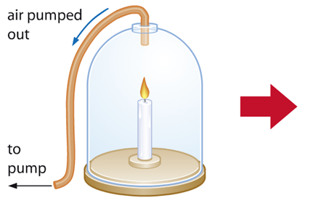
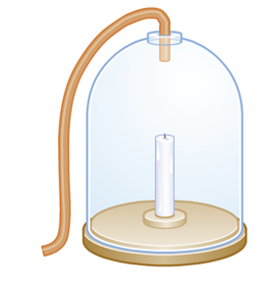
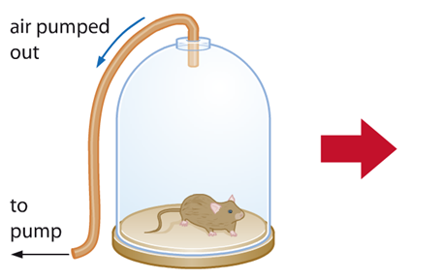
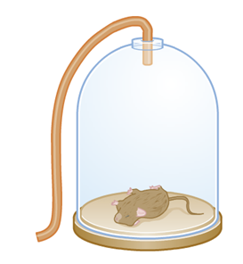
C/W
Aerobic Respiration
18/01/2019
A scientist called Robert Boyle conducted experiments to find out what happens to things with no air supply.
What happens next?
Did the candle go out and mouse die due to a lack of ‘air’?

Slide 5
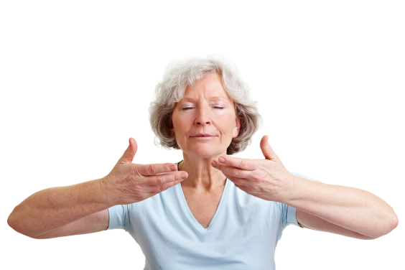
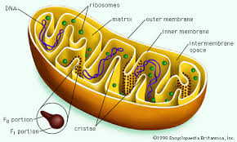
Copy and complete the word fill below.
Breathing is the mechanical action of getting a___ in and out of the l_____.
Respiration is a chemical reaction that releasese_____, so we can function. It happens in cells.
energy
air
lungs
So why did the mouse in the jar die?
Notes:
Class Q - Does anyone recognise the mitochondria

Slide 7
Aerobic Respiration
We need food and oxygen to make energy.
Imagine you are eating a piece of bread and breathing in oxygen…
1.Describe the path of your bread (digestive system).
2. Describe the path of your oxygen (breathing system).
3. How do they meet? (circulatory system, body cells).

Slide 8
Body parts involved in getting & using energy.

Slide 9
Copy and complete the word fill below.
The body needs a constant supply of _______ which comes from digested food.
Glucose, from digested ___________, is an important substance that contains stored ________ energy.
In the body’s cells, glucose and ______ react to release energy. Some of this is released as _____ and the rest is used by the cells.
energy
carbohydrates
chemical
oxygen
heat
oxygen chemical heat energy carbohydrates

Slide 10
Respiration Detection
The air we breathe out is called exhaled air. It is different to inhaled air (air breathed in).
Exhaled air contains;
more c_____ d______
less o______
more water vapour.
arbon
ioxide
xygen
armer
Exhaled air is also w______ and cleaner.

Slide 11
Limewater Test
What kind of gas do we breath out? How can we prove this?
Practical
1. Put a small amount of Limewater in a boiling tube.
2. Use a straw to slowly breath out into the limewater.
What happened to the Limewater? What does this prove?
Hint: Limewater becomes cloudy when it mixes with carbon dioxide.

Slide 12
Cobalt Chloride Paper Test
Breath onto Cobalt Chloride paper.
What happens to the Cobalt Chloride paper?
What does this tell you about your breath?
You can also try breathing onto a mirror so see water droplets.
Pink
Breath contains water.

Slide 13
Other Tests to Detect Respiration

Slide 14
Hydrogen Carbon Indicator Test
Practical
1. Put a small amount of hydrogen carbon indicator in a boiling tube.
2. Use a straw to slowly breath out into the hydrogen carbon indicator.
What happened to the colour? What does this prove?
Hint: hydrogen carbon indicator becomes yellow with carbon dioxide.

Slide 15
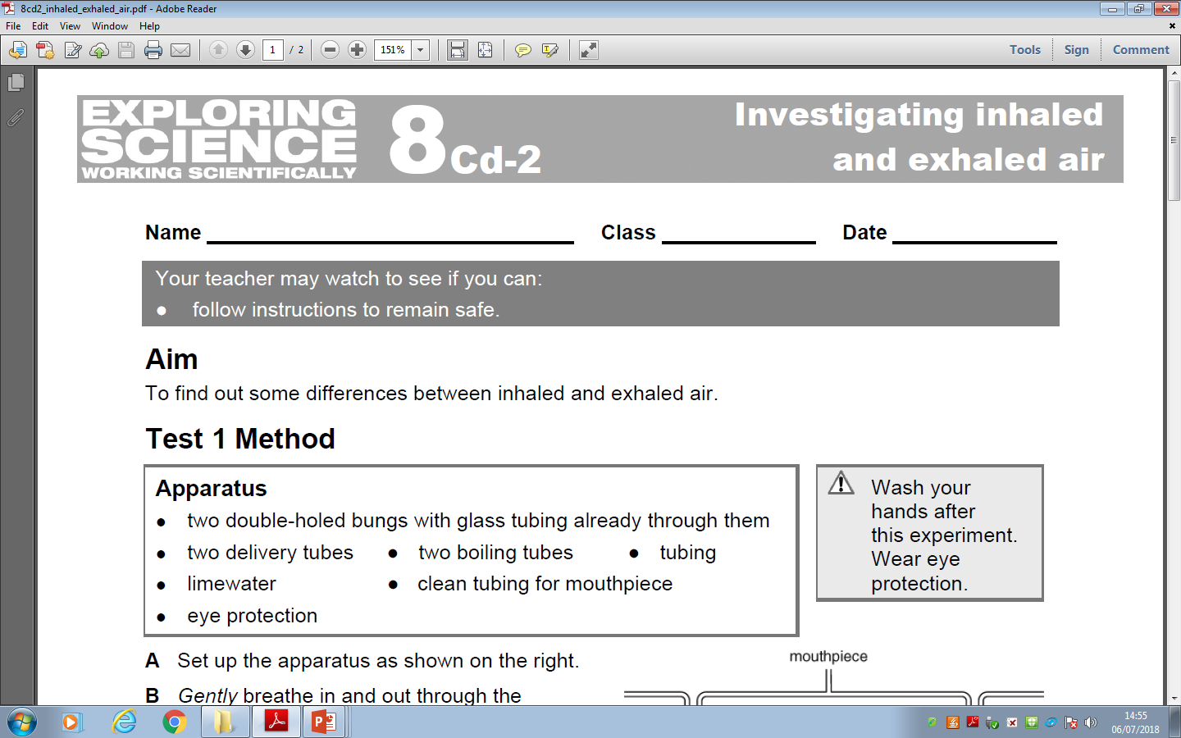

Slide 16
The equation for aerobic respiration

Slide 17
Respiration and combustion
Burning is the reaction between a fuel and oxygen. This reaction is called combustion:
fuel
+
oxygen
➔
carbon dioxide
+
water
During combustion, heat and light energy are released and carbon dioxide and water are also produced, so combustion is similar to respiration.
Respiration is a controlled reaction that slowly releases energy from food in the body’s cells and the cells do not catch fire!

Slide 18
Respiration and combustion

Slide 19
Answer

Slide 20
Optional Practical
Using a peak flow meter
1) Measure your peak flow and your height.
2) Work out if there is a correlation between the two using class data.

