Slide 1
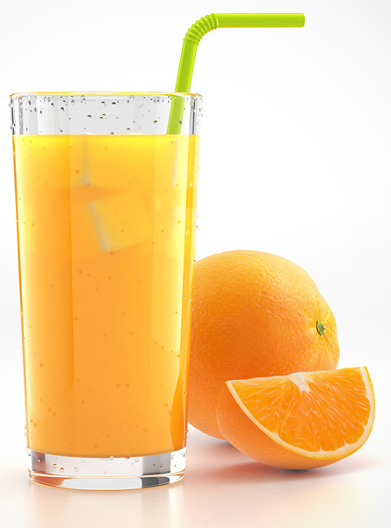
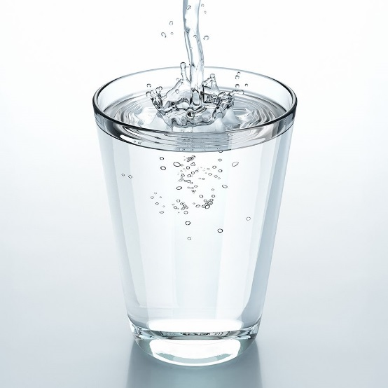
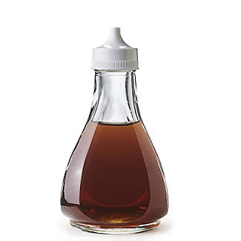
7Fd: Neutralisation
Do Now:
Which is the odd one out and why?

Slide 2
What happens when you mix an acid and an alkali?

Slide 3
What happens when you mix an acid and an alkali?
Write Down
Neutralisation

Slide 4
Write Down
In chemical reactions reactants change into products
Reactants Products
Acid + Alkali Salt + Water
Notes:
Demo any metal reacting with acid.

Slide 5
Write Down
Neutralisation produces substances called s______.
hydrochloric acid produces chloride salts.
sulphuric acid produces sulfate salts.
nitric acid produces nitrate salts.

Slide 6
Practical: Neutralisation
Health and Safety
Must wear goggles.
Acids and Alkalis are corrosive therefore must be handled with safely and sensibly.
Anyone messing will be banned from doing practicals for this unit.

Slide 7
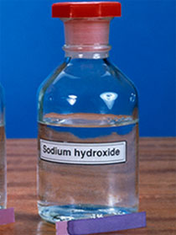
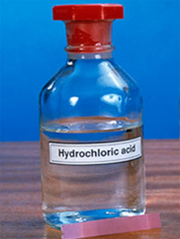
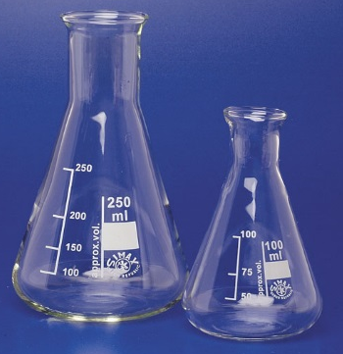
Equipment
Conical flask
pipette
Universal indicator
Sodium hydroxide
Hydrochloric acid
beakers

Slide 8
Table of Results
Write Down
Volume of Sodium Hydroxide Added (${cm}^{3}$) | Colour of Indicator

Slide 9
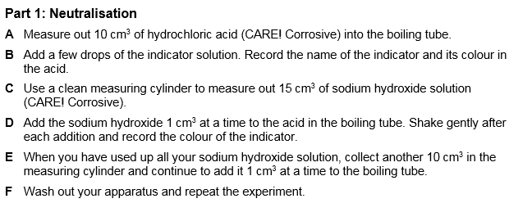
Method
1
2
3
4
5
6
7
8
9
10
11
12
13
14
strong acid
neutral
strong alkali

Slide 10
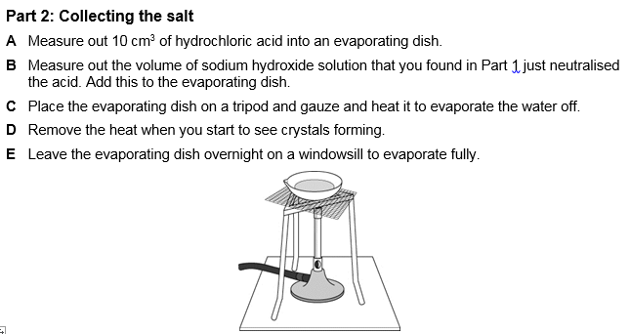
Method

Slide 11
Answer the following questions in full sentences
You poured in 10cm³ of hydrochloric acid in your conical flask. How much alkali do you need to add to make the acid neutral?
You have 25cm³ of sodium hydroxide (alkali). How much acid do you need to add to make the alkali neutral?
1
2
3
4
5
6
7
8
9
10
11
12
13
14
strong acid
neutral
strong alkali

Slide 12
Practical: Neutralisation
Health and Safety
Must wear goggles.
Acids and Alkalis are corrosive therefore must be handled with safely and sensibly.
Anyone messing will be banned from doing practicals for this unit.

Slide 13
Equipment
Conical flask
pipette
Universal indicator
Sodium hydroxide
Hydrochloric acid
beakers

Slide 14
Class Challenge
Organise yourselves to produce 14 flasks, one for each colour on the pH scale. Work as a team and help each other out!
1
2
3
4
5
6
7
8
9
10
11
12
13
14
strong acid
neutral
strong alkali

Slide 15
Quick Quiz
Write Down
Write 1 – 5 in the margin of your book
1.
2.
3.
4.
5.
Watch the video and take notes – you will have a quiz based on the video

Slide 16
Quick Quiz
What is a base? Is it an acid or alkali?
When you react an acid with a alkali what is this chemical reaction called?
Can you name an everyday example of neutralisation?
Your stomach contains hydrochloric acid. What pH is this?
In every neutralisation reaction, an acid and a base combine to form……………..

Slide 17
Quick Quiz
Alkali
Neutralisation
When indigestion tablets are taken to neutralise stomach acid
pH 2 or pH 1
Salt and Water

Slide 19
Write Down
In chemical reactions reactants change into products
Reactants Products
Metals + Acid Salt + Hydrogen gas
Notes:
Demo any metal reacting with acid.

Slide 22
Notes:
7Fd6

