Slide 1
7Fd3 prac

Slide 2
Objectives
Recall that acids react with alkalis and this is called neutralisation.
Explain how chemical reactions are different to physical changes.
Interpret a word equation to identify the products and reactants in a chemical reaction.
Recall some applications of neutralisation (changing the pH of soils).
Supply missing reactants or products to complete a word equation.
Model simple reactions using word equations.
Describe the reactions of acids with alkalis (including the salts produced by hydrochloric, sulfuric and nitric acids).
Explain how everyday examples of neutralisation are useful (changing the pH of soils).
Apply ideas about the pH scale to explain the changes that take place on neutralisation and dilution.
Plot and interpret graphs of pH against volume of acid or alkali added in a neutralisation reaction.

Slide 3
CW
7Fd neutralisation
Which one is
the odd one
out and why?
@hpscience

Slide 4
What happens when you mix an acid and an alkali?
Neutralisation!

Slide 5
Practical – Neutralisation
Risk Assessment and Health and Safety
Must wear goggles.
Acids and Alkalis are corrosive therefore must be handled with safely and sensibly.
You will be working in groups of 3.
Anyone seen misbehaving will be sent out and banned from doing practicals for this unit!!

Slide 6
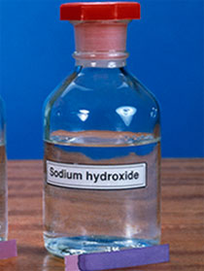
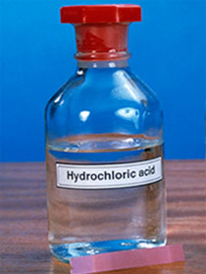
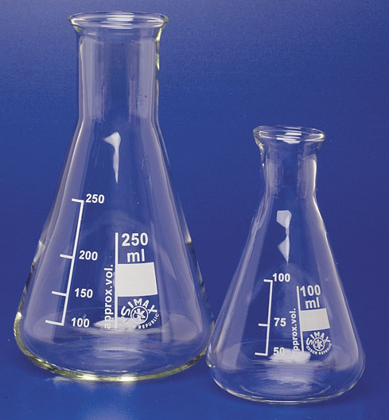
Equipment
Universal indicator
Sodium hydroxide
Hydrochloric acid
pipette
beakers
Conical flask
Notes:
Teacher make this into a quick question and answer activity, for assessment. Good for low ability students.

Slide 7
Copy the table

Slide 8
7Fd3 prac

Slide 9
Practical – Neutralisation
Method
Part 1: Neutralisation
A Measure out 10 cm3 of hydrochloric acid (CARE! Corrosive) into the boiling tube.
B Add a few drops of the indicator solution. Record the name of the indicator and its colour in
the acid.
C Use a clean measuring cylinder to measure out 15 cm3 of sodium hydroxide solution
(CARE! Corrosive).
D Add the sodium hydroxide 1 cm3 at a time to the acid in the boiling tube. Shake gently after
each addition and record the colour of the indicator.
E When you have used up all your sodium hydroxide solution collect another 10 cm3 in the
measuring cylinder and continue to add it 1 cm3 at a time to the boiling tube.
F Wash out your apparatus and repeat the experiment.
1
2
3
4
5
6
7
8
9
10
11
12
13
14
Don’t mix up the pipettes!
strong acid
neutral
strong alkali

Slide 10
Part 2

Slide 11
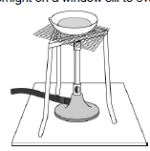
Practical – Neutralisation
Part 2: Collecting the salt
A Measure out 10 cm3 of hydrochloric acid into an evaporating dish.
B Measure out the volume of sodium hydroxide solution that you found in Part 1 just neutralised
the acid. Add this to the evaporating dish.
C Place the evaporating dish on a tripod and gauze and heat it to evaporate the water off.
D Remove the heat when you start to see crystals forming.
E Leave the evaporating dish overnight on a window sill to evaporate fully.

Slide 13
 Answer these questions in full sentences?
Method
1
2
3
4
5
6
7
8
9
10
11
12
13
14
strong acid
neutral
strong alkali
You poured in 10cm³ of hydrochloric acid in your conical flask.
How much alkali do you need to add to make the acid neutral?
2. You have 25cm³ of sodium hydroxide (alkali).
How much acid do you need to add to make the alkali neutral?

Slide 15
CW
7Fd neutralisation
Starter:
Which pH values indicate an acidic soil?
Which pH values indicate an alkaline soil?
Which plants grow well in a neutral soil?
@hpscience

Slide 16
Practical – Neutralisation
Risk Assessment and Health and Safety
Must wear goggles.
Acids and Alkalis are corrosive therefore must be handled with safely and sensibly.
You will be working in groups of 3.
Anyone seen misbehaving will be sent out and banned from doing practicals for this unit!!

Slide 17
Equipment
Universal indicator
Sodium hydroxide
Hydrochloric acid
pipette
beakers
Conical flask
Notes:
Teacher make this into a quick question and answer activity, for assessment. Good for low ability students.

Slide 18
Can we get all 14 colours on the pH scale?
Class challenge:
Organise yourselves to produce 14 flasks, one for each colour on the pH scale. Work as a team & help each other out!
1
2
3
4
5
6
7
8
9
10
11
12
13
14
strong acid
neutral
strong alkali

Slide 19
Quick Quiz
 Write 1-5 down the margin in your book
1.
2.
3.
4.
5.
Watch the video, as you are listening write notes. You will have a quick quiz based on the video.
Notes:
https://www.twig-world.com/film/acids-and-alkalis-part-1-1456/

Slide 20
Quick Quiz
What is a base? Is it an acid or alkali?
When you react an acid with a alkali what is this chemical reaction called?
Can you name an everyday example of neutralisation?
Your stomach contains hydrochloric acid. What pH is this?
In every neutralisation reaction, an acid and a base combine to form……………..
Alkali
Neutralisation
When indigestion tablets are taken to neutralise stomach acid.
pH 2 or pH 1
Salt + water

Slide 21
Neutralisation produces substances called s______.
hydrochloric acid produces chloride salts.
sulphuric acid produces sulfate salts.
nitric acid produces nitrate salts.

Slide 22
In chemical reactions:
Reactants change into products
Watch the demo and try and write down the reactants and products
(Mg + HCl)
Reactants Products
Metals + Acid Salt + Hydrogen gas
Notes:
Demo any metal reacting with acid.

Slide 23
Odd-one-out
Notes:
7Fa Getting a reaction

