Slide 1
C/W
15/09/2020
8Ia2 Density
Density is a way of saying how much mass there is in a certain volume.
Where is the density of something important?
$$ρ=\frac{m}{V}$$
m
ρ
V
Units for density: kg/m³ or g/cm³.

Slide 2
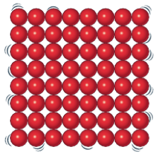
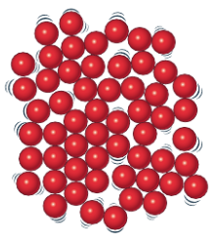
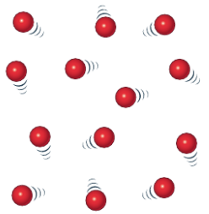
Which has the higher density, and why?
solid
liquid
gas
If I heat a solid what happens to it’s density?

Slide 3
My Learning Journey……
Completed
Developing | Securing | Working Scientifically
Describe how to measure the mass and volume of regular and irregular objects.
Explain how density depends on mass and volume.
State what is meant by density and recall is units and the factors affecting it.
Using the particle model describe how the density of a substance changes with temperature
Change the subject of a formula.

Slide 4
Copy the notes and discuss in pairs what method you would use.
Density Investigation
Aim
To investigate how to calculate the density of an object.
Method
What apparatus would you need?

Slide 5
Write out your method in a numbered list. Include what measurements you will take and the calculations you will do with them to find the volume and density.
How do we calculate volume?
How do we set out calculations in physics?
How do we calculate density?

Slide 6
Q
E
R
N
C
U
UANTITIES
 Write out QERNCU on your inside front cover.
QUATION
EARRANGE
UMBERS
ALCULATE
NIT

Slide 7
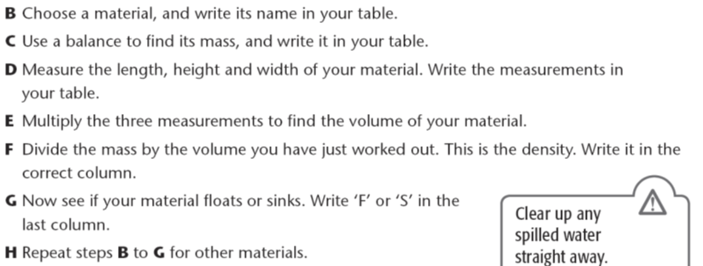
Write this down.
Correct your method as needed and carry it out for 3 materials.
Show all your working using QE(R)NCU.

Slide 8
Q
E
(R)
N
C
U

Slide 9
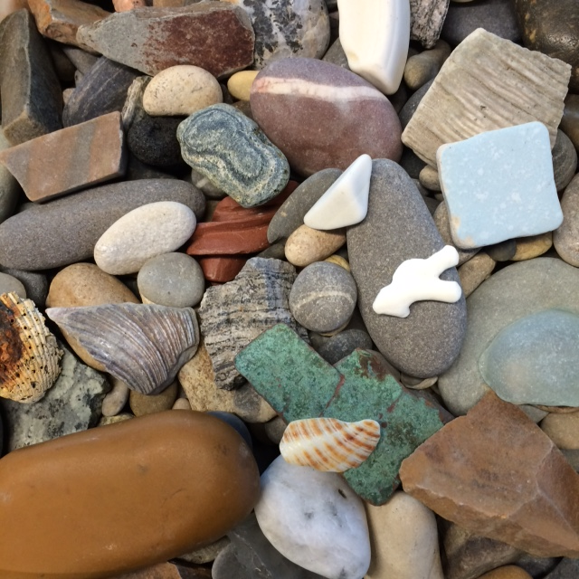
How do we calculate density for an irregular shaped object?

Slide 10
Collect your apparatus for method 2.
Write down the mass of the object and and the volume of water displaced.
Calculate the density of the object and whether it floats or sinks

Slide 11
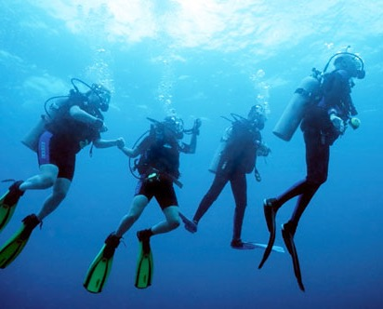
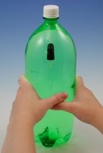
Why do some things float & others sink?
How does a cartesian diver work?
How can we get back up to the surface?

Slide 12
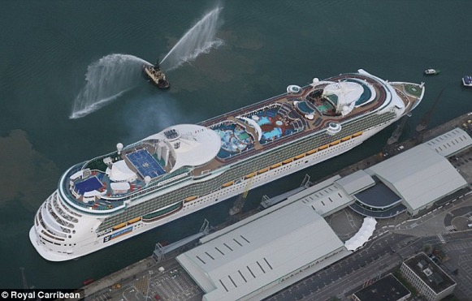
Materials with a ____ density sink and materials with a low density ____ in water.
Water has a density of 1 g/cm³. If a material has a density ____ than water it will float.
high
float
less
Density of steel = 7.7 g/cm³
How can this 160 000 tonne steel ship stay afloat?!

Slide 13
Q
E
R
N
C
U

Slide 14
Answer the example question using the triangle method to rearrange the equation.
Example

Slide 15
Self assess.

Slide 16
My Learning Journey……
Completed
Developing | Securing | Working Scientifically
Describe how to measure the mass and volume of regular and irregular objects.
Explain how density depends on mass and volume.
State what is meant by density and recall is units and the factors affecting it.
Using the particle model describe how the density of a substance changes with temperature
Change the subject of a formula.

Slide 17
 Give a clue or definition for these keywords.
Hot Seat

Slide 18
Hot seat
 Give a clue or definition for these keywords.
Volume

Slide 19
Hot seat
 Give a clue or definition for these keywords.
Density

Slide 20
Hot seat
 Give a clue or definition for these keywords.
g/cm³

Slide 21
Hot seat
 Give a clue or definition for these keywords.
Mass

Slide 22
Hot seat
 Give a clue or definition for these keywords.
Method

Slide 23
Hot seat
 Give a clue or definition for these keywords.
Displacement

Slide 24
Reqs
Class practical
Density blocks (including some irregular shaped objects). Mass balances. Rulers. Large beakers/tubs to test floating or sinking. Displacement cans. Measuring cylinders. Bosses & Clamps.
Demo
Cartesian diver

