Slide 1
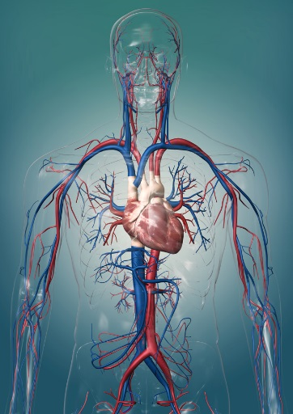
7Ae Organ Systems
Identify and recall the main organs in the plant water transport system
Identify and recall the main organs in the human locomotor, digestive, breathing, urinary and nervous system.
In the back of your books, write down everything you know about the circulatory system.

Slide 2
Learning outcomes
Developing | Secure | Exceeding
Must… | Should… | Could…
* Correctly use the term: organ system. * Describe how organs work together as organ systems. * Identify and recall the parts in the plant water transport system. * State the function of the plant water transport system. * Identify and recall the main organs in the digestive system. * State the function of the digestive system. * Identify and recall the main organs in the circulatory system. * State the function of the circulatory system. * Identify and recall the main organs in the breathing system. * State the function of the breathing system. | * Identify organs working together as a system. * Identify and recall the main parts of the urinary system. * Correctly use the word: urine. * State the function of the urinary system. * Identify the main parts of the nervous system. * Describe what the parts of the nervous system are made of. * State the function of the nervous system. | * Give examples of when organ transplants are needed.

Slide 3
Levels of organisation
Watch the video
https://www.youtube.com/watch?v=ZRFykdf4kDc

Slide 4
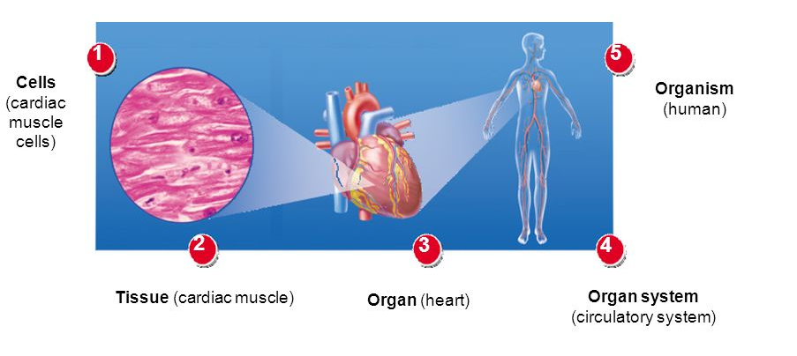
Levels of organisation

Slide 5
Levels of organisation

Slide 6
Levels of organisation
Copy the table below
Structure | Description
Cell | Basic structural and functional unit of a living organism
Tissue | Group of the same cells working together to perform a shared function
Organ | Structure made up of a group of tissues, working together to perform specific functions
Organ system | Group of organs with related functions, working together to perform body function
Organism | A living thing

Slide 7
Learning outcomes
Developing | Secure | Exceeding
Must… | Should… | Could…
* Correctly use the term: organ system. * Describe how organs work together as organ systems. * Identify and recall the parts in the plant water transport system. * State the function of the plant water transport system. * Identify and recall the main organs in the digestive system. * State the function of the digestive system. * Identify and recall the main organs in the circulatory system. * State the function of the circulatory system. * Identify and recall the main organs in the breathing system. * State the function of the breathing system. | * Identify organs working together as a system. * Identify and recall the main parts of the urinary system. * Correctly use the word: urine. * State the function of the urinary system. * Identify the main parts of the nervous system. * Describe what the parts of the nervous system are made of. * State the function of the nervous system. | * Give examples of when organ transplants are needed.

Slide 8
Organ systems
Notes:
Teacher notes
Pupils could be asked if they can name other systems in the human body and the organs involved in them.

Slide 9
Nervous system
Watch the video
https://www.twig-world.com/film/the-nervous-system-1567/

Slide 10
Locomotor system
Watch the video
https://www.youtube.com/watch?v=CuDgvE5LgTA

Slide 11
Locomotor system
Watch the video
https://www.youtube.com/watch?v=CuDgvE5LgTA

Slide 12
Organ systems
Copy and complete the table below
Organ system | Main organ(s) | Function
Breathing system |  | Moves oxygen in to the lungs to be absorbed into the blood. Removes carbon dioxide from the body.
Circulatory system | Heart
 | Kidneys and Bladder (ureter and urethra) | Eliminate waste from the body by producing urine
Digestive system | Stomach, small intestine, large intestine
Nervous system | Brain and spinal chord
Locomotor system | Skeleton and muscles

Slide 13
Organ systems
Use green pens to correct your answers.
Organ system | Main organ(s) | Function
Breathing system | Lungs | Moves oxygen in to the lungs to be absorbed into the blood. Removes carbon dioxide from the body.
Circulatory system | Heart | Pumps blood containing oxygen and nutrients around the body
Urinary system | Kidneys and Bladder (ureter and urethra) | Eliminate waste from the body by producing urine
Digestive system | Stomach, small intestine, large intestine | Breaks down food to be absorbed into the body.
Nervous system | Brain and spinal chord | Controls of the body and allows for communication among its parts.
Locomotor system | Skeleton and muscles | Protect organs, movement , shape and support

Slide 14
Learning outcomes
Developing | Secure | Exceeding
Must… | Should… | Could…
* Correctly use the term: organ system. * Describe how organs work together as organ systems. * Identify and recall the parts in the plant water transport system. * State the function of the plant water transport system. * Identify and recall the main organs in the digestive system. * State the function of the digestive system. * Identify and recall the main organs in the circulatory system. * State the function of the circulatory system. * Identify and recall the main organs in the breathing system. * State the function of the breathing system. | * Identify organs working together as a system. * Identify and recall the main parts of the urinary system. * Correctly use the word: urine. * State the function of the urinary system. * Identify the main parts of the nervous system. * Describe what the parts of the nervous system are made of. * State the function of the nervous system. | * Give examples of when organ transplants are needed.

Slide 15
Organ systems in plants
Watch the video
https://www.youtube.com/watch?v=g7HbmUnqGlM
https://www.activeteachonline.com/product/view/id/295/page/20/mode/dps?modal=/default/player/animation/id/312541/external/0

Slide 16
Organ systems in plants
Copy and complete the text below
Plant organs work together to make o____ s________.
For example, the w_____ t___________ system takes water from the soil up to the leaves. Water can flow through this system, because leaves are constantly loosing water through e___________.
The main organs in the water transport system are:
-r____
-stem
-l____

Slide 17
Organ systems in plants
Use green pens to correct your answers.
Plant organs work together to make o____ s________.
For example, the w_____ t___________ system takes water from the soil up to the leaves. Water can flow through this system, because leaves are constantly loosing water through e___________.
The main organs in the water transport system are:
-r____
-stem
-l____
Organ systems
Water transport
evaporation
roots
Name one tissue you would expect to find in these organs?
leaf
Notes:
Answer: Xylem tissue

Slide 18
Learning outcomes
Developing | Secure | Exceeding
Must… | Should… | Could…
* Correctly use the term: organ system. * Describe how organs work together as organ systems. * Identify and recall the parts in the plant water transport system. * State the function of the plant water transport system. * Identify and recall the main organs in the digestive system. * State the function of the digestive system. * Identify and recall the main organs in the circulatory system. * State the function of the circulatory system. * Identify and recall the main organs in the breathing system. * State the function of the breathing system. | * Identify organs working together as a system. * Identify and recall the main parts of the urinary system. * Correctly use the word: urine. * State the function of the urinary system. * Identify the main parts of the nervous system. * Describe what the parts of the nervous system are made of. * State the function of the nervous system. | * Give examples of when organ transplants are needed.

Slide 19
Organ Transplants
Copy the text below
Organ transplantation is the process of surgically removing an organ or tissue from one person (the organ donor) and placing it into another person (the recipient).
Transplantation is necessary because the recipient's organ has failed or has been damaged

Slide 20
Organ Transplants
Copy the text below
Organs that have been successfully transplanted include:
- Heart
Kidneys
Liver
Lungs
Pancreas
Intestine
Thymus.
Some organs, like the brain, cannot be transplanted.
Tissues include bones, tendons, cornea, skin, heart valves, nerves and veins have also been transplanted.

Slide 21
Learning outcomes
Developing | Secure | Exceeding
Must… | Should… | Could…
* Correctly use the term: organ system. * Describe how organs work together as organ systems. * Identify and recall the parts in the plant water transport system. * State the function of the plant water transport system. * Identify and recall the main organs in the digestive system. * State the function of the digestive system. * Identify and recall the main organs in the circulatory system. * State the function of the circulatory system. * Identify and recall the main organs in the breathing system. * State the function of the breathing system. | * Identify organs working together as a system. * Identify and recall the main parts of the urinary system. * Correctly use the word: urine. * State the function of the urinary system. * Identify the main parts of the nervous system. * Describe what the parts of the nervous system are made of. * State the function of the nervous system. | * Give examples of when organ transplants are needed.

Slide 22
Practical: 7Ae-2 Leaf surfaces (SEE FIREFLY)
Equipment per group:
● coverslip ● water
● pipette ● slide
● microscope ● forceps
● leaves ● clear nail varnish and brush
● labels

Slide 23
Worksheet: 7Ae1 Cells, 7Ad2 Examining tissue, 7Ad3 Human cheek cells, 7Ad4 Stains, 7Ad5 Animal Cell Model, 7Ad6 Plant Cell Model, 7Ad7 Discovering Cells, 7Ad8 Plant and animal cells, 7Ad9 Plant and animal cells and 7Ad10 Cells and Organelles

Slide 24
Worksheet: 7Ae1 Organ systems, 7Ae2 Leaf structures 1, 7Ae3 Leaf structures 2, 7Ae4 Organs and their systems, 7Ae5 Organs word search, 7Ae6 At what cost, 7Ae7 Organs in systems, 7Ae8 Human organ systems, and 7Ae 9 Kidney failures

Slide 25
The human circulatory system

Slide 26
The function of the circulatory system is to carry blood to every part of the body.
Click next for more information.
Next

Slide 27
The heart is slightly to the left of the middle of the chest. It is protected by the rib cage.
Its function is to pump blood through the blood vessels to all the tissues and organs in the body.
Click next for more information.
Next

Slide 28
The blood vessels are tubes that carry blood to every part of the body.
This picture shows only the largest vessels.
The blood carries vital substances to and from cells.
Click next for more information.
Next
© Pearson Education Ltd 2014. Copying permitted for purchasing institution only. This material is not copyright free.
Notes:
28

Slide 29
The blood brings substances to the cells that they need to work well, such as oxygen and food for respiration.
The blood also carries away things made by cells, either to be used in other parts of the body, or to be excreted.
Click on the either the heart or blood vessels to find out more.

Slide 30
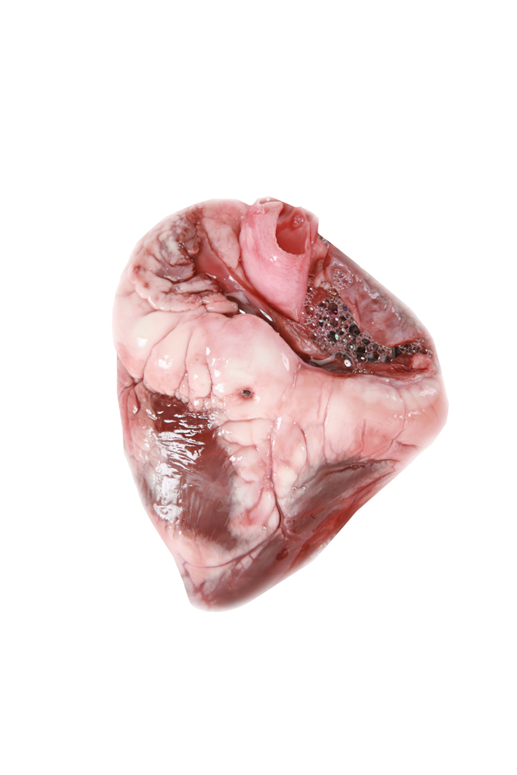
The heart is an organ, made of several different tissues.
Click on the heart to find:
• muscle tissue
• fat tissue
• nerve tissue.

Slide 31
Nerve tissue
Muscle tissue
Fat tissue
Click on each type of tissue to find out more.
End show
Back

Slide 32
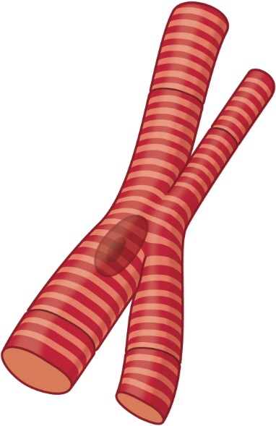
The heart contains a special kind of muscle called cardiac muscle. This tissue is made of cardiac muscle cells.
Click on the muscle cell to find out more.
cardiac muscle cell
nucleus

Slide 33
Cardiac muscle cells can contract (get shorter).
When many cardiac muscle cells contract at the same time, they make the spaces inside the heart smaller, and so push blood out of the heart.
cardiac muscle cell
nucleus
Back

Slide 34
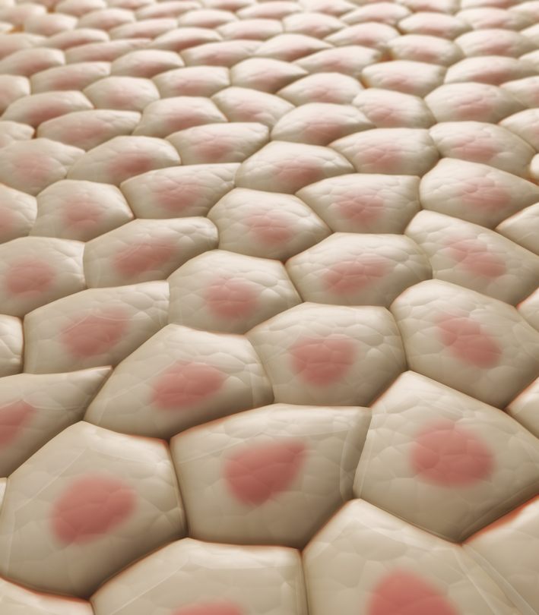
The heart is surrounded by a layer of fat tissue.
Fat tissue helps to protect the heart, however too much fat on the heart can cause illness.
Fat tissue is made of fat cells.
Click on the fat cell to find out more.
fat cell
fat cell

Slide 35
Fat cells are storage cells.
Each cell contains fat that can be used for respiration when the heart muscle cells are working quickly (e.g. during exercise).
fat cell
Back

Slide 36
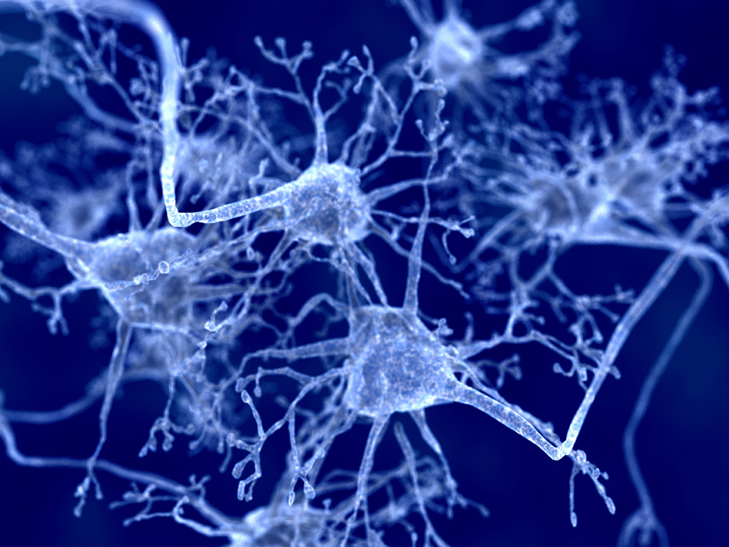
Nerve tissue is difficult to see as it is deep inside the heart.
It is made of many nerve cells that connect together and link to the brain.
Click on the nerve tissue to learn more.

Slide 37
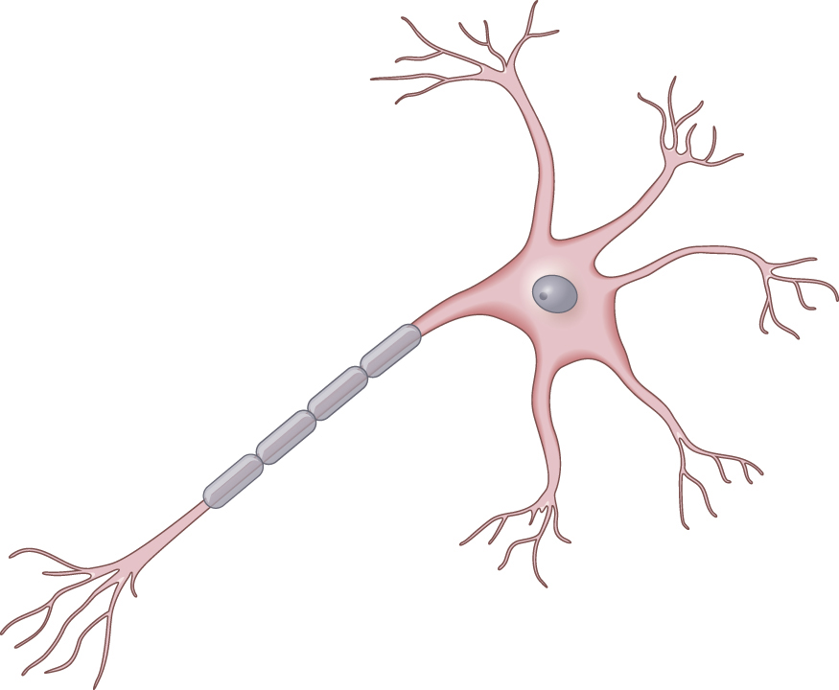
Nerve cells have long fibres that link to other nerve cells.
In the heart, they control when the muscle cells contract, so that the heart pumps properly.
Heart nerve cells are also linked to nerve cells in the brain.
nucleus
Back

Slide 38
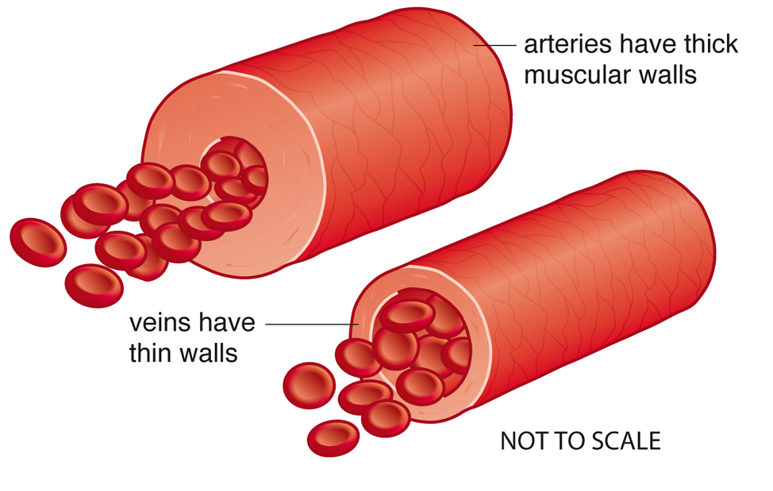
The blood vessels are tubes that pass through almost every tissue of the body.
Arteries take blood from the heart around the body, so they have thick walls.
Veins return blood back to the heart. Therefore, their walls can be thinner.
Click on either blood vessel to find out more.

Slide 39
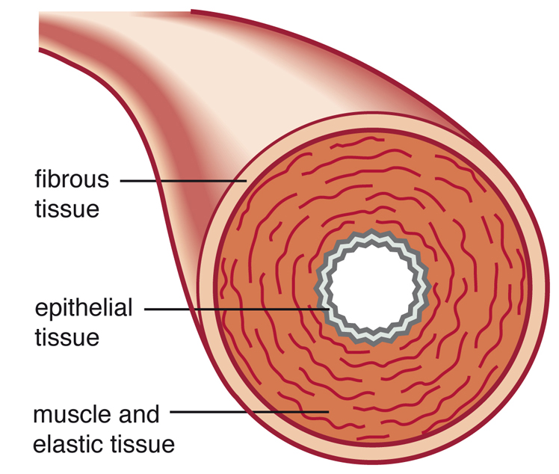
Blood vessels are surrounded by tough connective tissue.
This stops blood vessels bursting easily.
Most blood vessels also have a layer of muscle tissue.
This muscle helps blood vessels return to their original shape when blood has pulsed through them.
End show
Back

Slide 40
The human digestive system

Slide 41
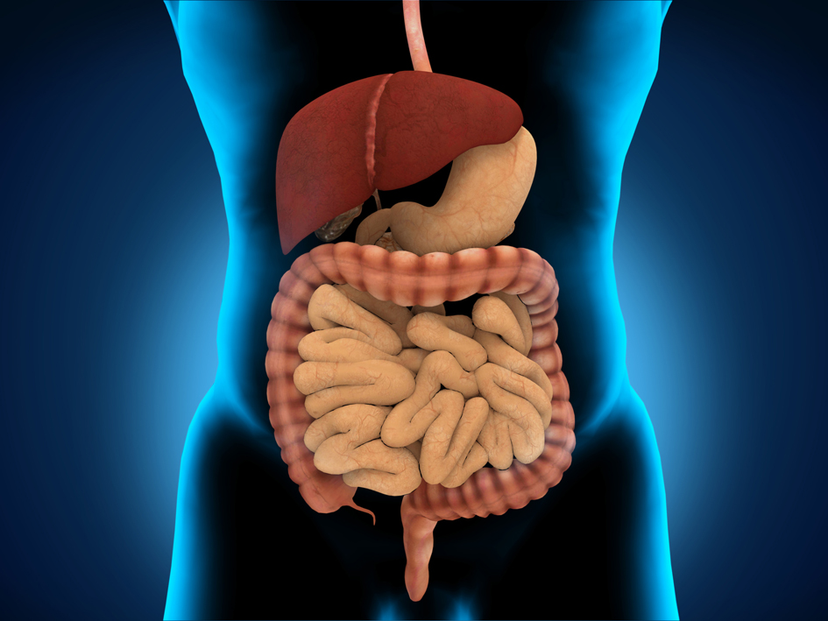
The human digestive system is made up of many organs.
Click on the picture to identify some of the organs in the digestive system.

Slide 42
Foodpipe (gullet)
Stomach
Liver
Large intestine
Small intestine
Rectum
Find six different organs by clicking on the picture.
Next
© Pearson Education Ltd 2014. Copying permitted for purchasing institution only. This material is not copyright free.
Notes:
42

Slide 43
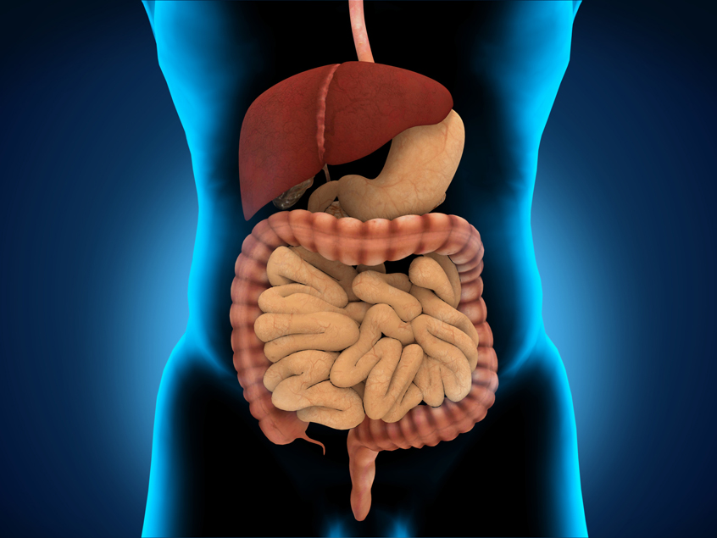
The organs of the digestive system work together to carry out the functions of digesting food substances and absorbing them into the body.
Click on the foodpipe to find out more.

Slide 44
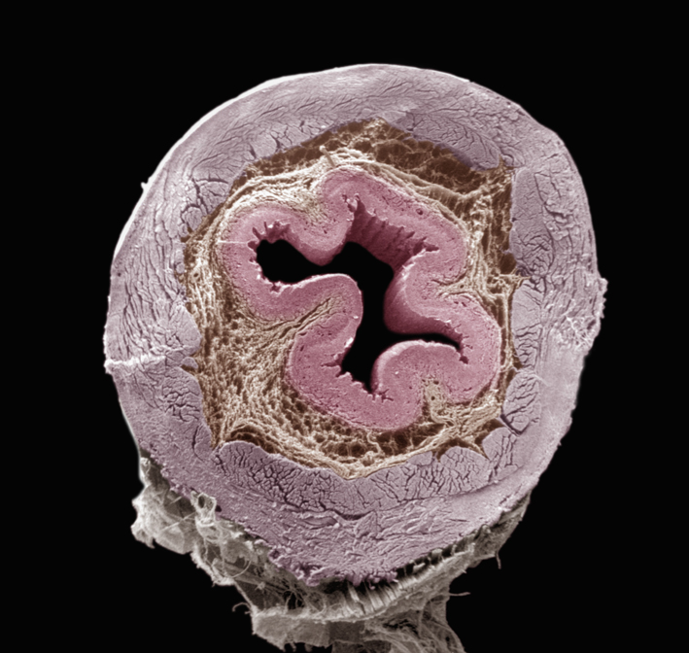
This is a cross section through a human foodpipe.
epithelial tissue
All the organs of the gut (foodpipe, stomach, intestines and rectum) contain 3 different types of tissue.
muscle tissue
connective tissue
food passes through here
Click on the labels to see the functions of these tissues.

Slide 45
Epithelial tissue lines the surfaces of the gut.
It is very thick in the foodpipe, as it protects the other tissues from getting damaged by large pieces of food.
Muscle tissue is made of muscle cells that can contract (get shorter).
These contractions move the food steadily through the whole of the digestive system, from the mouth to the anus.
Connective tissue is tough (strong). It holds other tissues together and stops them from being stretched to bursting point.
Next
Next
© Pearson Education Ltd 2014. Copying permitted for purchasing institution only. This material is not copyright free.
Notes:
45

Slide 46
Food passes from the mouth through the foodpipe to the stomach.
Click on the stomach to find out about tissues in the stomach.
© Pearson Education Ltd 2014. Copying permitted for purchasing institution only. This material is not copyright free.
Notes:
46

Slide 47
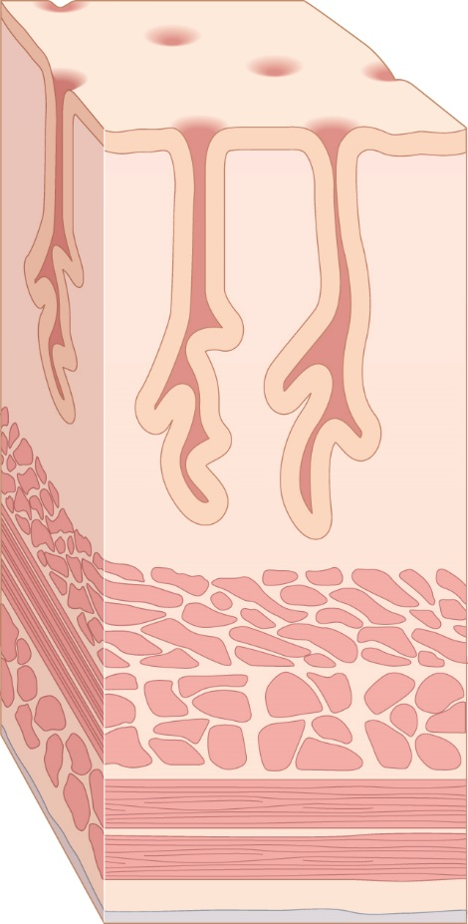
epithelial tissue (on inside surface)
The stomach is surrounded by muscle tissue and connective tissue, like the foodpipe.
The epithelial tissue of the stomach contains special cells.
Click next to find out more.
gland pit
gland tissue
muscle tissue
connective tissue
Next

Slide 48
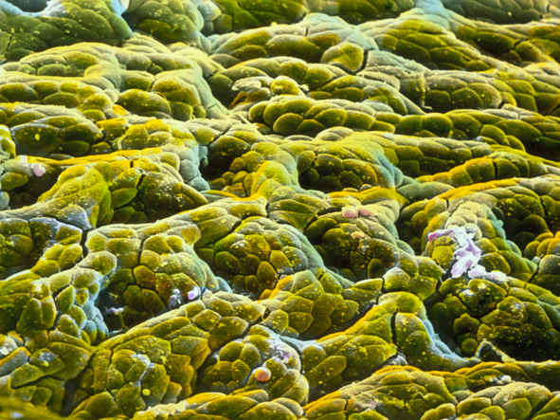
The epithelial tissue of the stomach contains pits.
Click on the label to find out what is in the pit.
The pits contain gland cells.
pit in stomach surface
These release substances (acid and enzymes) into the stomach that help to break down the food into smaller pieces.
By the time food leaves the stomach, it looks more like a thick soup.
Next

Slide 49
Partly digested food from the stomach is pushed by the muscles into the small intestine.
In the small intestine the digestion is completed.
Then, the digested food and water has to be absorbed.
Click on the small intestine to find out more.
© Pearson Education Ltd 2014. Copying permitted for purchasing institution only. This material is not copyright free.
Notes:
49

Slide 50
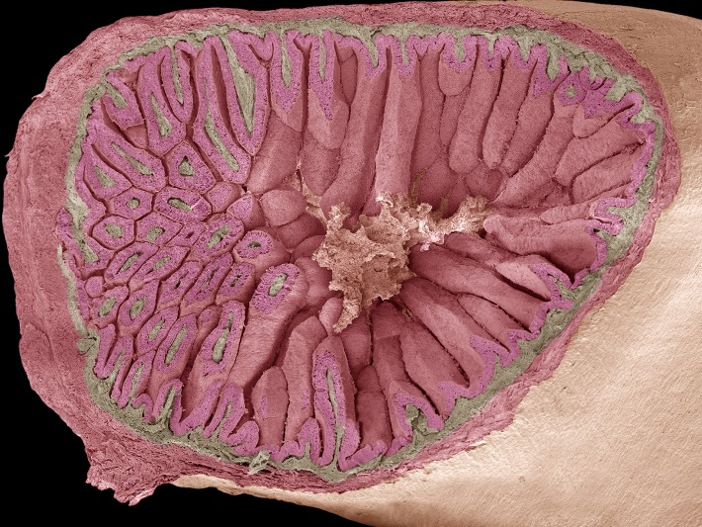
The epithelial tissue of the small intestine forms thousands of long ‘fingers’.
This gives a much larger area for absorbing the digested food.
Special cells in the ‘fingers’ release slimy mucus, which helps to protect the epithelial tissue.
muscle tissue
connective tissue
epithelial
tissue
food passes through the middle
Next

Slide 51
Anything that hasn’t been absorbed from the digested food in the small intestine is pushed into the large intestine by the muscle tissue of the gut wall.
Click on the large intestine to find out more.
© Pearson Education Ltd 2014. Copying permitted for purchasing institution only. This material is not copyright free.
Notes:
51

Slide 52
More water is absorbed in the large intestine.
The remaining solids (faeces) are pushed into the rectum.
The faeces are stored in the rectum until they are pushed out of the body through the anus.
Back to start
End show
© Pearson Education Ltd 2014. Copying permitted for purchasing institution only. This material is not copyright free.
Notes:
52

