Slide 1
Objectives
Describe what is seen when a solid dissolves, and correctly use the terms: soluble, solute, solvent, solution.
Describe how some solids can be used to form a solution, and identify the solvent and solute in a solution.
Describe what happens when a liquid will not dissolve any more of a solid and use correctly the terms: solubility, saturated solution.
State what happens to mass in a physical change.
Describe how factors affect how much of a substance dissolves.
Describe how we know that different solutes have different solubilities.
Plan a fair test to discover how different factors affect the solubility of a substance.

Slide 2
CW
7Eb solutions
Why do we filter tap water before we drink it ?
@hpscience

Slide 4
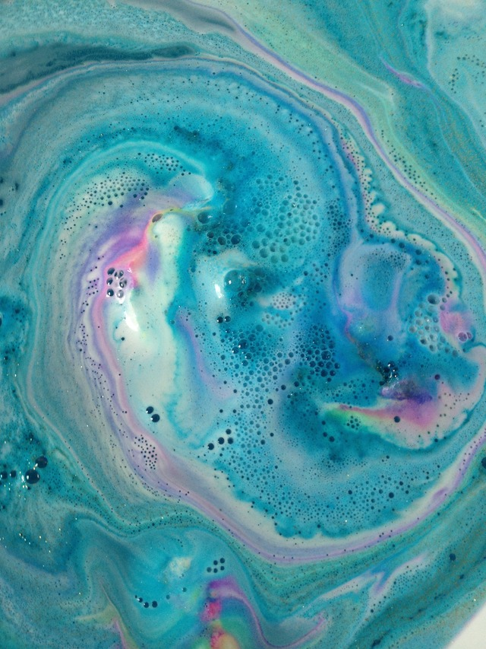
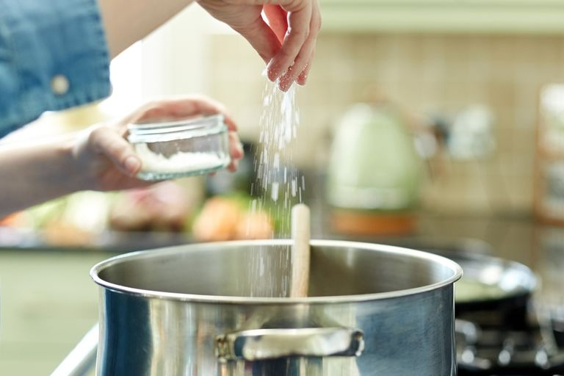
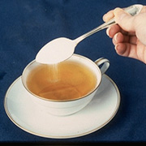
What is happening in these pictures?
Solubility: something that can be dissolved

Slide 5
Watch the video then copy and complete the sentences below
Some substances dissolve in a liquid to make a __________. The dissolved substance breaks up into pieces so ______ that light can pass straight though the _______. Therefore solutions are __________. A solution can be coloured or ________ depending on the substances in it.
solution
small
mixture
transparent
colourless
https://www.twig-world.com/film/olutions-1475/
Notes:
Video : https://www.twig-world.com/film/solutions-1475/

Slide 6
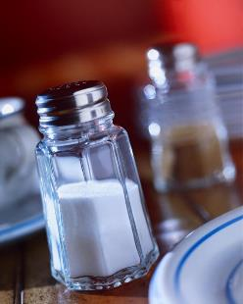
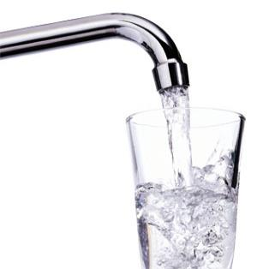
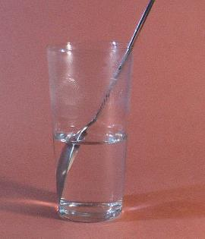
+
=
Name the
Solute
Solvent
Solution
Salt
Water
Salty water

Slide 7
solvent
The liquid in a solution is called the __________
The substance that is dissolved is called the _________
solute

Slide 8
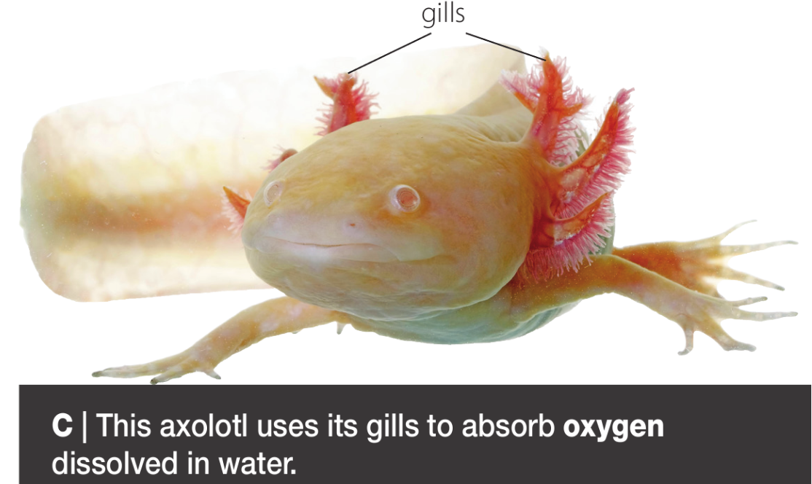
Do you know what these keywords mean?
Dissolves
Insoluble
Soluble
Solution
Saturated
Solubility
Solvent
Solute
Transparent
Now use worksheet 7Eb1 to match keywords to definition – work with the person next to you.
DO NOT STICK THEM IN UNTIL I HAVE GONE OVER THE ANSWERS

Slide 9
KEYWORDS
DEFINITIONS
dissolving
insoluble
soluble
solution
Saturated
solubility
solvent
solute
transparent
When a substance splits up and mixes with a liquid to make a solution.
Something that will not dissolve in a liquid
Something that will dissolve in a liquid
A mixture formed when a substance dissolves in a lqiuid
when a solution contains the most solute that will dissolve in the solvent
the amount of substance that dissolves in a given amount of liquid
A liquid in which other substances dissolve.
The substance that has dissolved in a liquid to make a solution
See-through

Slide 10
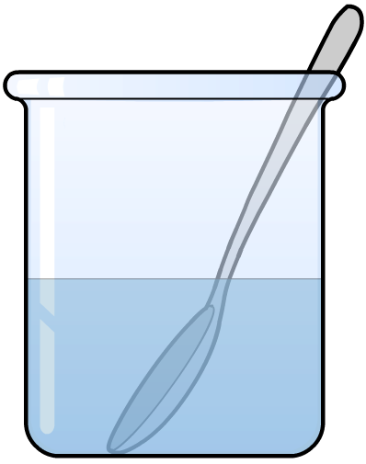
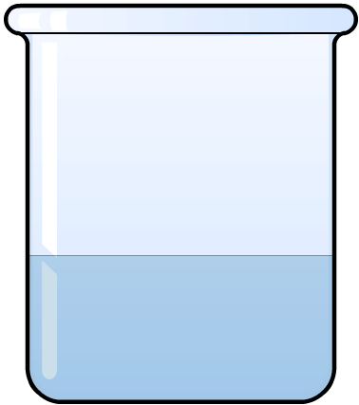
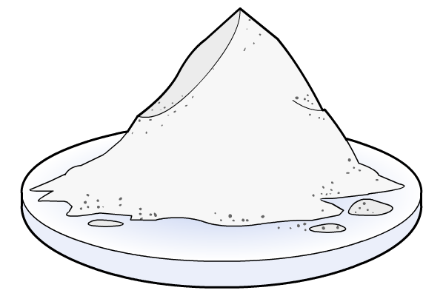
Conservation of mass
If 10 g of salt is added to 50 g of pure water, what is the mass of the solution?
Because all the solvent and solute particle are still in the beaker
MASS OF SOLUTION = MASS OF SOLVENT + MASS OF SOLUTE
+
➔
?
50 g
+
10 g
➔
60 g

Slide 12
Investigating temperature and solubility 7Eb-3
Method
A Measure 20 cm3 of water into a ___________ using a measuring cylinder.
B Measure the temperature using a ________________ , and write it in the table.
C Add a spatula of white substance and stir it until it has ___________ .
D Add another spatula of ______________ and keep stirring.
E _____________ this until no more will dissolve.
F Write down the number of _____________ of white substance that was added.
G Pour the solution down the __________ and put some clean water into the beaker.
This will be a fair test because it uses the _____________ amount of water.
H Heat the water to 30 °C, and find out how many spatulas of white substance dissolves in it.
I ________________ the experiment at 50 °C.
Beaker
thermometer
dissolved
salt
repeat
spatulas
sink
same
repeat
Notes:
Words: beaker dissolved repeat white substance
same sink spatulas thermometer

Slide 13
Copy this table into your books.

Slide 15
What happens to solubility as temperature increases?
As the temperature increases, the solubility also increases (more solute can dissolve)

