Slide 1
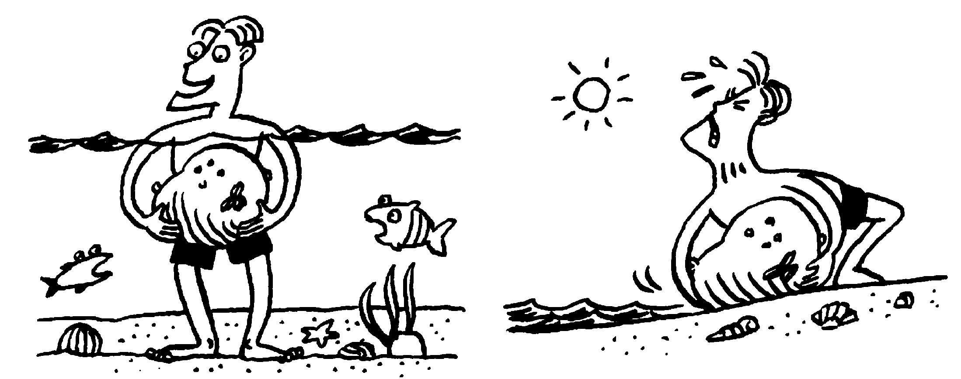
C/W
09/12/2021
8Id Floating and sinking
… but impossible to lift out of water?
Why is this rock easy to lift underwater…
 Draw a diagram and write down your ideas in the back of your book.

Slide 2
Object | Weight in air (N) | Weight in water (N) | Upthrust (N) | Floats?
Can you remember which objects will float from a few lessons ago?
 Draw the table above with pencil & ruler. Leave space for 6 objects.

Slide 3
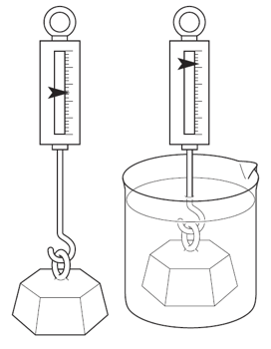
Object | Weight in air (N) | Weight in water (N) | Upthrust (N) | Floats?
Leave this column blank for now
 Weigh at least 3 objects in & out of water, recording your results.
What seems to happen to an objects weight in water?
What is true for objects that float?
polystyrene
aluminium

Slide 4
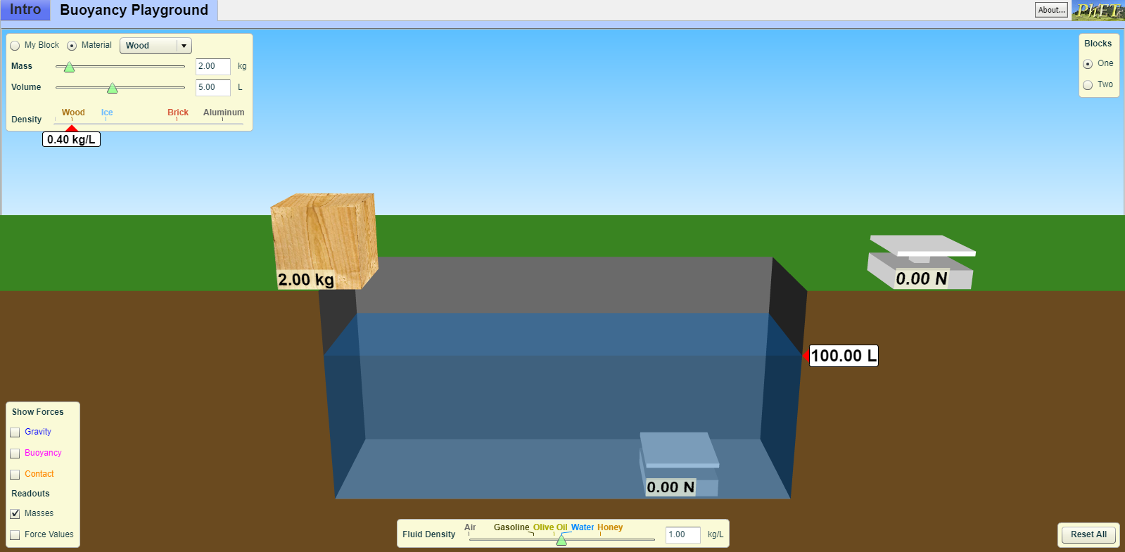

Slide 5
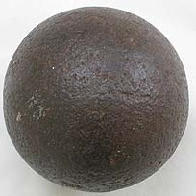
How can we calculate this upthrust?
Why does an object’s weight seem to be less in water?
weight in air
weight in water
upthrust
_
=

Slide 6
Object | Weight in air (N) | Weight in water (N) | Upthrust (N) | Floats?
_
=
 Calculate the upthrust on each of your objects. Add results from the group next to you if needed.
What is true for objects that float?
weight in air
weight in water
upthrust
_
=

Slide 7
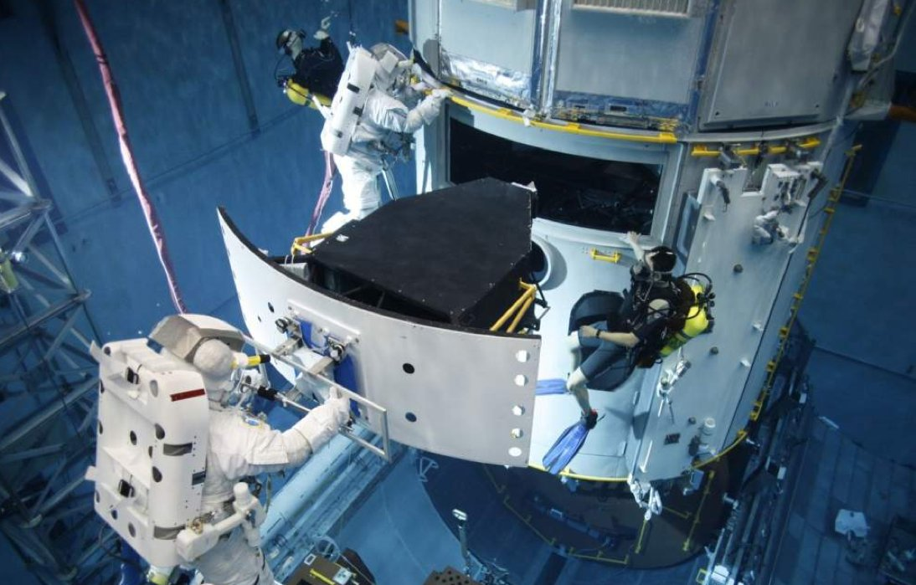

Slide 8
 Copy and complete.
less
Objects seem to weigh ____ (less/more) in water because of an upwards force from the water called upthrust. This pushes against your weight.
An object floats if the upthrust is _______ (equal to / bigger than / smaller than) its weight.
equal to
How can we increase the upthrust?

Slide 9
My Learning Journey……
Completed
Developing | Securing | Exceeding
State what is meant by upthrust.
Work out if something will float.
Explain that the upthrust depends on the weight of fluid displaced.
Explain why an object floats.
Use ideas about density changes to explain how a hot air balloon flies/how the depth of a submarine is controlled.
Use ideas about displacement to explain phenomena connected with floating and sinking.
Recall the factors that affect the amount of upthrust on an object.

Slide 10
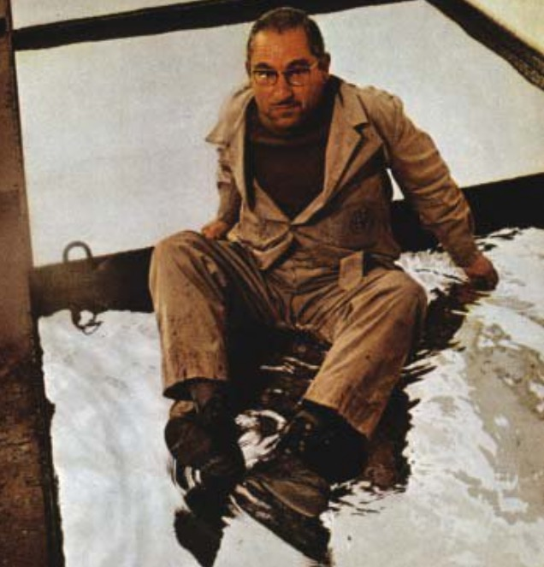
What is this man sitting on?
mercury
(high density liquid metal)

Slide 11
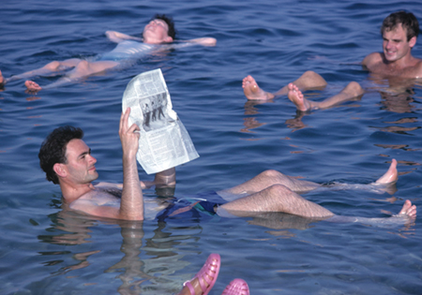
How is this possible?

Slide 12
Ever tried to hold a float underwater in the swimming pool?
What happens to the upthrust if you push a bottle further into the water?

Slide 13
 Copy and complete.
The upthrust is equal to the weight of displaced fluid, so is bigger if:
The liquid is _____ (more/less) dense, eg salty water.
____ (more/less) of the object is underwater (or the object has a greater volume).
more
More
How could we increase it?
What other condition for floating does this lead to? (8Ia)
Does air also cause an upthrust?

Slide 14
My Learning Journey……
Completed
Developing | Securing | Exceeding
State what is meant by upthrust.
Work out if something will float.
Explain that the upthrust depends on the weight of fluid displaced.
Explain why an object floats.
Use ideas about density changes to explain how a hot air balloon flies/how the depth of a submarine is controlled.
Use ideas about displacement to explain phenomena connected with floating and sinking.
Recall the factors that affect the amount of upthrust on an object.

Slide 15
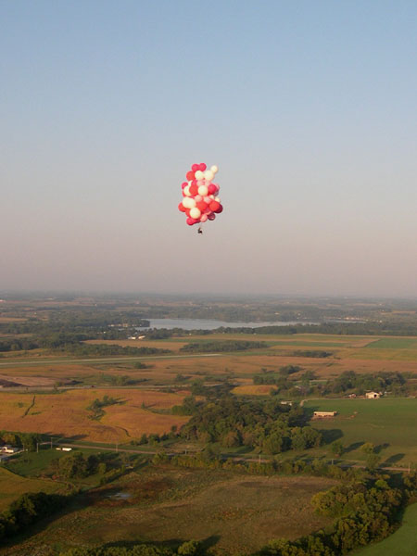
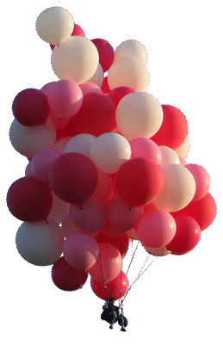
Do you think you could lift a real person like this?!

Slide 17
What happens if the upthrust is greater than the weight?
What about a house?!

Slide 19
Why does the pilot heat the air in the balloon?
How can we explain this using ideas of density and upthrust?

Slide 20
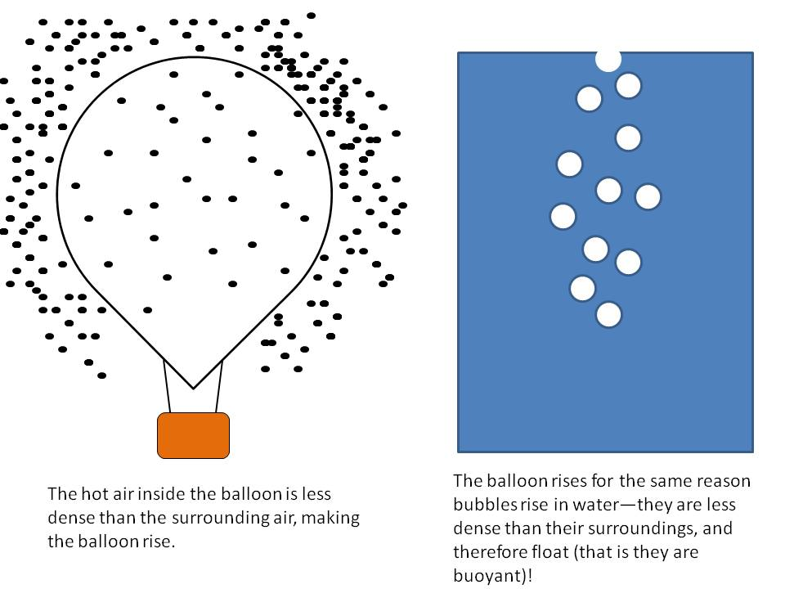
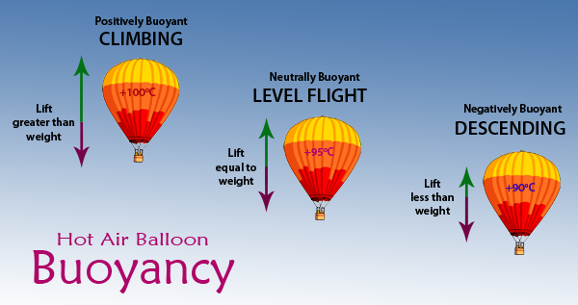

Slide 21
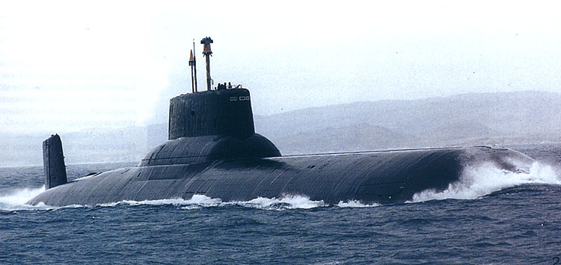
How can a submarine change whether it’s floating or sinking?
video

Slide 22
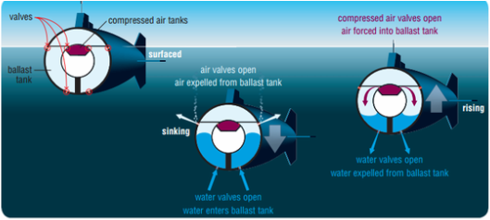

Slide 23
My Learning Journey……
Completed
Developing | Securing | Exceeding
State what is meant by upthrust.
Work out if something will float.
Explain that the upthrust depends on the weight of fluid displaced.
Explain why an object floats.
Use ideas about density changes to explain how a hot air balloon flies/how the depth of a submarine is controlled.
Use ideas about displacement to explain phenomena connected with floating and sinking.
Recall the factors that affect the amount of upthrust on an object.

Slide 24
Explain what happens when the pilot heats the air in a hot air balloon.
Explain what happens when a submarine fills its ballast tanks with water.

Slide 25
My Learning Journey……
Completed
Developing | Securing | Exceeding
State what is meant by upthrust.
Work out if something will float.
Explain that the upthrust depends on the weight of fluid displaced.
Explain why an object floats.
Use ideas about density changes to explain how a hot air balloon flies/how the depth of a submarine is controlled.
Use ideas about displacement to explain phenomena connected with floating and sinking.
Recall the factors that affect the amount of upthrust on an object.

Slide 26
 Give a clue or definition for these keywords.
Hot Seat

Slide 27
Hot seat
 Give a clue or definition for these keywords.
Upthrust

Slide 28
Hot seat
 Give a clue or definition for these keywords.
Newtons

Slide 29
Hot seat
 Give a clue or definition for these keywords.
Weight

Slide 30
Hot seat
 Give a clue or definition for these keywords.
Density

Slide 31
Hot seat
 Give a clue or definition for these keywords.
Floating

Slide 32
Reqs
Class practical
Plastic 1L beakers and/or washing up tubs, density blocks, rubber bands, variety of Newtonmeters (0-1 N up to 0-100N)
Demo
Large & small cubes of polystyrene, 3 empty plastic drinks bottles with lid, large glass trough.
Helium balloon(s) tied to small figure, sensitive mass balance, sellotape

