Slide 1
Objectives
Give examples of where chromatography is used.
Describe how chromatography is used to separate mixtures.
Explain how chromatography works, and interpret a chromatogram.
Evaluate the information provided by chromatograms.

Slide 2
CW
7Ed Chromatography
What colours make up the colour brown in a felt tip pen?
How can we test this?
@hpscience

Slide 3
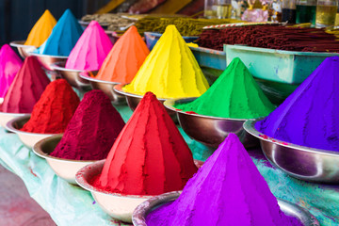
What is ink/dye?
A solid coloured pigment is dissolved into a liquid. Making a coloured solution.

Slide 4
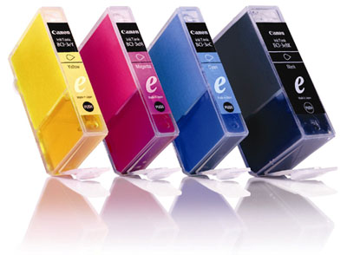
Think about your colour printer
How many ink cartridges does it use?
How many colours does it produce?

Slide 5
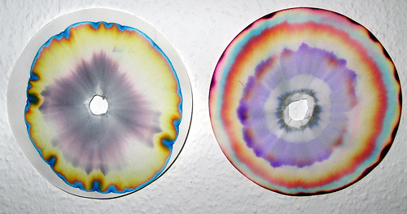
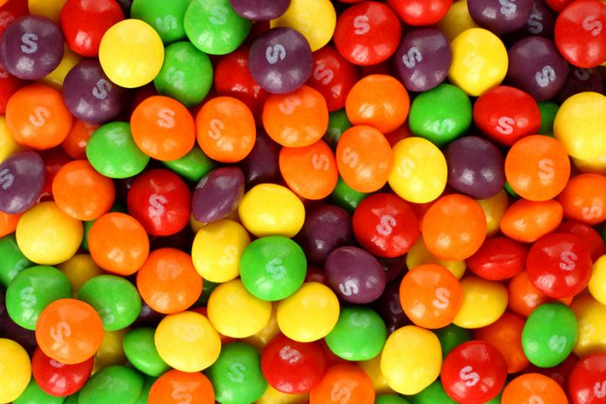
Watch the video then copy and complete the sentences below
Chromatography separates substances _________ in a mixture in order to ________ each substance.
It can be used to find out which colours are ______ together in different paints, dyes and inks.
The substances are carried at different ________, which separates them out.
dissolved
identify
mixed
speeds
Notes:
https://www.twig-world.com/film/forensics-chromatography-1481/

Slide 6
Copy and complete this diagram in your books.

Slide 7
Uses of chromatography
Chromatography can be used for:
Water analysis – clean water must be tested before it can be used for drinking water.
Testing for banned drugs
Forensic analysis
Food analysis
Notes:
Forensic analysis, testing for banned drugs, water analysis, food analysis.

Slide 8
Chromatography method - video
Notes:
https://www.activeteachonline.com/product/view/id/295/page/82/mode/dps?modal=/player/animation/id/312551

Slide 9
Chromatography experiment

Slide 10
chromatography
Check that your chromatography paper hangs close to the bottom of the empty beaker without touching it (as shown in the diagram).
Draw a pencil line on the paper, about 2 cm from the bottom.
Put a small spot of ink from each pen on your pencil line.
Label underneath each spot with a pencil.
Pour some water into the beaker to a depth of about 1 cm.
Lower the chromatography paper into the beaker so that the bottom of the paper is in the water, but the water level is below the spots.
Leave the paper in the beaker until the water reaches near the top of the paper.

Slide 11
Answer these questions in your books.

Slide 12
Mark your own in a GREEN pen.

Slide 14
Mark your own in a GREEN pen.

Slide 15
Analysing a chromatogram
Extension task

Slide 16
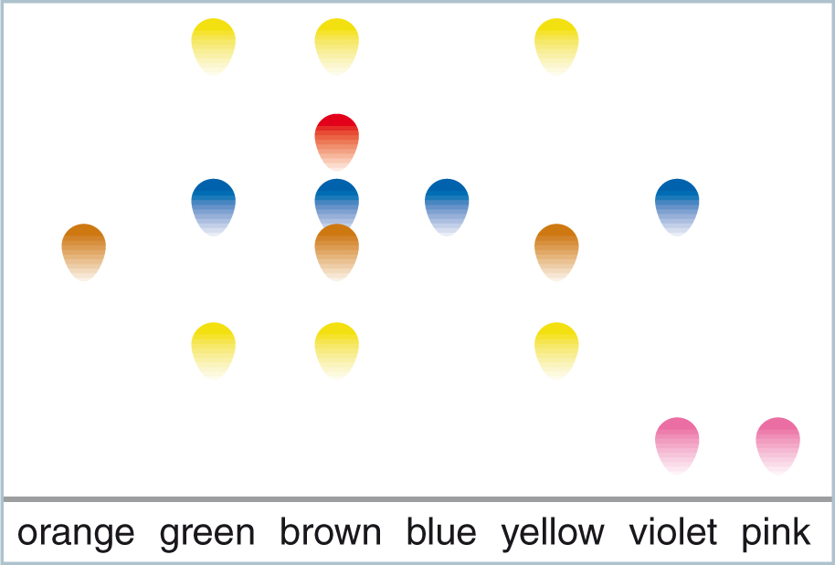
Analysing a chromatogram
The chromatogram below shows the colourings found in various coloured sweets.

Slide 17
From the chromatogram what can you tell about the colourings in the different sweets?
Which sweets have lots of different colours in them?
Which sweets have only a few?
© Pearson Education Ltd 2014. Copying permitted for purchasing institution only. This material is not copyright free.
Notes:
17

Slide 18
The orange, blue and pink sweets just contain one colouring because there is only one dot above these colours.
The violet sweets contain two colourings as there are two dots.
© Pearson Education Ltd 2014. Copying permitted for purchasing institution only. This material is not copyright free.
Notes:
18

Slide 19
How many colourings are in the brown sweets?
Answer =
5
© Pearson Education Ltd 2014. Copying permitted for purchasing institution only. This material is not copyright free.
Notes:
19

Slide 20
The brown and yellow sweets both contain the colouring substance used in the orange sweets.
They all have a dot of the same colour that moved the same distance above the start line.
© Pearson Education Ltd 2014. Copying permitted for purchasing institution only. This material is not copyright free.
Notes:
20

Slide 21
Which sweets contained the same colouring as the blue sweets?
Answer =
green, brown and violet.
© Pearson Education Ltd 2014. Copying permitted for purchasing institution only. This material is not copyright free.
Notes:
21

Slide 22
Which sweets have the colourings from the blue and pink sweets mixed together?
Answer =
violet.
© Pearson Education Ltd 2014. Copying permitted for purchasing institution only. This material is not copyright free.
Notes:
22

Slide 23
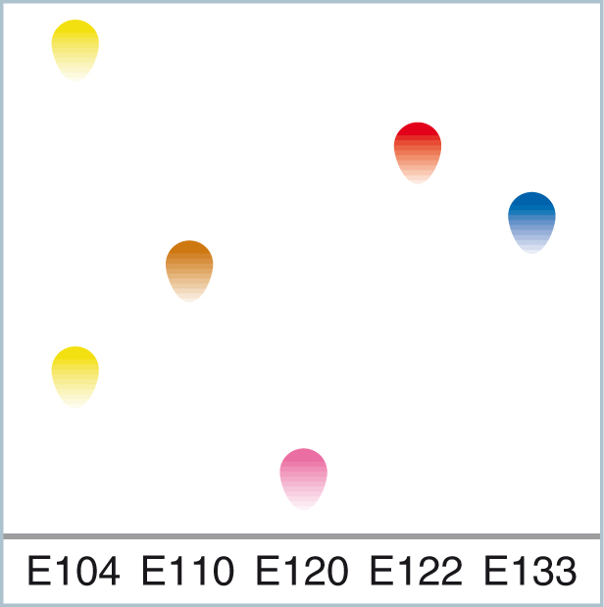
All food additives (including food colourings) are classified and given an ‘E number’.
The colourings in the sweets all have E numbers.
Some people can suffer allergic reactions with food additives.
© Pearson Education Ltd 2014. Copying permitted for purchasing institution only. This material is not copyright free.
Notes:
23

Slide 24
Therefore, it is important to know which E numbers are in which foods.
If you were allergic to E104 which sweets would it not be safe for you to eat?
Answer =
green, brown and yellow.
© Pearson Education Ltd 2014. Copying permitted for purchasing institution only. This material is not copyright free.
Notes:
24

