Slide 1
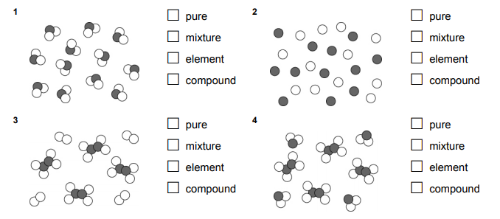
7Hd Making Compounds
CW
Do Now:

Slide 2
Requisitions
Equipment | Worksheets
DEMO/Practical: Magnesium Ribbon, Copper, Iron Nail, Iron Filings, Sulphur Powder, Iron and Sulphur Mix, Blow Torch Magnets | 7Hd6

Slide 3
Copy & Complete
Element | Appearance | Element | Appearance | Compound | Appearance
Copper |  | Oxygen
Magnesium |  | Oxygen
Iron |  | Oxygen
Iron |  | Sulphur

Slide 4
Copy & Complete
Element | Appearance | Element | Appearance | Compound | Appearance
Copper |  | Oxygen
Magnesium |  | Oxygen
Iron |  | Oxygen
Iron |  | Sulphur

Slide 5
Copy & Complete
During the reaction the atoms of iron and sulphur join together to form a _________ called iron sulfide.
We say that _____ have formed ________ the atoms.
compound
bonds
between
iron + sulphur → iron sulfide

Slide 6
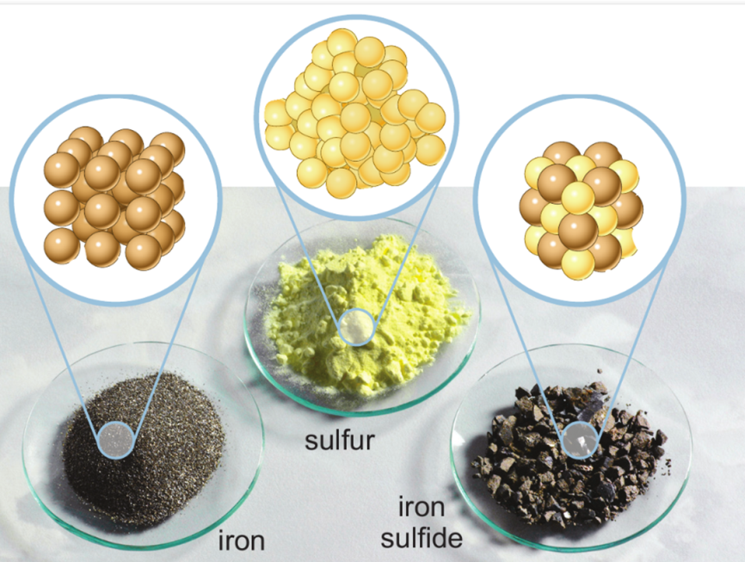

Slide 7
Naming Compounds
Copy & Complete
If one of the elements is a metal, its name goes first
The non-metal name at the end will change to end with –ide
iron + sulphur →
iron + oxygen →
sodium + chlorine →
aluminium + bromine →
tin + fluorine →
iron sulphide
iron oxide
sodium chloride
aluminium bromide
tin fluoride

Slide 8
“When the shiny lithium metal is heated and lowered into a container green chlorine gas, a chemical reaction occurs. The lithium appears to burns and a white solid forms on the sides of the container. The white solid is lithium chloride”.
Name the elements and the compound described in the above passage. Elements: ____________________ Compound: ___________________
Describe one difference in property between the elements and the compound they form. _______________________________________________________________________
What evidence is there for a chemical reaction occurring? _______________________________________________________________________
lithium and chlorine
lithium chloride
colour change
The product of the chemical reaction has different properties

Slide 9
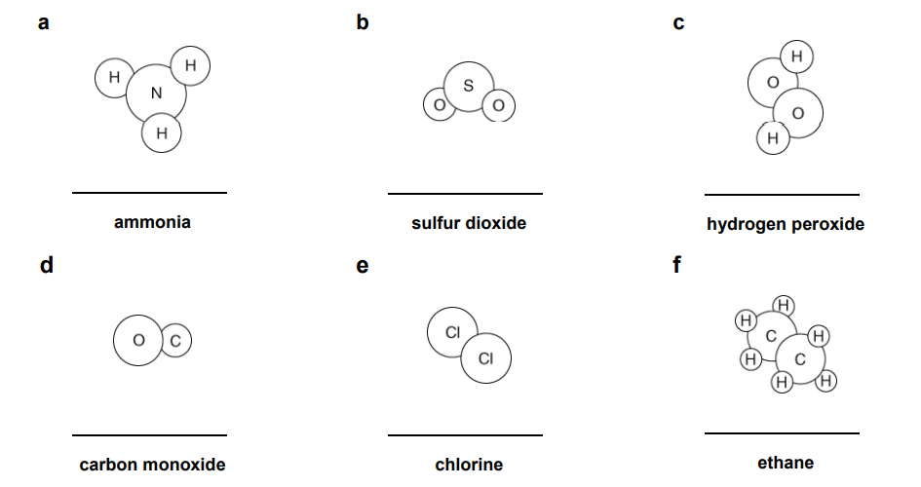
Stick in and Complete
NH₃
SO₂
H₂O₂
CO
Cl₂
C₂H₆
Notes:
7Hd-6

Slide 10
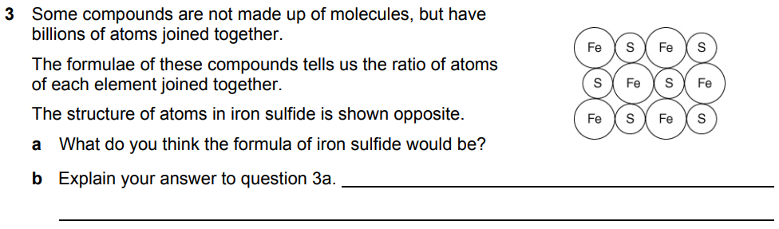
H
H
C
H
H
FeS

Slide 11
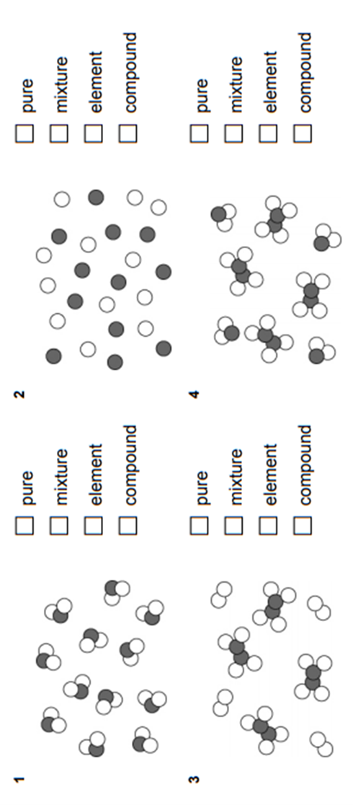
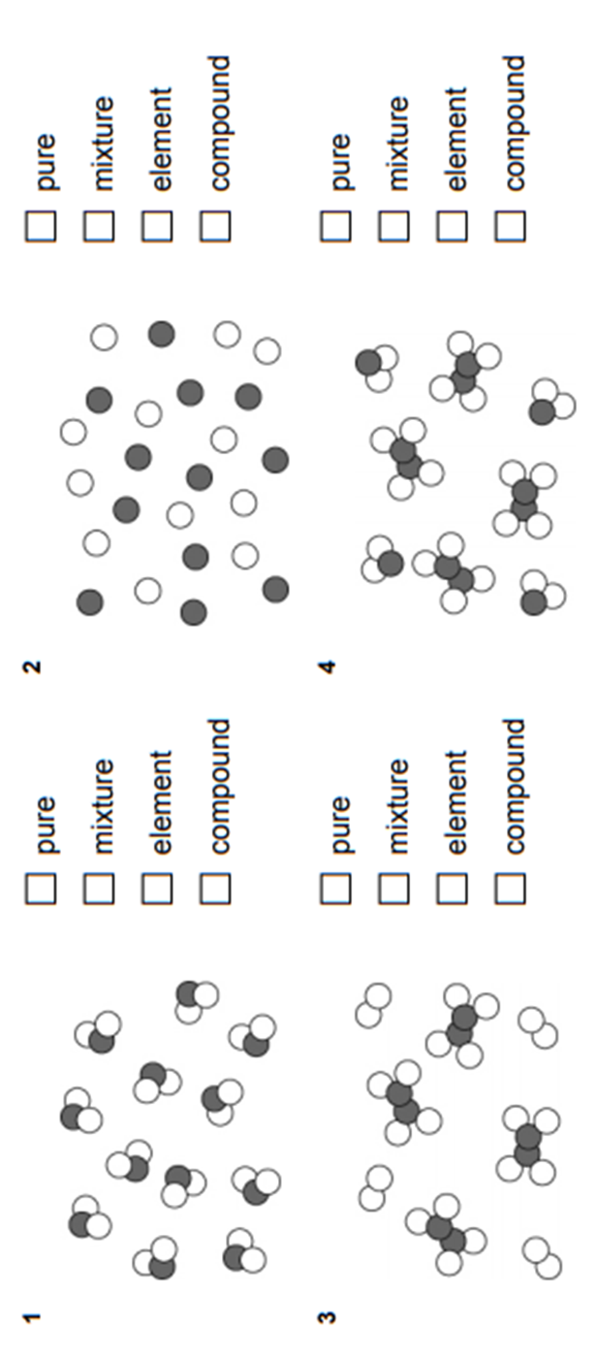

Slide 12
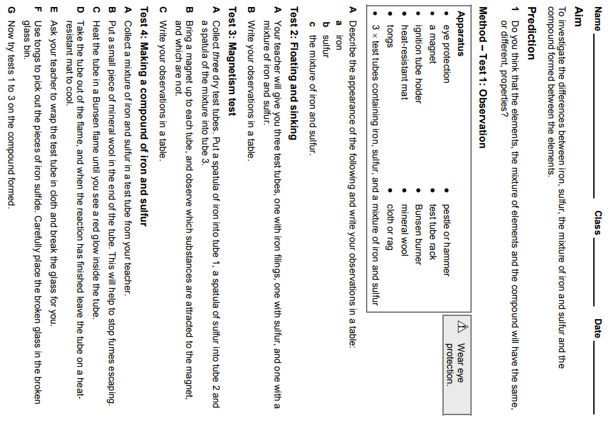

Slide 13
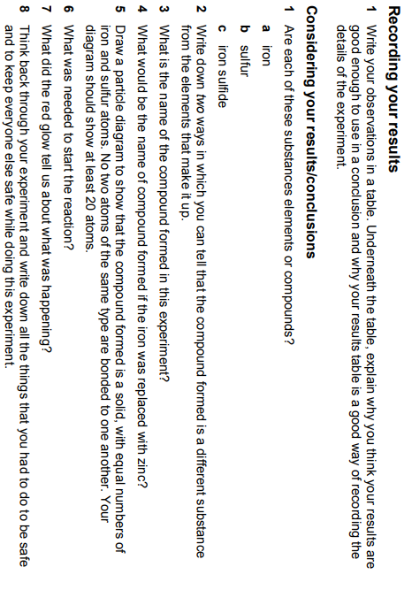

Slide 14
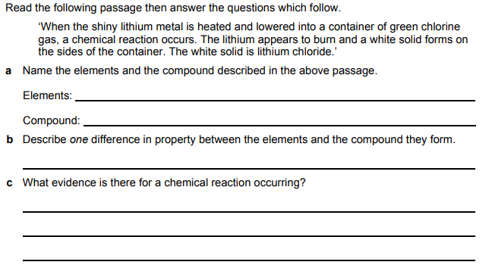

Slide 15
Element | Appearance of element | Element | Appearance of element | Compound | Appearance Of compound
copper |  | oxygen
zinc |  | oxygen
iron |  | oxygen
iron |  | sulphur
Element | Appearance of element | Element | Appearance of element | Compound | Appearance Of compound
copper |  | oxygen
zinc |  | oxygen
iron |  | oxygen
iron |  | sulphur

