Slide 1
CW
8Aa (PRACTICAL) Food tests
@hpscience

Slide 2
PRACTICAL – Testing food. Will take a whole lesson to do properly.
Iodine
Biurets
Filter paper
Different food
This is a triple award practical in year 10

Slide 3
Advice for staff
Do the starch and fat test. You do not need to do the protein test if you do not have time.
I wouldn’t bother with the sugar test or vitamin c test as they do take more time.
I also advise you to do this practical without printing any worksheets and get the students to draw their own table of results.

Slide 4
There are a series of worksheets for the food tests.
I would not print all of these worksheets.
8aa4 – testing foods is a good work sheet the rest just give instructions.
This worksheet is OK but it is better to get students to draw their own table of results.

Slide 5
Iodine test for starch
Method
Add two drops of iodine solution to the food sample
If the iodine turns from orange/brown to blue/black then starch is present.

Slide 6
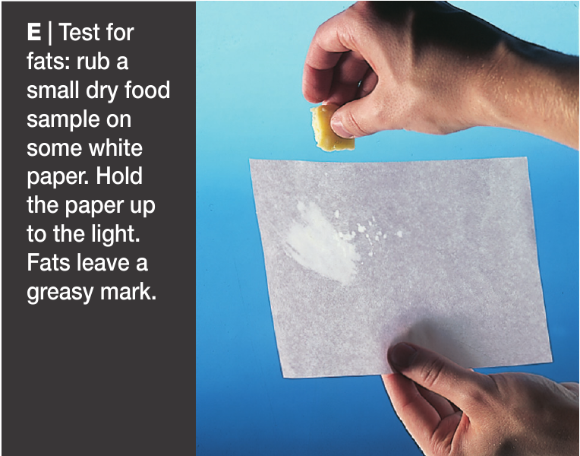
Test for fat
Method
Rub dry food sample on filter paper.
If it leaves a greasy mark then fat is present.

Slide 7
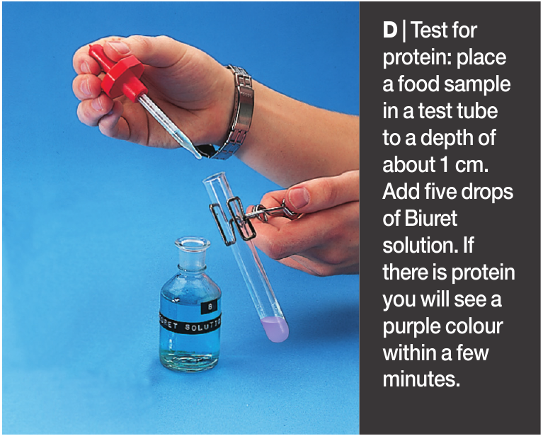
Test for protein
Method
Place food sample in a test tube.
Add five drops of Biuret solution.
If protein is present it will turn a purple colour

Slide 8
Draw a table of results
Name of food | Did it contain starch? | Did it contain fat? | Did it contain protein?

