Slide 1
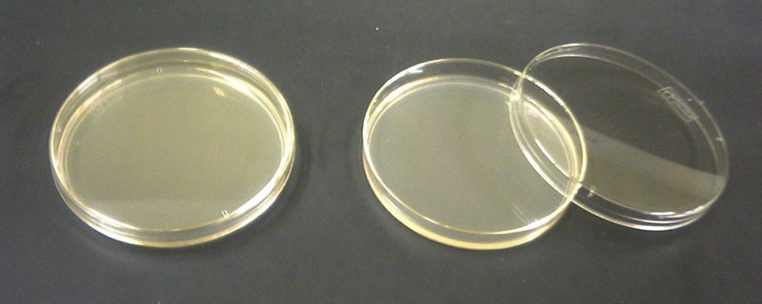
Agar plate analysis
To look at our agar plates and analyse what we have found.
Last week we used these dishes…
What were they called?
Why did we use them?
What do you think they were providing for the microbes?
(Hint: Think back to MRS GREN)

Slide 2
Nutrient Agar Plates
Agar jelly is a growth medium containing nutrients in order to help microbes to grow.
By medium we mean:
Matter in which something happens, is transmitted or is stored

Slide 3
Looking at Microbes
Look back in your books to read about what each microbe would look like.
Notes:
Photo credit (bacteria): Eye of Science / Science Photo Library
Klebsiella pneumoniae bacteria, light micrograph. These are Gram-negative rod-shaped (bacillus) bacteria that are usually found in the intestines of healthy individuals. However, in those with a weakened immune system K. pneumoniae can cause a number of infections. It most commonly causes hospital-acquired urinary tract or open wound infections, but can also cause pneumonia. Magnification: x500 when printed at 10 centimetres wide.
Photo credit (fungi): Herve Conge, ISM / Science Photo Library
Brewer's yeast (Saccharomyces cerevisiae), light micrograph using differential interference contrast illumination. This is a single-celled fungus that is widely used for brewing and baking, due to its ability to ferment sugars into carbon dioxide and ethanol (alcohol). Magnification: x1100 when printed 10cm wide.
Photo credit (virus): Eye of Science / Science Photo Library
Coloured transmission electron micrograph (TEM) of HIV (human immunodeficiency virus), which causes AIDS (acquired immune deficiency syndrome). The virus consists of a RNA (ribonucleic acid) genome, surrounded by an icosahedral (20-sided) protein nucleocapsid (coat). This is enclosed in a matrix of proteins and the whole virus is enclosed in an envelope derived from the host cell's plasma membrane. The envelope has viral proteins integrated into it, including glycoprotein spikes that aid attachment to host cells. HIV infects the immune system's T-lymphocytes, ultimately killing them, leading to a very weak immune system. Magnification: x300000 when printed 10 centimetres wide.

Slide 4
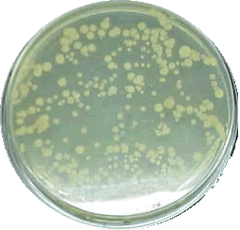
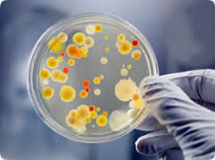
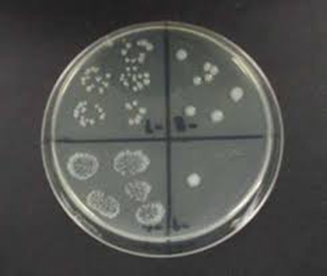
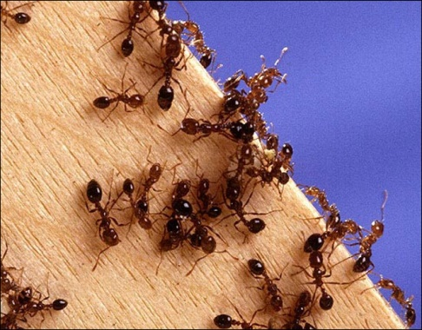
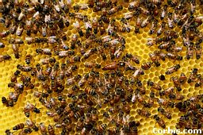
Let’s look at our agar plates from last week!
What is a ‘colony’?
Think → Pair → Share
Using your white boards try and write a definition of colony…

Slide 5
Complete the table below from LAST WEEK.
Position | Place around lab | Microbe type | No. of colonies
1
2
3
4
Which position had the biggest colonies? Why?
How could we test if antibiotics work?

Slide 6
Try and identify your microbes…
Do not worry about the ACTUAL name of the microbe, the main thing I am assessing is to see whether you can identify the type…
Bacteria, Mould or Yeast

Slide 7
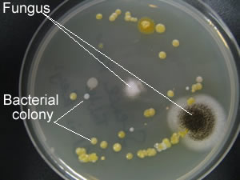
My Agar Plate
Take a picture of your agar plate and at home print it off to stick in your book!

Slide 8
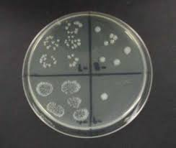
Analysis of agar plates!
Describe the appearance of your plates. Does every section look the same?
Which section shows the most microbial growth? Why do you think?
Write down any ideas you have about why microbes are found in the places you have investigated.
How could we test if antibiotics work?

