Slide 1
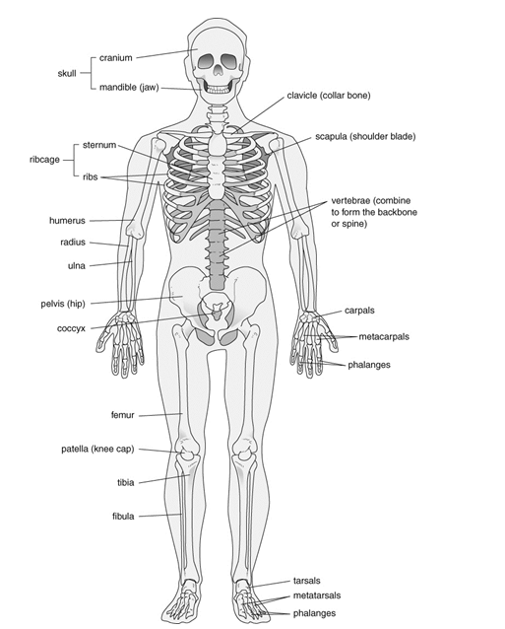
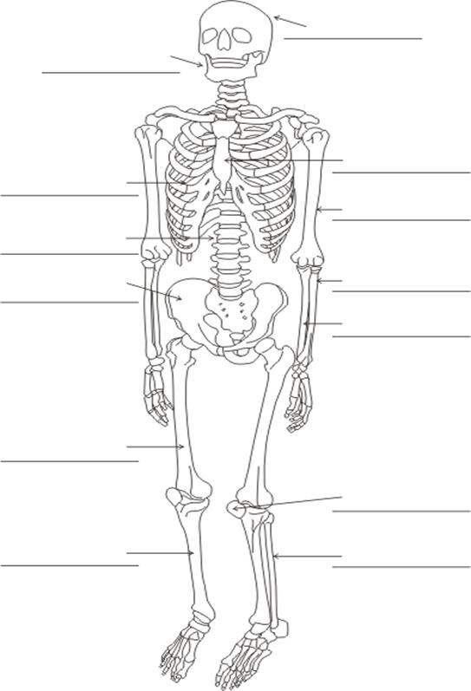
Use the skeleton on the left to label the skeleton on the right.

Slide 2
