Slide 1
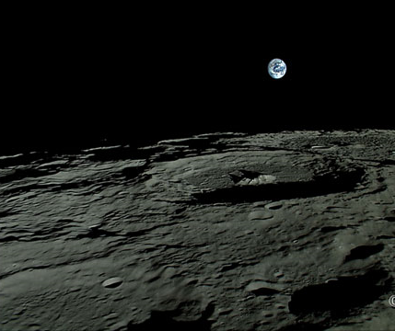
8La1 The Moon
8L Earth and Space
CW
Do Now:
Draw the moon
Try to draw up to 8 different shapes for the moon and put your drawings in order

Slide 2
Requisitions
Equipment | Worksheets
 | 8La-4

Slide 3
Objectives
Explain how we see the Moon.
Describe how the Earth, Moon and the planets move.
Describe the positions of the Earth and planets in the Solar System.
Describe some ways of investigating the planets.
Compare the geocentric and heliocentric models of the Solar System
Use a model to explain why we see phases of the Moon.
Explain how technological developments have increased our knowledge of the Solar System.
Explain why the heliocentric model is our current model of the Solar System.
Compare different theories for the origin of the Moon.
Use a model to explain why we have partial and total solar eclipses.

Slide 4
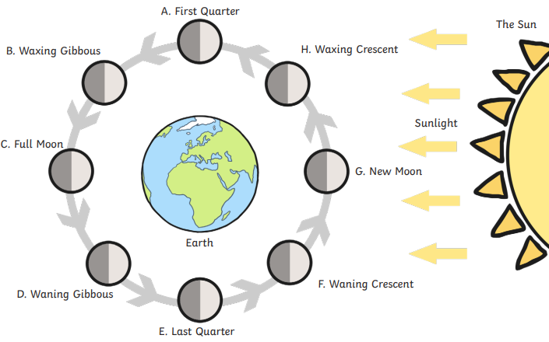
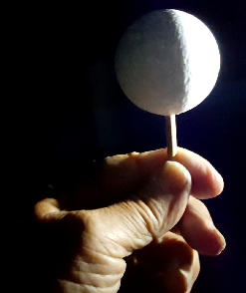
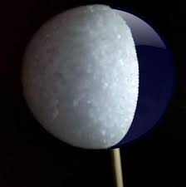
Complete your diagrams based on how the moon would look from Earth

Slide 5
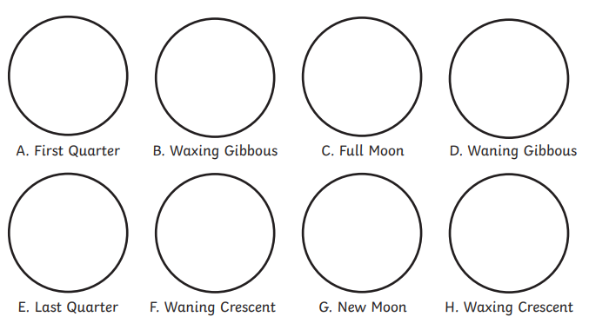

Slide 6
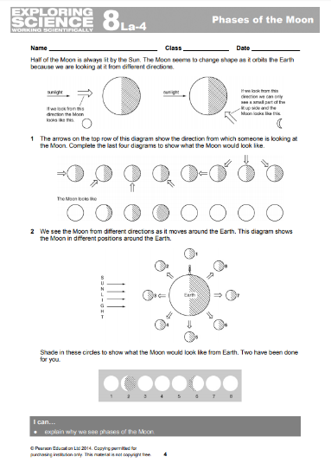
Read through the info on the top of the sheet.
Complete the diagrams using your rough drawings and ½ coloured spheres to help you.

Slide 7
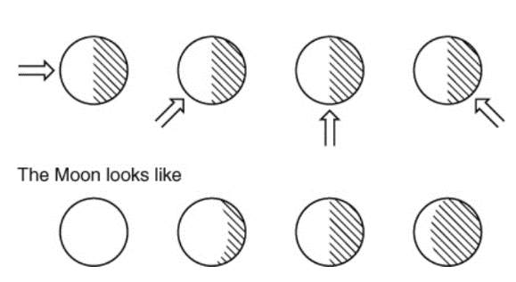
Which is easier: using the arrows, or following the pattern?

Slide 8
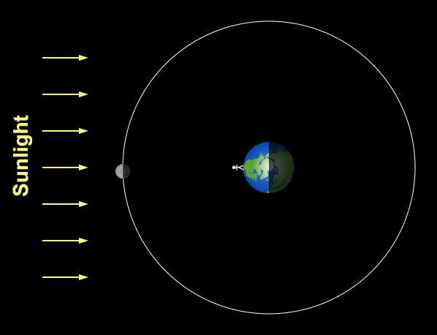

Slide 9
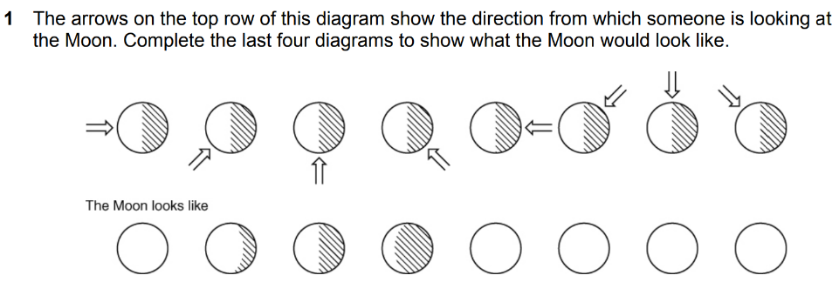

Slide 10
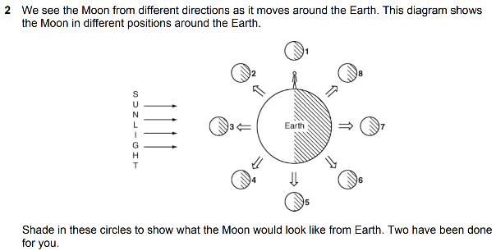

Slide 11
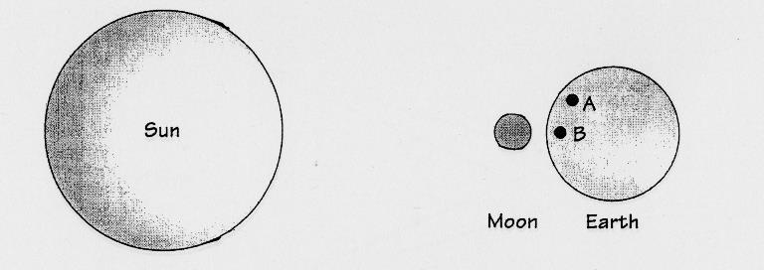
Solar Eclipse
Add lines from the top and bottom of the Sun to work out what the eclipse would look like at A and B.
What will a person at B see?
What will a person at A see?

Slide 12
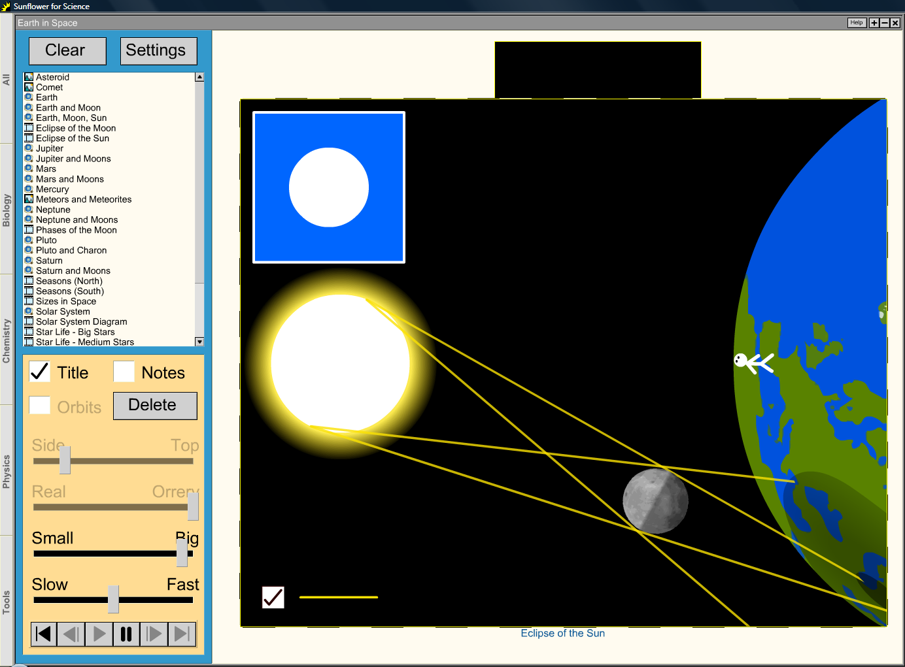
 Teachers in school only: Run Sunflower for Science as external application & choose ‘Earth in Space → Examples → Eclipses’.
Notes:
EXAMPLE SCREENSHOT ONLY:
Run Sunflower for Science as external application & choose ‘Earth in Space → Examples → Eclipses’.

Slide 13
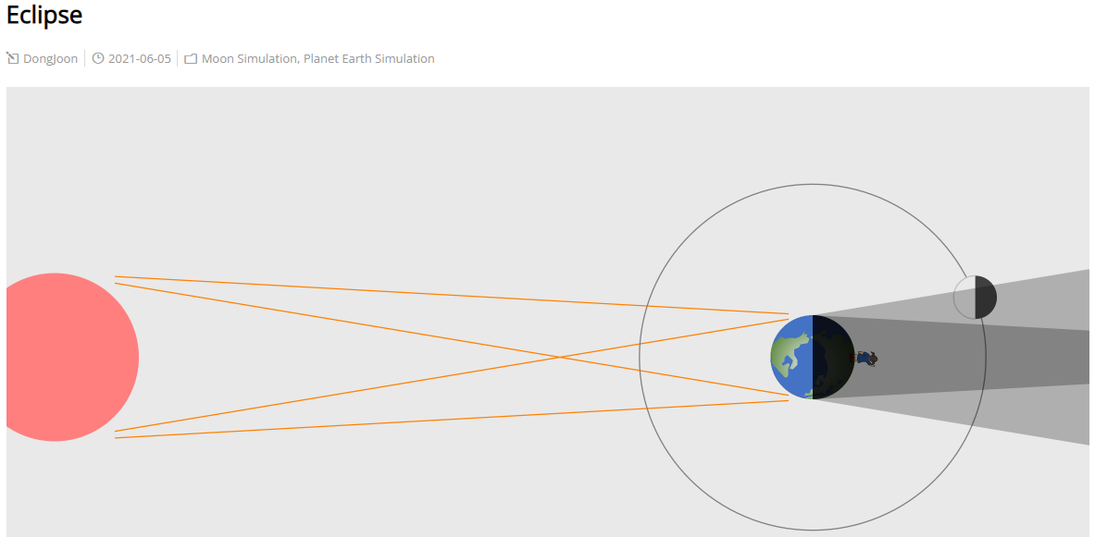

Slide 14
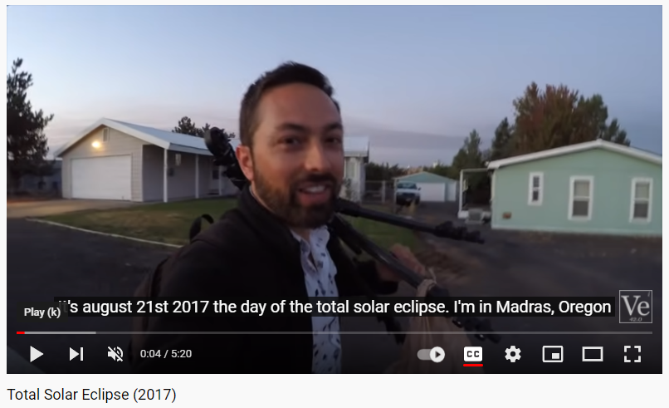

Slide 15
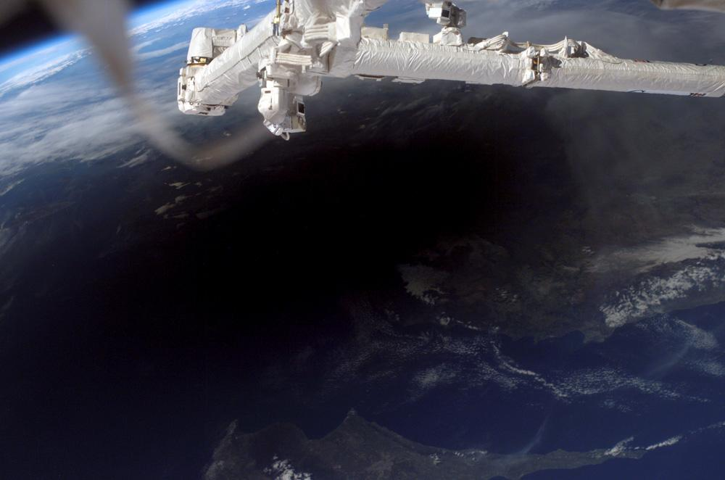
Total eclipse
Partial eclipse

Slide 16
Write Down
Solar Eclipse
What is a lunar eclipse?
Person at A sees a _______ eclipse.
Person at B sees a _______ eclipse.
partial
total

Slide 17
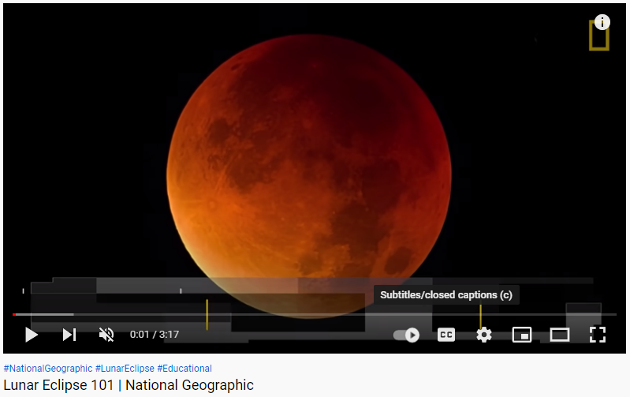

Slide 18
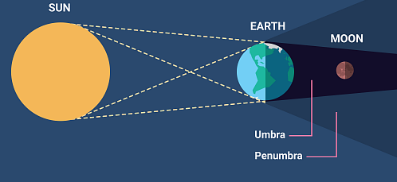
Write Down
Lunar Eclipse
Person at A sees___________________.
Person at B sees ___________________.

Slide 19
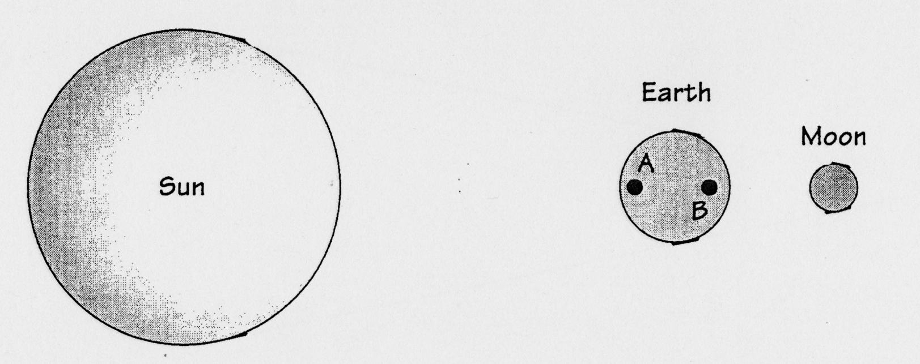
total
partial
Person at A sees a _______ eclipse.
Person at B sees a _______ eclipse.
Write Down
Lunar Eclipse

Slide 20
Origin of the Moon
From the next video write down what happened to create the Moon and what else this caused.
Has the Moon always been there?
What other theories are there?
Where did it come from?

Slide 21
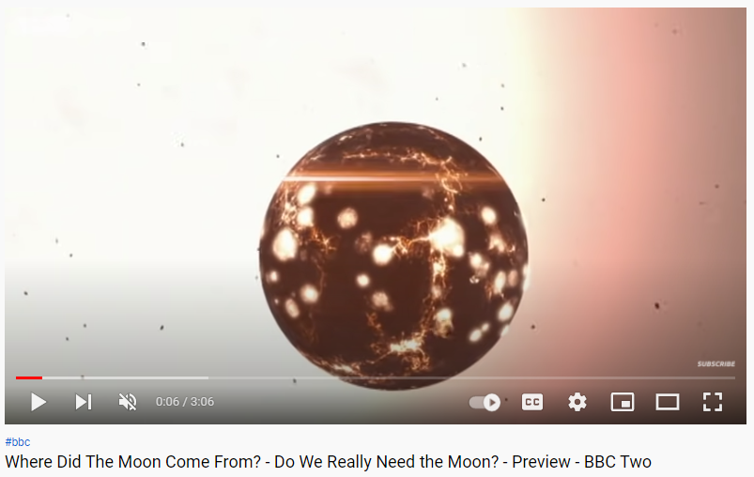

Slide 22
 Give a clue or definition for these keywords.
Hot seat
full moon

Slide 23
 Give a clue or definition for these keywords.
Hot seat
solar eclipse

Slide 24
 Give a clue or definition for these keywords.
Hot seat
crescent moon

Slide 25
 Give a clue or definition for these keywords.
Hot seat
partial eclipse

