Slide 1
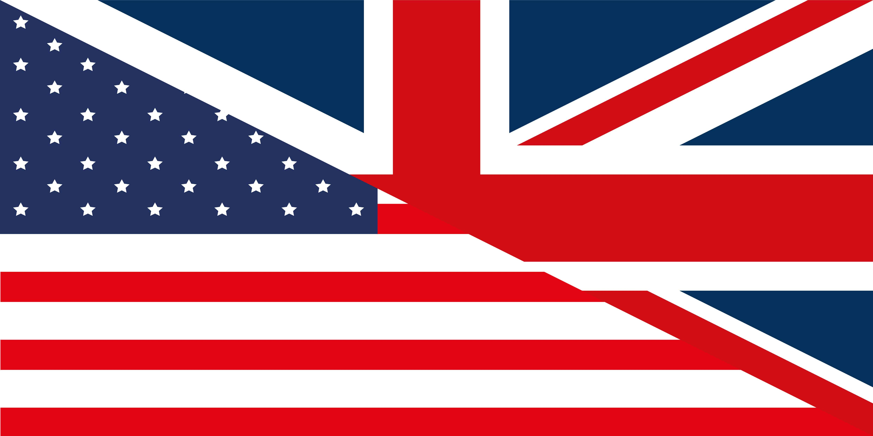
American vs British Language
by Ethan Cox 9G1

Slide 2
Noteworthy American slang and regional dialects
Ya’ll (meaning you singular or plural)
Yous guys (plural meaning you)
Heyna (regional dialect of North East Pennsylvania meaning don’t you agree?)
Fixin’ (regional dialect of southern US meaning preparing to do something)

Slide 3
American vs British Spellings
-or / - our (US/British)
Color/Colour
Parlor/Parlour
Behavior/Behaviour
-ize / -ise (US/British)
Sanitize/sanitise
Realize/realise
-ense or -ence
License/licence
Offense/offence
Final -e (US/British)
Ton/tonne
Program/programme
Glycerine/glycerine
-er / -re
Theatre/theatre
Saber/sabre
Fiber/fibre
Center/centre

Slide 4
Simplified spellings (US/British)
Airplane/aeroplane
Check/cheque
Que/queue
Plow/plough
Jewelry/jewellery
Sulfur/sulphur
Pediatrician/paediatrion
Estrogen/oestrogen
Mustache/Moustache
Pajamas/Pyjamas
Draft/draught
while/whilst

Slide 5
Some don’t follow a rule (US/British)
Gray/Grey
Tire/Tyre
Enroll/enrol
Skillful/skilful
Counsellor/counselor
Dreamed/Dreamt
Cilantro/Coriander
Fall/Autumn

Slide 6
Different Words mean the same thing
(US/British)
Apartment/Flat
Townhouse/Terraced House
Duplex/Semi-detached house
Sharp cheese/Chedder Cheese
Highway/Motorway
Desert/Pudding
Pudding/Custard
Cookies/Biscuit
Biscuit/Crackers
Fries/Chips
Chips/Crisps
Flashlight/Torch
Sweater/Jumper
Sneakers/Trainers

Slide 7
Blurred Lines
Because of global society the lines between language and dialects has become increasingly blurred.
For example, secondary and high school are often used interchangeably despite high school once being exclusively American.

