Slide 1
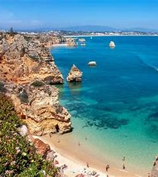
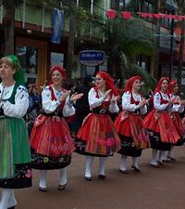
Portuguese
Portugal

Slide 2
Listen To Catia explaining her favourite Portuguese words…..

Slide 3
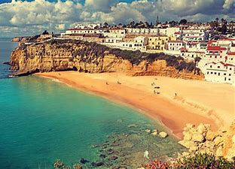

Slide 5
