Slide 1
Reqs
Rock Samples (sandstone and granite)
Porous vs Permeable Diagram
Extension/Homework
W/S 8Ha-5 (Less able class)
W/S 8Ha-6 (More able class)

Slide 2
Objectives
Recall some uses for rocks and some products made from limestone.
State what rocks are made of.
Recall why different rocks have different properties.
Recall some examples of rocks with different textures.
Explain why certain rocks are porous and/or permeable.

Slide 3
C/W
28/01/2019
8Ha1 – Rocks and Their Uses
Starter
Write down a list of rock uses that you see in everyday life.
Can you name the types of rocks being used?
Can you remember the names of the rocks?

Slide 4
Watch the video.
What are the 3 main Rock types?
Sedimentary
Igneous
Metamorphic

Slide 5
Copy the text below
Describing rocks
Grains consist of one or more chemical compounds. Each different compound is called a mineral.
The grains in rocks can be different shapes and sizes.
Interlocking grains (crystals) fit together without any gaps between them.
In contrast, if the grains are rounded, there can be gaps between them.

Slide 6
Draw 2 boxes of the same size and then complete the grain view diagrams and wordfill.
Granite
Sandstone
Granite is an example of a rock that has i__________ grains that leave no g___ between them
Sandstone is an example of a rock that has r__________ grains that have g___ between them
Notes:
Hand out a sample of granite and sandstone per pair of students as a reference for the next few slides

Slide 7
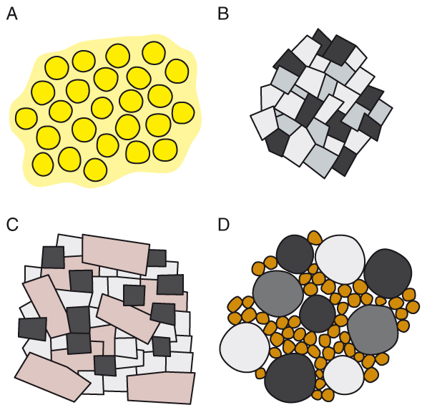
The diagrams below show the grains in four different rocks.
Which two rocks have interlocking crystals?
B and C

Slide 8
How many different kinds of minerals are there in:
rock A
rock B
rock C
rock D?
1
3
3
4
© Pearson Education Ltd 2014. Copying permitted for purchasing institution only. This material is not copyright free.

Slide 9
Granite consists of three or four main minerals.
One of the minerals often forms large crystals.
Which rock could be granite?
C

Slide 10
Conglomerate is made of quite large, rounded pebbles, in a mixture of much smaller grains.
Which rock could be conglomerate?
D

Slide 11
Copy the notes below.
Geologists describe the combination of different shapes and sizes of grains in a rock as the texture.
The texture of the rock can determine its properties.
Rocks made from interlocking grains are hard and do not wear away easily (e.g. Granite).
Rocks made from more rounded grains are not as strong and wear away more easily (e.g. Sandstone).

Slide 12
Copy the notes
Porous vs Permeable
Rocks with gaps between grains are sometimes described as porous.
Porous rocks are important because they can store or hold water in the gaps between their grains.
Most porous rocks are also permeable, meaning that water can run through them (the gaps are all connected to each other).
However, certain rocks can be porous without being permeable (the gaps do not connect).

Slide 13
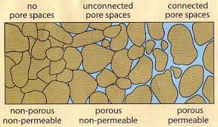
Label each of the 3 sections using the following terms:
Porous or non-porous
Permeable or non-permeable
Notes:
Source: https://deq.louisiana.gov/assets/docs/Water/DWPP_forkidsandeducators/PorosityandPermeability.pdf
, accessed 2019.

Slide 15
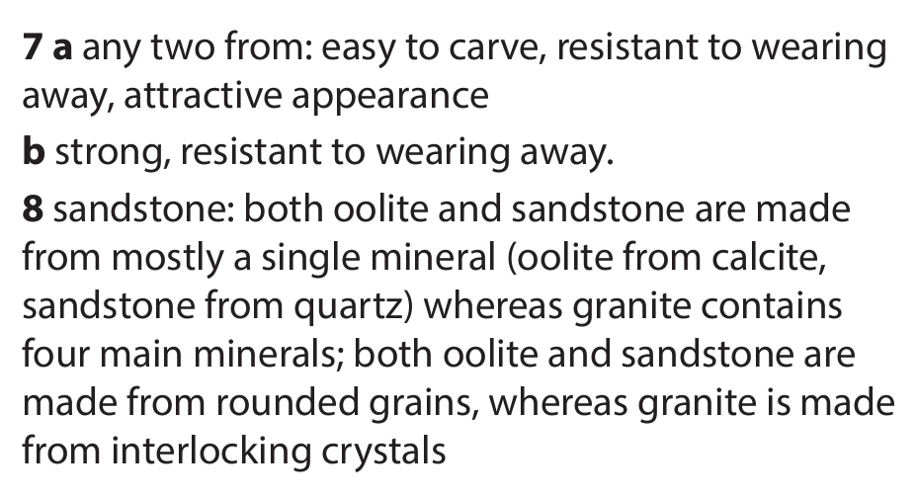

Slide 16
Extension/ H/W
Complete W/S 8Ha6

Slide 18
 Give a clue or definition for these keywords.
Hot Seat

Slide 19
Hot seat
 Give a clue or definition for these keywords.
Mineral

Slide 20
Hot seat
 Give a clue or definition for these keywords.
Interlocking

Slide 21
Hot seat
 Give a clue or definition for these keywords.
Permeable

Slide 22
Hot seat
 Give a clue or definition for these keywords.
Grain

Slide 23
Hot seat
 Give a clue or definition for these keywords.
Texture

Slide 24
Hot seat
 Give a clue or definition for these keywords.
Porous

