Slide 1
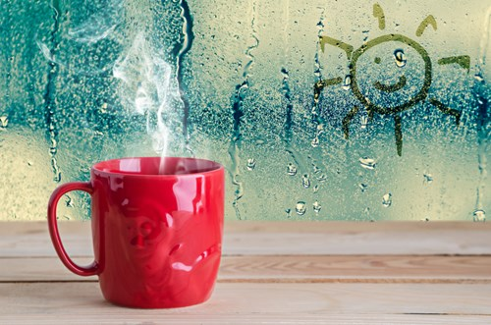
Ee: Distillation
Gas Taps are on!
Do Now: What happens to steam when it is cooled?

Slide 2
Requisitions
Equipment | Worksheets
 | 7Ee.1

Slide 3
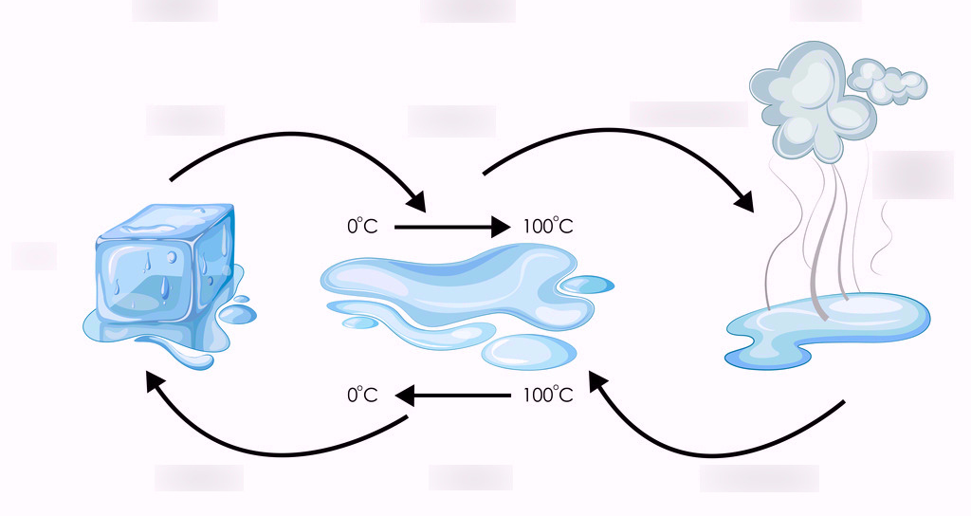

Slide 4
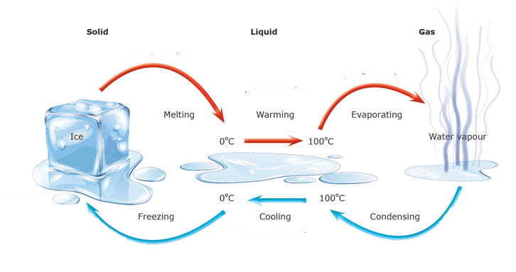

Slide 5
Write Down
Melting
Evaporating
Solid
Liquid
Gas
Freezing
Condensing
Increasing Temperature

Slide 6
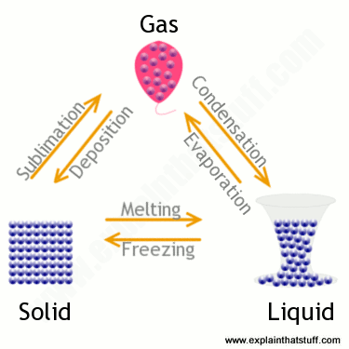

Slide 7
Where does our drinking water come from?

Slide 8
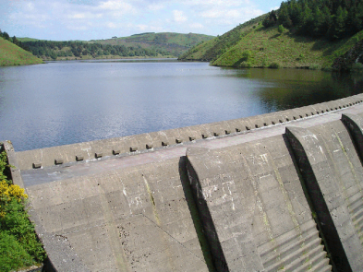
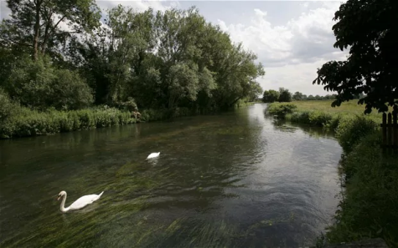
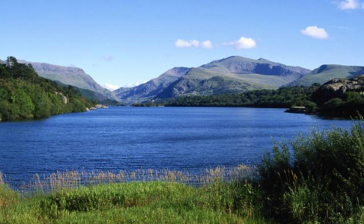
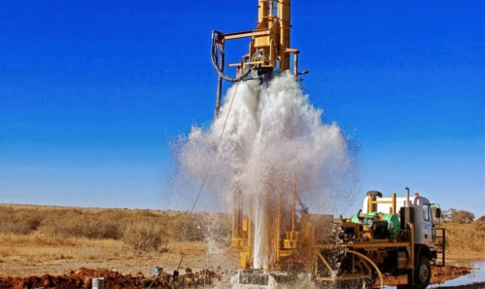
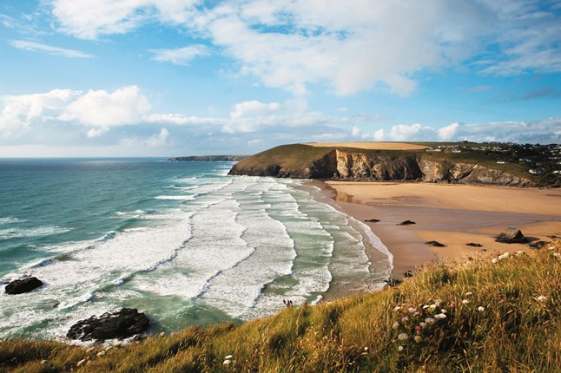
Drinking water can come from:
Reservoirs
Rivers
Lakes
Aquifers (rocks containing water)
The sea

Slide 9
Answer these questions in full sentences
Over 70% of the Earth’s surface is covered in water. Most of this is sea water which contains too many solutes to be safe to drink. Drinking water can be made from sea water using a process called desalination.
Desalination removed most of the salts from the water. This requires expensive equipment and a lot of space, so it is only suitable in some places.
What does desalination mean?
Why are desalination plants usually built next to the sea?

Slide 10
Answer these questions in full sentences
What does desalination mean?
Desalination is the removal of salt from sea water
Why are desalination plants usually built next to the sea?
They use sea water to produce fresh water by desalination

Slide 11
How can we make sea water drinkable?
Copy & Complete
Seawater is heated so the water evaporates to form ___________.
The steam is collected and __________ so that it ____________ back into liquid water.
This leaves us with ________ water, as the solutes in the sea cannot evaporate and are left behind.
steam
cooled
condenses
pure

Slide 12
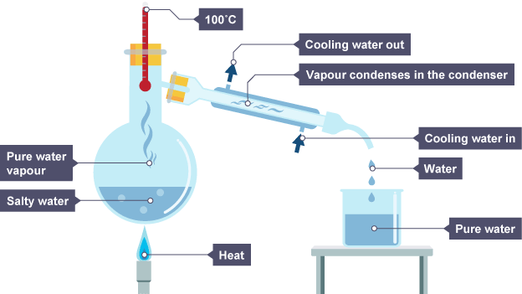
Distillation of Ink

Slide 13
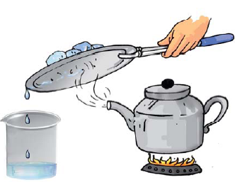
Write Down
Combining evaporation & condensation together is called distillation

Slide 14
Worksheet 7Ee.1

Slide 15
We use evaporation & condensation together when we distil impure water
The mixture of ink and w___ is put into the flask.
The mixture is h_____.
The water e_______ and forms steam. The ink does not evaporate
The steam goes into the condenser.
The cold water flowing around the outside of the c________ cools the steam.
The steam condenses to form p____ w_____.
The water runs into the b______.

Slide 16
The mixture of ink and water is put into the flask.
The mixture is heated.
The water evaporates and forms steam. The ink does not evaporate.
The steam goes into the condenser.
The cold water flowing around the outside of the condenses cools the steam.
The steam condenses to form pure water.
The water runs into the beaker.

Slide 17
Watch and Answer Questions
What state of matter (solid, liquid or gas) were the substances that were trying to be separated?
What property allowed the substances to be separated?
What type of special distillation is normally used in this situation?

Slide 18
What state of matter (solid, liquid or gas) were the substances that were trying to be separated? Liquids
What property allowed the substances to be separated? The liquids had different boiling points
What type of special distillation is normally used in this situation? Fractional distillation

